Slide 1

Regular Expressions
James Gerity
September 1, 2016
Slides available at http://www.github.com/jgerity/talks

Slide 2
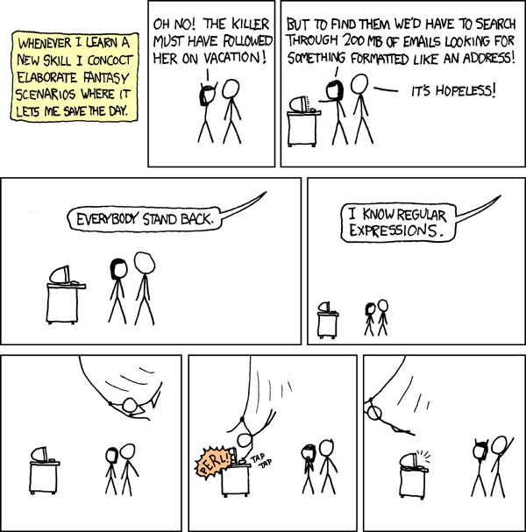
Scope of this talk
Learn to do this…

Slide 3
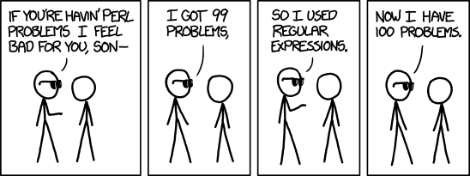
Scope of this talk
…without falling prey to this

Slide 4
Scope of this talk
What are regular expressions?
What are regular expressions used for?
How are regular expressions used with some common tools?
Hands on!

Slide 5
What are regular expressions (regex)?
Need an example pattern to pick apart

Slide 6
What are regular expressions (regex)?
A regex pattern matches a target string.
The pattern is composed of a sequence of atoms.
An atom is a single point within the regex pattern which it tries to match to the target string.
Example, a single literal character like ‘a’

Slide 7
What are regular expressions (regex)?
State machine picture of example regex

Slide 8
What are regular expressions (regex)?
A couple different flavors with differences
i.e. POSIX has [:alpha:] and [:blank:], vim uses \a and \s
Extensions give much more powerful tools like backreference, but these generally discard the regularity of the grammar
As a result, relying heavily on these can result in a much slower expression evaluation

Slide 9
What are regular expressions useful for?
Searching for a vague target
If you know the structure of a string, you can encode this information into your search
Search-and-replace
Sed, vim, awk

Slide 10
What are regular expressions not useful for?
Prime number sieve
The right tool for the right job!

Slide 11
Regular expression examples
grep
sed
awk
Peter
Python `re` module

Slide 12
Things I didn’t mention…

Slide 13
Useful resources
http://www.regular-expressions.info/

Slide 14
Thank you!

Slide 15
Feedback?

Slide 16
Backup Slides

