Slide 1
Follow-along instructions
All examples will include links!
Grab the slides from http://github.com/jgerity/talks
If you’d like to follow along on your own machine, I recommend Python 3.5+
3.6 has a really good string feature, I recommend it a lot!

Slide 2

Introduction to Python
James Gerity
September 25, 2018
Slides available at http://www.github.com/jgerity/talks

Slide 3
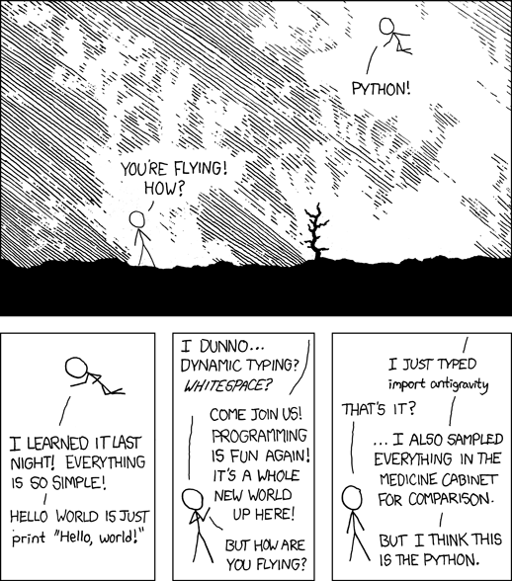
Scope of this talk
Image from xkcd.com under CC-BY-NC 2.5

Slide 4
Scope of this talk
More things to say than will fit in this talk, see the list of notes and reading material online.
And ask questions!
Assuming some programming familiarity
Programming is most rewarding as an auto-didactic process!

Slide 5
Scope of this talk
Python basics
Basic types, flow control, functions, classes, modules
Python tools
Jupyter and other editors
Python libraries
Primarily the SciPy stack

Slide 6
What is Python?
Python is an interpreted programming language with dynamic typing

Slide 7
What is Python?
Python is an interpreted programming language with dynamic typing
Interpreted (roughly*) means instructions are “translated” from a high level to machine code
Python details are kinda complicated, but punchline: need to have a Python interpreter installed in order to run our programs!
* If you’re curious about CPython’s innards, check out this post series, which explains the whole process! https://akaptur.com/blog/2013/11/15/introduction-to-the-python-interpreter/

Slide 8
What is Python?
Python is an interpreted programming language with dynamic typing
The type of an object must be known to check validity of operations, optimize, etc. In Python, types are tracked dynamically, i.e. at runtime.
Contrast with static typing in e.g. C/C++ (declaring type with int, char, etc.)

Slide 9
What is Python?
An example in Python. What does this do?
a+b
A: It depends on the types!
1+1 gives 2
‘a’+’b’ gives ‘ab’
[1,2]+[3] gives [1,2,3]
1+‘a’ gives TypeError

Slide 10
What is Python?
An example in Python. What does this do?
a+b
Under the hood:
Ask a if it knows how* to add b to itself
If that fails, ask b if it knows how* to add a
If all else fails, give up and raise TypeError
* “knows how” here means “dunder” methods like __add__() on the type’s class. You can learn more in section 3.3.8 of the Python docs: https://docs.python.org/3/reference/datamodel.html#emulating-numeric-types

Slide 11
A note on Python 2/3
“Python 2.x is legacy, Python 3.x is the present and future of the language”
Many libraries have already dropped support for 2.x, and official support ends in 2020. https://python3statement.org/
All the cool new stuff is in 3, you might as well learn it now!

Slide 12
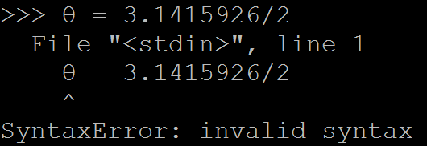


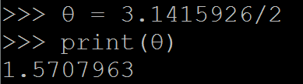
A note on Python 2/3
A distinction worth considering:
Python 2:
Python 3:

Slide 13
What is Python good for?
Development quality of life
Fewer “hoops” to jump through, more legible code (most pseudocode is almost Python!)
Portability
As long as the target has a Python interpreter, we can run Python there!
Rich ecosystem
Great libraries exist for most common tasks

Slide 14
What does a Python program look like?
The simplest Python programs fit on a single line.
python –c ‘print(“Hello world!”)’
Less trivial programs are stored in files (usually with the .py extension) and delimited by whitespace.
No {} to define blocks of code in Python!

Slide 15
A second short program in Python
python loops_example.py
Online at https://repl.it/@SnoopJeDi/WigglyHatefulWebpage

Slide 16
Functions
Because we often repeat the same task, it is convenient to write functions
Don’t Repeat Yourself (DRY)
In Python, we write:
def funcname(foo, bar):
‘funcname’ is the name of our function, ‘foo, bar’ are the arguments

Slide 17
A third program in Python
python –i functions_example.py
Online at https://repl.it/@SnoopJeDi/TangibleElectricAddition

Slide 18
Classes
We can also define our own objects using the class keyword, e.g.:
class Point():
def __init__(self, x, y):
self.x = x
self.y = y
def magnitude(self):
return (self.x**2 + self.y**2)**(.5)

Slide 19
What is Python not good for?
In general, a Python program may be slower to execute than a similar program in another language (C/C++/Fortran).
How fast is “fast enough?” A few 100 ms of slowdown is usually worth it.
Best of both worlds: fast libraries for tasks that must go fast, with “glue code” in Python

Slide 20
A word on speed
Is it actually slow?
Often faster to just try, you’ll be surprised!
Where is it slow?
Use a profiler! Look at the cProfile module
Why is it slow?
A working knowledge of asymptotic complexity (“big oh” notation) can help a lot

Slide 21
Numeric types
int – integer with at least 32 bits precision
boolean – truth value, True or False
None – indicates no value
float – a floating-point number (precision varies)
complex – complex number with floating point components
Literal form is A+Bj

Slide 22
Other types in Python
object – the base type of any object.
str – a string like “I’m a string!”
list – a mutable sequence of values, [1,2,3]
tuple – an immutable sequence, (1,2,3)
dict – a mapping of keys and values
set – sets of unique immutable objects

Slide 23
Iterables, iterators, and sequences, oh my!
Iterable –
“An object capable of returning its members one at a time.”
Iterator –
“An object representing a stream of data.”
More helpful: the object that does the iterating!
Sequence
“An iterable which supports access using integer indices…and [that] defines a…method that returns the length of the sequence.”

Slide 24
Exploring these types in REPL
Let’s explore each of these types using the Python interpreter’s REPL (Read, Eval, Print Loop)
python basictypes_example.py
https://repl.it/@SnoopJeDi/CharmingSoftRuntimes

Slide 25
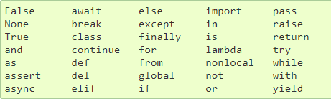
Other keywords
is does NOT mean equality! It tests that two objects are exactly the same object!
Try [1,2,3] is [1,2,3]

Slide 26
Managing your Python environment
You will likely use libraries like numpy/scipy, astropy, matplotlib, pandas, hdf5.
pip and Anaconda are two excellent tools for managing what’s installed.
E.g. to install numpy: ‘pip install numpy’
Anaconda allows you to create separate collections of packages, for version conflicts, etc.

Slide 27
Three more Python Programs
Determining last Friday’s date
https://git.io/v6bXt
Reading data from a text file
https://git.io/viqsg
Brownian motion
http://scipy-cookbook.readthedocs.io/items/BrownianMotion.html

Slide 28
IPython/Jupyter interface
A REPL is helpful when you want to type a handful of lines once, but not useful for long sessions
Jupyter notebooks allow the user to define “cells” of Python input which produce output, and can be run/edited arbitrarily.
Think Mathematica without the symbolic math

Slide 29


Slide 30
The Python Standard Library
Some fairly self-explanatory ones:
random, math, time, datetime, argparse
Data wrangling:
csv, xml, json, re
Quality of life:
itertools, io, logging, os, pathlib, sys, glob, pickle, collections

Slide 31
Numpy
Numpy implements a basic type called the ndarray that is useful for computation
As the name implies, an array with N dimensions
Uniform data type, “gridlike” structure.
In memory, a conventional array (1D)
In use, the array knows about the axes, so can jump directly to the right data as needed

Slide 32
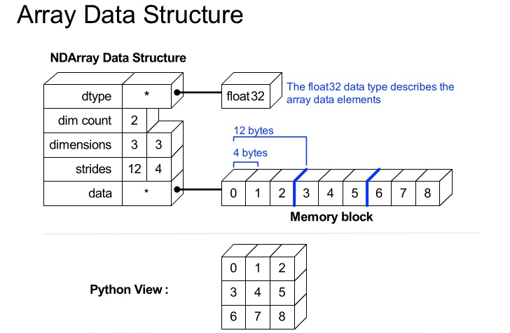
Numpy
Also known as the shape
Slide originally by Enthought, used under fair use

Slide 33
Numpy
Numpy’s main strength is that it is implemented in C and Fortran
Static typing and direct memory access → fast array operations
For a crash-course intro to numpy, see numpy/numpy_intro.ipynb

Slide 34
Numpy broadcasting
Often we have arrays of different shapes, and wish to ‘copy’ data across one or more arrays for an arithmetic operation
For example: adding a series of numbers to every row of a matrix
If we actually copy the data, this might be expensive in terms of memory!

Slide 35
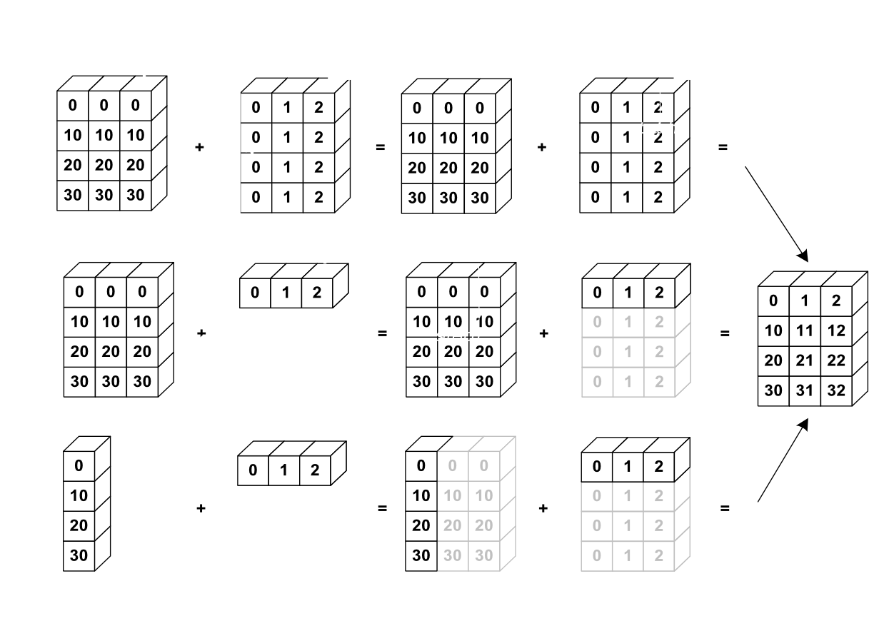
Numpy broadcasting

Slide 36
Numpy broadcasting
Broadcasting rule: trailing axes must either be the same size, or one of the operands must have size 1
An extremely useful article about how broadcasting works, with examples: http://scipy.github.io/old-wiki/pages/EricsBroadcastingDoc

Slide 37
SciPy
“SciPy is a collection of mathematical algorithms and convenience functions built on the Numpy extension of Python.”

Slide 38
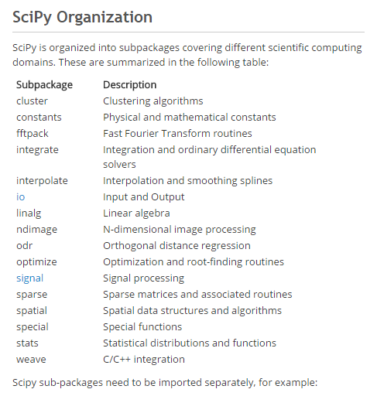
SciPy subpackages
tl;dr – there are a ton of them!
These are the ones we’ll talk about.

Slide 39
scipy.integrate
The integrate package has useful tools for simple numerical integration
See scipy/numerical_integration.ipynb

Slide 40
scipy.optimize
Multiple minimization algorithms
Fitting example from cookbook: see scipy/fitting_data.ipynb
Optimization is a very tricky subject, so be careful!
…but for common problems, this will do well
Non-linear solvers

Slide 41
scipy.signal
A variety of tools for splining and filtering of 1D/2D data
Chirp generation
Low/high/bandpass filters, see scipy/FIR_filter.ipynb
Also of interest is scipy.fftpack, which has (potentially slow!) FFT / DCT / DST transform implementations.

Slide 42
scipy.stats
Large number of available distributions for sampling random variables
Some statistical tests, methods
http://www.scipy-lectures.org/packages/statistics

Slide 43
SciPy library
Tons of examples in the cookbook:
http://scipy-cookbook.readthedocs.io/
Full documentation:
http://docs.scipy.org/doc/scipy-0.18.0/reference/

Slide 44
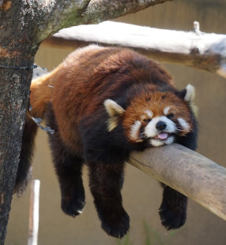
Pandas
PANDAS
Basic structure: DataFrame
Columns with names, expressive queries
Like R, but in Python!
Tutorial given at SciPy 2015
10 minutes to pandas: http://pandas.pydata.org/pandas-docs/version/0.18.1/10min.html

Slide 45
Astropy
!
I’M NOT AN ASTRONOMER
¯\_(ツ)_/¯
Astropy consists of a core package with common functionality:
units and constants
Juggling coordinate systems with multiple frames, units, etc. Seems to be mostly done with SkyCoord
Working with FITS files (astropy.io.fits)
Fitting/modeling routines (looks WIP)

Slide 46
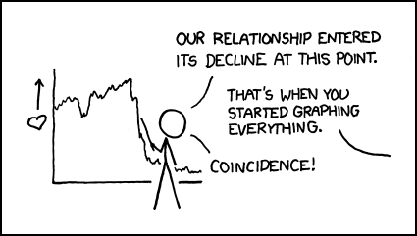
Plotting in Python
Image from https://xkcd.com/523/ under CC BY-NC 2.5

Slide 47
A brief rant on colormaps
Colormap matters! A poor choice can…
…create perceptual artifacts in data
…be a nightmare to print (→ grayscale conv!)
…screw with colorblind readers
…most importantly, be ugly

Slide 48
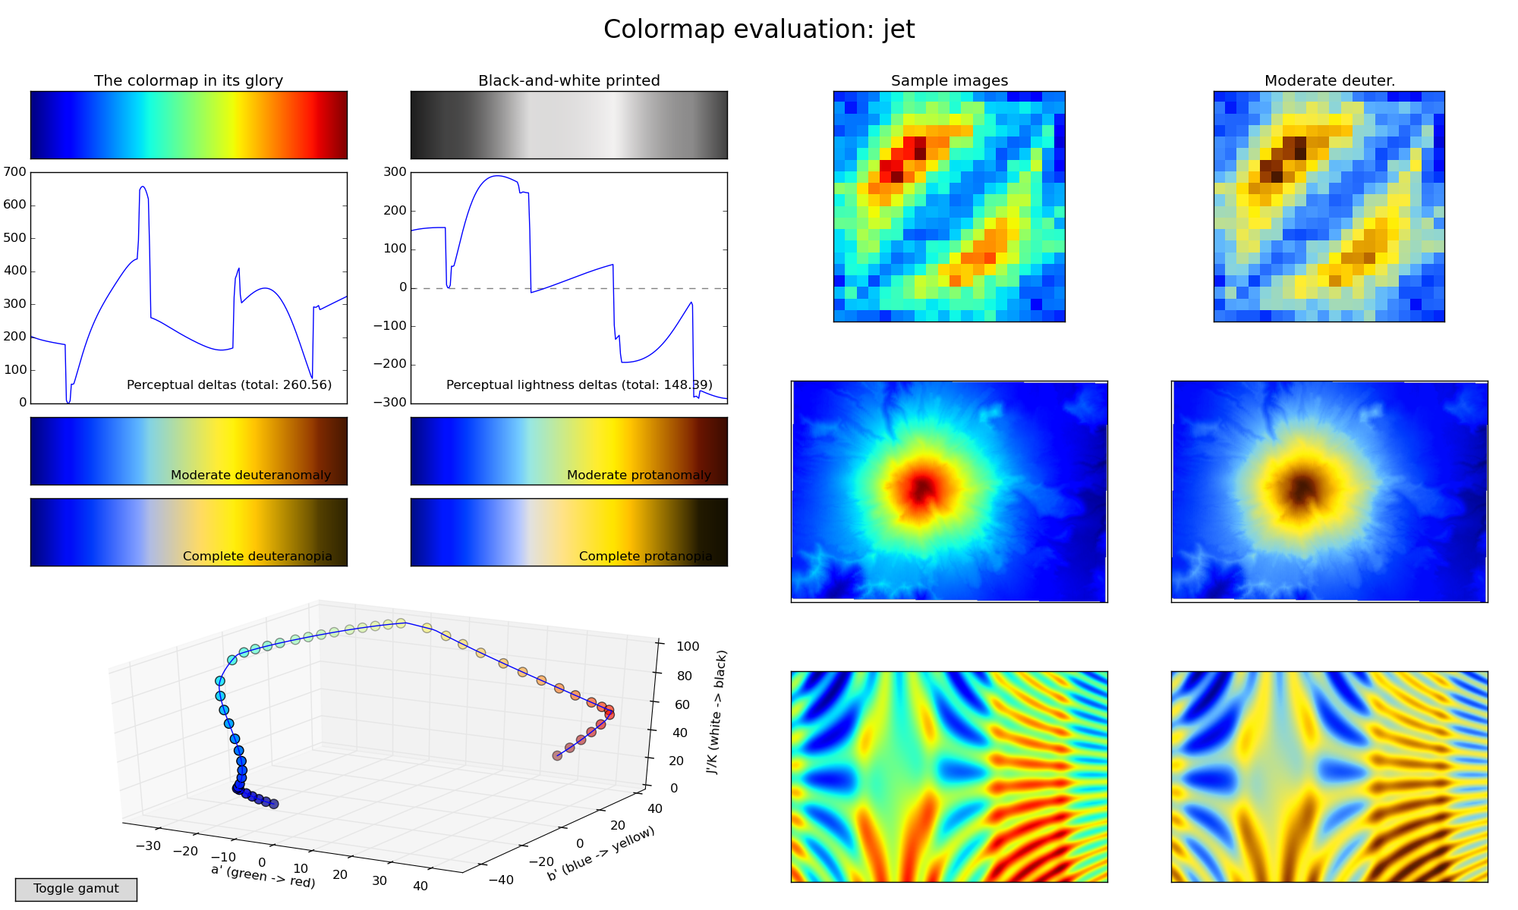
A “bad” choice: Jet
Figure from https://bids.github.io/colormap/

Slide 49
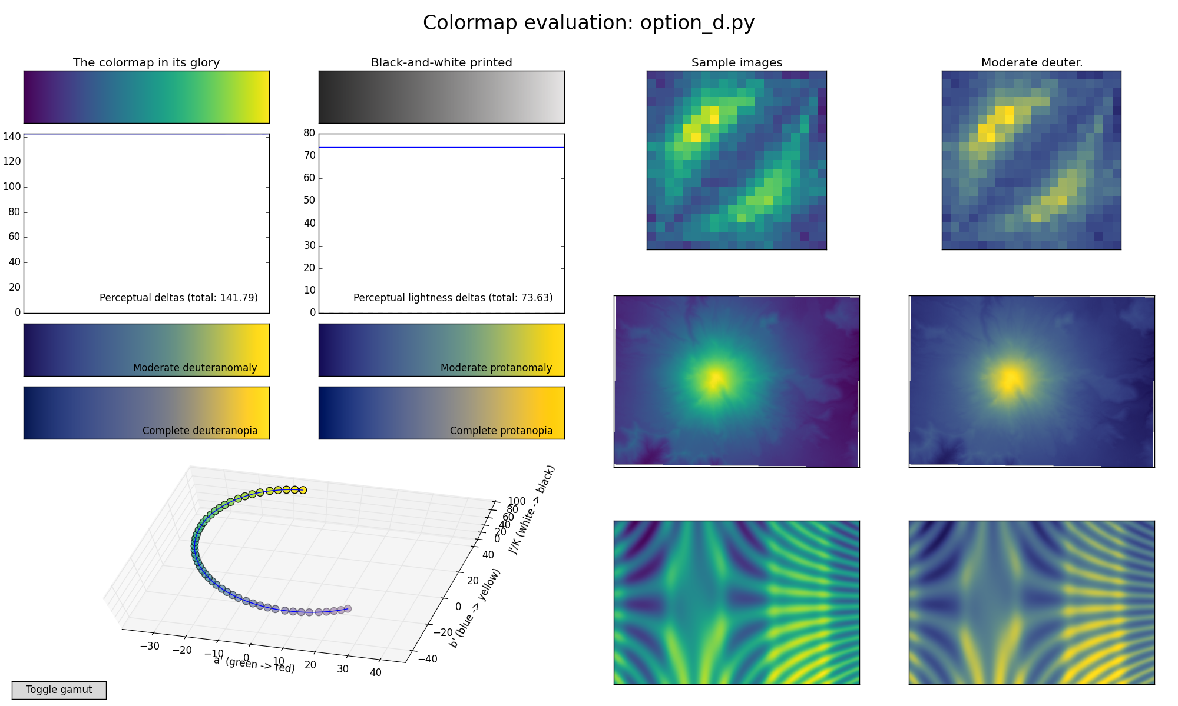
A “good” choice: Viridis
Figure from https://bids.github.io/colormap/

Slide 50
matplotlib
The principal visualization library for Python is matplotlib
matplotlib.pyplot: MATLAB-like plotting framework and probably already your BFF
matplotlib.cm: predefined colormaps and tools for making your own
…and lots of minutiae

Slide 51
Anatomy of a matplotlib figure
…in the form of a matplotlib figure!
See matplotlib/anatomy_of_matplotlib_figure.ipynb

Slide 52
matplotlib objects
Although the pyplot interface is useful, it is often more reliable to interact directly with the matplotlib API.
An example of a very creative plot that uses the GridSpec system to produce subplots with different sizes: http://gregj.net/JHEPC/

Slide 53
Writing code that doesn’t suck
Python makes it easier to write code that is simple to read
Enforced indentation and lack of braces helps
It doesn’t make writing bad code impossible!
Python’s PEP 8 is long, but has good guidelines
https://www.python.org/dev/peps/pep-0008/

Slide 54
Useful resources
CodeAcademy https://www.codecademy.com/learn/python
Scipy lectures https://scipy-lectures.github.io/
A long list of other resources available on GitHub, along with this presentation: https://github.com/jgerity/talks

Slide 55
The Zen of Python
When in doubt…
import this

Slide 56
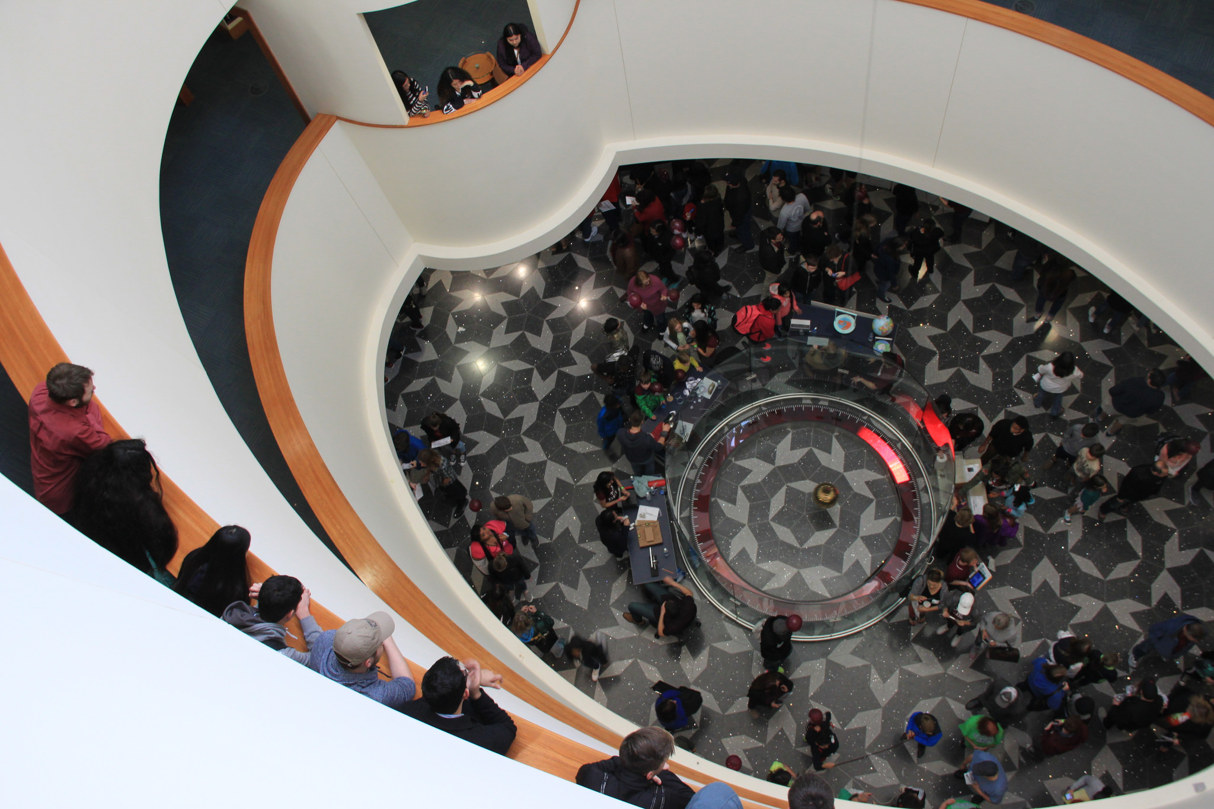
Thank you!

