Slide 1
Sample design for educational robotics site
Fruzzetti

Slide 2
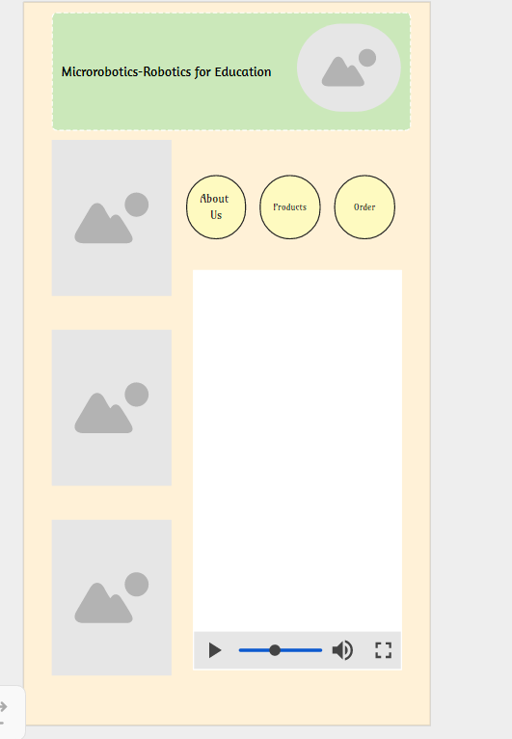
Phone Portrait

Slide 3
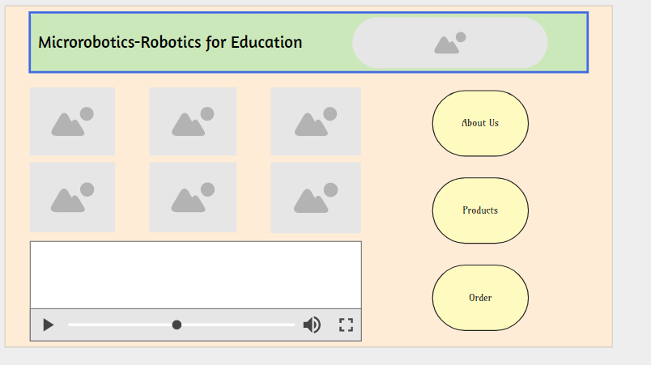
Phone Landscape

Slide 4
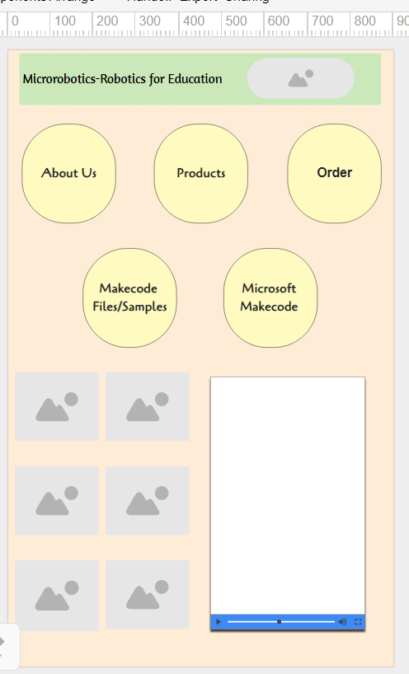
Desktop/Laptop

Slide 5
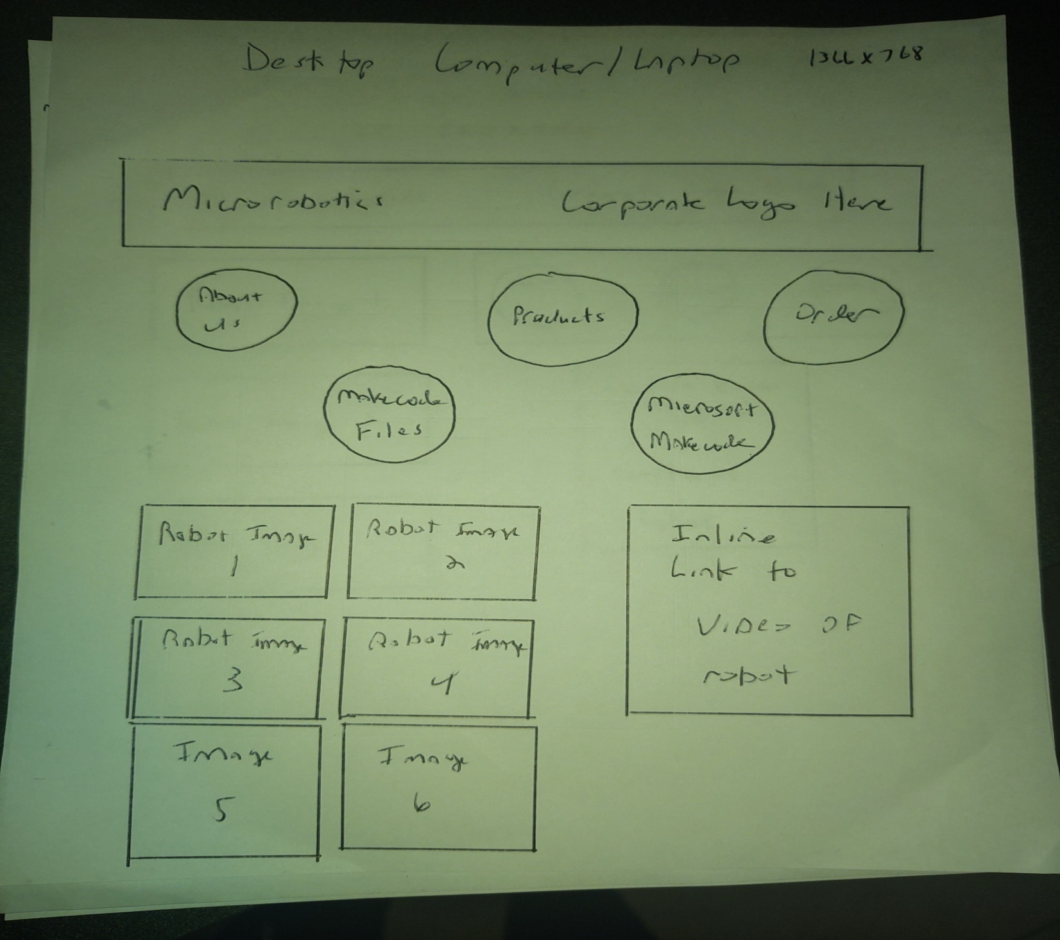

Slide 6
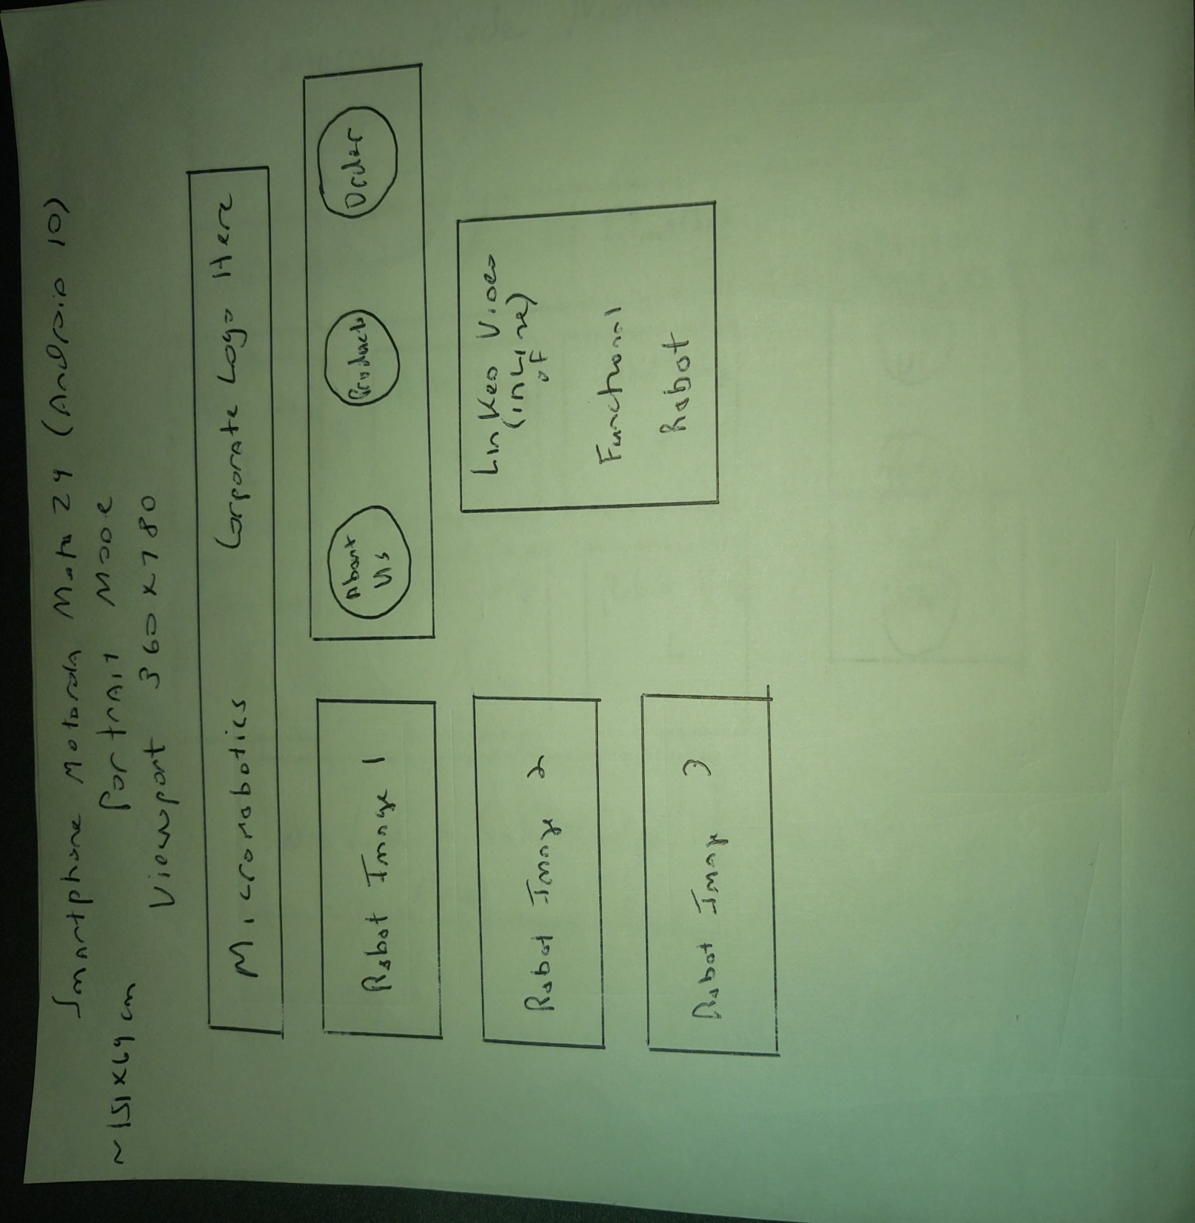

Slide 7
