Slide 1
雲端運算程式設計期末報告 第13組
8105056009陳原禾
7106056054黃筱真
7106056091李明翰
7106056111徐昀汝

Slide 2
實作GKA

Slide 3
資料集
Iris dataset
150 nodes
參數設定:
預設 分3群
Chromosome : 10 條
Iteration : 20 次

Slide 4
實作
GeneticK-Means Algorithm
Input:
Mutation Probability, Pm;
Population size, N;
Maximum number of generation, MAX GEN;
Output: Solution string, s;
{ Initialize the population, P;
geno = MAX GEN;
s = P1; (Pi is the ith string in P)
while (geno > 0)
{ Calculate Fitness values of strings in P;
^ P = Selection (P);
for i = 1 to N, Pi = Mutation( ^ Pi);
for i = 1 to N, K-Means(Pi);
s = string in P such that the corresponding weight
matrix Ws has the minimum SE measure;
if (S(Ws ) > S(Ws)), s = s;
geno = geno 􀀀 1;
}
output s;
}
根據GKA論文方法

Slide 5
實作
亂數產生10條染色體每條染色體有150nodes
10條染色體中隨機選出3個形心
計算10條染色體Fitness(SSE)
做Mutation
做K-means
重新產生10條新的染色體
做Selection 選出菁英染色體 當作下一個iteration的input

Slide 6
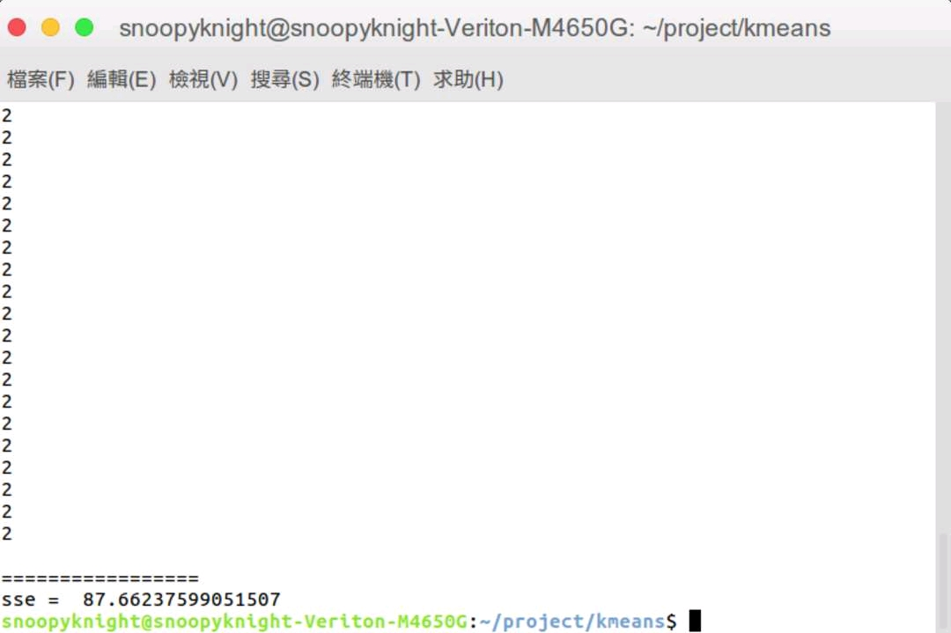
實驗結果 - Kmeans
SSE = 87.66

Slide 7
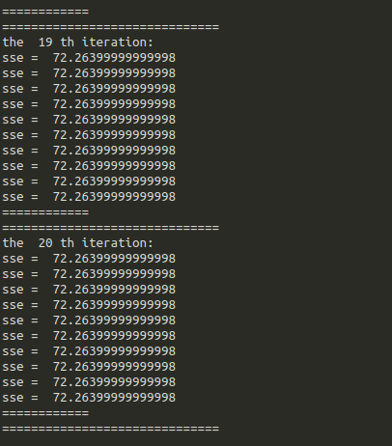
實驗結果 - GKA
SSE = 72.26

Slide 8
The End
Thank You !

