Slide 1
Robot Framework Browser Advanced Workshop
Tatu Aalto
René Rohner

Slide 2

High Level Architecture

Slide 3

High Level Architecture
*** Settings *** Library Browser

Slide 4
High Level Architecture
*** Settings *** Library Browser
Browser module

Slide 5

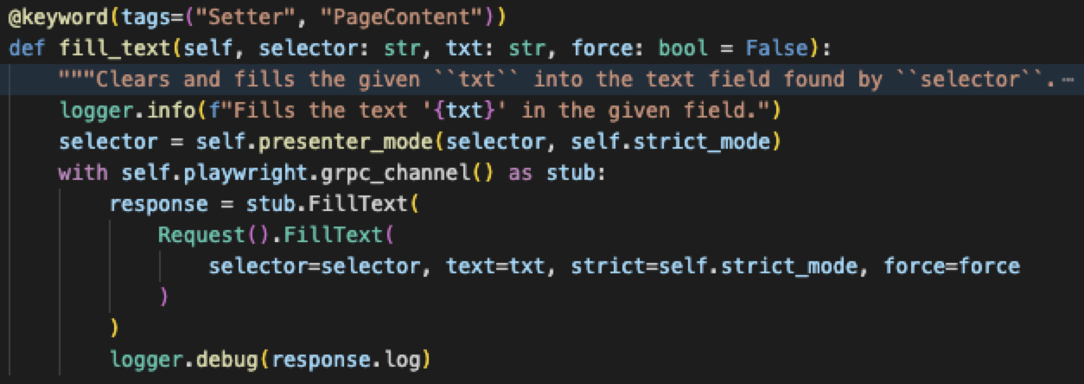
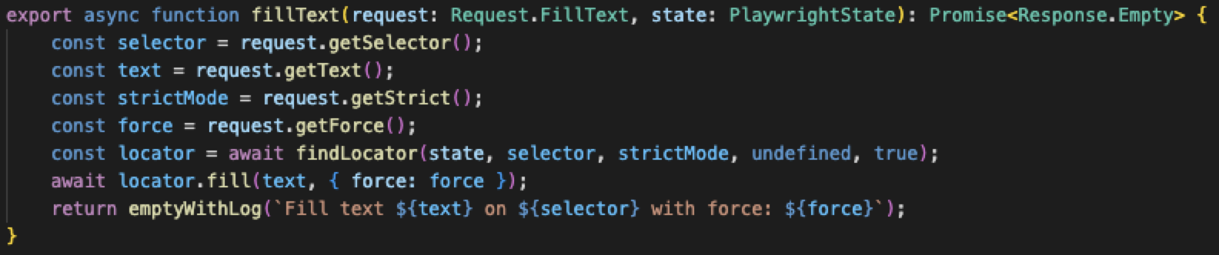
High Level Architecture
*** Settings *** Library Browser
Browser module
Start
JavaScript Side
Browser/keywords/interaction.py
Browser/wrapper/index.js

Slide 6
High Level Architecture
*** Settings *** Library Browser
Browser module
Start
JavaScript Side
Browser/keywords/interaction.py
Browser/wrapper/index.js

Slide 7



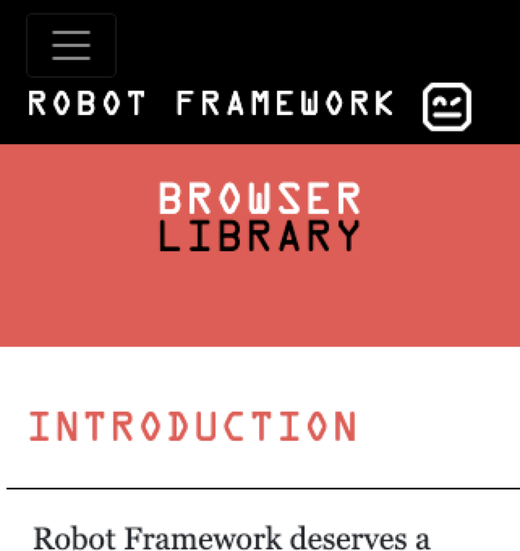

High Level Architecture
*** Settings *** Library Browser
Browser module
Start
JavaScript Side
Browser/keywords/interaction.py
Browser/wrapper/index.js
Start
Playwright NodeJS
CDP

Slide 8
Extending Browser

Slide 9
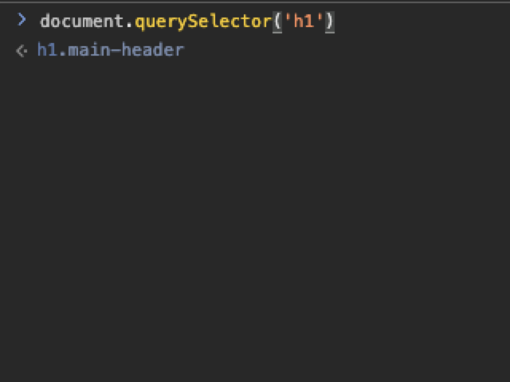
Evaluate JavaScript
(in Browser)
*** Settings *** Library Browser
Browser module
Start
JavaScript Side
Browser/wrapper/index.js
Start
evaluate_javascript
evaluateJavascript()
Playwright
CDP
locator.evaluate()

Slide 10
Plugin API
*** Settings *** Library Browser
Browser module
Start
JavaScript Side
Browser/keywords/interaction.py
Browser/wrapper/index.js
Start
Playwright NodeJS
CDP
Plugin API
Plugin API

Slide 11
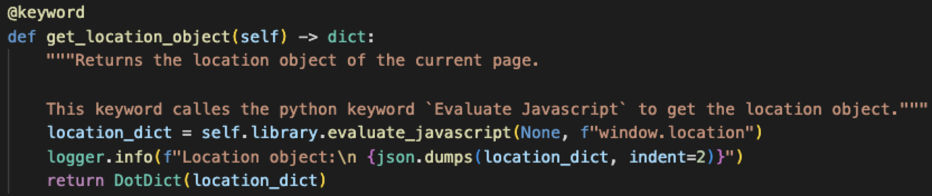
Python Plugin API (Add Keywords)
*** Settings *** Library Browser
Browser module
Start
JavaScript Side
Browser/keywords/interaction.py
Browser/wrapper/index.js
Start
Playwright NodeJS
CDP
Plugin API
Plugin API
Get Location Object

Slide 12
Python Plugin API (Add Keywords)
*** Settings *** Library Browser
Browser module
Start
Plugin API
JavaScript Side
Browser/keywords/interaction.py
Browser/wrapper/index.js
Start
Get Location Object
Playwright NodeJS
CDP
Plugin API

Slide 13
Python Plugins
*** Settings *** Library Browser
Browser module
Start
JavaScript Side
Fill Text
fillText
Start
Playwright NodeJS
CDP
Plugin API
Plugin API

Slide 14
Python Plugins (Overriding Keywords)
*** Settings *** Library Browser
Browser module
Start
JavaScript Side
Fill Text
fillText
Start
Playwright NodeJS
CDP
Plugin API
Plugin API
Fill Text (NEW)

Slide 15
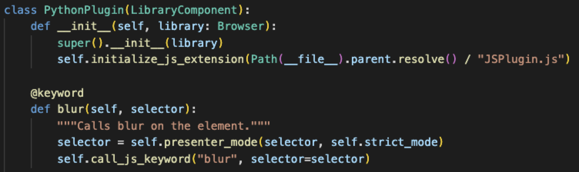
Hybrid Plugins (Python calls JS)
*** Settings *** Library Browser
Browser module
Start
JavaScript Side
Browser/keywords/interaction.py
Browser/wrapper/index.js
Start
Playwright NodeJS
CDP
Plugin API
Plugin API
Blur (python)
blur (JSPlugin.js)
init

Slide 16
Hybrid Plugins (Python calls JS)
Plugin API
*** Settings *** Library Browser
blur (JSPlugin.js)
Browser module
Start
JavaScript Side
Browser/keywords/interaction.py
Browser/wrapper/index.js
Start
Plugin API
Blur (python)
Playwright NodeJS
CDP

Slide 17
Hybrid Plugins (Python calls JS)
*** Settings *** Library Browser
Browser module
Start
JavaScript Side
Browser/keywords/interaction.py
Browser/wrapper/index.js
Start
Playwright NodeJS
CDP
Plugin API
Plugin API
Blur (python)
blur (JSPlugin.js)
init

Slide 18
Pabot and Browser

Slide 19
Pabot
Robot
Robot
Playwright
Playwright
CDP
Browser
CDP
Browser
Pabot Main
Robot
Robot
Playwright
Playwright
CDP
Browser
CDP
Browser
Robot
Robot
Playwright
Playwright
CDP
Browser
CDP
Browser

Slide 20
Pabot With Connect to Browser
Robot
Robot
Playwright
Playwright
CDP
Browser
CDP
Browser
Pabot Main
Robot
Robot
Playwright
Playwright
CDP
Browser
CDP
Browser

Slide 21
Pabot Shared Node Process&Browser
Playwright
Robot
Robot
CDP
Browser
CDP
Browser
Playwright
Playwright
Pabot Main
Robot
Robot
CDP
Browser
CDP
Browser
Playwright
Playwright
Robot
Robot
CDP
Browser
CDP
Browser
Playwright
Playwright

Slide 22
BROWSER

