Slide 1
Robot Framework Browser Advanced Workshop
Tatu Aalto
René Rohner

Slide 2

High Level Architecture

Slide 3

High Level Architecture
*** Settings *** Library Browser

Slide 4
High Level Architecture
*** Settings *** Library Browser
Browser module

Slide 5

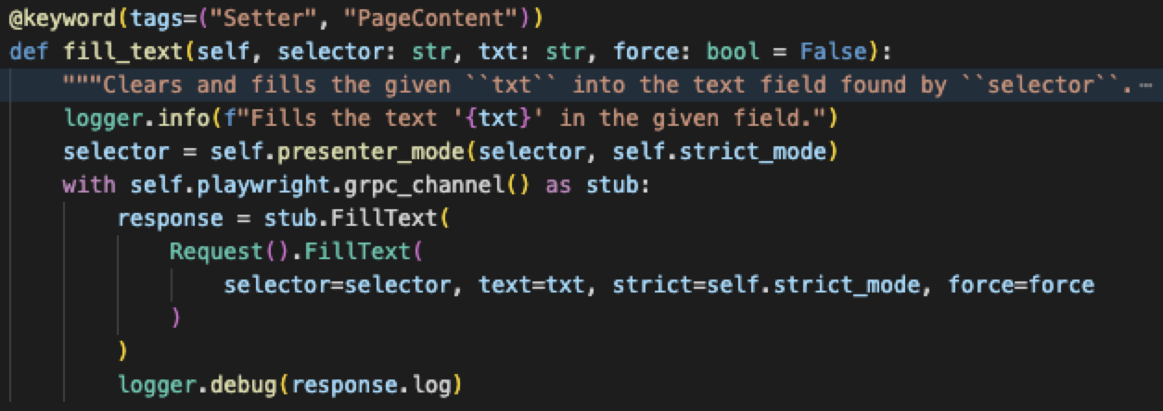
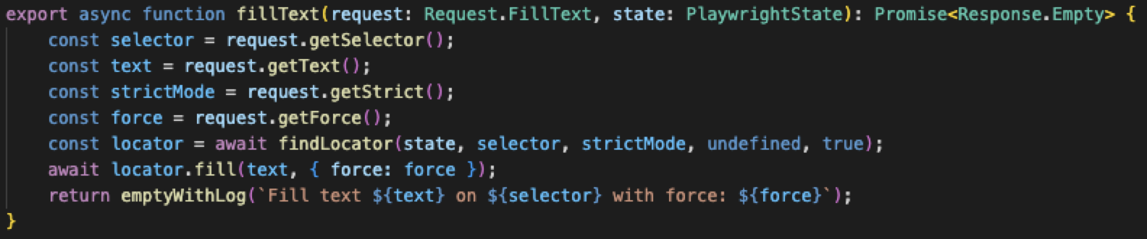
High Level Architecture
*** Settings *** Library Browser
Browser module
Start
JavaScript Side
Browser/keywords/interaction.py
Browser/wrapper/index.js

Slide 6
High Level Architecture
*** Settings *** Library Browser
Browser module
Start
JavaScript Side
Browser/keywords/interaction.py
Browser/wrapper/index.js

Slide 7



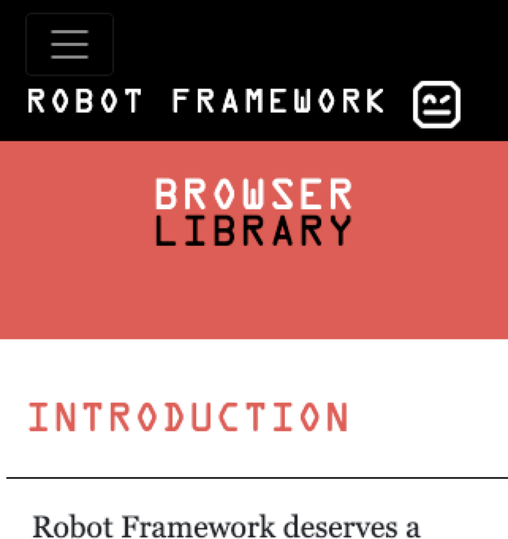

High Level Architecture
*** Settings *** Library Browser
Browser module
Start
JavaScript Side
Browser/keywords/interaction.py
Browser/wrapper/index.js
Start
Playwright NodeJS
CDP

Slide 8
Pabot and Browser

Slide 9
Pabot
Robot
Robot
Playwright
Playwright
CDP
Browser
CDP
Browser
Pabot Main
Robot
Robot
Playwright
Playwright
CDP
Browser
CDP
Browser
Robot
Robot
Playwright
Playwright
CDP
Browser
CDP
Browser

Slide 10
Pabot With Connect to Browser
Robot
Robot
Playwright
Playwright
CDP
Browser
CDP
Browser
Pabot Main
Robot
Robot
Playwright
Playwright
CDP
Browser
CDP
Browser

Slide 11
Pabot Shared Node Process&Browser
Playwright
Robot
Robot
CDP
Browser
CDP
Browser
Playwright
Playwright
Pabot Main
Robot
Robot
CDP
Browser
CDP
Browser
Playwright
Playwright
Robot
Robot
CDP
Browser
CDP
Browser
Playwright
Playwright

Slide 12
Extending Browser

Slide 13
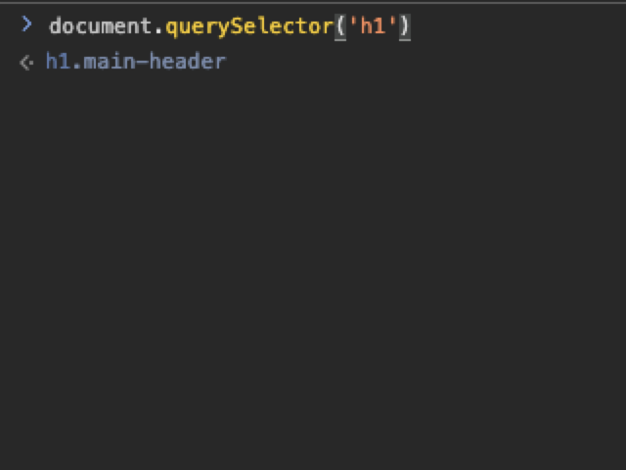
Evaluate JavaScript
(in Browser)
*** Settings *** Library Browser
Browser module
Start
JavaScript Side
Browser/wrapper/index.js
Start
evaluate_javascript
evaluateJavascript()
Playwright
CDP
locator.evaluate()

Slide 14
Plugin API
*** Settings *** Library Browser
Browser module
Start
JavaScript Side
Browser/keywords/interaction.py
Browser/wrapper/index.js
Start
Playwright NodeJS
CDP
Plugin API
Plugin API

Slide 15
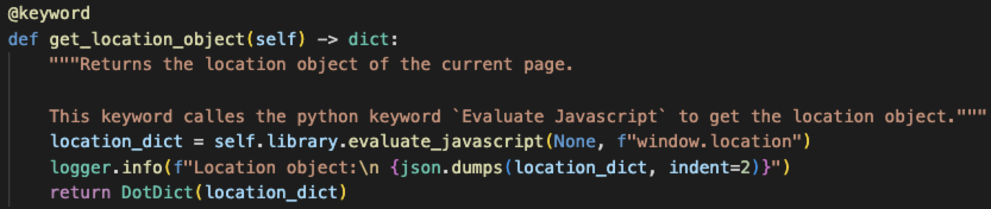
Python Plugin API (Add Keywords)
*** Settings *** Library Browser
Browser module
Start
JavaScript Side
Browser/keywords/interaction.py
Browser/wrapper/index.js
Start
Playwright NodeJS
CDP
Plugin API
Plugin API
Get Location Object

Slide 16
Python Plugin API (Add Keywords)
*** Settings *** Library Browser
Browser module
Start
Plugin API
JavaScript Side
Browser/keywords/interaction.py
Browser/wrapper/index.js
Start
Get Location Object
Playwright NodeJS
CDP
Plugin API

Slide 17
Python Plugins
*** Settings *** Library Browser
Browser module
Start
JavaScript Side
Fill Text
fillText
Start
Playwright NodeJS
CDP
Plugin API
Plugin API

Slide 18
Python Plugins (Overriding Keywords)
*** Settings *** Library Browser
Browser module
Start
JavaScript Side
Fill Text
fillText
Start
Playwright NodeJS
CDP
Plugin API
Plugin API
Fill Text (NEW)

Slide 19
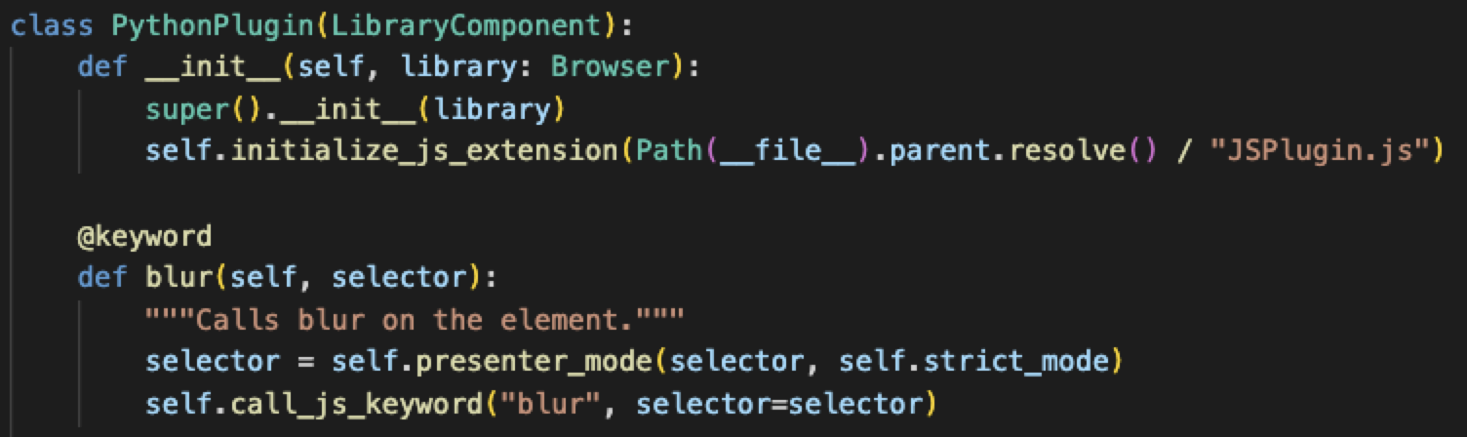
Hybrid Plugins (Python calls JS)
*** Settings *** Library Browser
Browser module
Start
JavaScript Side
Browser/keywords/interaction.py
Browser/wrapper/index.js
Start
Playwright NodeJS
CDP
Plugin API
Plugin API
Blur (python)
blur (JSPlugin.js)
init

Slide 20
Hybrid Plugins (Python calls JS)
Plugin API
*** Settings *** Library Browser
blur (JSPlugin.js)
Browser module
Start
JavaScript Side
Browser/keywords/interaction.py
Browser/wrapper/index.js
Start
Plugin API
Blur (python)
Playwright NodeJS
CDP

Slide 21
Hybrid Plugins (Python calls JS)
*** Settings *** Library Browser
Browser module
Start
JavaScript Side
Browser/keywords/interaction.py
Browser/wrapper/index.js
Start
Playwright NodeJS
CDP
Plugin API
Plugin API
Blur (python)
blur (JSPlugin.js)
init

Slide 22
BROWSER

