Slide 1


Slide 2
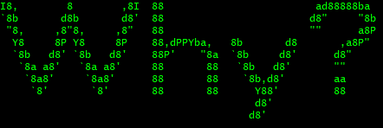
The public perception of hackers has become skewed by creative media.
General public is convinced that a hacker is always malicious.
Hackers are normally portrayed as having some form of mental illness.
They are also often portrayed as being loners, and possibly being socially distant.
Such perception is detrimental to those in security as well.
Is this truly the case?

Slide 3
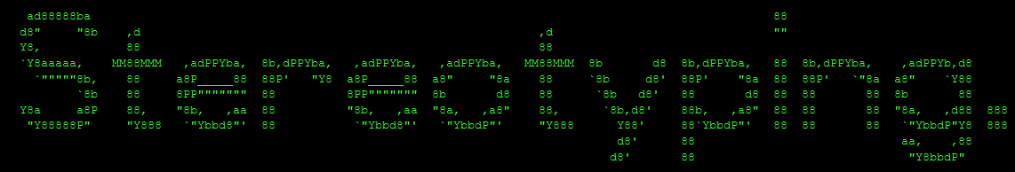
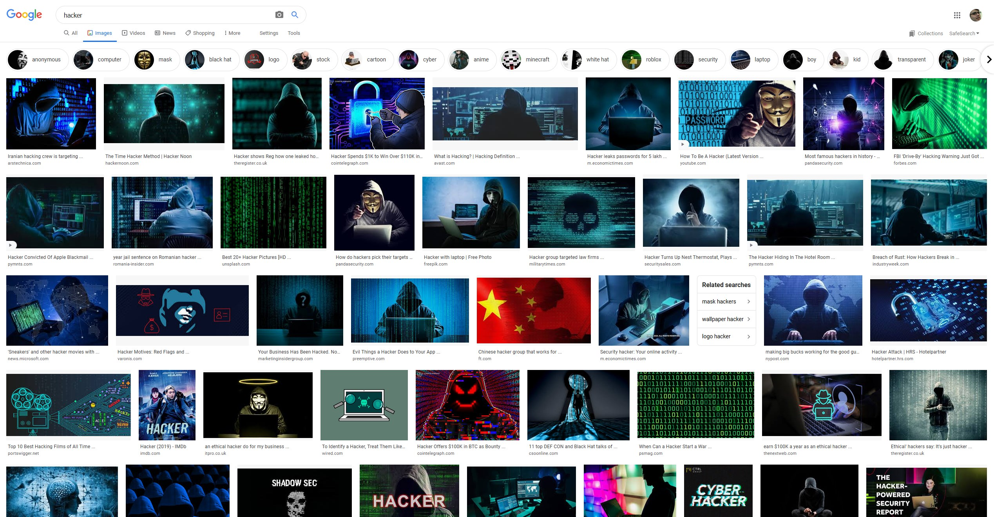

Slide 4
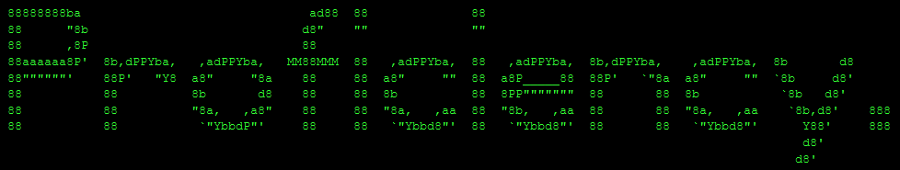
Does taking a Computer centric course make you more likely
to be a hacker?
A study by Seigfried-Spellar and Steinmetz in 2015 analysed
“computer deviant behaviour” across University majors.
They found no noticable difference in degree majors of
deviants and non-deviants.
They also found no significant difference in personality
traits, only noting that deviants tended to be less agreeable but not enough to draw a direct correlation.
The only clear correlation was between virus writers and low moral values.

Slide 5
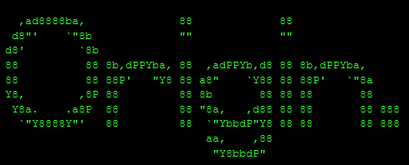
Hacker didn't always mean someone who breaks into a system.
In 2015 Steinmetz conducted a participant observation on a hacker group given the pseudonym “Union Hack”.
The observation was Overt.
Steinmetz also performed content analysis on a Hacker magazine called 2600: The Hacker Quarterly.
Steinmetz derived numerous personal characteristics that make a hacker:
Mentality, Skill, Guilds, Ownership, Transgression.

Slide 6
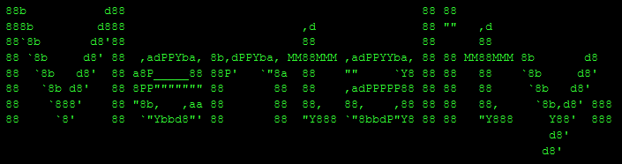
What you might expect.
An orientation towards problem solving.
Typically involving an unconventional way of thinking.
Looking to solve problems where other people might not see any.

Slide 7
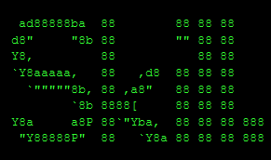
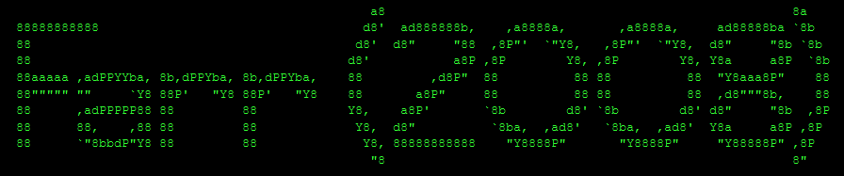
Not necessarily innate, not “natural”.
Steinmetz looks at this skill from a particularly social angle.
Hackers tend to learn their abilities from other hackers.
“Most people... are newbies... In a few Mondays... a few of these newbies will be contributing ideas of their own and be recognised by their peers.”
Steinmetz likened this process to tradeskill guilds.

Slide 8
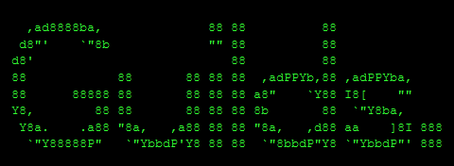
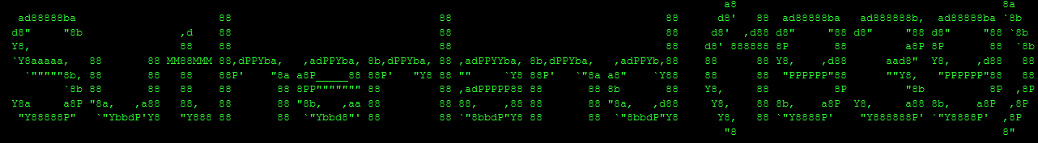
Steinmetz observes a tradescraft like hierarchy among the hackers.
Lower Apprentices are “Script Kiddies”
Which are being taught by Masters “Hackers”
Whilst conducting interviews it was found that most members of Union Hack had learned their skill through another hacker.
Guilds are also important for recognition.
“No one is a professional theif unless he is recognised by other professional theives.”

Slide 9
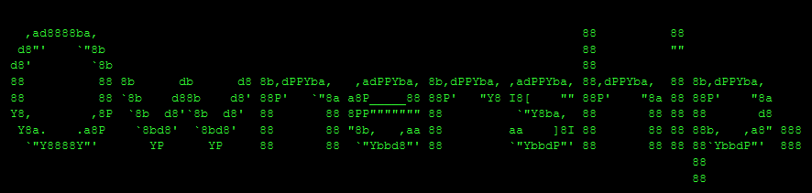
After developing skill, the newbies can become Hackers.
They do this by developing hacks of their own.

Slide 10
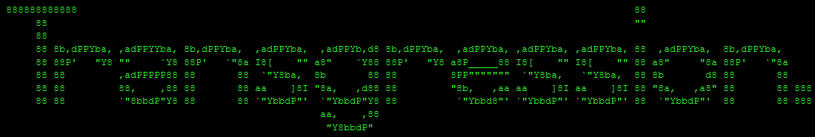
Steinmetz also identifies that eventually these hackers have to perform “Acts of Transgression”.
Steinmetz however doesn't explicitly say what this means, and leaves it at performing their own hacks.
Whether this is a malicious hack or not seems to be left in the open.

Slide 11
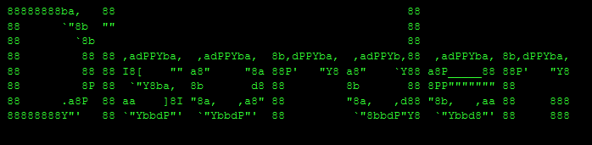
Interestingly there isnt a whole lot of study into disorders among hackers.
Siegfried and Spellar (2014) study the presence of hedonism, but this isnt necessarily a disorder.
Ledingham and Mills (2015) analysed a noticable rise in cases of Autism among arrested Cybercriminals.
They found very little to suggest this was actually true.
Siegfried and Spellar conducted another study in 2015 on Autism among hackers, and found nothing conclusive.

Slide 12
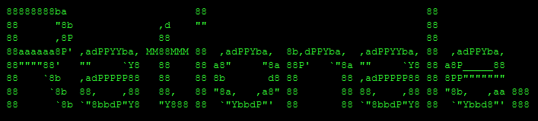
Why do hackers do what they do?
Woo et al (2004) performed content analysis on 770 defaced webpages, they found most of them (71%) were pranks and the others (23%) were Militant.
Silic and Lowry (2019) interviewed Black Hats.
They found that they tended to convince themselves they werent hurting people.
They also refused to acknowledge possible danger.
They all stated that they had a “Plan B” just incase.

Slide 13
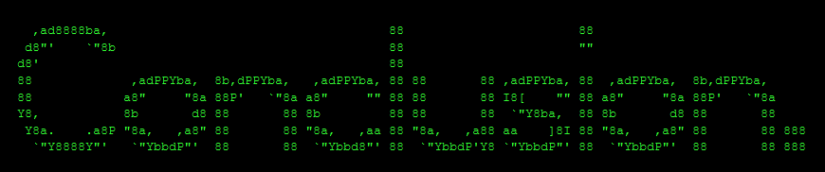
Hackers are a lot more complicated that what the stereotype makes out.
But this doesnt mean there arent hackers who fit the stereotype.
What constitutes a hacker quite obviously changes from person to person.
Just as every person in the world is uniquely different, so are hackers, right down to motives, characteristics, and flaws.
Study into why hackers do what they do is underexplored, and needs more work.

Slide 14
