Slide 1
Junior Matilda’s Prep

Slide 2
4 x 20min blocks
B1: Belco def mid-block
B2: Belco def high-press
B3: Belco def low-block
B4: Belco att set-pieces

Slide 3
Mid-Block
Midblock:
We move from 433 to 442
9
11
7
10
8
6
5
2
4
3
1
Notes:
Almost was us today….
But we’re going for it, we believe you can play our game and beat them.
It’s not a knockout, there’s no pressure.
In a knockout, we might think about this of course.
Let’s go.

Slide 4
Mid-Block
Midblock:
We move from 433 to 442
Wingers tuck in to join midfield
9
11
7
10
8
6
5
2
4
3
1
Notes:
Almost was us today….
But we’re going for it, we believe you can play our game and beat them.
It’s not a knockout, there’s no pressure.
In a knockout, we might think about this of course.
Let’s go.

Slide 5
Mid-Block
Midblock:
We move from 433 to 442
Wingers tuck in to join midfield
The 6 and 8 become square
9
10
11
8
7
6
5
2
4
3
1
Notes:
Almost was us today….
But we’re going for it, we believe you can play our game and beat them.
It’s not a knockout, there’s no pressure.
In a knockout, we might think about this of course.
Let’s go.

Slide 6
Mid-Block
Midblock:
We move from 433 to 442
Wingers tuck in to join midfield
The 6 and 8 become square
The 9 drops to join the 10
9
10
11
6
8
7
5
2
4
3
1
Notes:
Almost was us today….
But we’re going for it, we believe you can play our game and beat them.
It’s not a knockout, there’s no pressure.
In a knockout, we might think about this of course.
Let’s go.

Slide 7
Mid-Block
Midblock:
We move from 433 to 442
Wingers tuck in to join midfield
The 6 and 8 become square
The 9 drops to join the 10
And the final are the lines together
10
9
11
6
8
7
5
4
3
2
1
Notes:
Almost was us today….
But we’re going for it, we believe you can play our game and beat them.
It’s not a knockout, there’s no pressure.
In a knockout, we might think about this of course.
Let’s go.

Slide 8
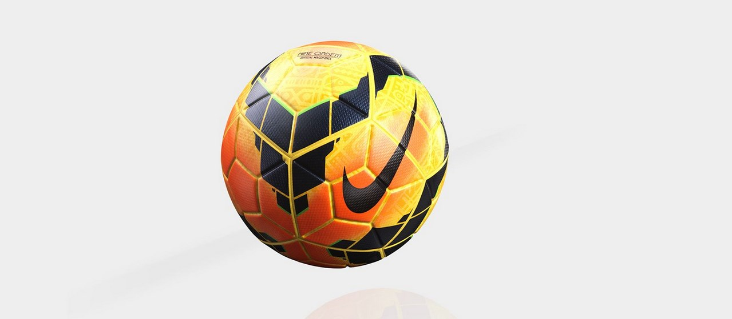
Mid-Block
Movements:
When ball is central
10
9
11
6
8
7
5
4
3
2
1
Notes:
Almost was us today….
But we’re going for it, we believe you can play our game and beat them.
It’s not a knockout, there’s no pressure.
In a knockout, we might think about this of course.
Let’s go.

Slide 9
Mid-Block
Movements:
When ball is their left
We slide across together.
We start to se our shape change.
Inc GK.
10
9
8
7
11
6
3
2
5
4
1
Notes:
Almost was us today….
But we’re going for it, we believe you can play our game and beat them.
It’s not a knockout, there’s no pressure.
In a knockout, we might think about this of course.
Let’s go.

Slide 10
Mid-Block
Movements:
If they play to someone higher.
The midfielder is the 1st defender.
Don’t over commit
More about delay than pressure.
9
10
7
11
6
8
3
2
5
4
1
Notes:
Almost was us today….
But we’re going for it, we believe you can play our game and beat them.
It’s not a knockout, there’s no pressure.
In a knockout, we might think about this of course.
Let’s go.

Slide 11
Mid-Block
Movements:
If they switch.
We re-adjust together.
And start again.
10
9
11
6
8
7
5
4
3
2
1
Notes:
Almost was us today….
But we’re going for it, we believe you can play our game and beat them.
It’s not a knockout, there’s no pressure.
In a knockout, we might think about this of course.
Let’s go.

Slide 12
High press
High press:
Two options
9
11
7
10
8
6
5
2
4
3
1
Notes:
Almost was us today….
But we’re going for it, we believe you can play our game and beat them.
It’s not a knockout, there’s no pressure.
In a knockout, we might think about this of course.
Let’s go.

Slide 13
High press
High press:
Press with the 10
3 and 6 and 8 roll-on
9
11
7
10
8
6
5
2
4
3
1
Notes:
Almost was us today….
But we’re going for it, we believe you can play our game and beat them.
It’s not a knockout, there’s no pressure.
In a knockout, we might think about this of course.
Let’s go.

Slide 14
High press
High press:
Press with the 10
3 and 6 and 8 roll-on
And we press high
Then we defend 1v1 everywhere.
Duels are important.
10
9
7
11
8
6
3
5
2
4
1
Notes:
Almost was us today….
But we’re going for it, we believe you can play our game and beat them.
It’s not a knockout, there’s no pressure.
In a knockout, we might think about this of course.
Let’s go.

Slide 15
High press
High press:
OR with the fullback
9
11
7
10
8
6
5
2
4
3
1
Notes:
Almost was us today….
But we’re going for it, we believe you can play our game and beat them.
It’s not a knockout, there’s no pressure.
In a knockout, we might think about this of course.
Let’s go.

Slide 16
High press
High press:
With the fullback
We end with the same shape
11
9
5
7
10
8
6
4
3
2
1
Notes:
Almost was us today….
But we’re going for it, we believe you can play our game and beat them.
It’s not a knockout, there’s no pressure.
In a knockout, we might think about this of course.
Let’s go.

Slide 17
Low-block
Low-block:
We know this one.
We sit in and use our principles.
9
11
10
7
8
6
5
4
3
2
1
Notes:
Almost was us today….
But we’re going for it, we believe you can play our game and beat them.
It’s not a knockout, there’s no pressure.
In a knockout, we might think about this of course.
Let’s go.

Slide 18
Low-block
Low-block:
We know this one.
We sit in and use our principles.
The 9s job is to filter play one-way
9
11
10
7
8
6
5
4
3
2
1
Notes:
Almost was us today….
But we’re going for it, we believe you can play our game and beat them.
It’s not a knockout, there’s no pressure.
In a knockout, we might think about this of course.
Let’s go.

