Slide 1
R3 – Majura
18-04-2026

Slide 2
R3 – Majura – 343 formation
Against Majura we will play a 343, not the usual 433.
Positions:
CB – Centre back
WB – Wing back
DM – Defensive midfielder (or 6)
AM – Attacking midfielder (or 10)
W – Winger (or 7 and 11)
S – Striker (or 9)
W
S
W
AM
WB
WB
DM
CB
CB
CB
GK
18-04-2026
Notes:
Almost was us today….
But we’re going for it, we believe you can play our game and beat them.
It’s not a knockout, there’s no pressure.
In a knockout, we might think about this of course.
Let’s go.

Slide 3
R3 – Majura – 343 formation
The lines help to show the 3 defenders, 4 midfielders and 3 forwards.
The next slide will show what we look like when we are building up from the back, e.g. like when you have the ball.
W
S
W
AM
WB
WB
DM
CB
CB
CB
GK
18-04-2026
Notes:
Almost was us today….
But we’re going for it, we believe you can play our game and beat them.
It’s not a knockout, there’s no pressure.
In a knockout, we might think about this of course.
Let’s go.

Slide 4
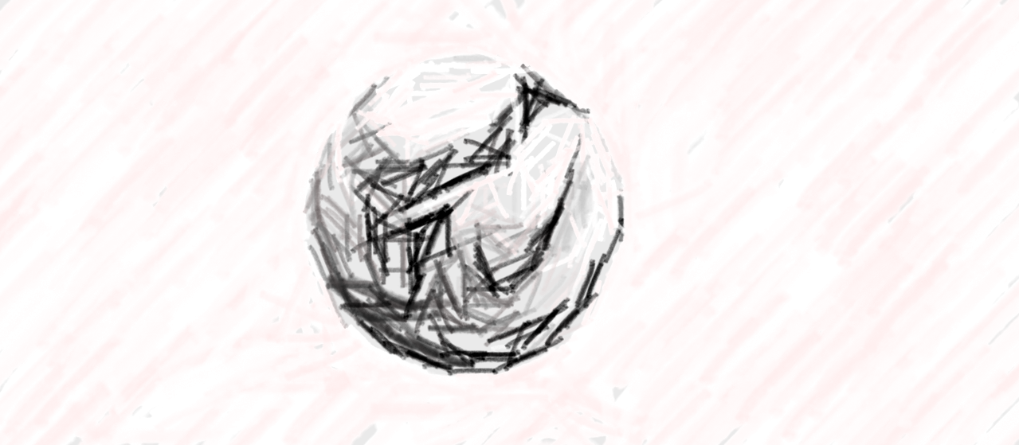
R3 – Majura – Buildup shape
When we buildup from the back (the ball is with you), the players will move to make a shape that you are familiar with seeing.
It will look like our normal 433.
The next slide will show you those connected lines so you can see how the 343 has moved.
S
W
W
WB
AM
CB
WB
DM
CB
CB
GK
18-04-2026
Notes:
Almost was us today….
But we’re going for it, we believe you can play our game and beat them.
It’s not a knockout, there’s no pressure.
In a knockout, we might think about this of course.
Let’s go.

Slide 5
R3 – Majura – Buildup shape
You can see that the 343 has shifted to make that shape to help increase our passing options during build up.
Then as we take the ball forward it will move back into a 343.
S
W
W
WB
AM
CB
WB
DM
CB
CB
GK
18-04-2026
Notes:
Almost was us today….
But we’re going for it, we believe you can play our game and beat them.
It’s not a knockout, there’s no pressure.
In a knockout, we might think about this of course.
Let’s go.

