Slide 1
Canberra United Prep

Slide 2
3 x 20min blocks
Setup
433 BP
442 BPO

Slide 3
Belconnen - BP shape
BP:
433.
8 play a little deeper to help buildup.
To help passing lanes:
10 play a little left.
9 play a little right.
Wingers try give width.
11
9
7
10
8
6
5
2
4
3
GK

Slide 4
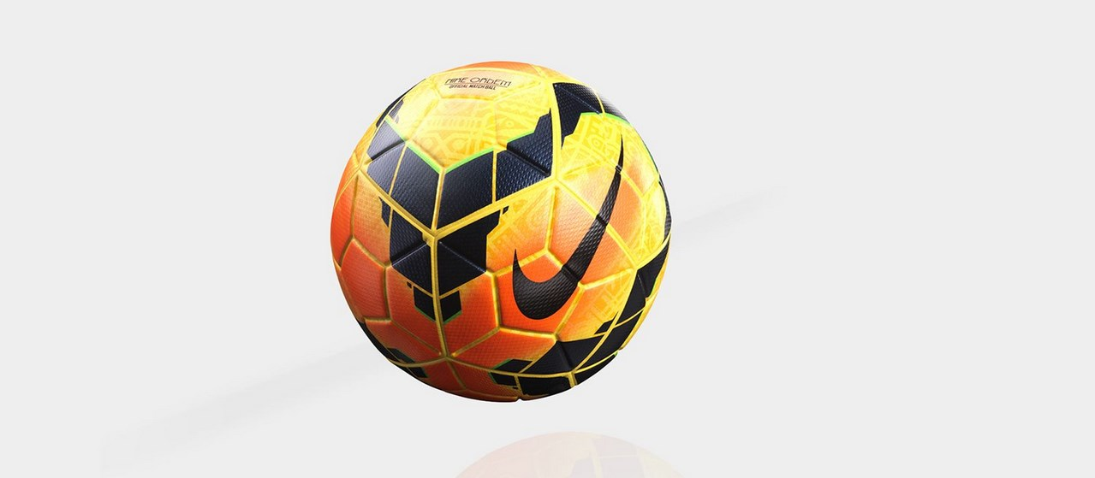
CU – BP shape
BP:
Usually CU play 352.

Slide 5
CU – BP shape
BP:
Outside centre backs are happy to advance.
They look to play direct into forward areas.

Slide 6
CU – BP shape
BP:
10 likes to run into this space.
Notes:
Almost was us today….
But we’re going for it, we believe you can play our game and beat them.
It’s not a knockout, there’s no pressure.
In a knockout, we might think about this of course.
Let’s go.

Slide 7
CU – BP shape
BP:
Wingbacks will try get into crossing positions.

Slide 8
CU – BP shape
BP:
Both forwards like to run in behind.
Neither drop-in to help buildup.

Slide 9
Belconnen – BPO shape
BPO:
From BP > BPO this is how we move from 433 to 442.
Nearest winger goes to ball.
Weak-sided winger drop and mark wingback.
Weak-sided fullback tuck in.
Strong-side fullback mark wingback.
11
9
7
10
8
6
5
2
4
3

Slide 10
Belconnen – BPO shape
BPO:
After movements we look like this.
9
7
10
11
8
2
6
5
4
3

Slide 11
Belconnen – BPO shape
BPO:
So the 442 looks like this.
Always the strong-sided wide players focus on the ball.
The weak-sided players drop and tuck in.
9
7
10
11
8
2
6
5
4
3
Notes:
Almost was us today….
But we’re going for it, we believe you can play our game and beat them.
It’s not a knockout, there’s no pressure.
In a knockout, we might think about this of course.
Let’s go.

Slide 12
Belconnen - BP shape
BP options:
Wide wingers could stretch their defenders.
11
9
7
10
8
6
5
2
4
3
GK
Notes:
Almost was us today….
But we’re going for it, we believe you can play our game and beat them.
It’s not a knockout, there’s no pressure.
In a knockout, we might think about this of course.
Let’s go.

Slide 13
Belconnen - BP shape
BP options:
This could open passing or forward run options.
11
9
7
10
8
6
5
2
4
3
GK
Notes:
Almost was us today….
But we’re going for it, we believe you can play our game and beat them.
It’s not a knockout, there’s no pressure.
In a knockout, we might think about this of course.
Let’s go.

Slide 14
Belconnen – BPO shape
BP options:
352 is strong centrally.
We might have more success in wide areas if our fullbacks can get forward.
Maybe 2v1 opportunities.
11
9
7
10
8
6
5
2
4
3

