Slide 1
Game 1 – Western Australia

Slide 2
WA – FIRST Half - Lineup
Lineup:
Enid
Grace
Sage
Dobbie
Abby
Siena
Darcy
Tehya
Ella
Luc
G
Subs:
Halle
Maya
Ciara
Lily
Ingrid
EH
G
DW
LP
TA
SD
AR
GY
D
SH
E
EMC 2025

Slide 3
WA – Likely formation
EMC 2025

Slide 4
WA – Key Objectives
BP: First touch forward, have a positive mindset
GK
Stay connected to backline if we progress up the field.
Defenders
FBs focus on level and outside. Look to go forward. By a positive first touch or get a bounce from the 6 or 8. Make the overload.
CBs avoid square passes, look to start our build-up. Support your FBs.
Midfielders
6 - prepare to connect with defenders (bounce to FB).
8/10 - Arrive in the box to mee the cutbacks or second balls - don’t stand still at the edge.
Attackers
If your opposite winger is attacking, make sure to be at the far post to score.
In 1v1 moments be brave and confident to win the duel.
EMC 2025

Slide 5
WA – Key Objectives
BP: First touch forward, have a positive mindset
GK
Stay connected to backline if we progress up the field.
Defenders
FBs focus on level and outside. Look to go forward. By a positive first touch or get a bounce from the 6 or 8. Make the overload.
CBs avoid square passes, look to start our build-up. Support your FBs.
Midfielders
6 - prepare to connect with defenders (bounce to FB).
8/10 - Arrive in the box to mee the cutbacks or second balls - don’t stand still at the edge.
Attackers
If your opposite winger is attacking, make sure to be at the far post to score.
In 1v1 moments be brave and confident to win the duel.
EMC 2025

Slide 6
WA – Key Objectives
BP: First touch forward, have a positive mindset
GK
Stay connected to backline if we progress up the field.
Defenders
FBs focus on level and outside. Look to go forward. By a positive first touch or get a bounce from the 6 or 8. Make the overload.
CBs avoid square passes, look to start our build-up. Support your FBs.
Midfielders
6 - prepare to connect with defenders (bounce to FB).
8/10 - Arrive in the box to mee the cutbacks or second balls - don’t stand still at the edge.
Attackers
If your opposite winger is attacking, make sure to be at the far post to score.
In 1v1 moments be brave and confident to win the duel.
EMC 2025

Slide 7
WA – Key Objectives
BPO: Press in the Attacking Third
GK
Focus on positioning, how can you help the team in the moment.
Defenders
CB - Step into midfield space behind the press.
CB/FB - Stay connected and focus on shape while they build-up.
Midfielders
Be ready to help the press in the front third.
Be responsible for staying with your opponent – don’t pass on
Attackers
Read triggers (e.g. poor touch, back pass) and go when you see it.
Press as a unit: one goes, others step with them – don’t solo press.
EMC 2025
Notes:
GK – Where is the ball – how can you adjust, what info can you give.
FB – everything is based on where the ball is, where your positioning should be. That’s your reference.
Beware to not ball watch, it will allow the winger to make a run on your blindside.
Midfield – the key to our press today is how you step forward to help.
When not pressing, stay with your player, don’t let them get on your blindsides.

Slide 8
WA – Key Objectives
BPO: Press in the Attacking Third
GK
Focus on positioning, how can you help the team in the moment.
Defenders
CB - Step into midfield space behind the press.
CB/FB - Stay connected and focus on shape while they build-up.
Midfielders
Be ready to help the press in the front third.
Be responsible for staying with your opponent – don’t pass on
Attackers
Read triggers (e.g. poor touch, back pass) and go when you see it.
Press as a unit: one goes, others step with them – don’t solo press.
EMC 2025
Notes:
GK – Where is the ball – how can you adjust, what info can you give.
FB – everything is based on where the ball is, where your positioning should be. That’s your reference.
Beware to not ball watch, it will allow the winger to make a run on your blindside.
Midfield – the key to our press today is how you step forward to help.
When not pressing, stay with your player, don’t let them get on your blindsides.

Slide 9
WA – Key Objectives
BPO: Press in the Attacking Third
GK
Focus on positioning, how can you help the team in the moment.
Defenders
CB - Step into midfield space behind the press.
CB/FB - Stay connected and focus on shape while they build-up.
Midfielders
Be ready to help the press in the front third.
Be responsible for staying with your opponent – don’t pass on
Attackers
Read triggers (e.g. poor touch, back pass) and go when you see it.
Press as a unit: one goes, others step with them – don’t solo press.
EMC 2025
Notes:
GK – Where is the ball – how can you adjust, what info can you give.
FB – everything is based on where the ball is, where your positioning should be. That’s your reference.
Beware to not ball watch, it will allow the winger to make a run on your blindside.
Midfield – the key to our press today is how you step forward to help.
When not pressing, stay with your player, don’t let them get on your blindsides.

Slide 10
WA – FIRST Half - Press
CB
CB
RB
EH
LB
G
D
DM
LP
SD
TA
AR
GY
D
SH
E
EMC 2025

Slide 11
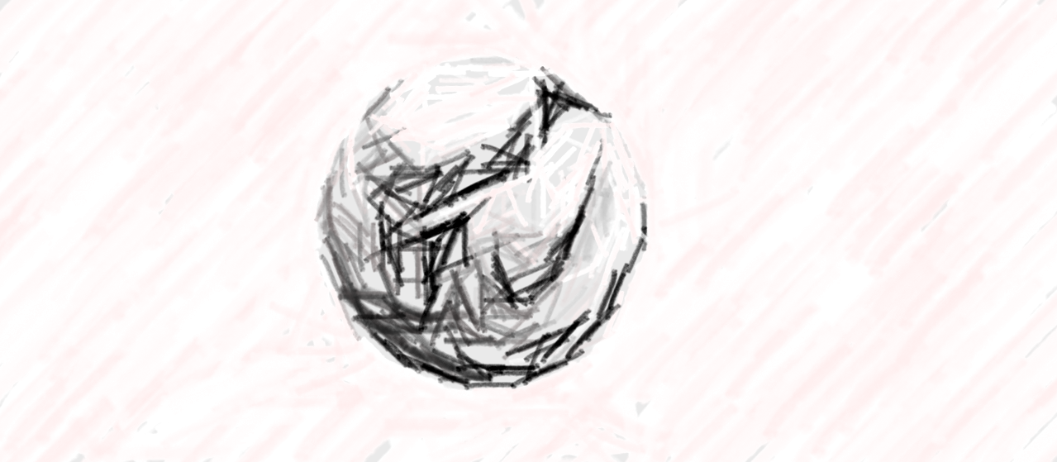
WA – FIRST Half - Press
CB
CB
RB
EH
LB
G
D
DM
LP
SD
TA
AR
GY
D
SH
E
EMC 2025

Slide 12
WA – FIRST Half - Press
CB
CB
RB
EH
LB
G
D
DM
LP
SD
TA
AR
GY
D
SH
E
EMC 2025

Slide 13
WA – FIRST Half - Set Pieces (Corners For)
D
EH
LP
Takers:
Luc
Dobbie
Attack the goal:
Tehya
Siena
G
Grace
Edge of box:
Dobbie/Luc
Darcy
Near post:
Ella
Defend:
Abby
Sage
TA
SD
G
GY
DW
D/
LP
SH
AR
EMC 2025

Slide 14
WA – FIRST Half - Set Pieces (Corners Against)
LP
E
AR
SD
Man marking:
Dobbie
Grace
Tehya
Sage
Ella
Posts:
Abby - near
Luc - far
Edge of box/halfway:
G
Darcy
D
GY
EH
SH
TA
G
DW
EMC 2025

Slide 15
WA – SECOND Half - Lineup
Lineup:
Enid
Grace
Sage
Halle
Maya
Dobbie
Lily
Ciara
Ella
Luc
G
Subs:
Abby
Tehya
Siena
Darcy
Ingrid
EH
G
LA
LP
CG
D
M
GY
H
SH
E
EMC 2025

Slide 16
WA – SECOND Half - Set Pieces (Corners For)
D
EH
LP
Takers:
Luc
Dobbie
Attack the goal:
Tehya
Siena
G
Grace
Edge of box:
Dobbie/Luc
Darcy
Near post:
Ella
Defend:
Abby
Sage
TA
SD
G
GY
DW
D/
LP
SH
AR
EMC 2025

Slide 17
WA – SECOND Half - Set Pieces (Corners Against)
M
E
LP
D
Man marking:
Sage
Halle
Grace
G
Ella
Posts:
Luc - near
Maya - far
Edge of box/halfway:
Ciara
Lily
SH
H
EH
GY
G
CG
LA
EMC 2025

Slide 18
WA - SECOND Half - Press
CB
CB
RB
EH
LB
G
D
DM
LP
SD
TA
AR
GY
D
SH
E
EMC 2025

Slide 19
WA - SECOND Half - Press
CB
CB
RB
EH
LB
G
D
DM
LP
SD
TA
AR
GY
D
SH
E
EMC 2025

Slide 20
WA - SECOND Half - Press
CB
CB
RB
EH
LB
G
D
DM
LP
SD
TA
AR
GY
D
SH
E
EMC 2025

