Slide 1
Quarter Final – Charles Perkins XI

Slide 2
CP – FIRST Half - Lineup
Lineup:
Ingrid
Grace
Halle
Sage
Abby
Dobbie
Ella
Ciara
Siena
Tehya
Lily
Subs:
G
Maya
Luc
Darcy
Enid
SD
LA
EH
TA
CG
D
AR
GY
SH
H
I
EMC 2025

Slide 3
CP – Likely system
BP:
Direct. Go forward quickly – no tempo
No.12 and others quite fast.
Less technical, more physical
433
BPO:
433
Back 4 was not organised.
Big spaces between lines – vertically not connected
EMC 2025

Slide 4
CP – BP – Key Objectives
BP: Control the tempo. Keep them under pressure.
We keep the ball, we keep control – they won’t get to rest.
GK
Communicate. Be calm – manage the tempo.
Release early if it’s on, but don’t rush if it’s not.
Defenders
Stay composed – your calmness sets our tempo.
Play forward when it’s on and it’s ok to play long into space.
Midfielders
Be patient, don’t force risky passes.
Control the middle – we’ll create when they open up.
Attackers
Time your runs – don’t go too early and vary your options.
When your moment arrives, take it.
EMC 2025
Notes:
It took all the sessions and the 4th friendly to decide on what our identity was going to be.
It’s pressing, pressuring, and countering.
I know we have technical qualities, but by themselves that’s not an identity.
Our technical level adds to the approach that is about pressure.
So today we build again on the first day, we’re 2 steps now.

Slide 5
CP – BPO – Key Objectives
BPO: Stay organised. Stay in control.
They're direct and individual – our structure stops that from working.
GK
Manage your box. Keep the back line alert – talk and organise.
Step out early for through balls or high balls – own your area.
Defenders
Be aware of their speed – adjust your position early.
Stay connected to close off gaps together before they appear.
Midfielders
Jump into the press if the attackers jump.
Stay tight to your player – don’t pass them on.
Attackers
Identify the pressing triggers (bad touch, backwards pass).
Show them passes into the midfield, for us to counter immediately.
EMC 2025
Notes:
BPO first today – because our BP moments come from our BPO moments.
We’re more of a BPO team that harasses the other team, to take the ball and then we go do our thing.
Defenders – remember your own little press moments, when your player does those triggers.

Slide 6
CP – Mid-Block
CB
CB
RB
LB
DM
SD
DW
LA
EH
CG
TA
AR
H
SH
GY
I/E
EMC 2025
Notes:
Almost was us today….
But we’re going for it, we believe you can play our game and beat them.
It’s not a knockout, there’s no pressure.
In a knockout, we might think about this of course.
Let’s go.

Slide 7
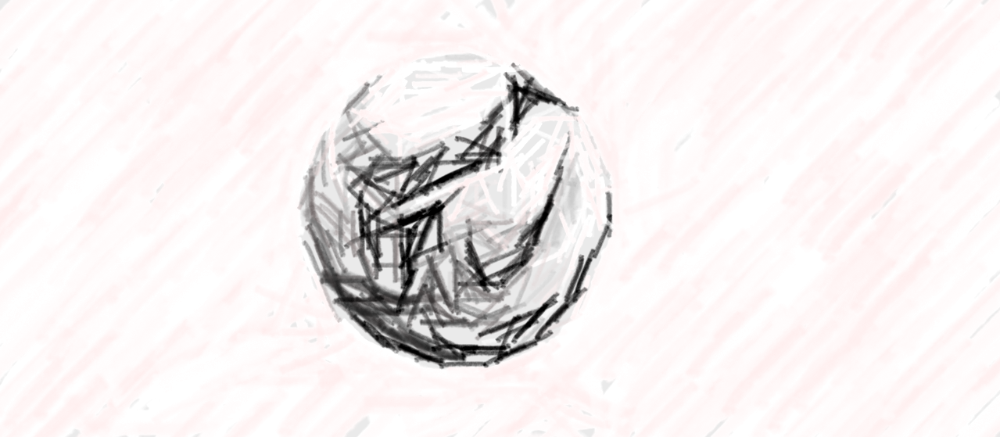
CP – Goal kicks
RB
CB
SD
CB
LB
LA
DM
EH
TA
CG
D
GY
AR
SH
H
I/E
EMC 2025
Notes:
Almost was us today….
But we’re going for it, we believe you can play our game and beat them.
It’s not a knockout, there’s no pressure.
In a knockout, we might think about this of course.
Let’s go.

Slide 8
CP – FIRST Half - Press
CB
CB
RB
SD
LB
LA
EH
DM
TA
CG
D
AR
GY
H
SH
I
EMC 2025

Slide 9
CP – FIRST Half - Press
CB
CB
RB
SD
LB
LA
M
DM
TA
CG
D
AR
GY
H
SH
I
EMC 2025

Slide 10
CP – FIRST Half - Press
CB
CB
RB
SD
LB
LA
EH
DM
TA
CG
D
AR
GY
H
SH
I
EMC 2025

Slide 11
CP – FIRST Half - Set Pieces (Corners For)
CG
EH
TA
Takers:
Tehya
Ciara
Attack the goal:
Siena
Lily
Halle
Grace
Edge of box:
Ciara/Tehya
Dobbie
Near post:
Ella
Defend:
Abby
Sage
SD
LA
H
GY
D
CG
SH
AR
EMC 2025

Slide 12
CP – FIRST Half - Set Pieces (Corners Against)
CG
I
AR
Man marking:
Halle
Ella
Tehya
Sage
Grace
Free 6-yard:
Siena
Posts:
Abby - near
Ciara - far
Edge of box/halfway:
Dobbie
Lily
SD
H
TA
GY
SH
EH
D
LA
EMC 2025

Slide 13
CP – SECOND Half - Lineup
Lineup:
Enid/Ingrid
Grace
Ciara
Sage
Maya
Dobbie
Ella
Tehya
Darcy
Luc
Lily
Subs:
G
Halle
Abby
Siena
GK
DW
LA
EH
LP
TA
D
M
GY
SH
CG
I/E
EMC 2025

