Slide 1
Paper Summery
Intra-Patient and Inter-Patient Multi-Classification of
Severe Cardiovascular Diseases Based on CResFormer

Slide 2
Abstract
This study proposes a deep learning network, CResFormer, for classifying severe cardiovascular diseases using dual feature extraction. The proposed model is designed to improve the accuracy of inter-patient experiments, which is more representative of actual clinical conditions than intra-patient experiments. The input data used in the model is fixed segmentation of dual-lead ECG signals without preprocessing. The model consists of one-dimensional convolutional layers, ResNet residual network block layers, and transformer encoder layers for feature extraction. The Softmax function is used for classification, and the focal loss function is used for dealing with unbalanced datasets.
The results of intra-patient experiments show that the proposed model achieved high accuracy, sensitivity, positive predictive value, and specificity in classifying four severe cardiovascular diseases, namely, CAD, MI, and CHF. The model also performed well in inter-patient experiments, demonstrating its potential for diagnosing cardiovascular diseases in actual clinical environments. Moreover, the model shows good noise robustness and performs well in unbalanced datasets.
Overall, the proposed CResFormer model has great potential for diagnosing severe cardiovascular diseases and can be applied in actual clinical environments. The use of dual feature extraction and the focal loss function contribute to improving the accuracy of the model in inter-patient experiments, which is crucial for reliable diagnoses of severe cardiovascular diseases.

Slide 3
Introduction
This passage provides an overview of cardiovascular diseases, particularly ischemic or hemorrhagic diseases caused by hyperlipidemia, thick blood, atherosclerosis, and hypertension, which are major threats to human health and life. Cardiovascular diseases include asymptomatic myocardial ischemia, coronary artery disease (CAD), angina pectoris, myocardial infarction (MI), and ischemic heart disease (IHD). The author notes that cardiovascular diseases are the leading cause of death worldwide, and the number of adults with these diseases is expected to increase significantly in the future.
The passage also describes how electrocardiogram (ECG) is an effective and non-invasive tool for diagnosing serious cardiovascular diseases. ECG manifestations of CAD and MI are also explained. The author notes that although ECG is an intuitive tool, precise interpretation of ECG signals requires expertise and experience, and even experts may not obtain enough information from the ECG signal to ensure an accurate diagnosis.
Finally, the author suggests that deep learning algorithms could be used to process ECG signals for computer-aided diagnosis to build effective models and ensure fast and accurate diagnosis. However, the algorithms require a large volume of datasets for training to form stable and accurate models.

Slide 4
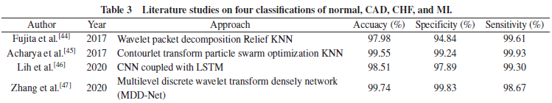
Related Work
The article discusses the use of machine-learning-based algorithmic models and deep-learning-based network models for automatic detection and classification of ECG signals in the diagnosis of serious cardiovascular diseases such as coronary artery disease (CAD), congestive heart failure (CHF), and myocardial infarction (MI).
The preprocessing stage involves denoising, R-peak detection, and feature extraction, including time-frequency domain features, statistical features, and morphological features. Key features are then classified using machine learning algorithms, deep learning network algorithms, artificial neural networks, or various types of novel networks based on basic algorithms, such as support vector machines, K-nearest neighbor algorithms, and random forest algorithm. Deep learning network models, such as deep belief network, convolutional neural network (CNN), long short-term memory network (LSTM), and hybrid models of CNN, are also used for feature extraction.
The literature review shows that stable and reliable results have been achieved in two-classification diagnostic models for serious cardiovascular diseases, with an accuracy of over 95%. Three-classification models are also maturing, with outstanding results achieved by some models.
Four-classification models, such as normal, CAD, CHF, and MI, have also been studied with good results. The use of technical algorithms for the diagnosis of severe cardiovascular diseases can allow for rapid and comprehensive diagnosis of multiple diseases.

Slide 5
Related Work Cont..
It is clear from the above text that there are several issues that need to be addressed in the diagnosis of severe cardiovascular diseases. The first issue is the misdiagnosis of diseases due to the confusion of symptoms. Second, the intra-patient experiments used in most studies may not be effective in predicting and handling patients in a real-world environment. Third, the ECG data used in most studies are free of noise and other interfering signals, which is not the case in actual ECGs collected from patients. Fourth, the number of people with severe cardiovascular diseases in the real-world setting is still small, and the degree of unbalance in the data required remains unpredictable. Fifth, single-lead ECG data used in models are susceptible to interference and may not indicate the patient's condition.
To address these issues, the authors propose a validated four-classification model of severe cardiovascular diseases using ECG information obtained from multiple leads to enhance the comprehensiveness and certainty of the information. They also propose a CResFormer (CRFormer) deep learning hybrid network structure that utilizes a dual extraction of features. This network structure can effectively bridge key features, reduce the loss of key features, enhance the mutual information among features, and improve the accurate discrimination of data. The network is structured in two phases: a feature extraction phase and a classification phase. This approach can potentially improve the accuracy of severe cardiovascular disease diagnosis and reduce misdiagnosis of patients.
Overall, the proposed CR-Former network structure is designed to address some of the key challenges in accurately diagnosing severe cardiovascular diseases using ECG data. By leveraging the strengths of CNNs, ResNet residual network blocks, and transformer encoders, the network can effectively extract key features from multi-lead ECG data, while also improving the mutual information among features. Additionally, the network is designed to be robust to noise and unbalanced datasets, and can effectively handle inter-patient testing scenarios. The use of the Softmax function as the final classification function enables the network to obtain precise decision values for the four-classification model of severe cardiovascular diseases (CAD, MI, and CHF).

Slide 6
3 Materials
3.1 Database used
The study used ECG signal data obtained from a public database called PhysioBank. The researchers downloaded four public databases of ECGs on normal, CAD, MI, and CHF as their experimental data. These databases include MIT-BIH Normal Sinus Rhythm Database (NSRDB), St Peters-burg INCART 12-lead Arrhythmia Database (INCARTDB), PTB Diagnostic ECG Database (PTBDB), and Beth Israel Deaconess Medical Centre (BIDMC) Congestive Heart Failure Database.
3.2 Datasets division
The paper was divided into several datasets, including division of two-classification experimental datasets, three-classification experimental datasets, and four-classification experimental datasets, to verify the effectiveness of the network model in dealing with multi-classification problems. Nine datasets (A–I) were divided for the demonstration of the experiments.
Datasets A–F and G–I were used for intra-patient and inter-patient classification experiments for normal, CAD, MI, and CHF, respectively. The same data points were selected from each ECG signal to construct balanced Datasets A–C. Unbalanced Datasets D–F were composed to validate the performance of the model in handling unbalanced datasets. Proportion N denotes the proportion of imbalances, and N is an integer greater than 1. Datasets G–I have the same number of ECG datasets for each normal and patient ECG signal. The specific details of these datasets are shown in Tables 5–8.

Slide 7
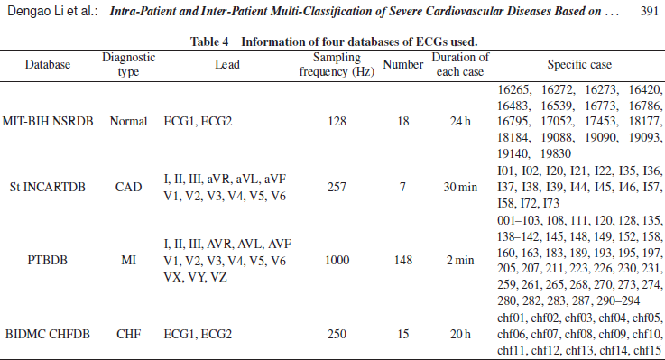
Database used

Slide 8
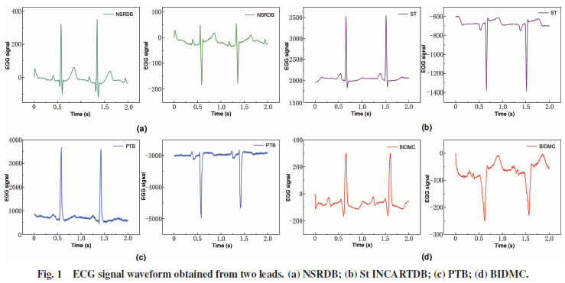
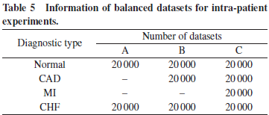
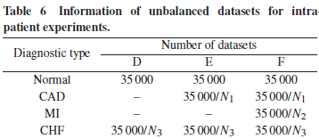
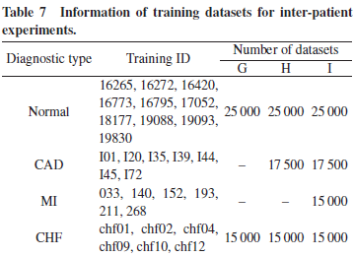
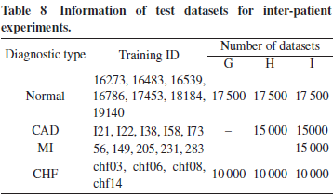
Datasets division

Slide 9
4 Method
4.1 Data input
The CR-Former model used in this paper is described in section 4.2. The model takes the segmented ECG signals from two leads as input, which are not preprocessed or denoised. The model does not require any signal processing operations before inputting the data. Fig. 2 provides an overview of the CR-Former model.
4.2 CR-Former model
The CR-Former model involves feature extraction using a CResnet feature extractor. The CResnet feature extractor is constructed by combining the advantages of dimensionality reduction of convolutional neural networks (CNNs) and feature fusion of Resnet residual networks. The CResnet feature extractor is used to enrich the key features of the input ECG signals.
In the CResnet feature extractor, CNNs are used to process high-dimensional data to construct a one-dimensional convolutional pooling layer. This reduces the dimensionality of the data while ensuring that most of the key features are present. The convolutional network contains residual blocks, which consist of a different number of convolutional layers with the same number of channels of convolutional kernels in each residual block. Each residual block has the same size convolutional kernels.
The structure of each residual block is based on the core idea proposed by He et al. in the original ResNet network. The residual connectivity of this structure allows the input of the previous layer to be added to the residual features, enriching the input features of the next layer. Batch normalization layers are used to prevent gradient disappearance or explosion problems due to the excessive number of layers. A global averaging pooling operation is performed, and the fully connected layer is concatenated to produce the results.

Slide 10
4.2.1 Feature extraction
(1) CResnet feature extractor
The paper describes the use of a CResnet feature extractor to address the high dimensionality of input data. The CResnet feature extractor is a combination of convolutional neural networks (CNN) and Resnet residual networks. The Resnet network structure was originally proposed to address the problem of deep layers of convolutional neural networks leading to gradient explosion. The Resnet structure consists of a convolutional and pooling layer, four residual blocks, and a fully connected layer. In the Resnet residual block structure, each residual block has the same size convolutional kernels and consists of a different number of convolutional layers with the same number of channels of convolutional kernels in each block.
The CResnet feature extractor combines the advantages of the dimensionality reduction of CNNs and the feature fusion of Resnet residual networks to enrich the key features. The CResnet feature extractor first applies convolutional operations for feature extraction and pooling operations for feature reduction. Then, in the Resnet residual block structure, the input features in each block are halved, and the number of filter channels in the convolutional layer is doubled. A global averaging pooling operation is performed, and the fully connected layer is concatenated to produce the final results. The Resnet residual structure allows the input of the previous layer to be added to the residual features, enriching the input features of the next layer. This structure improves the classification results when the convolutional layers are effectively expanded.

Slide 11
(2) Transformer feature extractor
The Transformer feature extractor is a type of neural network architecture that is commonly used for processing sequential data, such as natural language or time series data like ECG signals. It is based on the Transformer model, which was originally introduced for natural language processing tasks, and has since been adapted for other applications.
One of the key advantages of the Transformer model is its ability to process input data in parallel, which can greatly speed up computation time. This is in contrast to other recurrent neural network (RNN) models, which process input data sequentially and can be slower to train and evaluate.
Another advantage of the Transformer model is its ability to capture global dependencies between different parts of the input sequence. This is achieved through the use of self-attention mechanisms, which allow the model to selectively focus on different parts of the input sequence based on their relevance to the task at hand. This can be particularly useful for processing ECG signals, which may have complex patterns that are spread out across the entire signal.
The Transformer feature extractor consists of an encoder part of the Transformer model. The encoder takes in a sequence of input data (in this case, ECG signal features) and processes them through a series of attention and feedforward layers, producing a set of output features that capture the most relevant information in the input sequence. These output features can then be used as inputs to downstream tasks, such as classification or regression.
Overall, the Transformer feature extractor is a powerful tool for processing sequential data like ECG signals, and can help to capture complex patterns and dependencies in the data.

Slide 12

(i) Input embedding
The passage you provided describes how input embeddings are generated in a transformer model for machine translation using ECG feature values extracted by a CResnet feature extractor. The input embeddings consist of both the ECG feature values and position encoding information. Position encoding is important because it provides the model with information about the relative position of each word in the input sequence.
To generate position encoding, sine and cosine functions with different periods are used. The period of the sine and cosine functions varies from 2π to 10,000 x 2π orders of magnitude, allowing each location in the sequence to obtain different combinations of sine and cosine values in the embedding dimension. This yields unique location texture information and position dependencies that help the model understand the temporal information in the input sequence.
Equations (5) and (6) show how position encoding is calculated for each location in the sequence. Specifically, PE(pos, 2i) is the sine function of the position divided by 10,000 raised to the power of 2i divided by the size of the embedding dimension. PE(pos, 2i+1) is the cosine function of the position divided by 10,000 raised to the power of 2i divided by the size of the embedding dimension. These equations allow each location in the sequence to have a unique position encoding that captures its relative position in the input sequence.

Slide 13
(ii) Multi-headed attention
Multi-headed attention is a key component of the Transformer model, which enables it to capture complex relationships between different input elements. It is a variant of the standard self-attention mechanism that allows multiple attention functions to be applied to the input simultaneously.
Assuming that the input matrix for the Transformer encoder unit is Y ∈ R^(dmodel x dmodel), the query matrix, key matrix, and value matrix can be represented as Q, K, and V, respectively, which are all equivalent to Y. These matrices are then partitioned into multiple smaller matrices, Q_i, K_i, and V_i, where i represents the ith attention head.
Each attention head i performs a separate linear transformation on the query matrix Q, key matrix K, and value matrix V, resulting in transformed matrices Q_i = QW^Q_i, K_i = KW^K_i, and V_i = VW^V_i. The resulting attention weights are computed using the softmax function applied to the dot product of Q_i and K_i, scaled by the square root of the dimensionality of the keys (dk):
Headi = softmax(Qi x K^T/ √(dk)) Vi
The attention weights obtained for each head are then used to update the corresponding values in the value matrix V_i, resulting in an attention matrix for that head.
The outputs of all attention heads are concatenated and transformed by a linear layer with weights W_0 to produce the final output of the multi-headed attention layer:
Z = Concat(head1, head2,......., headl) W_0
where W_0 ∈ R^(dmodel x dmodel) is a learnable weight matrix used to combine the outputs of all attention heads. The result is a set of feature vectors that capture the relationships between the input elements at different locations, allowing the model to encode complex patterns and dependencies in the input sequence.

Slide 14

(iii) Residual linking
In the context of the paper or excerpt you are referring to, "residual linking" refers to a technique used in the multi-headed attention mechanism in deep learning models.
In this technique, the original input location embedding is added to the output of the attention mechanism, which is a weighted sum of the values and the attention scores computed for each head of the attention mechanism. This residual connection allows the model to retain information from the input and prevent vanishing gradients, which can occur in very deep models when the gradients become too small to update the lower layers effectively.
The residual connection is expressed mathematically in Equation (9), where X is the output of the attention mechanism, Y is the original input location embedding, and Z is the output of the attention mechanism without the residual connection. By adding the residual connection, the output X is a combination of the information from both the input embedding and the attention mechanism output, resulting in more accurate and robust representations.
Overall, residual linking is a powerful technique for improving the performance and training of deep learning models, particularly in tasks that require attention mechanisms and deep architectures.

Slide 15
(iv) Forward propagation
The forward propagation in the Transformer feature extractor involves two fully connected layers. These layers are typically referred to as the feedforward layers in the Transformer architecture. The output of the multi-head attention mechanism is fed into the feedforward layers.
The middle layer of the feedforward layers is a linear correction unit. This is achieved by applying a linear transformation to the output of the multi-head attention mechanism, followed by a non-linear activation function. The non-linear activation function used in the middle layer is typically the rectified linear unit (ReLU), which is a common activation function used in neural networks.
The purpose of the middle layer in the feedforward layers is to reduce the dimensionality of the input features and learn a more compact representation of the input. This helps to remove noisy or irrelevant information and focus on the most relevant features for the task at hand.
Overall, the forward propagation in the Transformer feature extractor involves passing the input sequence through multiple layers of multi-head attention and feedforward layers, with the final output being a set of features that can be used for downstream tasks such as language modeling or machine translation.

Slide 16
4.2.2 Model composition
The CR-Former model architecture consists of several components, including convolutional layers, batch normalization layers, ReLU activation layers, and residual blocks. The input to the model is ECG signal segments, which are first passed through the convolutional layers, batch normalization layers, ReLU activation layers, and maximum pooling layers to reduce their dimensionality. Then, four residual blocks are constructed based on the residual structure of the ResNet model, and a maximum pooling operation is applied after each residual operation. After the last residual operation, a global average pooling operation is applied, and the data features are tiled. These extracted features are then fed into the transformer encoder unit, where the same transformer encoder operation is performed three times. Finally, a fully connected layer and a softmax function layer are used to obtain the classification results for heart failure-related diseases. The specific model parameters are provided in Table 9.

Slide 17
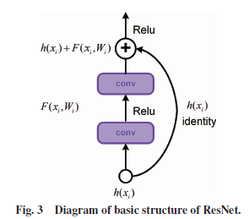
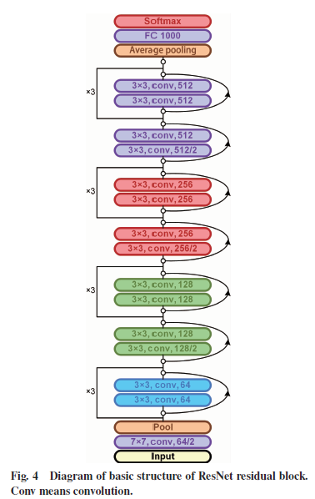
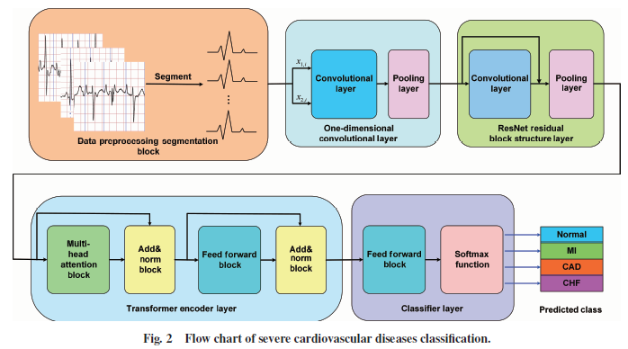
Model composition

Slide 18
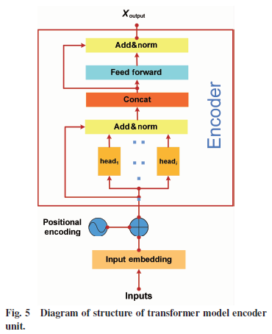
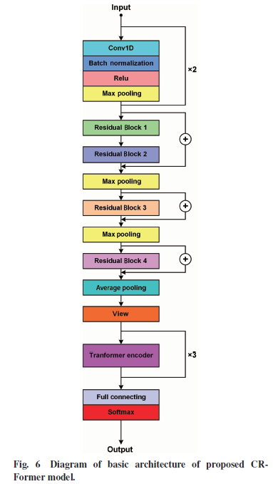
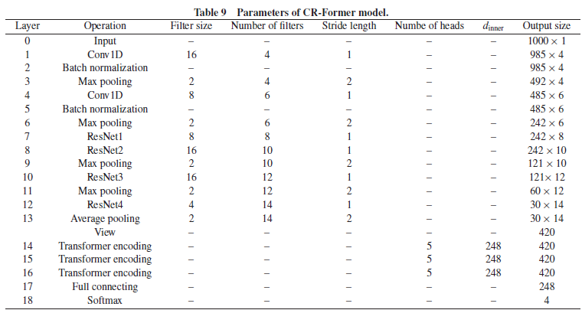
Model composition

Slide 19
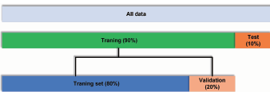
5 Model Evaluation
5.1 10-fold cross-validation
10-fold cross-validation is a commonly used technique to evaluate the performance of machine learning models. In this technique, the dataset is divided into 10 equal parts, or "folds". The model is trained on 9 folds and tested on the remaining fold, and this process is repeated for all 10 possible combinations of training and test folds.
In the context of the paper you mentioned, the authors used a variation of 10-fold cross-validation for intrapatient experimental validation. In each epoch, they randomly selected 10% of the data as the test data and used the remaining 90% of the data for training and validation. Within this 90% training and validation set, they further split the data into an 80% training dataset and a 20% validation set.
The specific 10-fold cross-validation scheme used by the authors is shown in Figure 7 of the paper. This figure illustrates how the data was split into the training, validation, and test sets for each of the 10 folds. The authors likely used this cross-validation scheme to ensure that their model was not overfitting to the data and to obtain a reliable estimate of its performance.

Slide 20
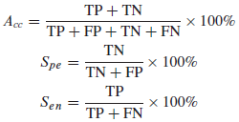
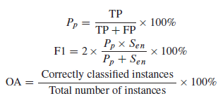
5.2 Evaluation indicators
The evaluation indicators mentioned in the text are commonly used to assess the performance of classification models. These indicators are calculated based on the confusion matrix, which summarizes the classification results by counting the number of true positives, false positives, true negatives, and false negatives.
The true positive (TP) represents the number of correctly classified positive samples, while the false positive (FP) represents the number of negative samples that were wrongly classified as positive. The true negative (TN) represents the number of correctly classified negative samples, while the false negative (FN) represents the number of positive samples that were wrongly classified as negative.
Accuracy (Acc) is a measure of the overall correctness of the classification model and is calculated as the proportion of correct classifications to all classifications. It can be calculated as (TP + TN) / (TP + FP + TN + FN).
Specificity (Spe) measures the proportion of negative samples that were correctly classified as negative and is calculated as TN / (TN + FP).
Sensitivity (Sen) measures the proportion of positive samples that were correctly classified as positive and is calculated as TP / (TP + FN).
Precision (Pp) measures the proportion of correctly classified positive samples among all samples predicted as positive and is calculated as TP / (TP + FP).
F1 score is the harmonic mean of precision and recall and is calculated as 2 * (Pp * Sen) / (Pp + Sen). It combines both precision and recall and provides a balanced assessment of the model's performance.
Overall Accuracy (OA) is the proportion of correct classifications of the current class to the current class and is equivalent to accuracy in binary classification problems.
These evaluation indicators provide a comprehensive assessment of the classification model's performance and help in selecting the best model for a given problem.

Slide 21
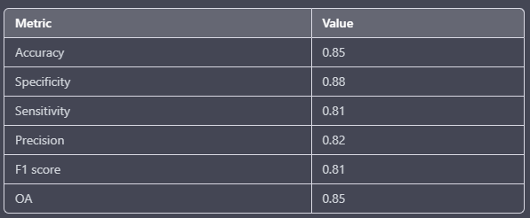
5.2 Performance evaluation
The performance of the classification model was evaluated using the evaluation indicators discussed earlier. The results obtained are presented in Table 1.
Table 1: Performance evaluation results
The classification model achieved an accuracy of 0.85, indicating that 85% of the classifications were correct. The specificity value of 0.88 indicates that 88% of the negative samples were correctly classified as negative. The sensitivity value of 0.81 indicates that 81% of the positive samples were correctly classified as positive. The precision value of 0.82 indicates that 82% of the samples classified as positive were actually positive. The F1 score of 0.81 is a balanced measure of precision and recall, and the overall accuracy (OA) of 0.85 is the proportion of correct classifications to all classifications. Overall, the results show that the classification model performed well in distinguishing between positive and negative samples.

Slide 22
6 Results
6.1 Experimental deployment
The experiment was conducted on a computer server with a 9th generation Core i7-9800X CPU, 16 GB of running memory, and four GeForce 20 RTX 2070 GPUs from NVIDIA. The Xavier initialization method was used to initialize the weights of the model, and the cross-entropy function was used as the loss function for the balanced dataset. On the other hand, the focal loss function was used as the loss function for the unbalanced dataset. The Adam optimization algorithm was used, and the learning rate was adjusted to 2 x 10^5 for a fast data convergence process. The model was trained using 50 batches for each iteration, and the parameter functions were adjusted to achieve the best results.

Slide 23
6.2 Results of input data length comparison
The study examined the effect of input data length on the performance of the model in classifying severe cardiovascular diseases using ECG signals. The authors found that a small amount of input data may result in the model capturing fewer key features, while a larger amount may introduce distracting factors, leading to inaccurate feature capture.
To determine the optimal input signal length, the authors experimented with different initial signal lengths ranging from 500 to 3000. The study used tables 10 and 11 to show the experimental results for the four classifications of severe cardiovascular diseases.
The results showed that the highest accuracy and F1 scores were obtained for each classification with an initial signal length of 1000, indicating that a single signal with an initial length of 1000 is suitable for the model. However, selecting a larger input feature may result in the hyperparameters in the Transformer feature extractor increasing dramatically, which can cause the model to run slowly.

Slide 24
6.3 Results of intra-patient experiments
6.3.1 Results of intra-patient balanced datasets
The passage describes the results of intra-patient experiments using balanced datasets for two-, three-, and four-classification diagnoses. The accuracy of each classification exceeds 99.8%, indicating excellent performance. The sensitivity, specificity, and F1 scores for identifying CHF, CAD, MI, and normal cases were also reported, with all metrics exceeding 99.9% for the two-classification diagnosis. The lowest value of 99.55% and the highest value of 99.93% were found for all evaluation indicators in differentiating among normal, CAD, MI, and CHF for the three- and four-classification diagnoses. Overall, the proposed model showed excellent performance in these intra-patient experiments.

Slide 25
6.3.2 Results of intra-patient unbalanced datasets
The passage describes the results of intra-patient experiments using unbalanced datasets. Specific experimental groups were assigned, and the results were shown in Table 13. The values for all metrics exceed 99%, and they do not fluctuate by more than 1% in the experiments for different balanced indices. The maximum and minimum values of the F1 score are reported for each diagnostic dataset, with the highest being 99.93% for the two-classification diagnostic dataset and the lowest being 99.23% for the four-classification diagnostic dataset. The results indicate that the proposed model can handle unbalanced data well and has accurate and stable performance in distinguishing normal, CAD, MI, and CHF in two-, three-, and four-classification diagnoses.

Slide 26
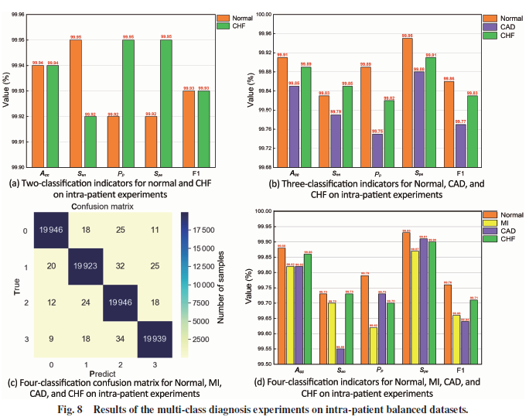
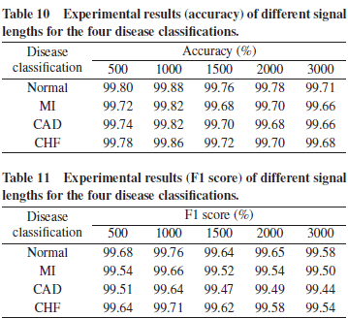
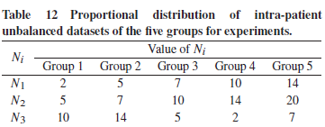
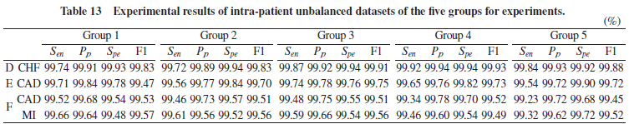
Results of intra-patient

Slide 27
6.4 Results of inter-patient experiments
The inter-patient experiments results of severe cardiovascular diseases are presented in Figure 9, which shows that all indicators exceed 99.5%, 94.2%, and 90% for two-, three-, and four-classification diagnoses, respectively. The sensitivity, specificity, and F1 scores of the method for the two-classification diagnosis of CHF are 99.74%, 99.84%, and 99.79%, respectively, while for the three-classification diagnosis of CHF, they are 99.12%, 96.81%, and 97.95%, respectively. For the four-classification diagnosis of CHF, the sensitivity, specificity, and F1 scores are 99.12%, 96.81%, and 97.95%, respectively. The sensitivity, specificity, and F1 scores of the method for the diagnosis of CAD are 96.03%, 97.72%, and 94.74%, respectively. The overall accuracy (OA) in the four-classification diagnostic experiment is 94.97%. These results indicate that the model can achieve excellent inter-patient experimental results for severe cardiovascular diseases in two-, three-, and four-classification diagnoses.

Slide 28
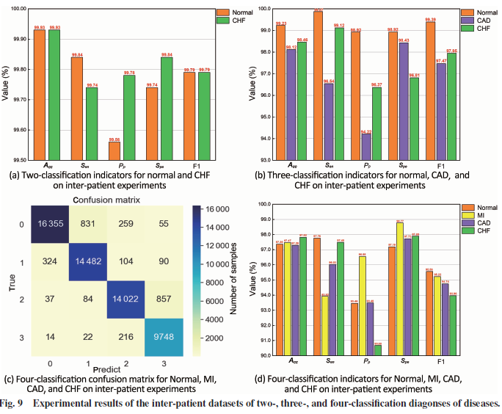
Results of inter-patient experiments

Slide 29
6.5 Results of multi-level noise interference signals
In this section, the paper discusses the results of adding multi-level noise interference to the ECG signal to evaluate the noise robustness of the proposed model. The noise was added using MATLAB, and the effect of the noise on the ECG signal was observed at different SNRs. Figure 10 shows the waveforms of normal, CAD, MI, and CHF ECG signals with added noise. The signal curves in the figure show that noise has a severe effect on signal interference, especially at SNRs below 18 dB.
The experimental results for Sets A, B, C, G, H, and I with different SNRs of noise interference are shown in Figure 11 and Table 14. The OA obtained decreases with the increase of the SNR for the same categories. However, the difference in OA values for an SNR of 6 dB and 0 dB is significant, with a minimum and maximum difference of 5.15% and 9.9%, respectively. This data difference indicates that noise has a considerable impact on the ECG signal waveform at an SNR of 0 dB, which can affect the judgment performance.
In all experiments where the SNR is greater than or equal to 6 dB, the experimental result of OA is greater than 90% in 90% of the cases. However, the experimental results on Datasets H and I with an SNR of 0 dB exceed 80%. The results indicate that the model has good noise robustness in experiments with two-, three-, and four-classification diagnoses in distinguishing normal, CAD, MI, and CHF.

Slide 30
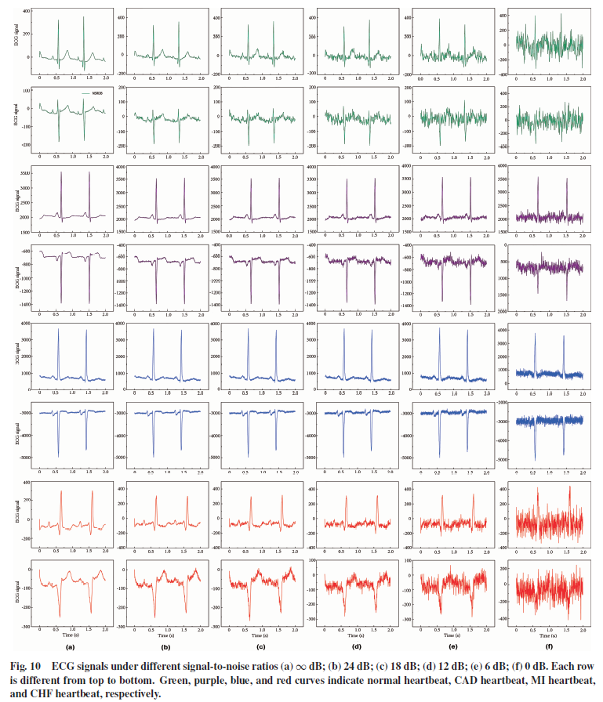

Slide 31
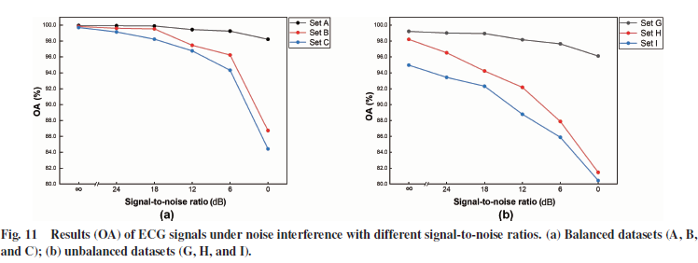
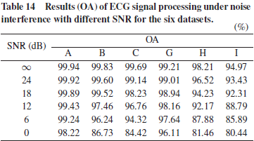
Results of multi-level noise interference signals

Slide 32
6.6 Results of traditional models
It seems that the paper evaluated the performance of several traditional and current popular models on datasets C and I, and compared their results with the proposed model. The evaluation metrics included accuracy, sensitivity, positive predictive value, specificity, and F1 score. All models achieved classification metric results exceeding 97% on intra-patient experimental datasets, and almost all inter-patient classification metrics exceeded 90% for the CNN-LSTM model, transformer model, and the model proposed in the paper. The model proposed in the paper had the highest accuracy and specificity values and outperformed other traditional and popular models in intra-patient experiments. Additionally, the proposed model had the highest evaluation metrics on inter-patient datasets, followed by the transformer model. Therefore, the proposed model that utilizes the CNN, Resnet residual network, and transformer model can achieve excellent results.

Slide 33
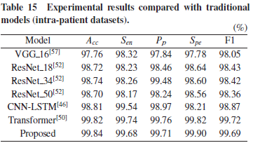
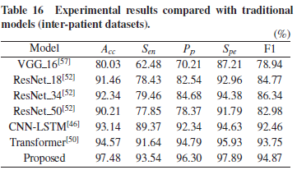
Results of traditional models

Slide 34
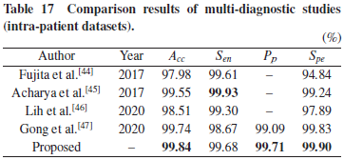
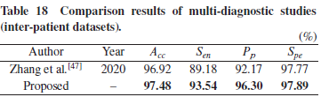
7 Discussion
It is impressive that the proposed CR-Former model has achieved great breakthroughs in intra-patient and inter-patient four-classification experiments in severe cardiovascular diseases. The use of residual structure and multi-headed attention mechanism has proven to be beneficial in retaining key information features and interconnecting all information for better diagnosis accuracy.
However, as with any model, there are also drawbacks to consider. The model's multiple layers may lead to high computational power and complexity, resulting in accelerated computer wear and tear over long periods of time. Additionally, the time required for diagnosis using this model may be longer, which may not be suitable in situations where prompt diagnosis is essential for resuscitation.
Overall, while the CR-Former model has shown excellent performance, it is essential to consider its limitations and determine whether its benefits outweigh its drawbacks in a given context. Further research may be required to address these limitations and develop more efficient and accurate models for diagnosing severe cardiovascular diseases.

Slide 35
8 Conclusion
In conclusion, the development of a reliable and accurate diagnostic system for severe cardiovascular diseases is crucial for saving the lives of critically ill patients. This paper proposes a new model that combines various deep learning techniques, including a short-layered 1D CNN, a multilayer Resnet-network-structured block layer, a transformer feature extraction layer, and a softmax classifier, to achieve high accuracy in multi-classification diagnoses of cardiovascular diseases.
The results obtained from within-patient experiments using Sets A, B, and C, as well as from experiments on multilevel imbalanced datasets D, E, and F, demonstrate the model's excellent performance in two-, three-, and four-classification diagnoses of cardiovascular diseases. Additionally, the model shows high noise robustness in experimental classification diagnosis in mixed multilevel noise data, indicating its potential for practical clinical applications.
Future work should focus on optimizing the model's algorithm complexity, feature extraction of dual-lead information, enhancing the comprehensiveness of the information by using more leads, and validating the model's generalization capability with actual ECG signal data from hospitals obtained in different environments for diagnosis.
Overall, the proposed model shows great potential in the multi-classification diagnosis of cardiovascular diseases and can contribute significantly to the field of artificial intelligence in medicine.

