Slide 1
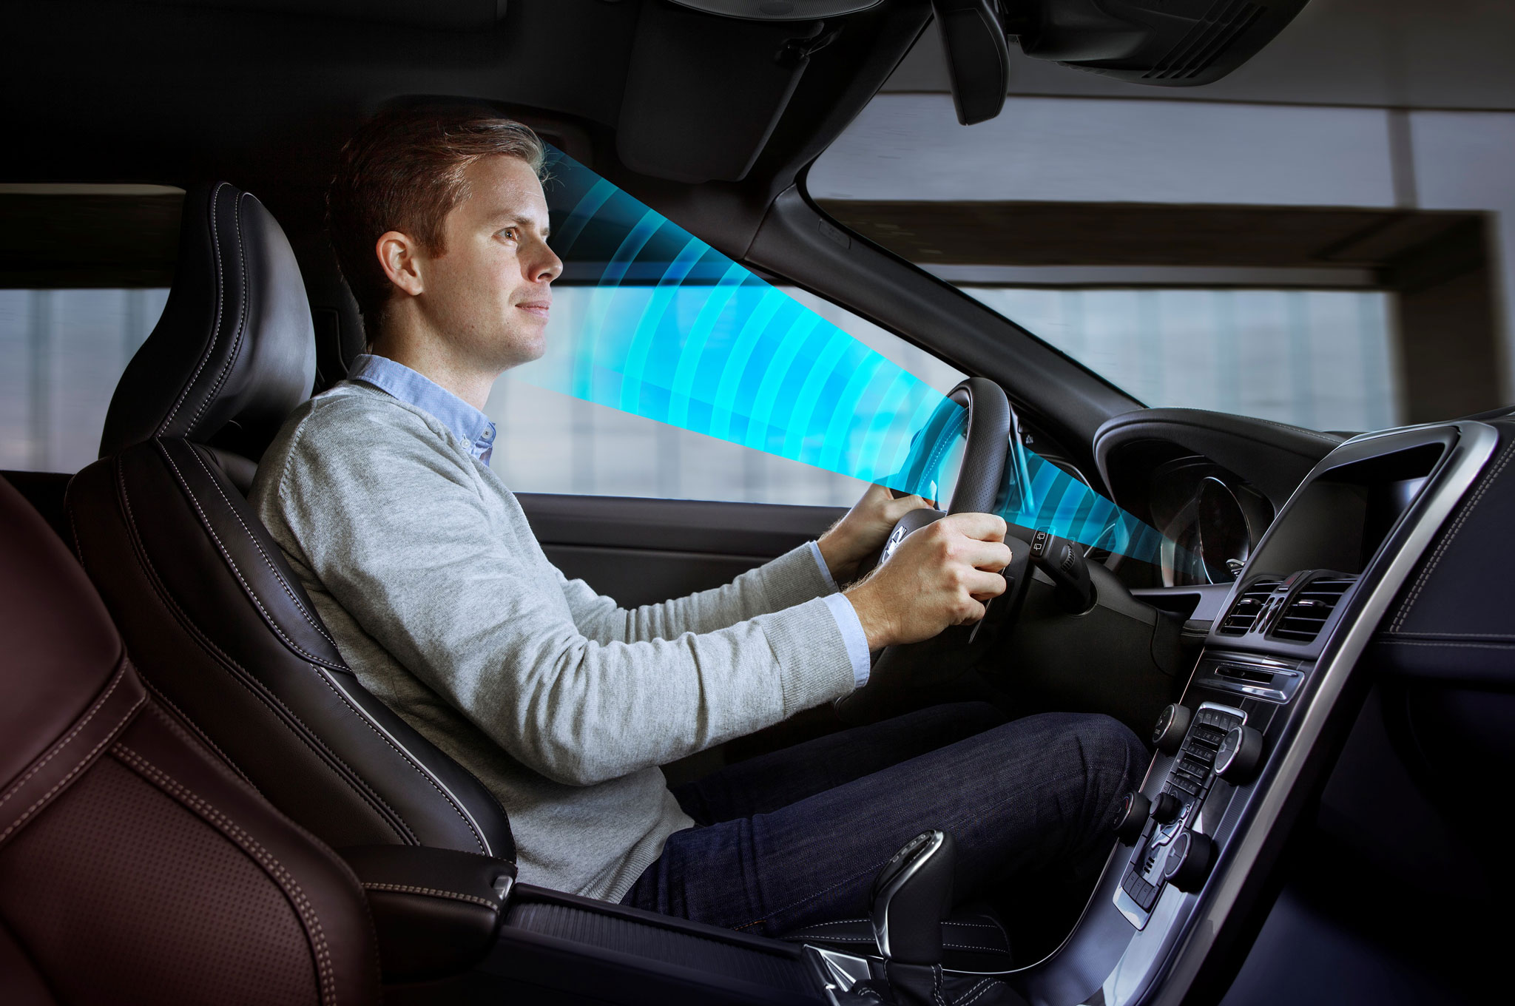
Выполнили: Данилюк Арсений Железнов Артем 6113-100503D
Yawning detection

Slide 2









Contents
Introduction
Methods
Eye detection
Mouth movement
Head position detection
Hands detection
Communications
Results
Conclusions

Slide 3
Introduction
In this presentation, we will discuss modern methods of detecting yawning and analyze their effectiveness. Additionally, a solution will be proposed to improve these methods for greater efficiency.

Slide 4
Eye detection
The behavioral characteristics of drivers in fatigue driving include blinking, nodding, eyes closing and yawning. In these behaviors, yawning is one of the main forms of fatigue manifestations. Therefore, due to the important role of yawning in fatigue driving detection, researchers have done a lot of research on yawning detection.

Slide 5
Mouth movement
Some researchers used the histogram features of the mouth area to detect yawning, but this method had obvious shortcomings such as low accuracy and poor robustness. Petropoulakis L et al. [7] proposed a yawning detection method that detected yawning by the variation of aspect ratio of mouth profile.

Slide 6
Head position detection
When the tester's head rotated more than a certain angle, the facial feature points will become difficult to detect. Appearance-based methods have the advantage of easy calculation, but the calculation of threshold is very sensitive to external factors and has poor anti-noise capability.

Slide 7
Hands detection
In Germany and other European countries, one in ten accidents is the result of drivers' inattention due to smartphones, the <url> newspaper writes. In Russia, there are no separate statistics on how many accidents occur due to phones. But you can find reports of such incidents in the news feeds.

Slide 8
Communications
Thousands of people are killed, or seriously injured due to drivers falling asleep at the wheels each year. Road safety is seriously threatened by driver fatigue. An investigation was conducted by the National Highway Traffic Safety Administration in the USA.

Slide 9
Results
To expand on the thought, while artificial intelligence can significantly enhance the capabilities of existing methods, it's important to consider the ethical implications and ensure that such technologies are developed with safety and privacy in mind. AI has the potential to not only refine detection systems but also to revolutionize them by learning from vast amounts of data and identifying patterns that may not be immediately obvious to humans. This could lead to more proactive and preventative measures in various applications, including automotive safety.

Slide 10
Conclusion
In conclusion, we would like to say that modern yawning detection systems are imperfect. They can be improved with the help of artificial intelligence. These systems are already being integrated into vehicles of some brands.

Slide 11



