Slide 1
Nexus Core 3.0
Your business is changed by software

Slide 2
Page Lifecycle
Controller
View
Get Request Action
Setup Layout View
Post Request Action
Build Post Header Model
Setup Layout View
Layout - Render Drop Zone
Child Action - Drop Zone
Partial View - Render Controls
Child Action- Default Render Controls
Apply Model Value Settings
Check Post Header Pass Value
Choose View
Default View for Module
Custom View for Module
Child Action- Custom Render Controls
Apply Model Value Settings
Check Post Header Pass Value
Choose View
Default View for Module
Custom View for Module

Slide 3
Authentication: Website
3rd Party Open ID
Website Login
Open ID provider (Google, Facebook etc…)
Choose Login Method
Has local account
Login as local
No
Yes
Local Account
Create Local account
Check linked local account
Yes
OWIN AuthenticationManager
No
Link to local account

Slide 4
Authentication: Mobile App
Website Login
Authorization Server
Choose Login Method
Get Token
Get Token
Save token in app
3rd Party Open ID
Open ID provider (Google, Facebook etc…)
Web Service
No
Has local account
Check Token
Yes
Create Local account
Check linked local account
Yes
No
Link to local account

Slide 5
Master Layout
Placeholder: picking from system
Render Section: picking from sub layout
<Header>
Meta Data placeholder
Meta Data Render Section
Editor Menu Section (Admin Section Only)
Top header Render Section
Header Script/CSS placeholder
Bottom header Render Section
<Body>
Top script placeholder
Top script Render section
Body Render section
Bottom script placeholder
Bottom script Render section

Slide 6
Content Placeholder Names
Logo
Company Title
Menu
Header
Hero Screen
Side Body
Main Body
Side Body 2
Bottom Body
Footer
Slider2
Script
Slider

Slide 7
Page Inherit Sample
CSS & Scripts
Parent page Level
Logo
Header
Body Drop Zone (page level)
Side Drop Zone
Tag: BodyLeft (child drop zone)
Tag: BodyRight (child drop zone)
Blog Content Object
Html Content Object
Html Content Object
Tag: PageLink
Html Content Object
Html Content Object
Scripts

Slide 8
Page Content Editor
status message
Widget Item
Widget Item
Widget Item
Widget Item
Menu Item
item
Requests for Permissions
Menu Item
item
Menu Item
Product Name is requesting the following:
Menu Item
item
Access my basic information
Includes name, profile picture, gender, networks, User ID,
list of friends, and any other information I ahve made public.
MyProduct
Menu Item
item
item
Access my profile information
Likes, Music, TV, Movies, Books, Quotes, About me,
Activities, Interests, Birthday, Education History and Work
item
Access my basic information
Includes name, profile picture, gender, networks, User ID,
list of friends, and any other information I ahve made public.
Logged In as Username. Log out
Allow
Do not Allow

Slide 9
User Interface - Dashboard
Logo / Version Login / Notification / Message
Dashboard | Web Contents | Websites| File Manager | Analytics | Permissions
Customizable Information
Customizable Information
Customizable Information
Customizable Information
About |Channel |Contacts

Slide 10
User Interface – Web Contents
Logo / Version Login / Notification / Message
Dashboard | Web Contents | Websites| File Manager | Analytics | Permissions
Sub Action1 | Action 2 | Action 3 | Action 4 | Text Information
Source Trees
Master Root (MasterRoot)
Clients (Client)
Websites (WebsiteRoot)
Website1 (Website)
Menu (MenuRoot)
Menu1 (Menu)
Homepage (MenuItem)
Products
Product1
Product2
About Us
Contact
Menu2 (Menu)
Spring Landing page
Pages (PageRoot)
Layout1 (Layout)
Page1 (Page)
Page7
Page8
Page2
Page3
Layout2
Page4
Page5
Page9
Page10
Page6
Website2 (Website)
Modules (ModuleRoot)
Module1 (Module)
Module2
Contents (ContentRoot)
Category1 (Category)
Form
About |Channel |Contacts

Slide 11
User Interface – Sub UI s
Logo / Version Login / Notification / Message
Dashboard | Web Contents | Websites| File Manager | Analytics | Permissions
Sub Action1 | Action 2 | Action 3 | Action 4 | Text Information
Form
About |Channel |Contacts

Slide 12
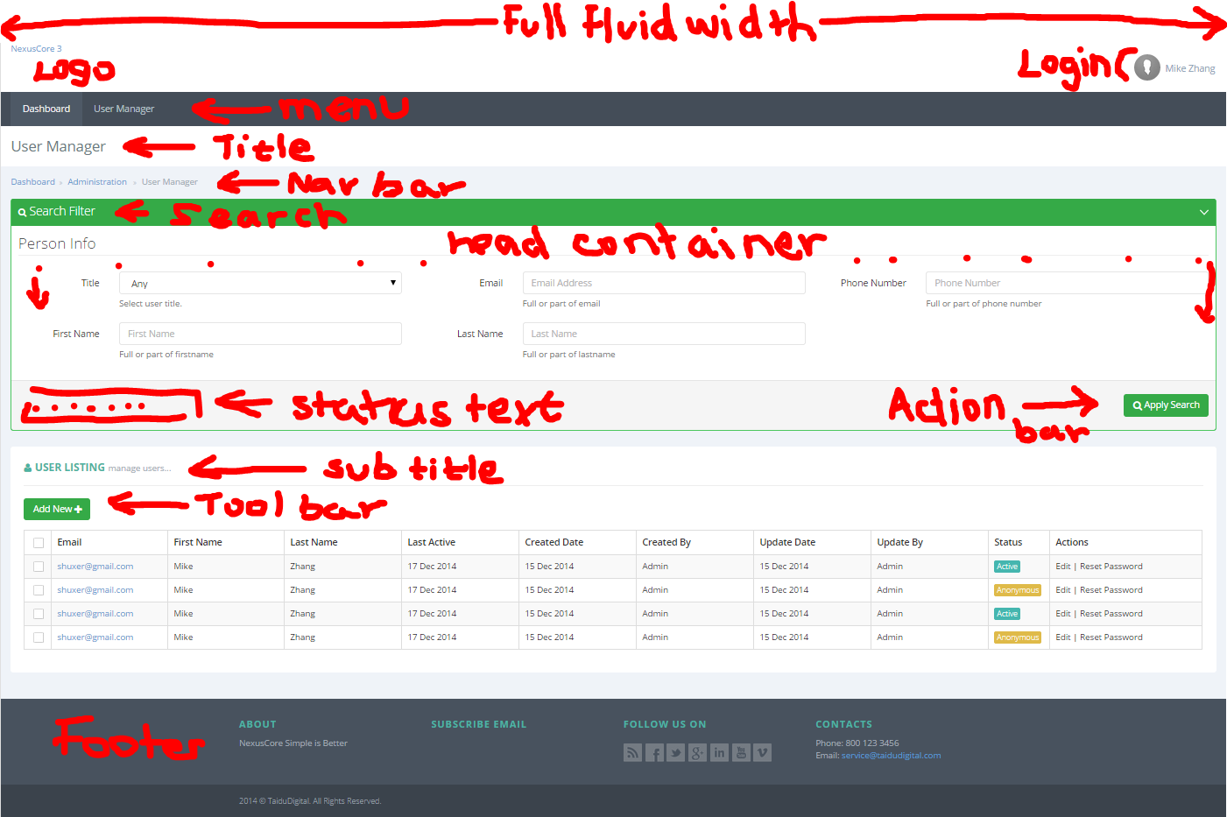
User Interface – HTML Priview

