Slide 1
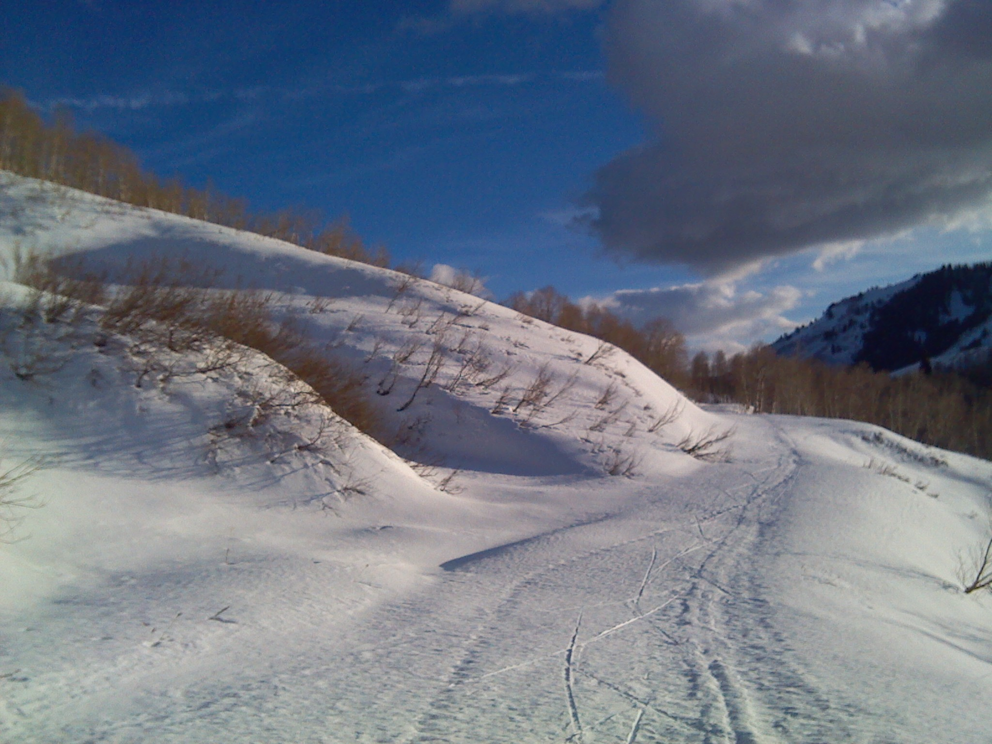
GIS Programming Project: SnowExplorer
Will Garner, Jiří Kadlec
Github.com/SnowMappers/SnowExplorer

Slide 2
Purpose of SnowExplorer
For any polygon in the USA, find out:
Snow water volume (m³)
Snow covered area (m²)
Our data source:
SNODAS snow model dataset from National Snow and Ice Center (NSIDC), 1993 – 2015
http://nsidc.org/data/docs/noaa/g02158_snodas_snow_cover_model/index.html

