Slide 1

Database Overview
Rachel Kelly, MLIS
Learning Resource Center - California Aeronautical University
September, 2024

Slide 2
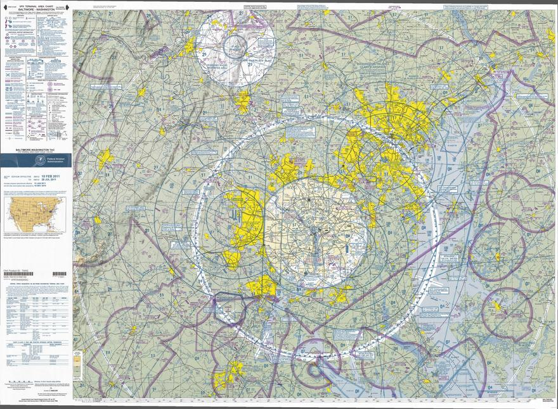
Overview
Why should I use them?
  What can I find in them?
  What are peer-reviewed sources?
Where are the databases?
Which do I use?
  What if I need a specific one?
Search strategies
Questions?

Slide 3

Why?
Reputable, reliable, evaluated information that doesn’t require a subscription.
Find:
  News
  Magazines
  Scholarly, Peer-Reviewed Articles*
  Books

Slide 4
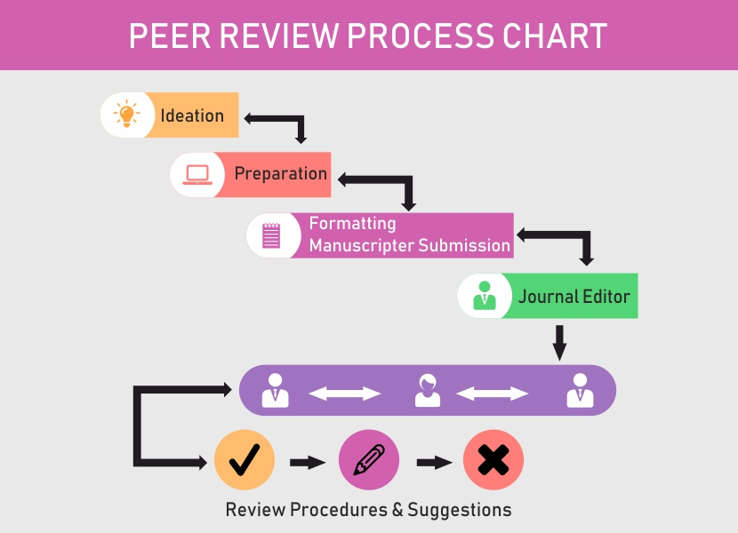
Scholarly, Peer-Reviewed Sources
Think of a doctor, a lawyer, or other professionals like geologists…
  Why do you trust them?
    Education, experience, accreditation, training, professional organizations –
    Published works are REVIEWED by other experts
Scholarly, Peer-Reviewed Articles
  Prepared by professionals in field
  Reviewed by experts in field
  Experts choose if article is fit for publication
By Using Effectively: lends its expertise, knowledge, reputation to your paper and its claims
Remember to cite!
Notes:
Click on title for animations

Slide 5
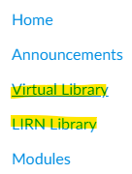
Where are the databases?
LIRN Library in Canvas
  Access to Databases
Virtual Library
  Help with selecting database, subject specific, class specific *WIP*, outside reputable resources
Note: accessing databases in Virtual Library requires you to click-through LIRN library first
Notes:
Show students how to access databases

Slide 6


Which do I use?
Choose specific or
  ProQuest Central
  Gale Academic OneFile
OR

Slide 7

Choosing Specific
Virtual Library can help you choose
  ABI/INFORM Trade & Industry – Business topics: companies, products, executives, trends, etc.
  Advance Technologies & Aerospace Database – More scientific-based applications in Aviation: engineering, astronautics, applied physics, comm/networks, etc.
  Career & Technical Education Database – Careers / technical resources
  Engineering Database: aircraft design, arctic/tropical engineering, civil engineering, etc.
  Gale OneFile: Insurance and Liability: aviation law, insurance topics
  Gale OneFile: Military and Intelligence – topics relating to Air Force, military, etc.

Slide 8

Can’t Decide?
Use ProQuest Central or Gale Academic OneFile
  Vendor View will show the databases they cover
  Best for first search to get an idea

Slide 9
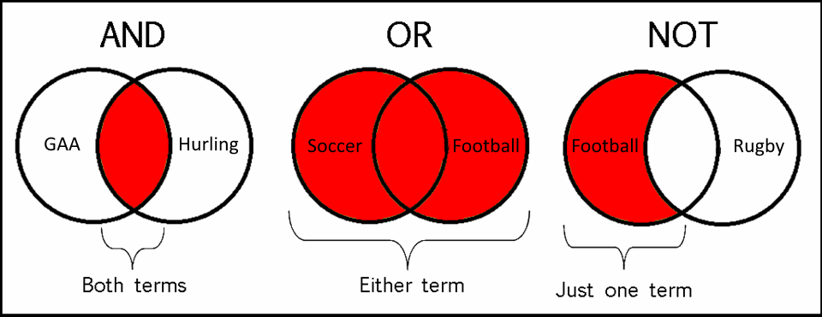
Search Strategies
Check Full-Text
  If looking for full-text, scholarly works: check Peer-Reviewed.
Use Advance Search – Use Limiters and Modifiers
  English
  Type
  Year
  AND: Narrow / OR: Broaden / NOT: Exclude / “”: Exact phrase
Gale: Publication Subject
ProQuest: Advanced Search>Thesaurus (look for terms)
Start searching for things! See what you can find!

Slide 10

Questions?

Slide 11

Further Questions?
Contact CAU Librarian: rachelk@calaero.edu
Phone: (661) 615-5915 Ext 1842
Appointments: contact me
Remote hours: M-F 10A-3P
Please note, hours may vary depending on student need.

