Slide 1
Social media features
Tom Son

Slide 2
Agenda
Behat FEATURE requirements and SCENARIOS
Mock forms
ER Diagram and SQL Queries
Class Diagram

Slide 3
Behat features
Feature: Login
In order to use Baghchal gaming community
As a user
I need to be able to log into my account to enjoy community

Slide 4
Scenario: User Id and password matches
Given: Right username with right password
When: User puts the details into login area
Then: User should be logged into community.

Slide 5
Scenario: username or password doesn’t match
Given: Either wrong username or password
When: User puts the details into login area
Then: User should be seeing a warning pop up that tells details aren’t correct
And: User can try to put details again

Slide 6
Scenario: Username is not valid
Given: Username is not under community’s database
When: User puts the details into login area
Then: User should be seeing a warning pop up that tells this username has not been registered yet
And: User can sign up to enjoy the community (But sign up is not my feature)

Slide 7
Behat features
Feature: Searching posts with keywords
In order to search specific posts
As a user
I need to be able to search posts with keywords

Slide 8
Scenario: searching posts with ‘level’ in title
Given: There are posts that contains keyword, ‘Level’ in their title
When: User put Level in search area and choose ‘Title’ then click search
Then: User will see the list of posts that contains keyword ‘Level’ in title

Slide 9
Scenario: searching posts with ‘level’ in author
Given: There are posts that contains keyword, ‘Level’ in author
When: User put Level in search area and choose ‘Author’ then click search
Then: User will see the list of posts that contains keyword ‘Level’ in author

Slide 10
Behat features
Feature: Write a post
In order to write a post
As a user
I need to be able to post on group

Slide 11
Scenario: User wants to share information with others
Given: There is a place where all users can write their own post
When: User is clicking ‘Write’ button to write a post
Then: User can start typing contents and submit the post.
AND: They can communicate / share information with others

Slide 12
Behat features
Feature: Liking the post
In order to give feedback to author
As a user
I need to be able to give Like to author’s post

Slide 13
Scenario: Giving a like to a post user likes
Given: There is a post that user likes
When: Click ‘Like’ button
Then: It will count +1 on number of counts

Slide 14
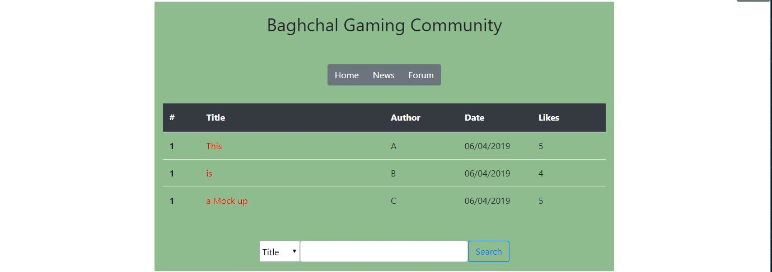
Mock html - index

Slide 15
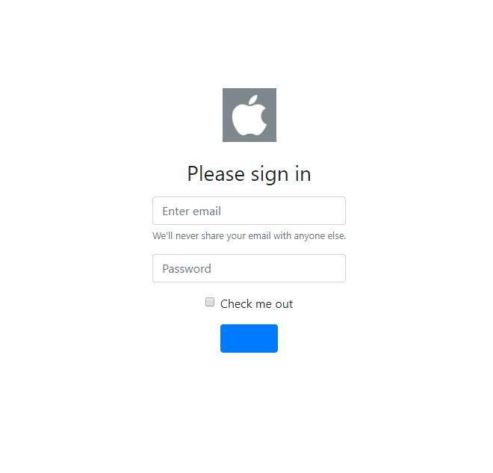
Mock html - Login

Slide 16
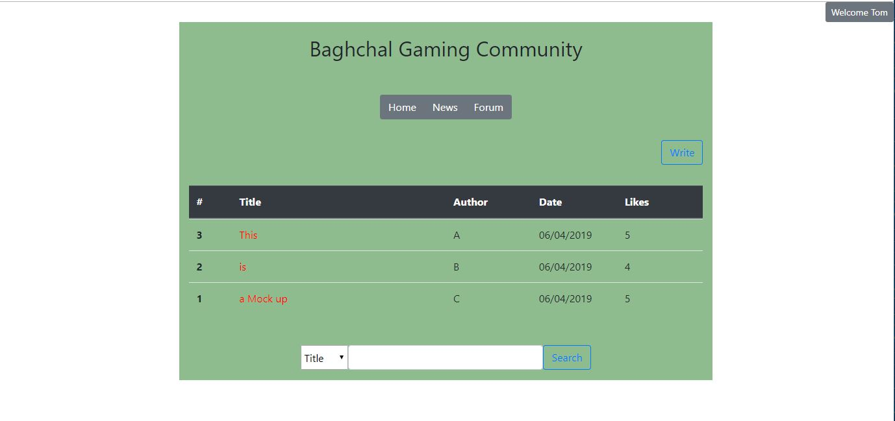
Mock html - Loggedin

Slide 17
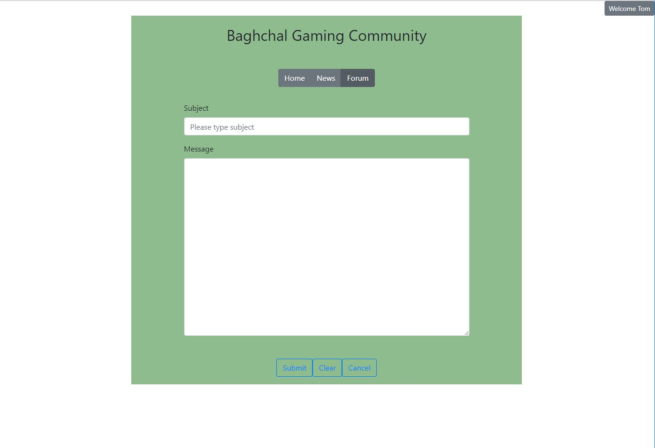
Mock html – Write post

Slide 18
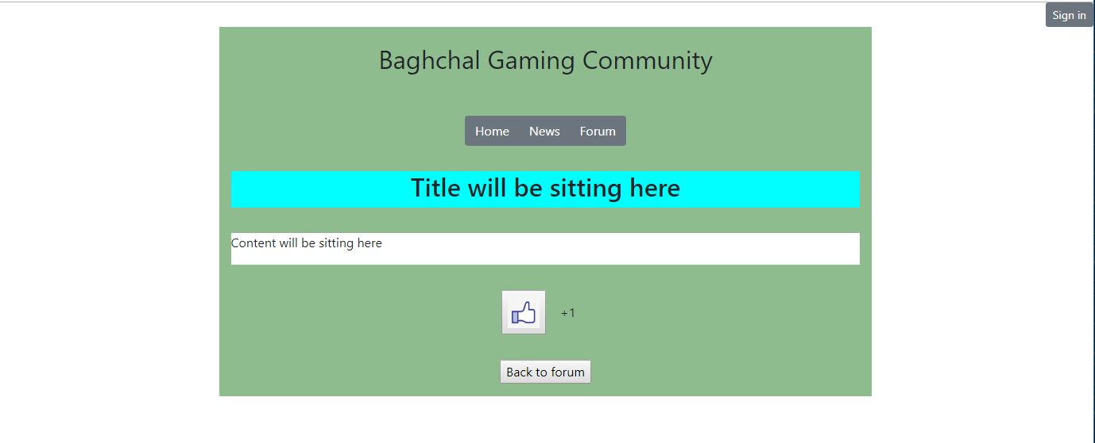
Mock html – Sample post

Slide 19
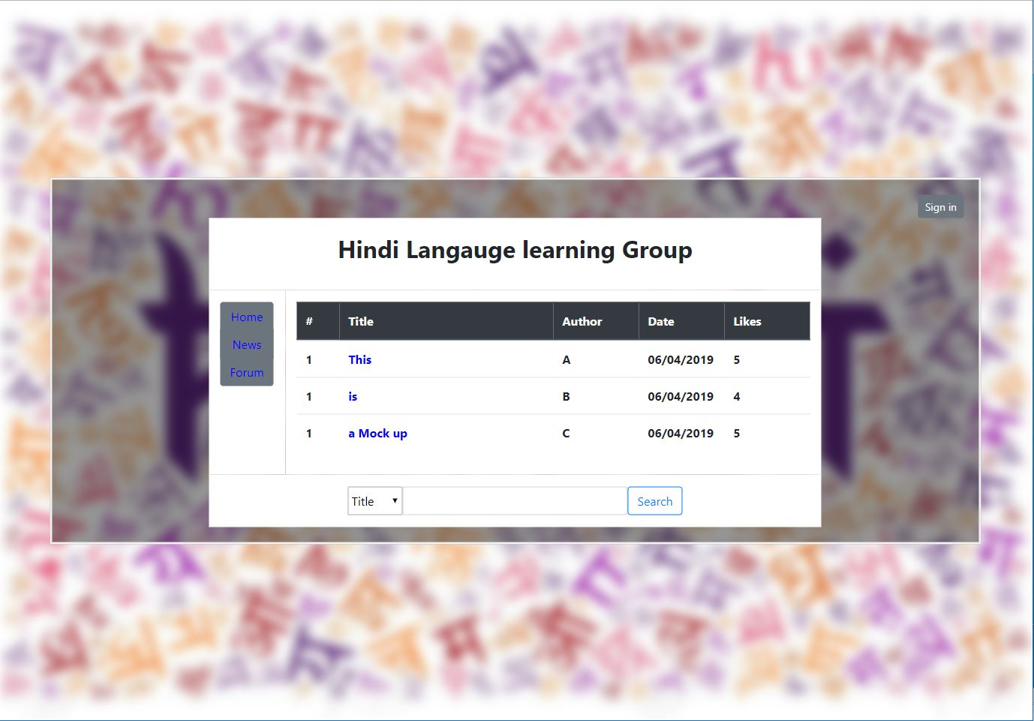
Mock html – Index

Slide 20
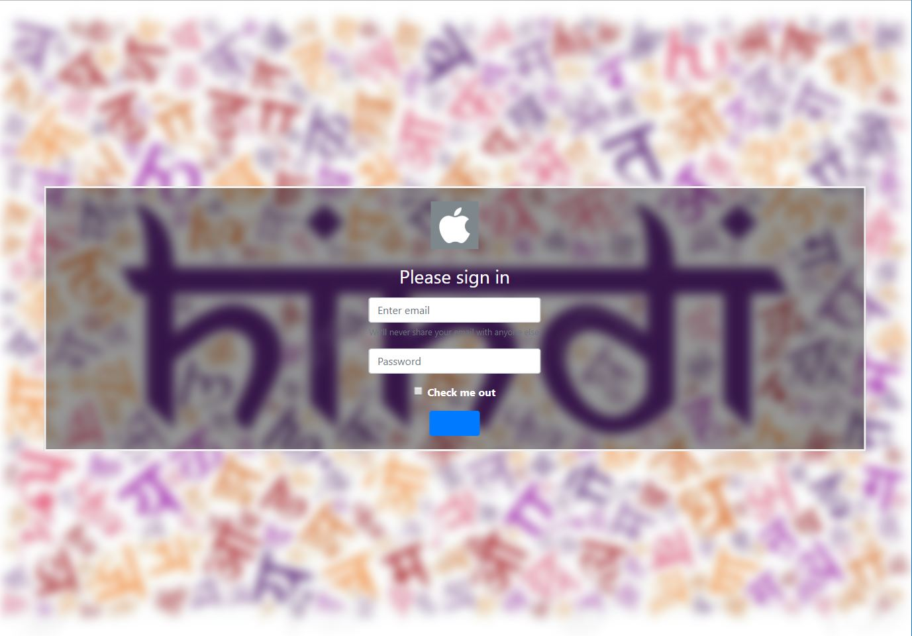
Mock html – Log in

Slide 21
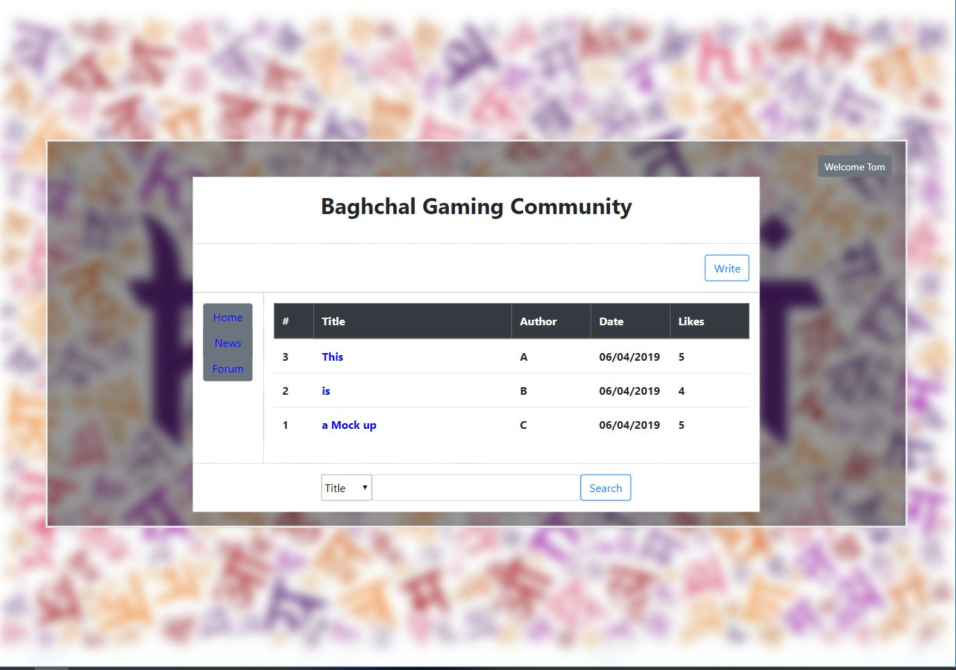
Mock html – Logged in

Slide 22
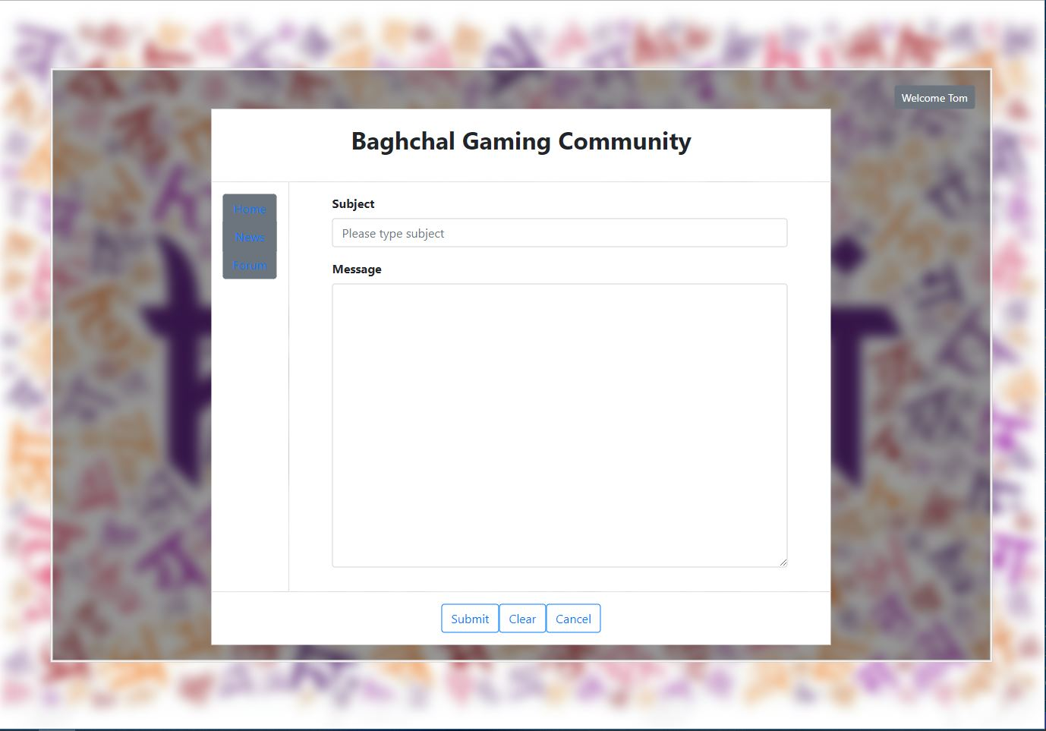
Mock html – Writing post

Slide 23
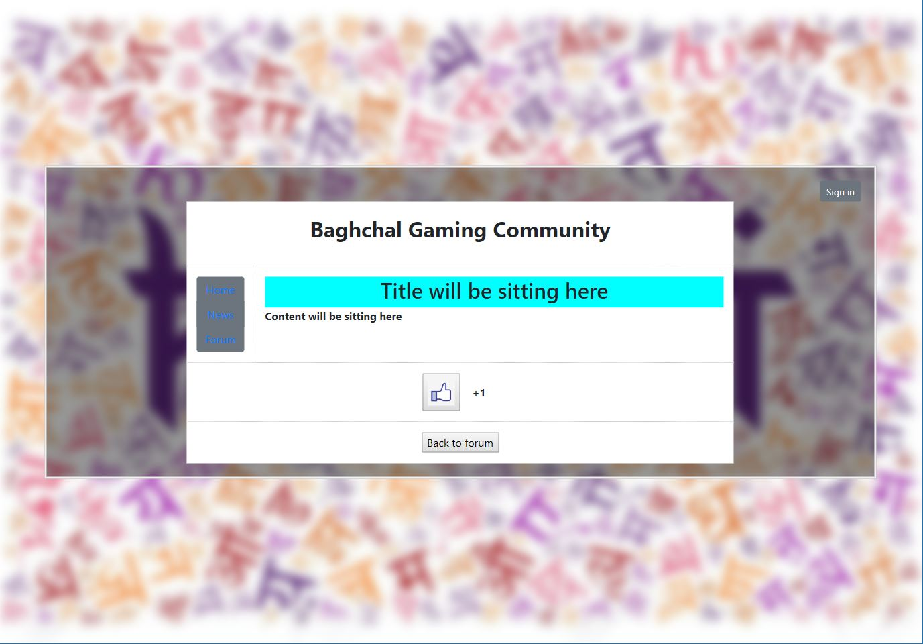
Mock html – Reading post

Slide 24
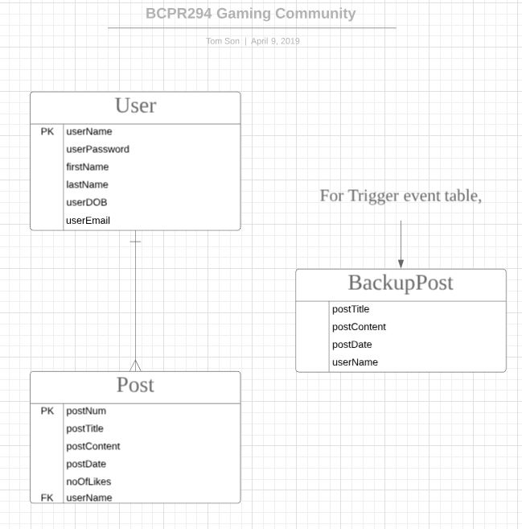
ER diagram Gaming Community

Slide 25
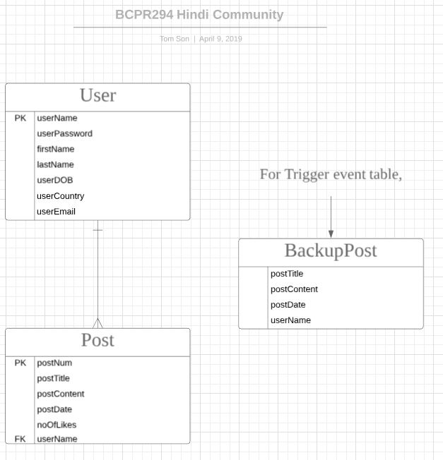
ER diagram Hindi Community

Slide 26
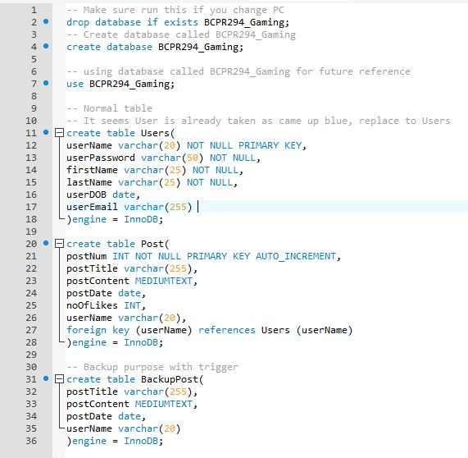
Create db for gaming community

Slide 27
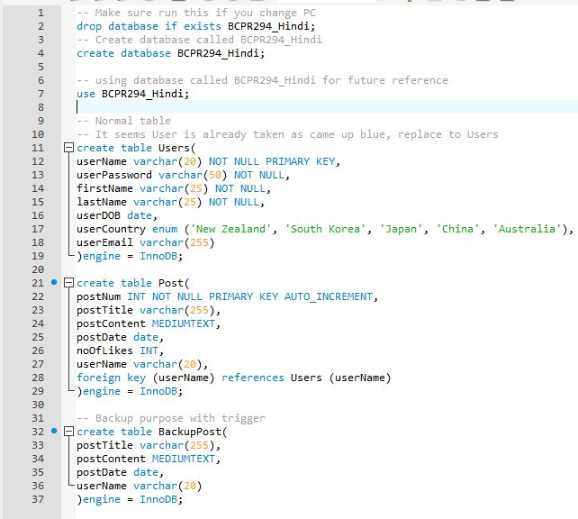
Create db for Hindi community

Slide 28
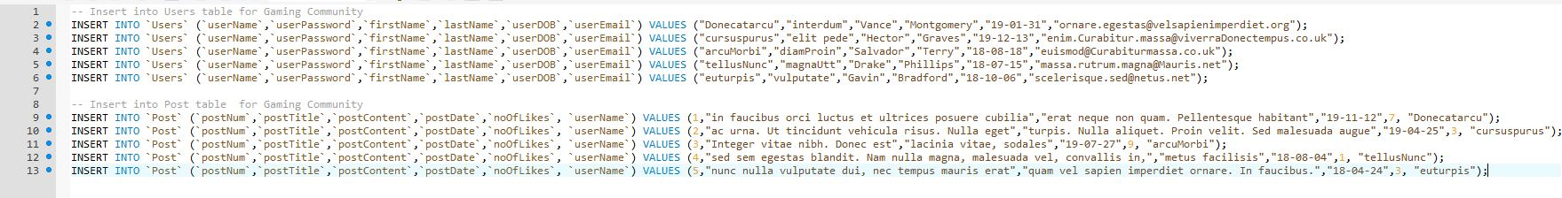
INSERT data for gaming community

Slide 29
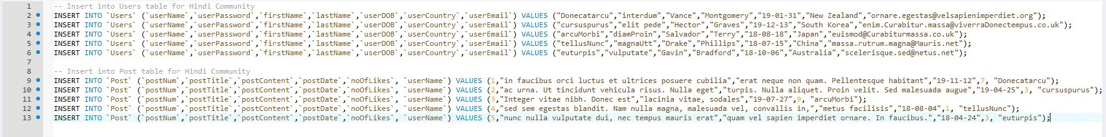
INSERT data for Hindi community

Slide 30

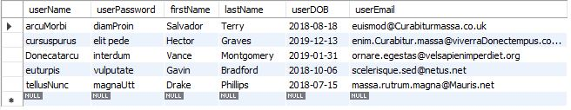
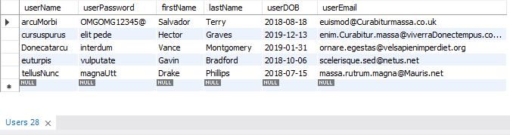
Change query for gaming community
Change Query
Before Change
After Change

Slide 31
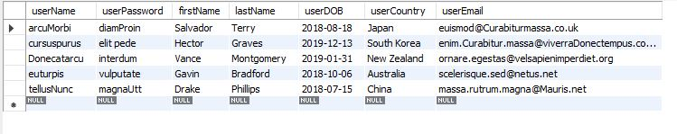
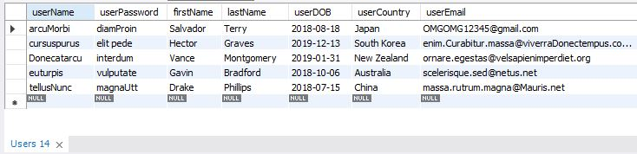
Change query for Hindi community
Change Query
Before Change
After Change

Slide 32


simple query for gaming community
Simple Query
Simple Query Result

Slide 33

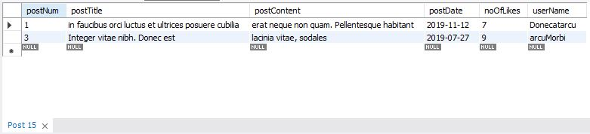
Simple query for Hindi community
Simple Query
Simple Query Result

Slide 34
Complex query for gaming community
Complex Query
Complex Query Result

Slide 35

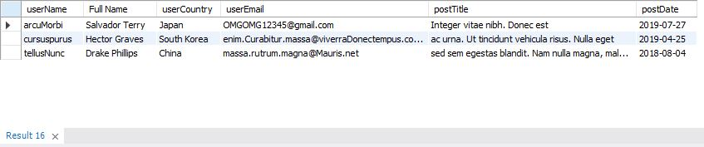
Complex query for Hindi community
Complex Query
Complex Query Result

Slide 36
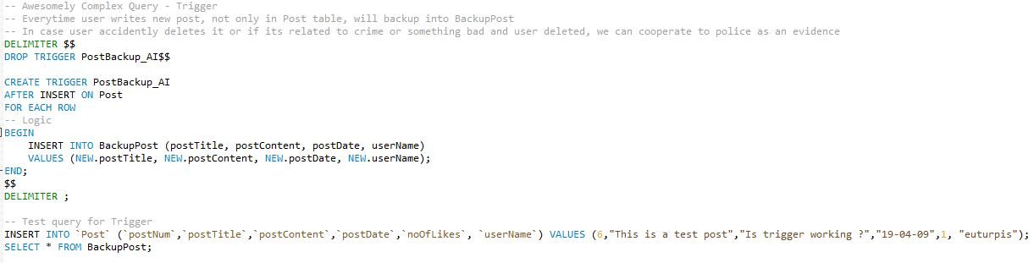


Awesomely complex query for both community
Awesomely Complex Query & Test
Before Change
After Change

Slide 37
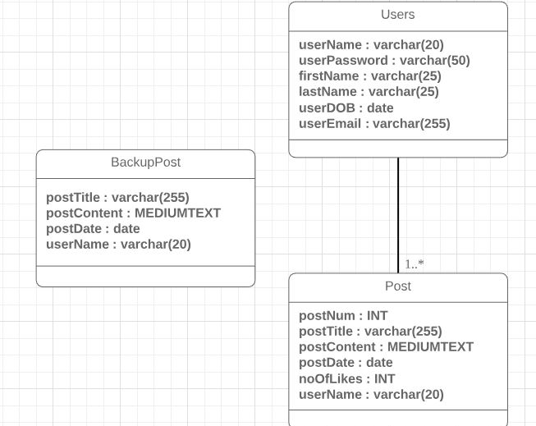
Class diagram gaming community

Slide 38
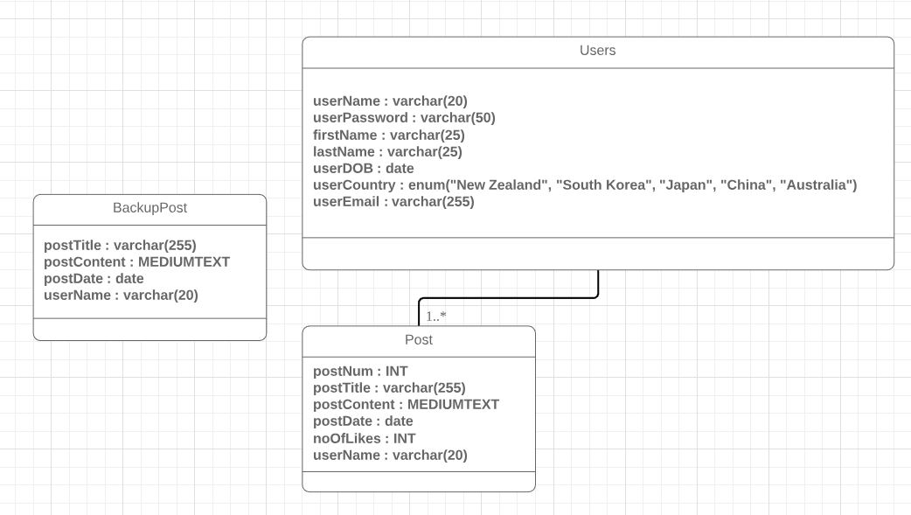
Class diagram Hindi community

