Slide 1
Backstage@Snow
Anthony Allen / Lead Site Reliability Engineer
Teddie Stenvi / Principal Engineer

Slide 2
Where are the docs?
And other discoverability problems
Docs spread over a mixture of GitHub repos and confluence spaces
What libraries are available?
What dependencies to micro services have on other services?
What APIs are available?
Where is my service running and what version is it?
Which team owns what?

Slide 3
Reflections
Nice way to model service dependencies using domain-driven design
Easy to drill down from the high-level view of the domain -> system -> entity -> [dependencies]
The more plugins you add, the more you want

Slide 4
First steps
Backstage docs contain most of what you need to know but can be difficult to navigate. Could not find a canonical reference for app-config.yaml
Quite a few examples in the docs are written for local dev and/or non-production. Read through the entire doc before you start developing as there are sometimes caveats quite far further down.
Each plugin maintains its own postgres database. So either backstage needs permissions to create databases or there is extra toil involved.
Auth/SignIn (at the moment) doesn’t appear to be a security boundary. It is mentioned in the docs, but worth repeating. We use oauth2-proxy in front of our deployment.

Slide 5
Gotchas
Read the YAML file format page carefully. We had a catalog-info.yaml not being processed as a metadata.tags value had upper case letters.
Changing name of an entity requires manual cleanup of the entity with the previous name. And “replumbing” of the dependent entities with a new dependency.
Too tight scan interval against many Github repositories cause rate limiting in the github API, even with github-apps.
At the moment, we check the backstage logs for errors in the catalog-info.yaml from the scan. Would be nice with a linter in the CI build.

Slide 6
Tips and tricks

Slide 7
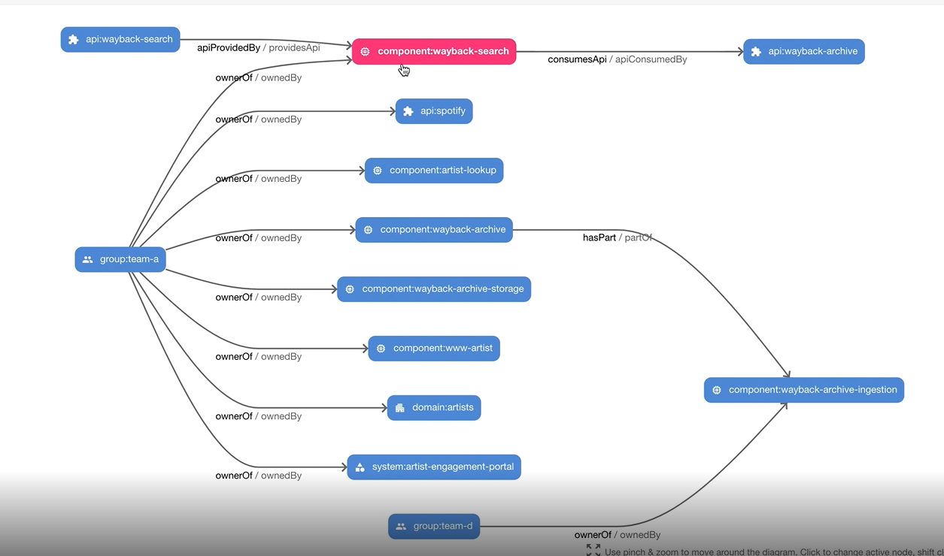
Catalog-Graph plugin is awesome

Slide 8
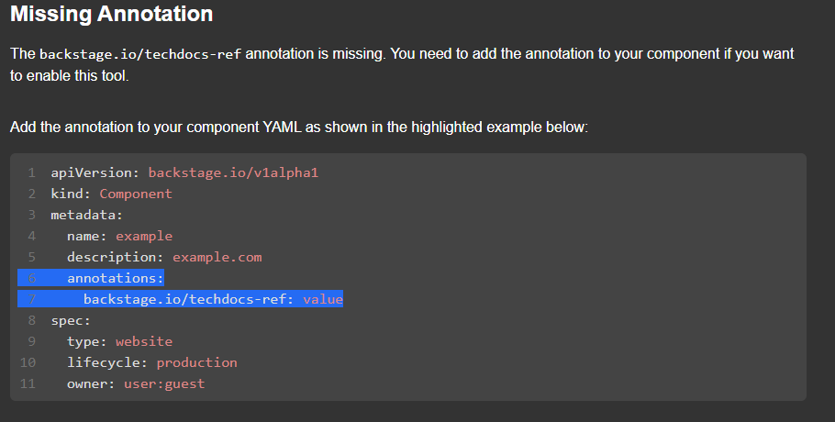


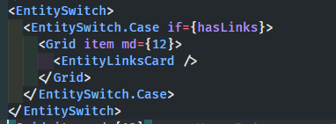
Hide irrelevant cards
packages/app/src/components/catalog/EntityPage.tsx

Slide 9
Logging environment variables
NODE_ENV=production - Sets logs to be json formatted
LOG_LEVEL=warn – Does what it says on the tin ☺

Slide 10

Avoiding errors when scanning all repos

Slide 11
Plugins
How to stop the always wanting more?
Plugins used so far
Catalog-graph
CircleCI
Kubernetes
Tech docs
Plugins under consideration
ArgoCD
Github Pull Requests
Jira
PagerDuty
Security insights
Tech radar

Slide 12
Feature requests ☺
RBAC support – On it’s way!
Usage stats
Popular services, APIs, docs
Unique viewers

Slide 13
Questions?

Slide 14



Thank You
Contact Snow Software
snowsoftware.com

