Slide 1
Ray Tracing : In A Weekend (with a Python)
16 신지홍 정보컴퓨터공학부

Slide 2
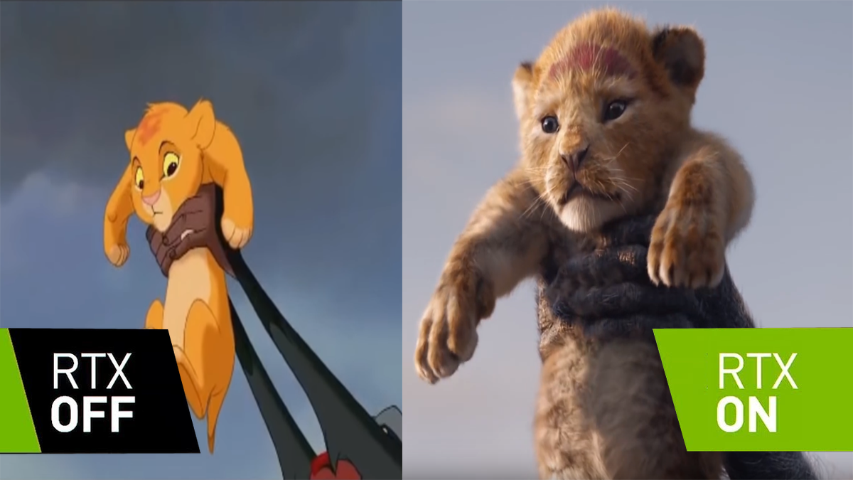

Slide 3
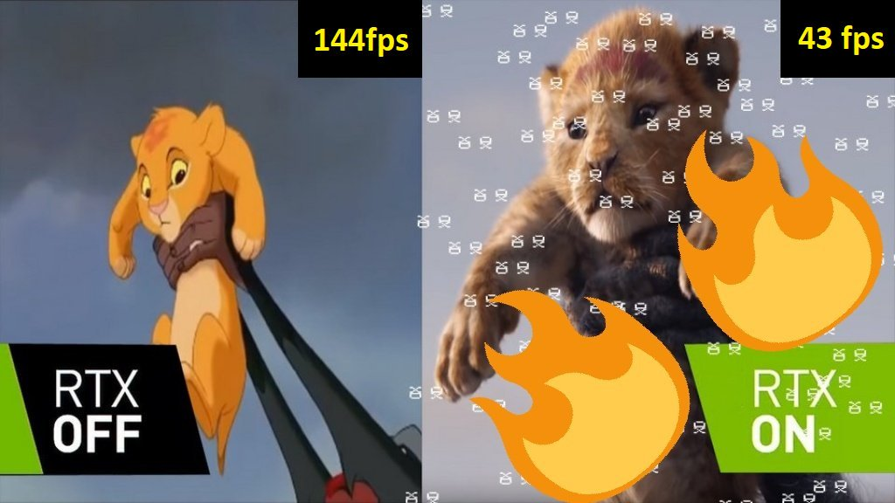
1) https://twitter.com/gamersnexus/status/1065921443790241793

Slide 4
RTX
interface for real-time ray tracing for rendering graphics that was created by Nvidia.

