Slide 1
맛보기
Ray Tracing : In A Weekend (with a Python)
16 신지홍 정보컴퓨터공학부

Slide 2
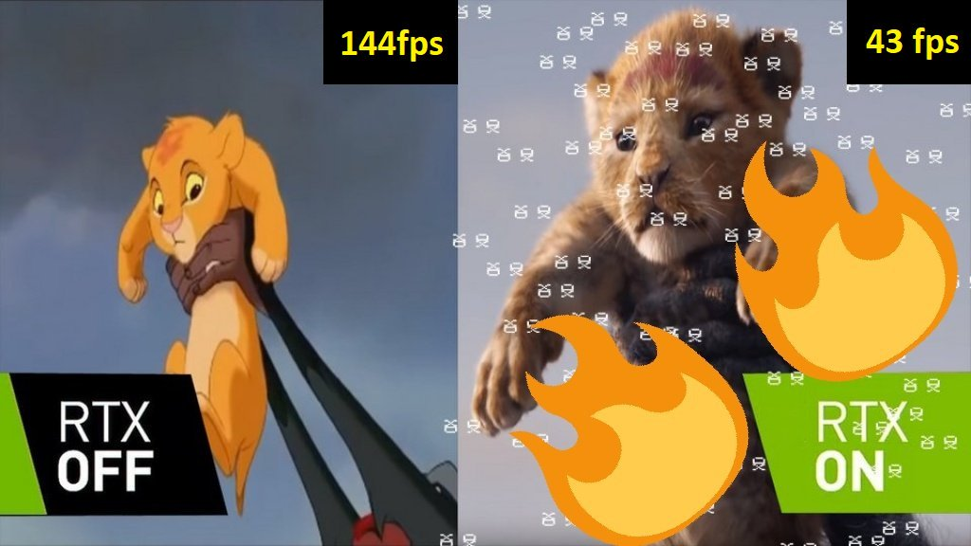
1) https://twitter.com/gamersnexus/status/1065921443790241793

Slide 3
RTX Graphics Card
1) interface for real-time ray tracing for rendering graphics that was created by Nvidia.
1) https://en.wikipedia.org/wiki/RTX

Slide 4
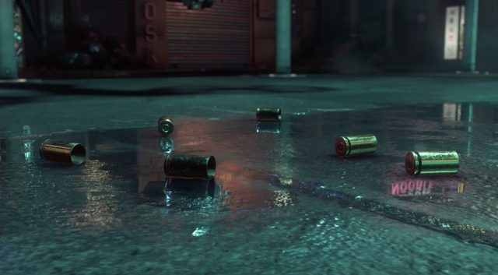
Ray-Tracing
1) https://www.extremetech.com/gaming/287942-crytek-demo-showcases-real-time-raytracing-on-amd-vega-56

Slide 5
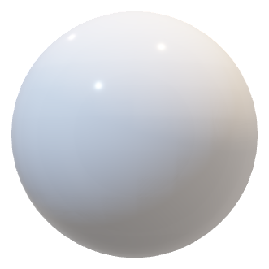
Ray-Tracing Basic
y
카메라
x
z
스크린

Slide 6
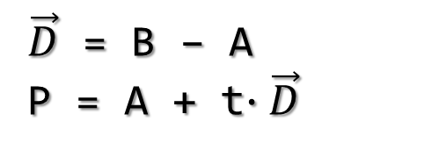
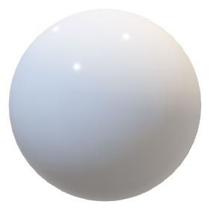
y
t=-1
t=0
t=1
t=1
t=2
A
P
카메라
B
x
$\vec{D}$ = B – A
P = A + t$∙\vec{D}$
A
z
스크린

Slide 7
y
t=-1
t=0
t=1
t=1
t=2
A
P
카메라
$\vec{D}$ = B – A
P = A + t$∙\vec{D}$
A
x
C
z
스크린

Slide 8






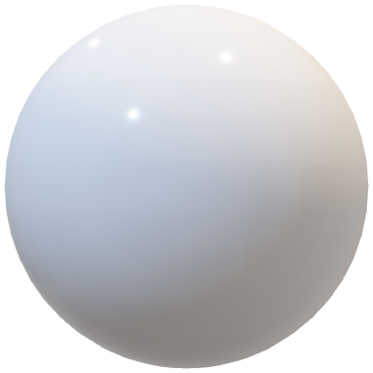



$$b_{2}$$
천장
광원
카메라
$$b_{3}$$
y
$$b_{0}$$
x
$$a_{0}$$
$$b_{4}$$
z
스크린
$$b_{1}$$
$$a_{1}$$
$$a_{3}$$
바닥
$$a_{2}$$

Slide 9

Hello world!
PPM 이미지 포맷
P3
3 2
255
255 0 0
0 255 0
0 0 255
255 255 0
255 255 255
0 0 0
1) https://en.wikipedia.org/wiki/Netpbm_format

Slide 10
Hello world!
width
File open
Write “P3\n20 10\n255\n”
for i = 0; width :
for j = 0; height :
R = (i / width) * 255
G = (j / height) * 255
B = 0.2 * 255
Write R G B end of for end of for
File Close
height

Slide 11

Hello world!

Slide 12
Sphere Ray-Tracing
(-2, -1, -1)
(+2, +1, -1)
-z
y
x
z

Slide 13

for i = 0; width
for j = 0; height
P
(-2, -1, -1)
$$\vec{B}$$
(+2, +1, -1)
-z
A
y
x
z

Slide 14
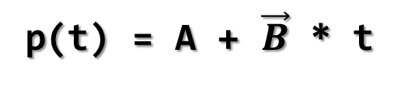

for i = 0; width
for j = 0; height
P
(-2, -1, -1)
$$\vec{B}$$
p(t)
(+2, +1, -1)
-z
A
y
p(t) = A + $\vec{B}$ * t
x
z

Slide 15

(cx, cy, cz)
(x-cx)^2 + (y-cy)^2 + (z-cz)^2 = R^2
R
p(t)
$$\vec{B}$$
A

Slide 16
(cx, cy, cz)
(x-cx)^2 + (y-cy)^2 + (z-cz)^2 = R^2
dot((p-c), (p-c)) = R*R (p = (x, y, z), c = (cx, cy, cz))
r
p(t)
$$\vec{B}$$
A

Slide 17
(cx, cy, cz)
(x-cx)^2 + (y-cy)^2 + (z-cz)^2 = R^2
dot((p-c), (p-c)) = R*R
(p = (x, y, z), c = (cx, cy, cz))
dot((A+B*t – c), (A+B*t – c)) = R*R
(p = p(t) = A + B*t)
r
p(t)
$$\vec{B}$$
A

Slide 18
(cx, cy, cz)
(x-cx)^2 + (y-cy)^2 + (z-cz)^2 = R^2
dot((p-c), (p-c)) = R*R
(p = (x, y, z), c = (cx, cy, cz))
dot((A+B*t – c), (A+B*t – c)) = R*R
(p = p(t) = A + B*t)
dot(B,B)*t^2 + 2*dot(B,A-C)*t + dot(A-C,A-C) – R*R = 0
r
p(t)
$$\vec{B}$$
A

Slide 19
(x-cx)^2 + (y-cy)^2 + (z-cz)^2 = R^2
dot((p-c), (p-c)) = R*R
(p = (x, y, z), c = (cx, cy, cz))
dot((A+B*t – c), (A+B*t – c)) = R*R
(p = p(t) = A + B*t)
dot(B,B)*t^2 + 2*dot(B,A-C)*t + dot(A-C,A-C) – R*R = 0
a*t^2 + b*t + c = 0 (a=dot(B,B), b=2*dot(B,A-C), c=dot(A-C,A-C)-R*R))
(cx, cy, cz)
r
p(t)
$$\vec{B}$$
A

Slide 20


$$p_{2}$$
(x-cx)^2 + (y-cy)^2 + (z-cz)^2 = R^2
dot((p-c), (p-c)) = R*R
(p = (x, y, z), c = (cx, cy, cz))
dot((A+B*t – c), (A+B*t – c)) = R*R
(p = p(t) = A + B*t)
dot(B,B)*t^2 + 2*dot(B,A-C)*t + dot(A-C,A-C) – R*R = 0
a*t^2 + b*t + c = 0 (a=dot(B,B), b=2*dot(B,A-C), c=dot(A-C,A-C)-R*R))
D = b^2 - 4*a*c
(D >= 0 ? There is sphere : Background)
(cx, cy, cz)
r
$$p_{1}$$
p(t)
$$\vec{B}$$
A

Slide 21

WA!!…..

Slide 22
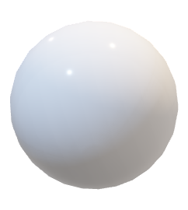
2D 물체와 3D 물체의 차이
Do not Shading
Do Shading

Slide 23
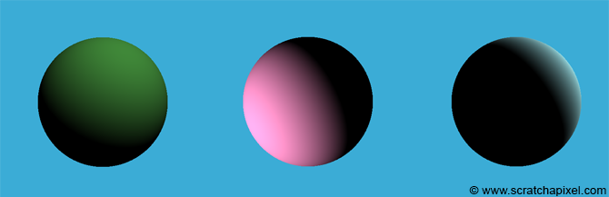
Lambertian Shading Model
1) https://www.scratchapixel.com/lessons/3d-basic-rendering/introduction-to-shading/diffuse-lambertian-shading

Slide 24


Diffuse Material
$$\vec{n}$$
$$\vec{n}$$
Rough Surface
Smooth Surface
1) Real-time-rendering 3rd edition (Book)

Slide 25
Diffuse Material
Small sphere
Huge sphere

Slide 26
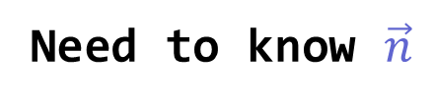

Diffuse Material
$$\vec{n}$$
Need to know $\vec{n}$

Slide 27
(x-cx)^2 + (y-cy)^2 + (z-cz)^2 = R^2
dot((p-c), (p-c)) = R*R
(p = (x, y, z), c = (cx, cy, cz))
dot((A+B*t – c), (A+B*t – c)) = R*R
(p = p(t) = A + B*t)
dot(B,B)*t^2 + 2*dot(B,A-C)*t + dot(A-C,A-C) – R*R = 0
a*t^2 + b*t + c = 0 (a=dot(B,B), b=2*dot(B,A-C), c=dot(A-C,A-C)-R*R))
D=b^2-4*a*c
(cx, cy, cz)
r
p(t)
$$\vec{B}$$
A

Slide 28







$$p_{2}$$
(cx, cy, cz)
$$c$$
r
$$p_{1}$$
$$p_{1}$$
p(t)
접선
$$\vec{B}$$
$$\vec{n}$$
A

Slide 29








$$\vec{n}$$
vector
normalize
$$c$$
$$\vec{n}$$
Unit vector
$$(x, y, z)$$
-1 ~ 1
$$p_{1}$$
conversion
접선
$$(R,G,B)$$
0 ~ 1
$$(R,G,B)$$
$$\vec{n}$$

Slide 30


200
100
y
x
z

Slide 31



200
100
After Anti-aliasing

Slide 32










$${\vec{s}}_{1}$$
$${\vec{v}}_{1}$$
$$p_{1}$$
$${\vec{n}}_{1}$$
랜덤 벡터 ${\vec{v}}_{1}, {\vec{v}}_{2}$
합성 벡터 ${\vec{s}}_{1},{\vec{s}}_{2}$
$$c$$
$$p_{2}$$
$${\vec{n}}_{2}$$
구의 아래쪽 -> 빛 반사 多
$${\vec{v}}_{2}$$
구의 위쪽 -> 빛 반사 小
$${\vec{s}}_{2}$$

Slide 33
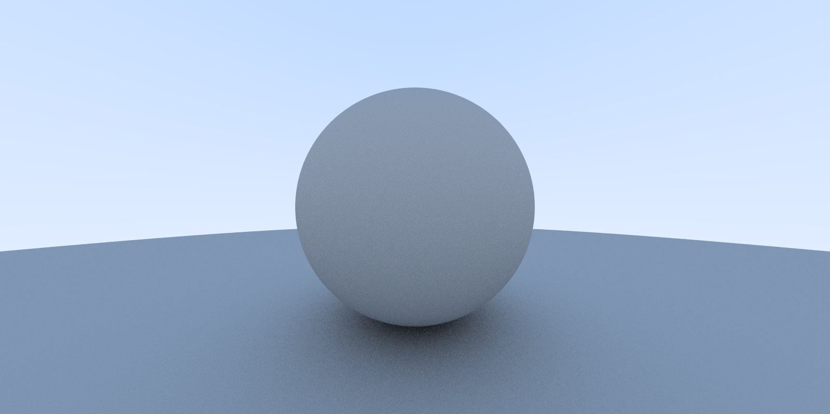
High-resolution Result
1600
800

Slide 34
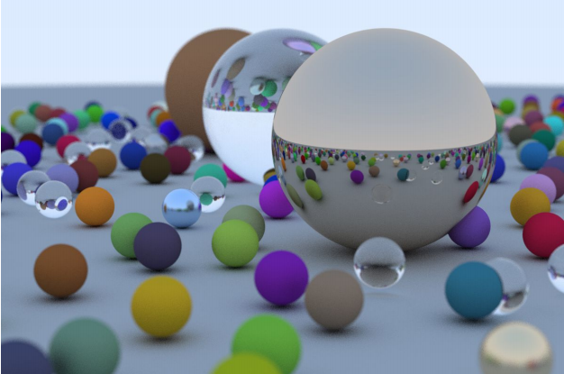
Next step..
1) http://www.realtimerendering.com/raytracing/Ray%20Tracing%20in%20a%20Weekend.pdf

Slide 35
References )
http://www.realtimerendering.com/raytracing/Ray%20Tracing%20in%20a%20Weekend.pdf
http://www.realtimerendering.com/raytracing/Ray%20Tracing_%20The%20Next%20Week.pdf
Github : https://github.com/Snowapril/Raytracing-In-A-Weekend-Python
1학년 신입생분들을 위한 Github에서 코드 다운로드 받는법:
위의 링크를 타고 들어가서 오른쪽 중앙에 보이는 Clone or download 클릭 후 Download ZIP 선택 !

