Slide 1

SnowPro Study Group
01/28/2026
Snowflake AI Data Cloud Features and Architecture

Slide 2



Lance England
Senior Consultant at Improving
Data and cloud specialist with certifications from Snowflake and Microsoft

Slide 3
New SnowPro exam coming Feb 2026!
COF-C02 to retire May 14, 2026
COF-C03 available Feb 16, 2026
We will update content to COF-C03
Changes include:
  Refined domains (five instead of six)
  New content (Iceberg, Notebooks, Cortex)
  New weights: More emphasis on architecture and performance

Slide 4
Learning Approach
Switch it up:
Use videos, documentation, hands-on practice, and podcasts.
03
Study time:
Use time between meetings to supplement
02
Meet regularly:
Monthly cadence to cover highlights for discussion.
01

Slide 5
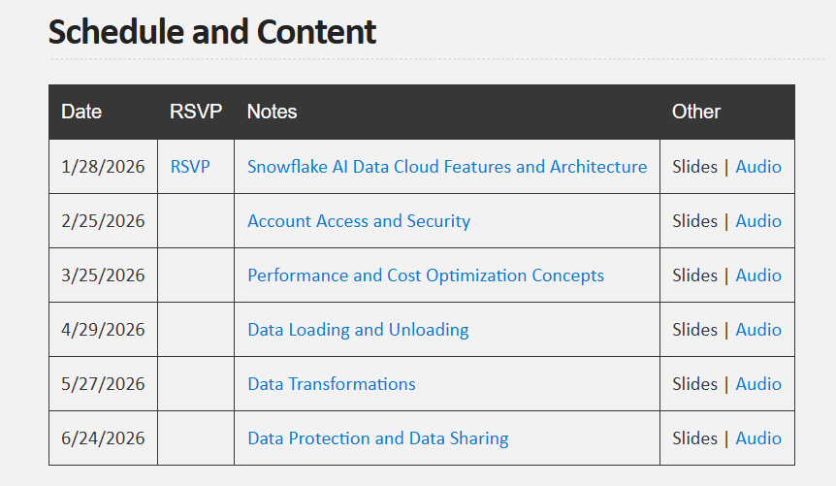
Group Website
https://snowflake-study-group-atlanta.github.io
Has links for notes, slides, and “podcasts” generated from NotebookLM

Slide 6
Other Resources
Official Docs
docs.snowflake.com
Snowflake Trial
signup.snowflake.com
Tom Bailey’s Udemy course (recommended)
https://www.udemy.com/course/ultimate-snowpro-core-certification-course-exam/
Notes:
The website has a page for each domain, organized to match the official study guide (as of Aug 2025).

Slide 7
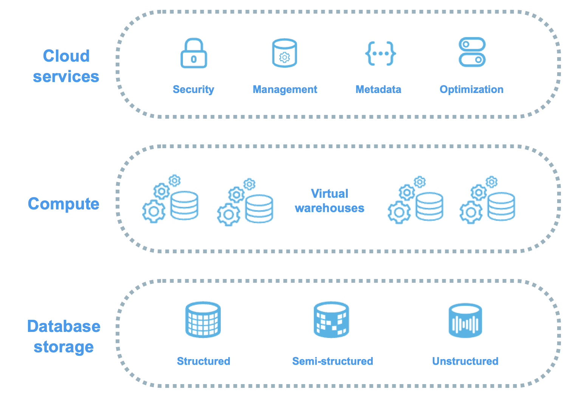
Architecture

Slide 8
Key Concept
Snowflake’s architecture is a hybrid of traditional shared-disk and shared-nothing database architectures.
Shared disk = central data repository accessible from all compute nodes
Shared nothing = parallel processing where each node has a portion of the data
Hybrid = Each node contains a cached portion of the shared data.

Slide 9
Editions
https://docs.snowflake.com/en/user-guide/intro-editions#feature-and-edition-matrix
Standard | Enterprise | Business Critical | Virtual Private Snowflake
Hybrid Architecture Authentication/Authorization Encryption (in-flight/at-rest) Virtual warehouses (scalable compute) Native handling of JSON, Parquet, etc. Time Travel and Fail-safe Much more! | All Standard Features Multi-cluster compute Granular governance and privacy Extended time-travel windows Query acceleration Search optimization service Much more! | All Enterprise Features Fail-over and fallback Tri-secret (authentication + Snowflake key + customer-key) Private connectivity Much more! | Most Business Critical Features Dedicated compute Removes marketplace Removes public listings Removes collaborative “clean rooms”

Slide 10
Key Tools
Snowsight – Modern web UI, your primary tool
SnowSQL – command-line
SnowCD – Snowflake connectivity diagnostic
Streamlit – Framework for Python-based web apps
Snowpark – Framework in Snowflake Data Cloud for Java, Scala, and Python
Cortex – Managed AI/ML services
Drivers + connectors – drivers handle the plumbing, connectors wrap them
API – REST-based SQL

Slide 11
Database Objects
Database, Schema | Containers of organization
Stages (internal/external) | Storage for files
Table, Views | More on table types next slide
Stored Procedures, UDF (scalar), UDTF (rows) | Procedural logic
Streams | Change-data capture
Tasks | Schedules work, can be chained
Pipes | Continuous data loading (streaming)
Shares | A secure way to share data

Slide 12
Table Types
Permanent: 7-day Time Travel (90 days Enterprise), has Fail-safe
Transient: 24-hour Time Travel max, NO Fail-safe
Temporary: Session-specific
External: Query files in external stages as tables
Iceberg: Apache Iceberg format with evolution & time travel on data lake

Slide 13
Storage Concepts
Micro-partitions = Fundamental storage unit
Snowflake does this for automatically
Immutable and ~50–500 MB uncompressed
Micro-partition metadata (column min/max) query pruning
Columnar format reduces the amount of data scanned
Immutablity means preserving historical data => time-travel feature

Slide 14
Discussion

