Slide 1
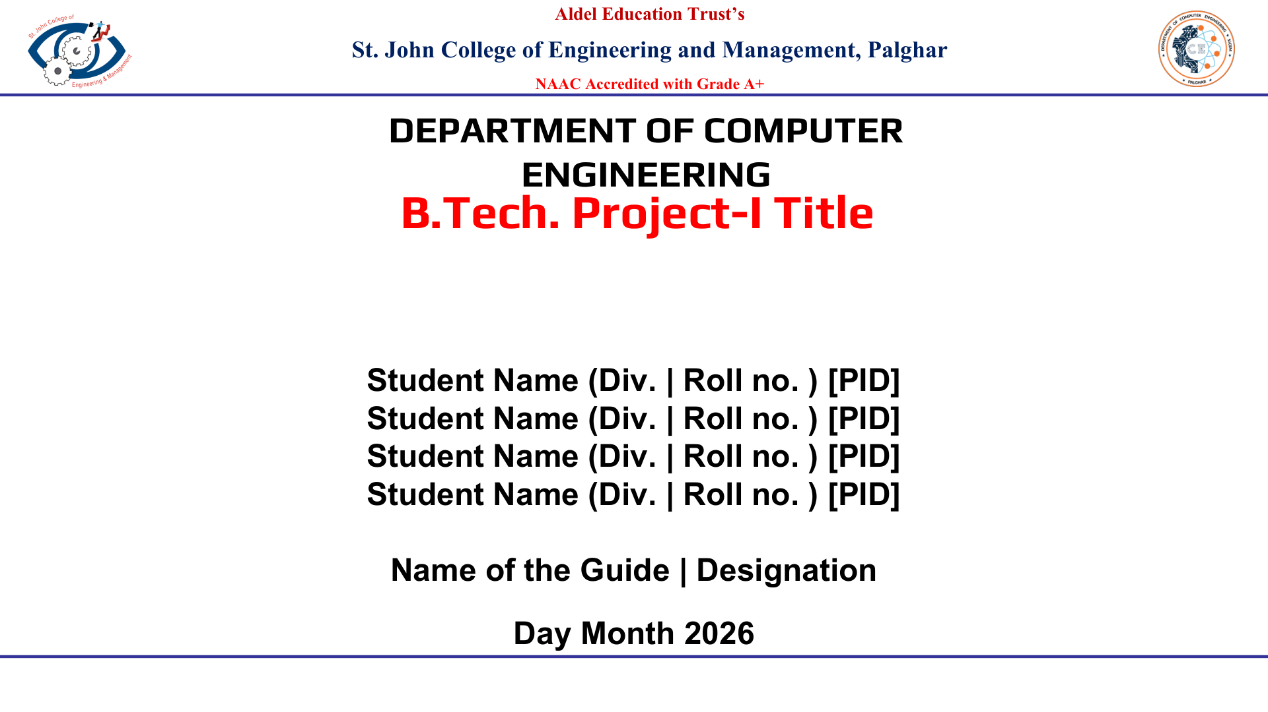
QUIZ BUZZER SYSTEM
B.Tech. Project-I
Pruthviraj Kute | Div. A | Roll No. 43 | EU1252083
Adarsh Maurya | Div. A | Roll No. 47 | EU1252013
Mubasshir Memon | Div. A | Roll No. 49 | EU1252082
Shlok Mishra | Div. A | Roll No. 53 | EU1252079
Guide: Oniza Ridwan Shaikh | Designation: Assistant Prof.
September 2026

Slide 2
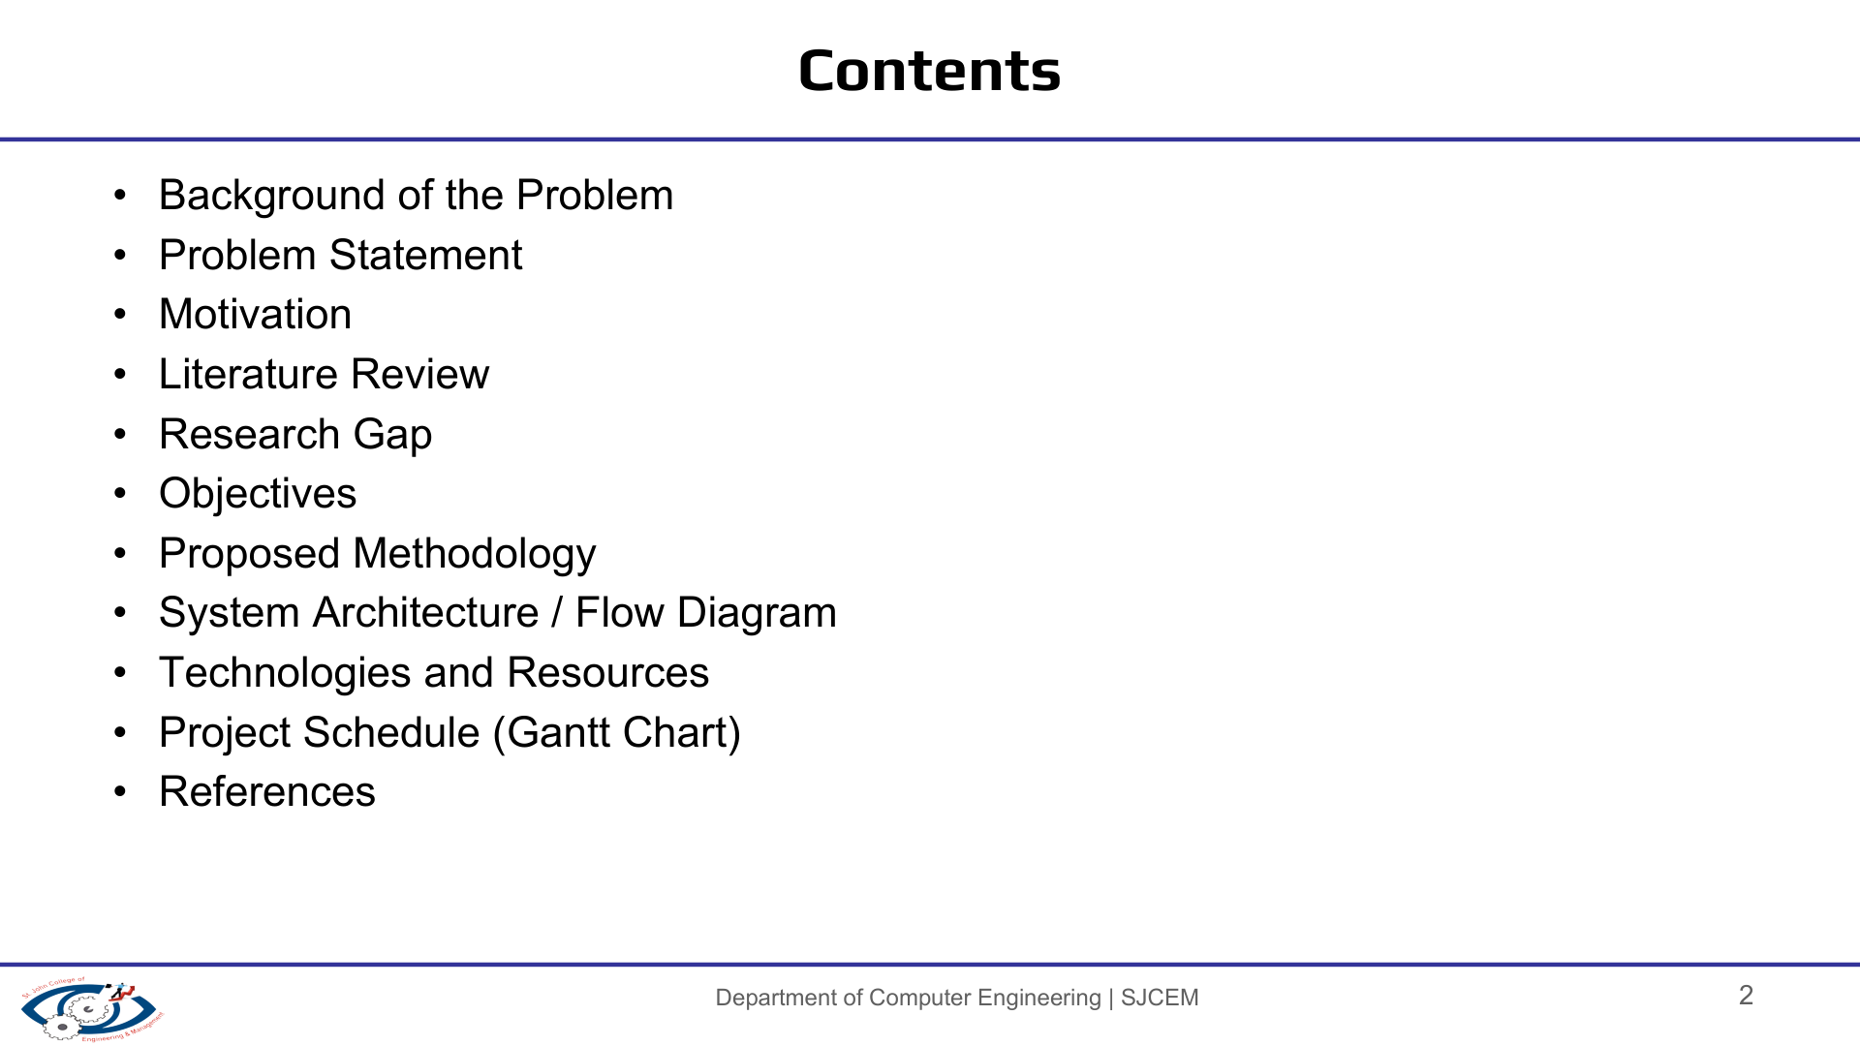
Background of the Problem
Problem Statement
Motivation
Literature Review
Research Gap
Objectives
Proposed Methodology
System Architecture / Flow Diagram
Technologies and Resources
Project Schedule (Gantt Chart)
References
PROJECT IN ONE LINE
A four-player, hardware-only quiz buzzer that latches the first valid button press using AND-gate logic and D flip-flops, then blocks later inputs until reset.
DESIGN APPROACH
No microcontroller or software. The prototype uses combinational logic for gating and sequential logic for storing the winner state.

Slide 3
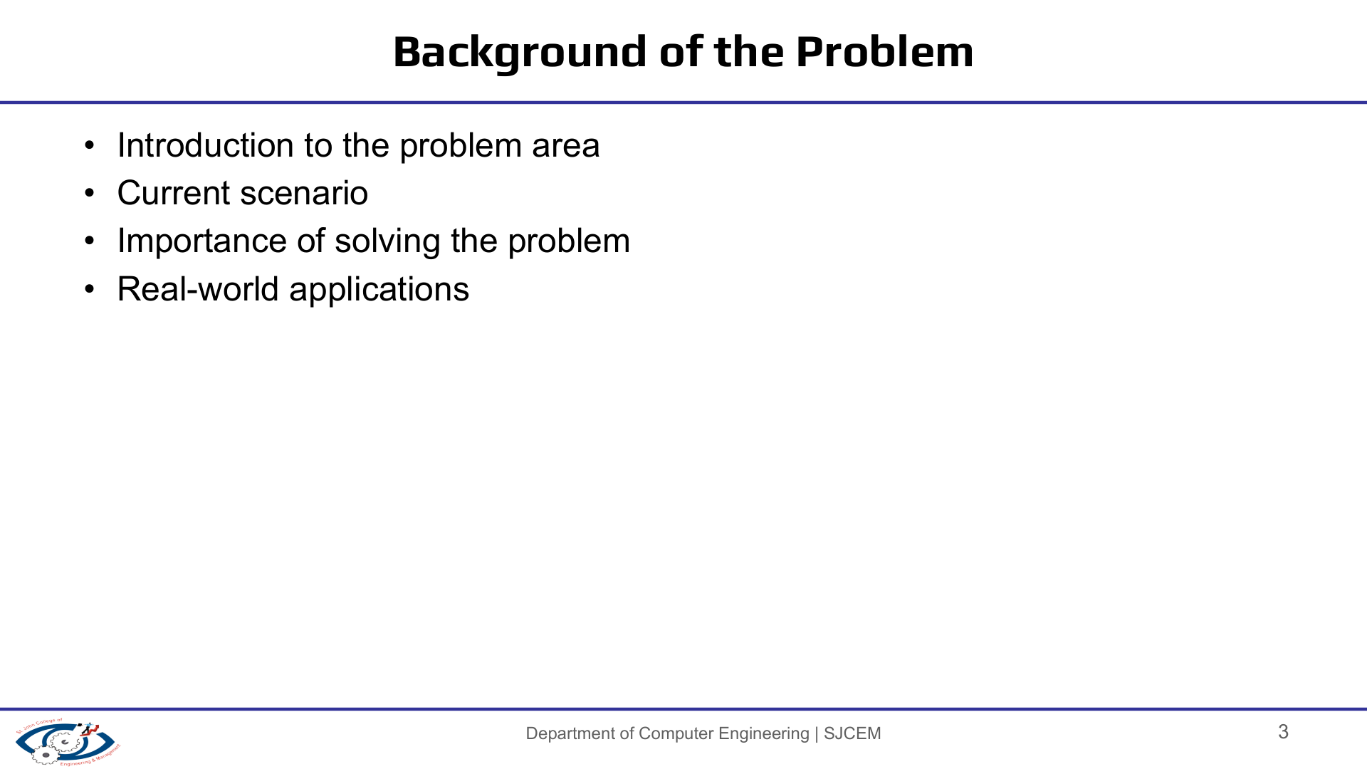
Quiz competitions need a clear way to identify which participant responded first.
With multiple people pressing almost together, visual/manual judgment can be difficult.
An electronic buzzer can give an immediate visual and audible indication of the registered response.
Our prototype demonstrates this using only discrete digital logic ICs rather than a microcontroller.
REAL-WORLD CONTEXT
Classroom quizzes • Inter-college competitions • Game-show style activities • Training and team activities
CORE IDEA
First press → latch winner → lock remaining inputs → indicate winner → reset for next round.
WHAT WE ARE DEMONSTRATING
Practical use of combinational logic, sequential logic, asynchronous reset, LED indication and transistor-driven output.

Slide 4
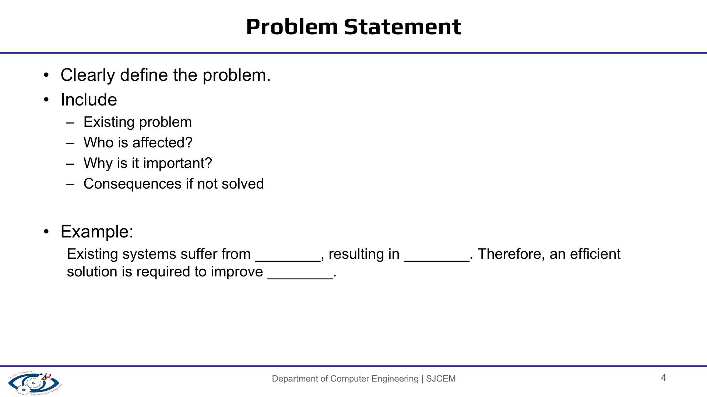
DESIGN PROBLEM
CONSTRAINTS
Design and implement a four-player quiz buzzer that can:
• detect the first valid button press,
• latch that winner,
• prevent subsequent player inputs from changing the result,
• provide immediate LED + buzzer feedback, and
• return to the ready state through a manual reset.
• No microcontroller
• No programming/software
• Four player inputs
• One common reset
• Breadboard implementation
• Low-voltage DC operation
EXPECTED RESULT
At most one player's state remains latched during a round. Later button presses are ignored until the administrator/reset button clears the stored state.

Slide 5
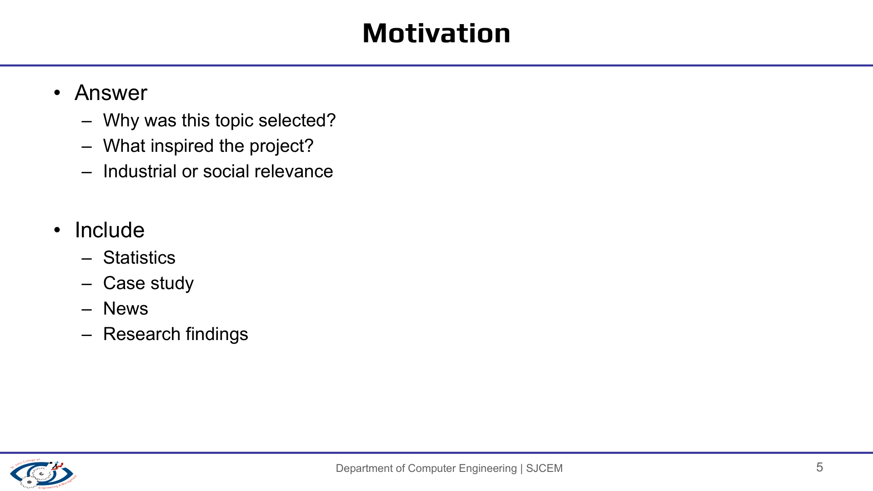
We did not begin from a claim that existing quiz buzzers are unusable.
WHY THIS PROJECT
WHY HARDWARE-ONLY
WHY IT MATTERS ACADEMICALLY
The topic was selected as a manageable hardware project that lets us turn digital-logic theory into a working physical system.
Using AND gates and D flip-flops makes the first-response mechanism visible and explainable at circuit level instead of hiding it inside software.
The project combines combinational logic, sequential logic, latching, reset behavior, current limiting and output driving in one demonstrable prototype.
Project motivation: learn by building a real first-response digital system.

Slide 6
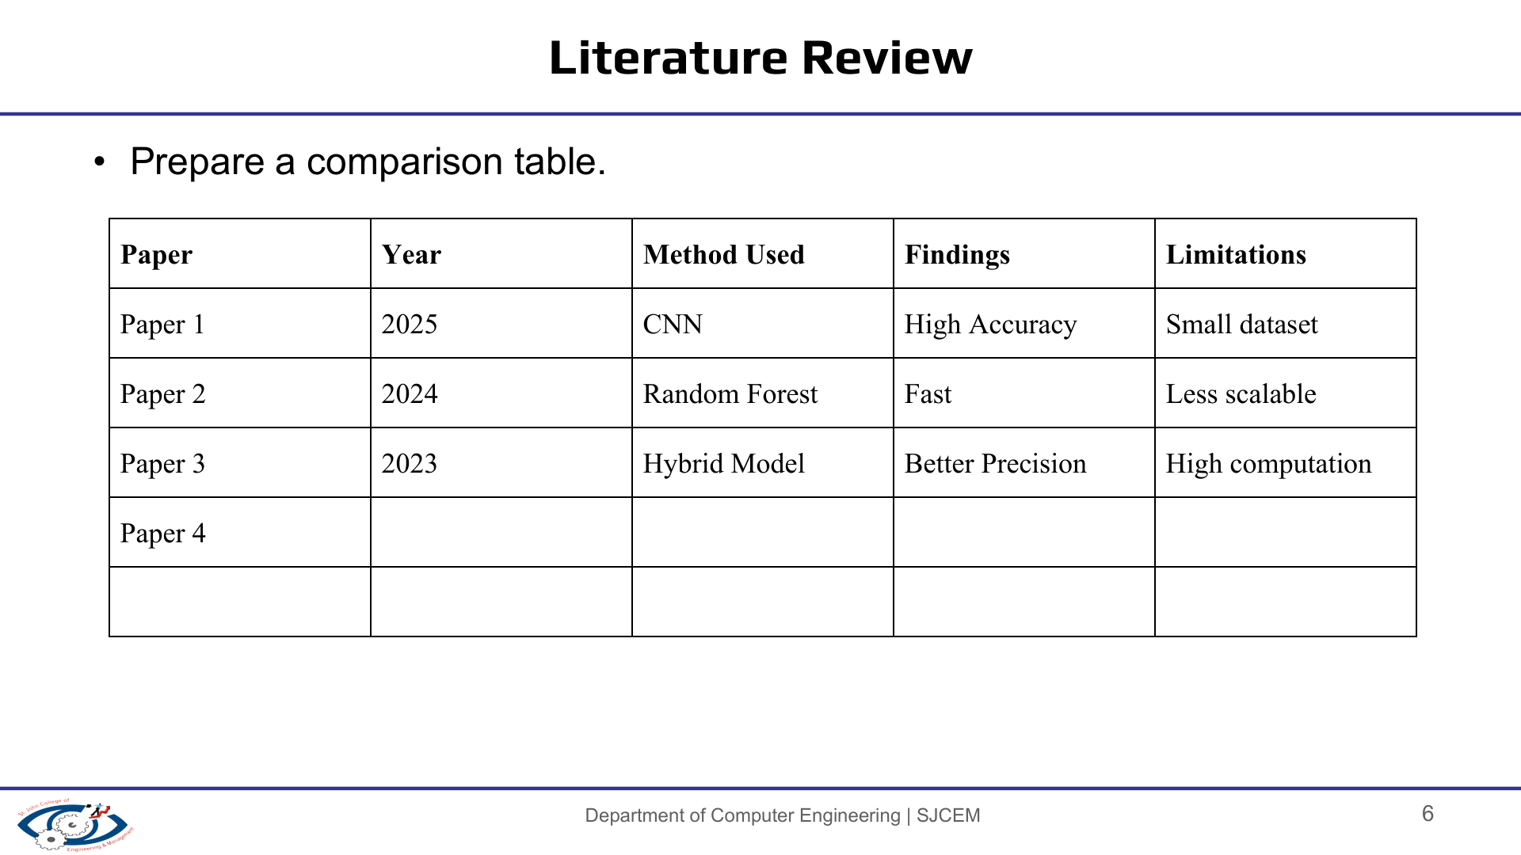
Source
Year
Method
Relevant finding
Limitation / difference
Sundaresan & Perumal
2016
Low-cost quiz-controller approaches
Addresses first-responder detection and affordability in quiz settings.
Different circuit approach; not our exact IC combination.
Havizul & Zulkarnain
2023
NodeMCU ESP8266 + buttons/LED/buzzer
Microcontroller can detect and lock the first response.
Requires programmable controller/software.
Yan & Xu
2024
74LS175 + AND-gate hardware buzzer
Four-person hardware circuit uses flip-flop memory and AND-gate locking.
Uses different IC family/design.
Konade et al.
2026
Arduino Nano + LCD
Automated first-input detection, lockout and display.
Microcontroller-based; more features than our hardware-only scope.
Literature indicates that first-response latching is commonly implemented with programmable controllers or discrete sequential logic; our project focuses on the latter.

Slide 7
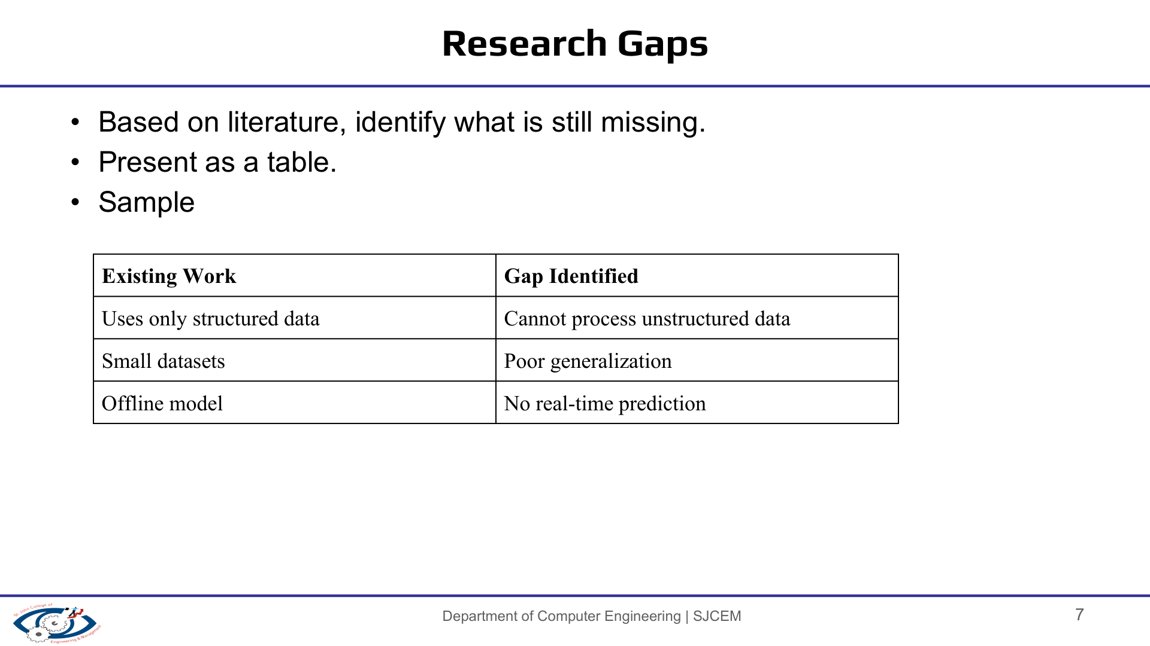
We treat this as a design gap for our project scope, not as a claim of novel research.
Existing Work / Common Approach
Gap / Our Project Focus
Microcontroller-based implementations can detect, lock and display the first response.
Some hardware designs use flip-flops and logic gates but vary in IC choice and circuit organization.
Commercial systems may add displays, timers, scoring and communication features.
Demonstrate the complete first-response mechanism without a microcontroller or code.
Use SN74HC08N AND gates for gating and CD4013BD D flip-flops for state retention.
Keep the prototype focused: 4 inputs, 4 LED indicators, buzzer and manual reset.

Slide 8
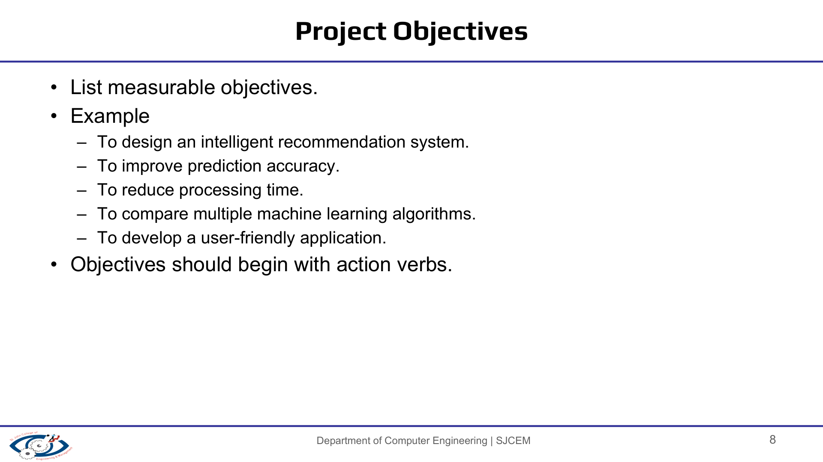
Design a four-player first-response detection circuit using discrete logic ICs.
Latch the first valid response so the winning state remains stored after the button is released.
Block subsequent button inputs until the administrator/reset button is activated.
Provide immediate visual indication through four player LEDs and an audible buzzer.
Demonstrate practical application of AND-gate logic and D flip-flop memory.
SUCCESS CRITERIA
One winner is retained per round • Later presses do not alter the result • Reset clears the stored state • LED/buzzer feedback is observable

Slide 9
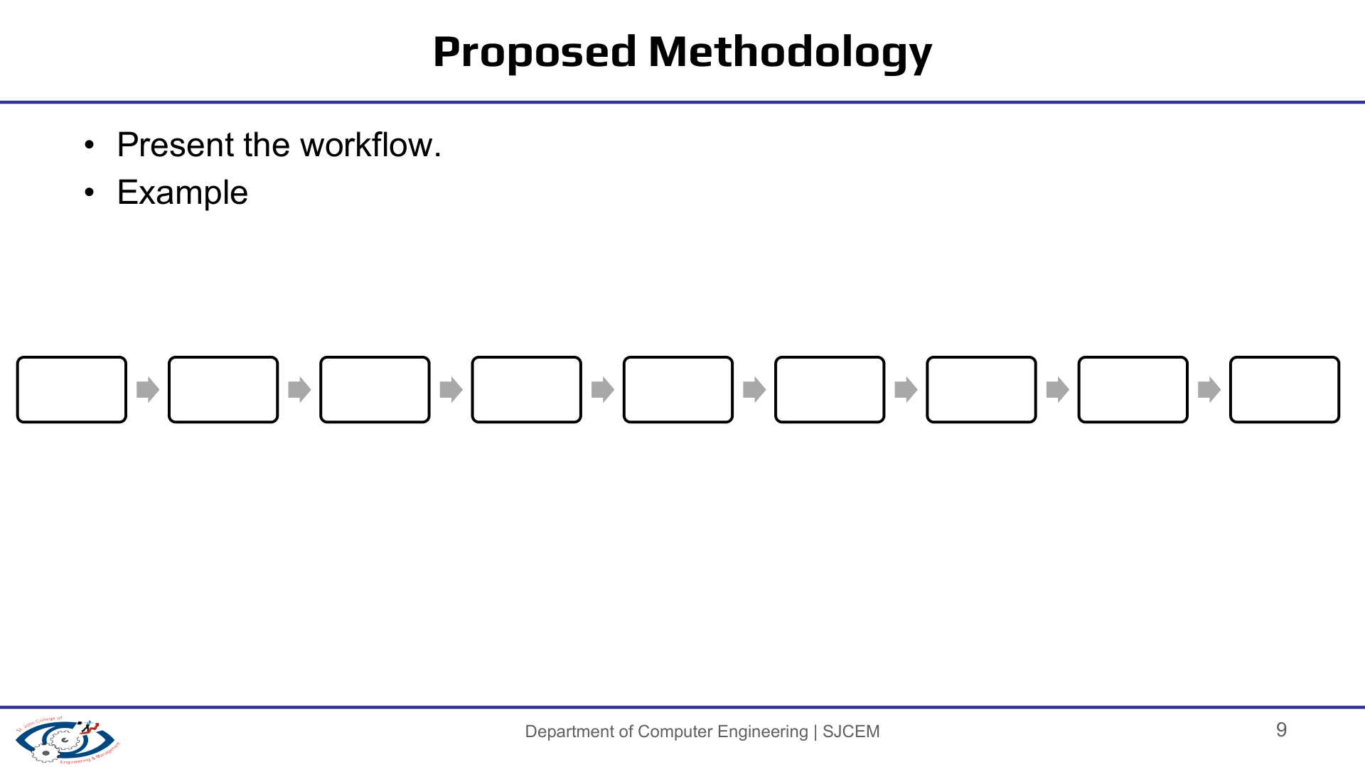
Requirements
Circuit study
Logic design
Breadboard build
Power & output test
Lock/reset test
Debugging
Final demo
Logic verification focus
Button input → 74HC08 gating → CD4013 state latch → LED / buzzer output → reset
The implementation is hardware-driven: no firmware, database or ML model is used.

Slide 10
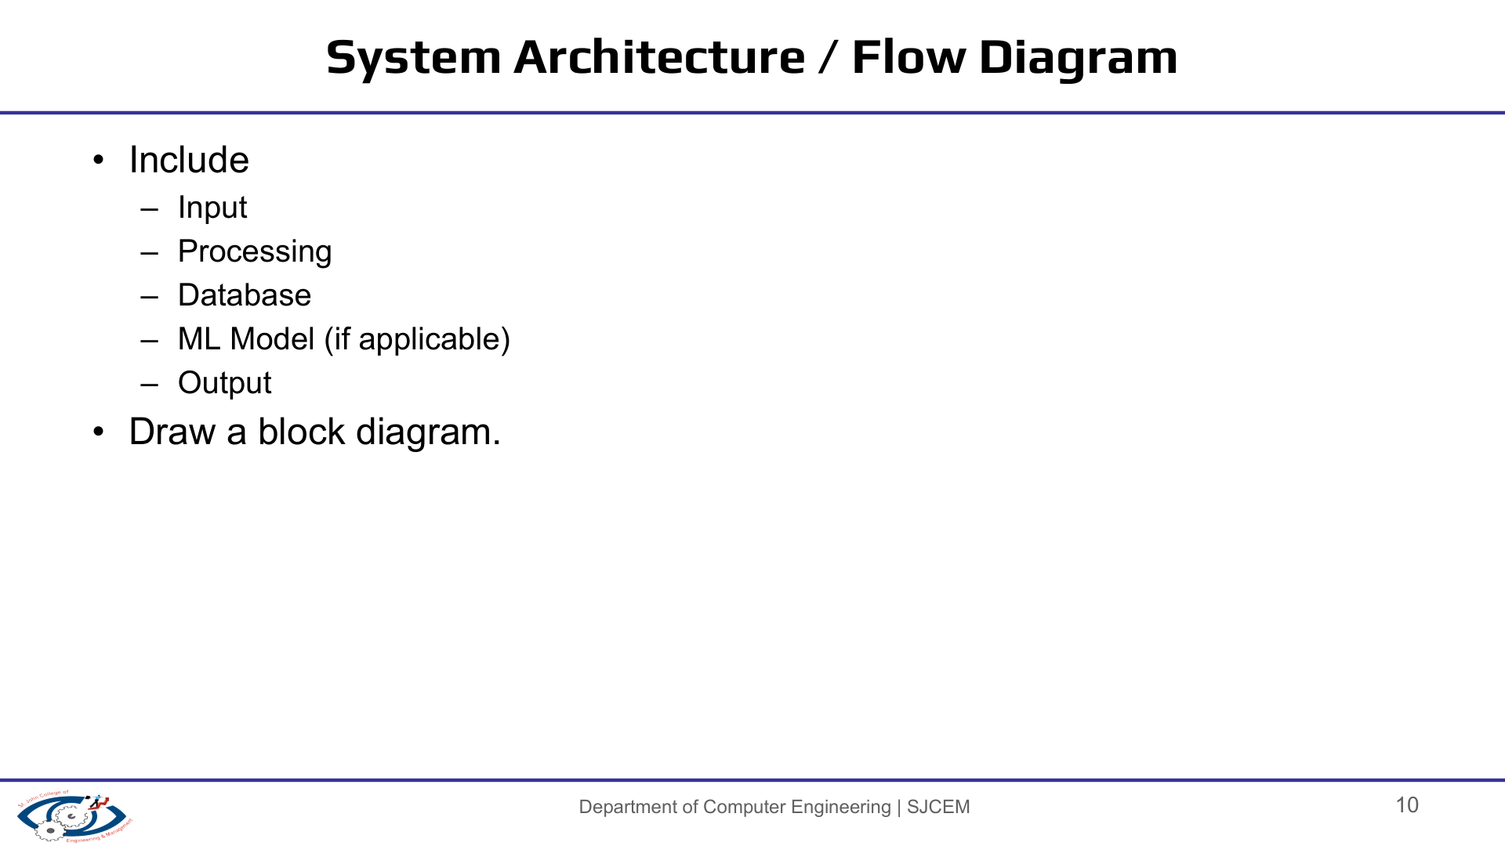
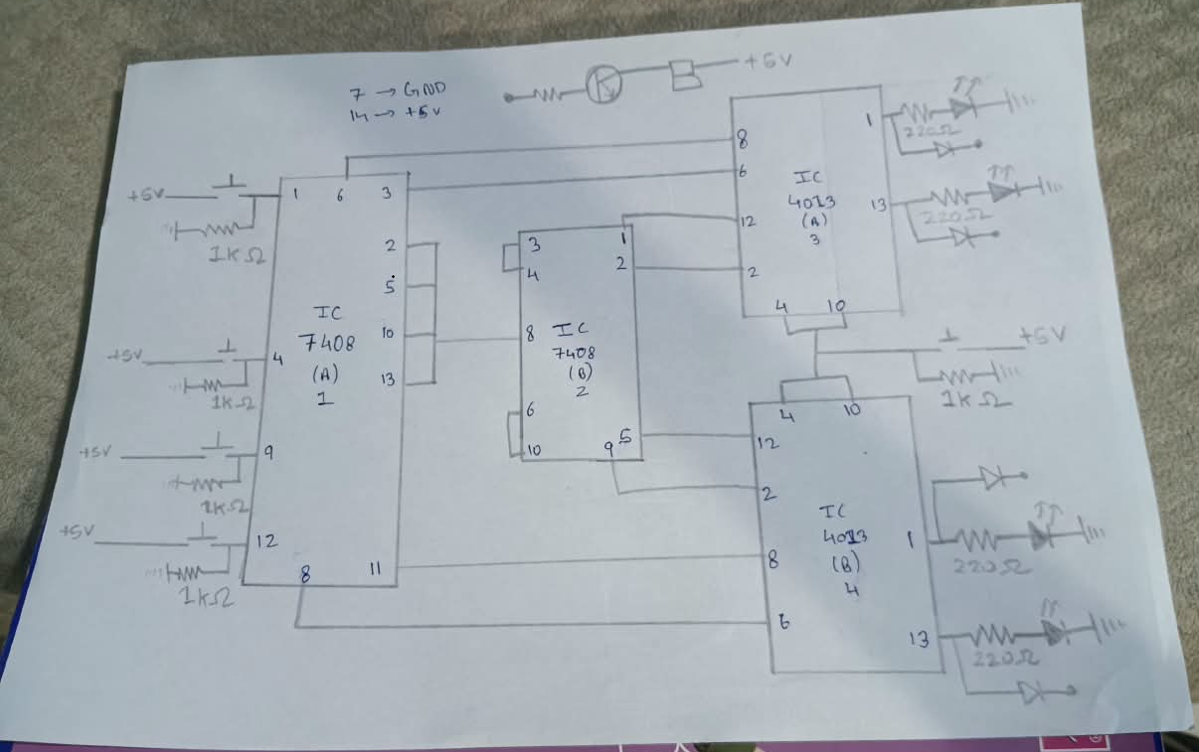
Functional block flow
Reference circuit schematic
PLAYER INPUTS
4 push buttons
COMBINATIONAL LOGIC
2 × SN74HC08N
AND-gate network
SEQUENTIAL MEMORY
2 × CD4013BD
D flip-flops
OUTPUTS
4 LEDs + buzzer
CONTROL
Admin / Reset
The CD4013 stores the winner state; the 74HC08 logic uses that state to prevent later button signals from registering.

Slide 11
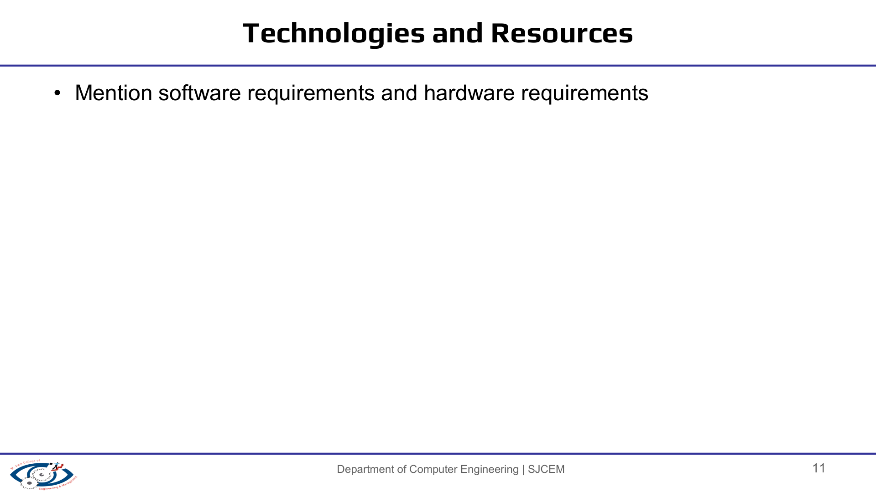
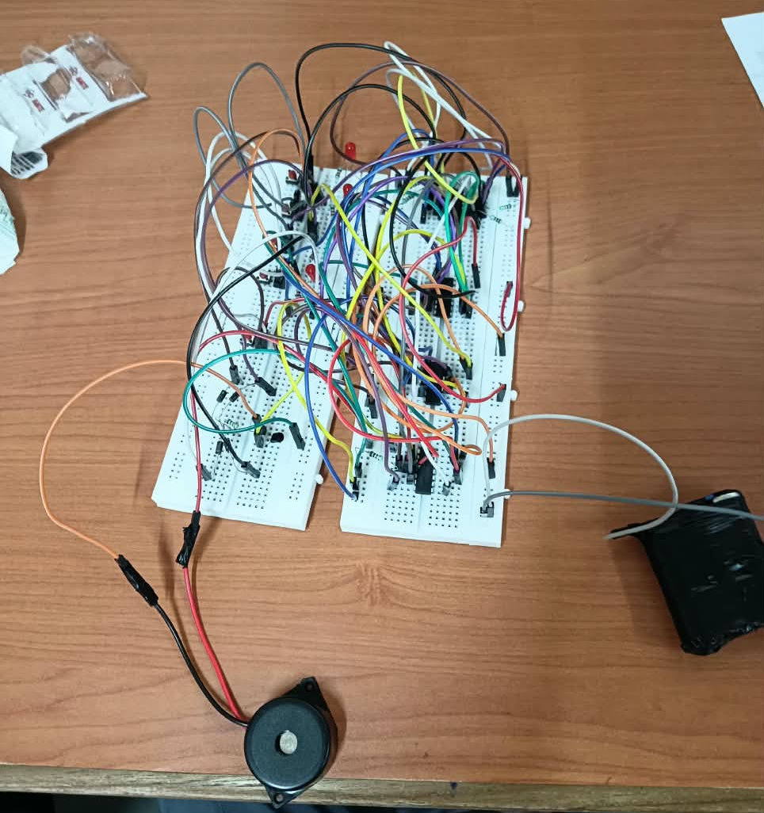
LOGIC ICs
INPUT / OUTPUT
SUPPORT COMPONENTS
2 × SN74HC08N — quad 2-input AND gates
2 × CD4013BD — dual D-type flip-flops
4 × player push buttons
1 × admin/reset button
4 × red LEDs
1 × buzzer
1 × NPN transistor
5 × 1 kΩ resistors
4 × 220 Ω resistors
1 × 10 kΩ resistor
4 × 1N4007 diodes
HARDWARE
SOFTWARE
Breadboards • jumper wires • low-voltage DC supply / battery source • connecting hardware
No software or microcontroller firmware. The logic is implemented directly in hardware.
Breadboard prototype

Slide 12
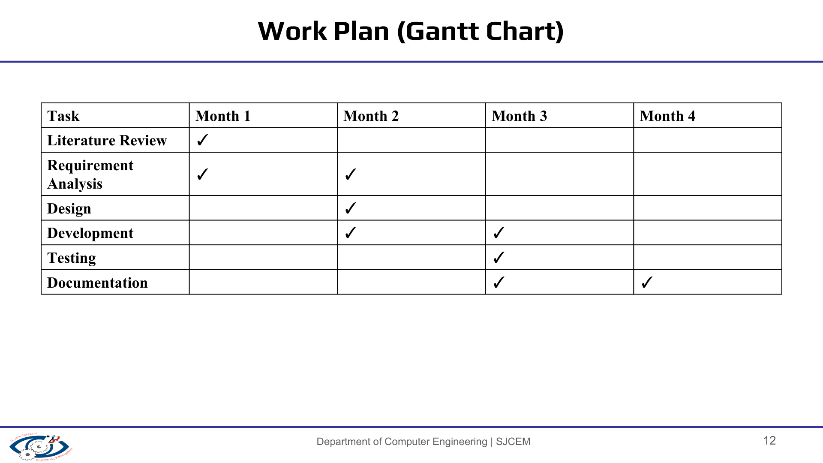
Activity
Month 1
Month 2
Month 3
Month 4
Topic selection & requirement analysis
Circuit study / component identification
Breadboard implementation
Power + input/output testing
Lock/reset verification & debugging
Documentation / PPT / final demonstration
Planned work sequence; update month labels if your actual project schedule differs.

Slide 13
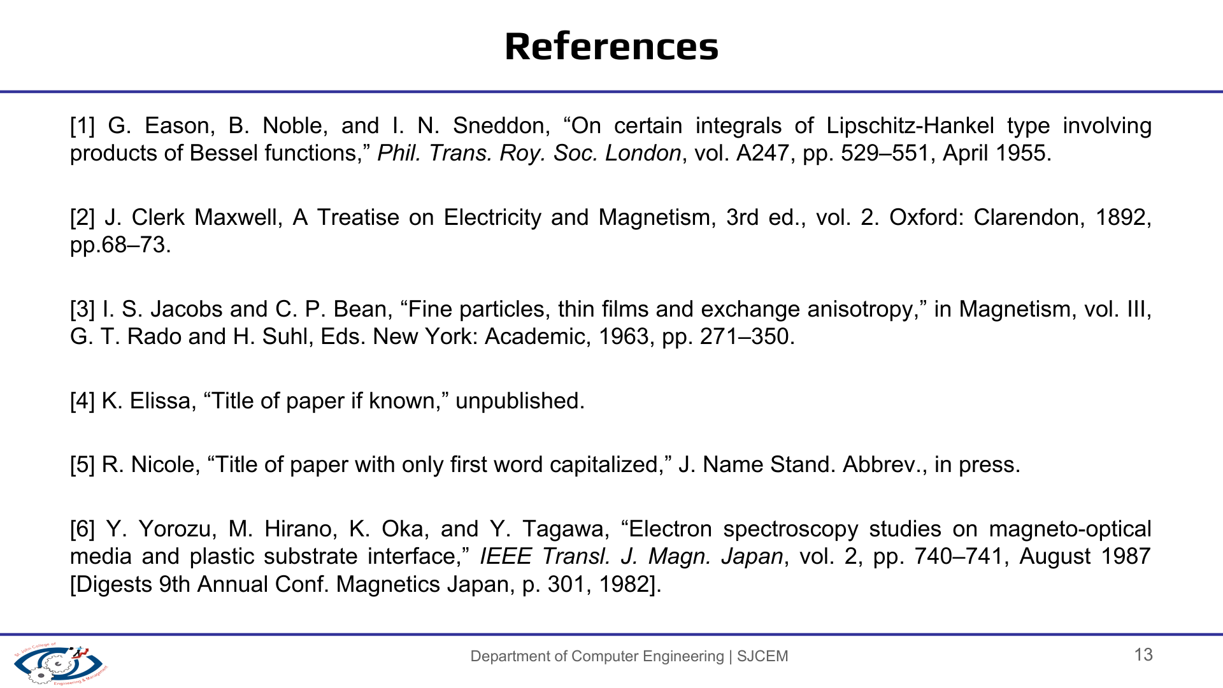
1. Texas Instruments, “SN74HC08 Quadruple 2-Input AND Gates,” product/data-sheet documentation.
2. Texas Instruments, “CD4013B CMOS Dual D-Type Flip-Flop,” product/data-sheet documentation.
3. Sundaresan, Y. B. & Perumal, K., “A Comparative Analysis of Low Cost Solutions for Quiz Controller and Classroom Access Control Systems,” 2016.
4. Havizul & Zulkarnain, “Quiz Bell Design Using NodeMCU ESP8266 for Quiz Contest at IAIN Pontianak,” Jurnal Edukasi Elektro, 2023.
5. Yan, S. & Xu, D., “Portable Buzzer Circuit Design for Reform of Electronic Technology Experiments,” Frontiers in Computing and Intelligent Systems, 2024.
6. Konade, S. B. et al., “Digital Quiz Buzzer System Using Microcontroller,” IJRASET, 2026.
7. Project circuit reference / schematic used during prototype study.
Technical references:
ti.com/product/SN74HC08 • ti.com/product/CD4013B

Slide 14

THANK YOU
Quiz Buzzer System
A hardware-only first-response detection prototype

Slide 15
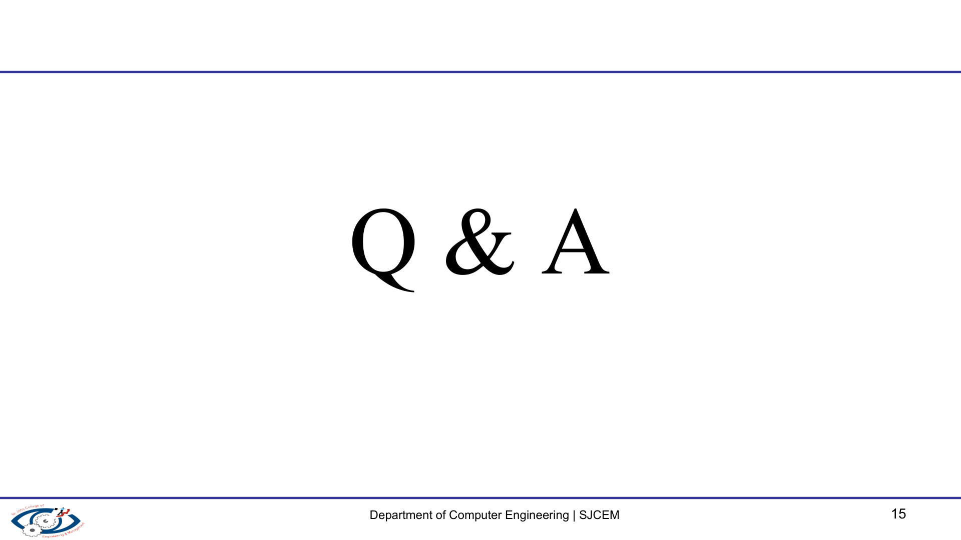
Q & A
Quiz Buzzer System
Key concepts: AND-gate logic • D flip-flop memory • first-press latching • reset

