Slide 1

RO-Crate Schema Plus: Schematized Exchange Profile
Andreas Meier
Juan Fuentes

Slide 2
Background
Interoperability projects in the ETH domain
Deals with ELNs, LIMSs, data repositories and analysis software
Objects graphs are of particular interest
Object graph: linking of metadata entities to other metadata entites and datasets, keeping context intact

Slide 3
Goals
One common, machine-to-machine interchange format containing:
Metadata
Schema describing the metadata
Onotological annotations
Bundled ontologies to guard against link rot

Slide 4

Number of integrations – Problem
Exchanging metadata with RO-Crate often uses different exchange formats leadings to repeated integrations: 3 systems → 6 integrations, 4 systems →12 integrations, 5 systems →20 integrations
Growth n^2-n ?

Slide 5
Number of integrations – Idea
Common metadata exchange format though the use of RO-Crate.

Slide 6
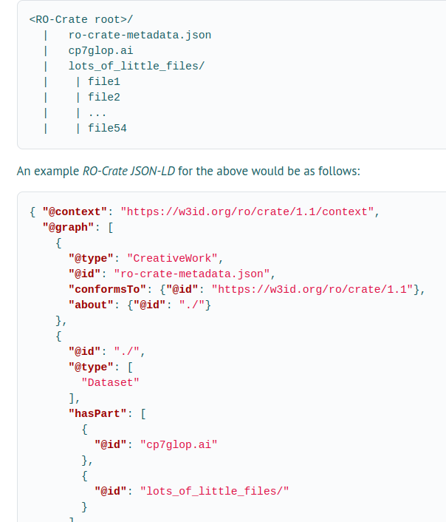
What is RO-Crate?
What is RO-Crate?
What is RO-Crate?
Research Object Crate
A zip/directory with metadata and research data
Manifest with JSON-LD (graph format)
Prefers schema.org types
Otherwise freeform
https://www.researchobject.org/ro-crate/specification/1.1/data-entities

Slide 7
Why use RO-Crate?
Research Object Crate is a common format
It’s gaining traction
Community extensions (profiles) are possible

Slide 8
Limitations: Extending RO-Crate for interoperability
RO-Crate cannot ship customx schemas for metadata
No standard to ship metadata with schemas
No official libraries with support for this
But RO-Crate allows the definition of profiles: Conventions used in a subset of RO-Crates
Our work aims to provide a profile and software libraries to handle this use case

Slide 9
How do we express schemas and ontologies?
We build on RDF (Resource Description Framework) technologies
RDF can be expressed as JSON-LD
Concretely:
RDFS (RDF Schema) for describing the schema
OWL (Web Ontology Language) for annotating types and properties
OWL for expressing cardinality information
Our work aims to provide a profile and software libraries to handle this use case

Slide 10
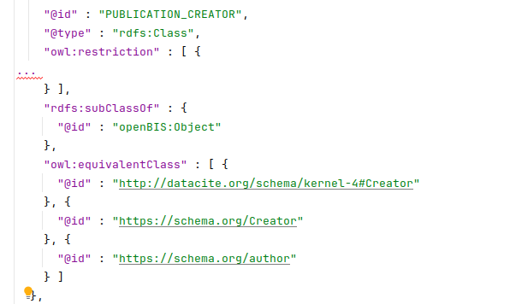
How do we express schemas and ontologies? - Example
RDFS Classes and RDFS Properties for expressing tabular data
OWL Annotation on these to express ontological annotation
Type
 | Property Type A | Property Type B | Property Type C
ENTRY A
ENTRY B
ENTRY C

Slide 11
Where can you find our work? - Libraries
We have a website: https://researchobjectschema.github.io/ro-crate-schema-web/
Here you can find links to the specifications and implementations of libraries
So far, there is a Java library available as a preview
Python and JavaScript libraries are planned
Notes:
Paste link in chat!

Slide 12
The profile in use: openBIS RO-Crate API
openBIS is offering an RO-Crate API that handles RO-Crates following our schema
- export of RO-Crate
- validation of RO-Crate internals
- import of RO-Crate
This is currently in development for interoperability with various ETH Domain projects, most strongly PSI’s SciCat and SciLog

Slide 13
Upcoming Features
We are investigating other formats, most notably CSVW
Support for indicating datasets in the schema and library
Additional tooling, e.g. a SHACL validation for the profile

Slide 14
Questions

