Slide 1
Noise deep-dive
Lorenzo Rossi, Crittografia Applicata, 2023

Slide 2
What is Noise
Noise is a framework for cryptographic protocols based on Diffie Hellman.
You can build your own protocol within Noise limits, the resulting protocol will have a proof of security against certain attacks, along with a formal proof model.
Used by: Whatsapp (Noise Pipe), WireGuard (IK), I2P, Lightning

Slide 3



System Model
Each endpoint has:
static key
ephemeral key
We want to create a secure connection between Alice and Bob.
Maybe we need to:
Exchange keys on the go
We already have the server key and we need to perform authentication
We need to encode data securely for an offline protocol
Build your own!
Static
Ephemeral

Slide 4

System Model
Security guarantees:
Confidentiality
Authenticity
Deniability
Forward Secrecy
Identity Hiding
Each model has its own set of guarantees!

Slide 5

General Idea
Elliptic Curve
AEAD
Hash
Pattern
Noise protocol:
Noise Pattern
Elliptic Curve: Curve(25519|448)
AEAD: AES-GCM | ChaChaPoly
Hash: SHA(256|512) | Blake2(s|b)
Noise Protocol

Slide 6
General Idea
Study general patterns, without specifying
details.
Elliptic curves, AEAD and Hashes are interchangeable.
Security implications of patterns will hold with every implementation if the primitives hold some security guarantees.
Noise_XX_25519_AESGCM_SHA256
Pattern
XX:
-> e
<- e, ee, s, es
-> s, se
Noise_XX_448_ChaChaPoly_BLAKE2b

Slide 7
Pattern
Operations to perform during the handshake state, executed as a Turing Machine.
Payload might be sent after each Handshake pattern, but it might have inferior security guarantees if the handshake is not complete.
XX:
-> e
<- e, ee, s, es
-> s, se
[extra] there is also support for one-way handshake patterns!

Slide 8

Encryption
Data Received
Data Sent
Every party has:
h: a value that hashes all data sent and received
ck: chaining key, used for encryption
h is like a continuous finished in TLS, it ensures that no MitM attack is taking place.
HASH
ciphertext = AEAD(key, nonce, plaintext, ad=h)
the chaining key performs a similar function with key material
(DH outputs, and information shared between parties outside of the protocol)

Slide 9
Pattern Tokens
Each token performs a computation as a Turing machine.
e | s -> Writes or receives a DH public key (static of ephemeral)
ee | es | se | ss -> Performs a DH exchange and
appends the result to the chaining key,
deriving a new encryption key.
psk -> a pre-shared symmetric key is added to the hash and
chaining key, deriving a new encryption key.
XX:
-> e
<- e, ee, s, es
-> s, se
e
s
ee
e
s
se
es
ss
Alice
Bob

Slide 10
Example: XX Pattern
XX:
-> e
Alice:
- send ephemeral
Bob:
- send ephemeral
- compute DH (ephem ephem)
- send static
- compute DH (ephem static)
Alice:
- send static
- compute DH (static ephem)
<- e, ee, s, es
<- From here, messages are encrypted!
<- New DH added to old key
-> s, se

Slide 11
Pattern names
Pattern names (XX, IK, NK…) are not random.
The first letter represents Alice’s key, the second Bob’s key.
N = No static key
K = Static key already known (before the protocol begins)
X = Static key transmitted
I = Static key immediately transmitted (only for initiator)

Slide 12
Example: IK Pattern
IK:
<- s
…
Things known before the protocol is executed
(Bob’s static key)
Alice:
- send ephemeral
- compute DH (ephem static)
- send static
- compute DH (static static)
Bob:
- send ephemeral
- compute DH (ephem ephem + static ephem)
Messages before “…” (pre-messages)
represent data already transmitted before the protocol is executed
-> e, es, s, ss
<- Using static key known in advance
<- After this, payload is already
encrypted, this means 0RTT!
-> e, ee, se
Last message is to remove Replay and KCI attacks [extra]!

Slide 13
The Pre-shared Symmetric Keys (PSK) modifier
If both parties have a high-entropy shared symmetric key, it can be mixed into the encryption key (even when payload had previously no encryption).
When a psk token is processed, the symmetric key is mixed with both hash and key, to prevent key-reuse, the ephemeral key is also mixed in the key, randomizing it.
KN:
-> s
…
-> e
<- e, ee, se
KNpsk0:
-> s
…
-> psk, e
<- e, ee, se
The number after “psk” in the modifier name indicates the position in the pattern.
+ psk

Slide 14
Compound protocols
Until now, Noise protocols have exactly 0 branching points!
Each pattern is executed from the beginning to the end.
But what if we want some more complex scenario?
Ex:
1. Alice communicates with Bob using XX, saves the key
2. Alice creates a 0RTT IK connection with Bob (using saved key)
3. Alice sends another 0RTT connection but Bob has changed static key.
(how?? fallback to XX)
??3 different protocols??

Slide 15
Compound protocols
Only one protocol switch point allowed at the beginning of the protocol.
Alice (the initiator) sends what protocol it wants to execute in the first packet, Bob uses the same protocol for the rest of the communication.
Much less powerful than a TLS negotiation, smaller attack surface
👩🏻
👨🏻
👩🏻
IK
XX

Slide 16
Compound protocol - Rollback attack
An active attacker can modify negotiation data to perform a Rollback attack.
This is preventable by using the Prologue field of a Noise connection, every data in the prologue will be mixed in the hash data, if a mismatch between prologues is detected the decryption will fail (remember, the hash is used as ad in AEAD).
👩🏻
😈
👨🏻
v2
v1
v1
v1

Slide 17
Noise Pipe
A Noise Pipe (Noise Spec 10.4) is a compound protocol that supports a full handshake (XX) or a 0RTT handshake (IK) with a fallback plan.
XX:
-> e
<- e, ee, s, es
-> s, se
IK:
<- s
…
-> e, es, s, ss
<- e, ee, ss
XXfallback:
-> e
…
<- e, ee, s, es
-> s, se
Bob initiated!
But we leak what handshake we are using by side-channel discriminants
(message size and number of packets exchanged)

Slide 18
Noise Pipe with Handshake Indistinguishability
To make the chosen handshake indistinguishable from each other we can pad the data sent to a fixed length.
Scenarios:
IK: same as random-padded IK
XX: alice sends e padded with random bytes, Bob fails to decode IK and switches to XXfallback
Failed IK: Bob fails to decode the (real) IK, switches to XXfallback
IK:
<- s
…
-> e, es, s, ss
<- e, ee, ss
XXfallback:
-> e
…
<- e, ee, s, es
-> s, se
This works because the first packet always contains an unencrypted ephemeral key but an attacker could use this to check whether this is a Noise communication.

Slide 19
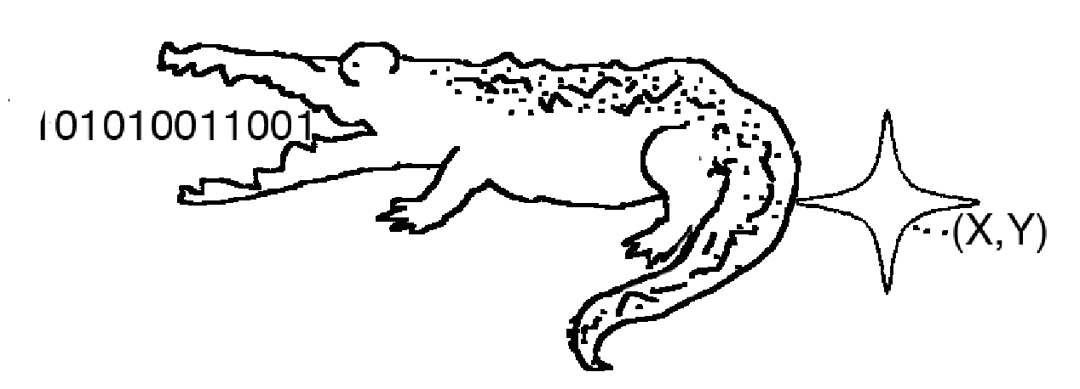
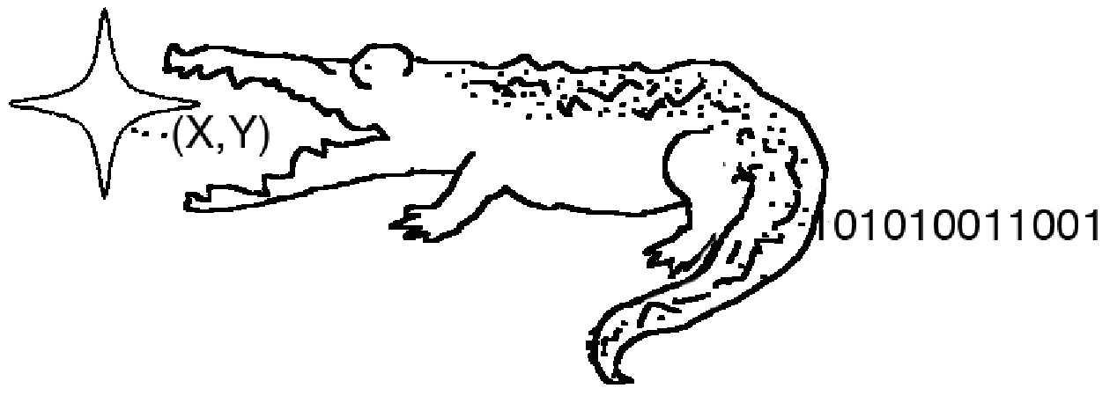
Elligator¹
Problem: every Noise protocol begins by sending an ephemeral Elliptic Curve key.
Encoded EC keys are easy to detect (they have special mathematical properties).
Elligator is a way to hide Elliptic Curve points as random noise, so that any key exchange will be indistinguishable from random data.
The inverse (hash to curve) is frequently used in aPAKE protocols.
Hash to curve
Curve to Hash
(Remember OPAQUE?)
1: Bernstein, Daniel J., et al. "Elligator: elliptic-curve points indistinguishable from uniform random strings." Proceedings of the 2013 ACM SIGSAC conference on Computer & communications security. 2013.

Slide 20

My Demo - noisy-chan
Proof of Concept of Elligator-encoded Noise Pipe.
Every message is random-padded to a fixed length (51`2 bytes)
The two endpoints execute either an XX or IK protocol, when possible with 0RTT support.
Thanks to Elligator the protocol is safe from deep packet inspection firewalls!
DEMO TIME!
https://github.com/SnowyCoder/noisy-chan

Slide 21
Rest of the journey
What is missing:
KCI attacks
Channel binding
Rekey
More details about Noise state machine
Payload security properties
Identity Hiding
Deferred patterns
…
Now you already know a good chunk of Noise, check the specification for the rest, it’s easily readable
Ask me! (be warned, more slides incoming)
Lorenzo Rossi

Slide 22
Additional points of interest
Interesting points found during research that need further reading:
I2C has Deep Packet Inspection resistance without Elligator (pros/cons?)
Whatsapp uses both Noise (client to server) and Signal (end to end) protocols (major differences btw Noise and Signal? can Noise be adapted to reach Signal use-cases?)

Slide 23
[EXTRA] Why not TLS?
Noise is more lightweight and has a smaller attack surface, it is better suited where there is no need for x509 certificates and the application can control both endpoints.
Noise is also much easier to study and implement given that the complete TLS1.3 specification is almost 3x larger than Noise.
TLS1.3 has features that are not yet in Noise (Post-quantum resistance as an example).

Slide 24
[EXTRA] Channel binding
Every data sent and received is hashed in a custom “h” field.
At the end of the Handshake, “h” can be used as a session identifier for a Channel Binding procedure.
Any attempt to tamper with any part of the protocol will result in different a different hash since “h” summarizes all bytes in the communication
Inbound Cipher
Noise Handshake
Outbound Cipher
“h” (session id)

Slide 25
[EXTRA] Rekey
To have forward-secrecy after the Noise handshake, the user can call Rekey() on the Cipher. The function rotates the key with a one-way function.
Why? To have forward-secrecy, if someone steals k at moment t, it cannot decode messages before the last Rekeying.
This method does NOT handle post-compromise security, similarly to Signal Symmetric Ratchet. Cryptographic context is very different between Noise and Signal, no post-compromise security is required since connections are short-lived. Noise ciphers have a hard limit of 2**56 bytes, after that another handshake is required.
Rekey():
k := KDF(k)

Slide 26
[EXTRA] Key Compromise Impersonation (KCI) Attacks
Scenario:
We have Bob’s static key (sb), what can we do?
We can impersonate Bob to any Alice, by sending Sb as public key and using sb to perform DH handshakes.
Can we do other attacks?
Can we impersonate Alice to Bob?
👩🏻
👨🏻
😈
?

Slide 27
[EXTRA] Key Compromise Impersonation (KCI) Attacks
Alice - Bob DH(ss)
-> Sa
<- Sb
K = DH(sa, Sb) = DH(Sa, sb)
👩🏻
👨🏻
Alice sends public to Bob
Bob sends public to Alice
😈
✅
Eve does not have sa, but they have sb and Sa!
Eve can fake a DH exchange between Bob and any other party with a known public key, without knowing their private key!

Slide 28

[EXTRA] Key Compromise Impersonation (KCI) Defense
When can we make a KCI attack?
When we perform DH with Bob’s private key and any other key.
So we can prevent the attack by also using an ephemeral key for DH
Eve cannot perform a DH exchange between Alice’s static and Bob’s ephemeral!
Any “se” Noise exchange will protect Bob from KCI.
👩🏻
👨🏻
👿
❌

