Slide 2
Full Name
/*
*
*
* Bild
*
*
*
*/
Goals:
.
.
.
.
Frustrations:
.
.
.
.
Motivations
Incentive
Fear
Achievement
Power
Social
//Quote
Personality:
Bio:
.
.
.

Slide 3
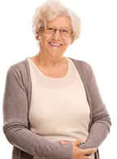
Anna Grey, 67
Goals:
Learning about different cultures
Making new friends
Learning new languages
Comfortable traveling
Frustrations:
Being bored
People who aren‘t open-minded
Politics
Motivations
Adventures
Fear
Achievement
Power
Social
„Life is too short to stay at home“
Personality:
Kind
Loves animals
Adventurous
Bio:
Her husband passed away nine years ago. Since then she travels around the world to make new friends and discovers the beauty of different cultures.

Slide 4
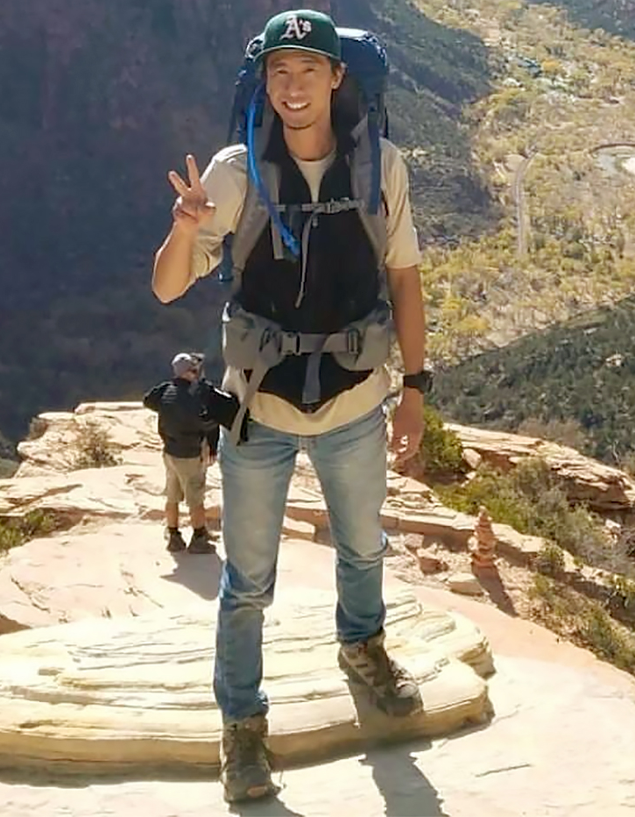
Jason Huang, 23
Goals:
Learning about different cultures
Meeting new people
(Hitch-)hiking
Going on adventures
Frustrations:
Society
Suppression
War
Motivations
Adventures
Fear
Achievement
Power
Social
„In every walk with nature, one receives far more than he seeks.”
Bio:
After he graduated from Highschool he decided to explore nature and the most beatiful places Earth has to offer.
Personality:
Spontanious
Happy

Slide 5
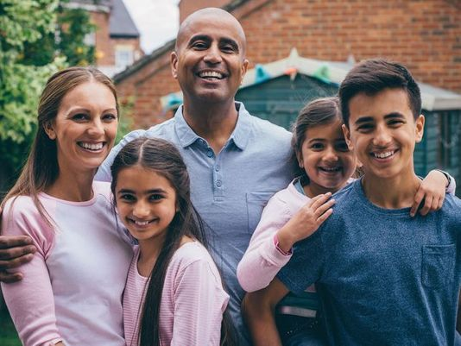
Family Skelter, 50/48/14/10/6
Goals:
Relaxing holiday
Not worrying about anything during holiday
Frustrations:
Delayed flights
Overpriced hotels
Motivations
Adventures
Fear
Achievement
Power
Social
„The most important thing in the world is family and love”
Family Members:
Mother: Sharon, 48
Father: John, 50
Son: Sasha, 14
Daughter: Fabia, 10
Daughter: Sansa, 6
Bio:
A typical family that usually spends their holiday with one week trips to relax and take some time off. From time to time they also plan road trips.

