Slide 1
Waveform Optimisation for Information and Power Transfer
Waveform Optimisation for Information and Power Transfer
15 Feb. 19
The Nonlinear Harvester Model and Rate-Energy Tradeoff
Yang Zhao (yang.zhao18@imperial.ac.uk)

Slide 2

Wireless Information and Power Transfer (WIPT)
Waveform Optimisation for Information and Power Transfer
15 Feb. 19
Topics
Energy harvest models (linear, nonlinear)
Rate-energy (R-E) region characterisation
Transmitter and receiver architecture
Waveform design
Modulation
Beamforming and input distribution
Resource allocation
RF spectrum use
“A WIPT system should therefore be designed such that the RF radiation and the RF spectrum are exploited in the most efﬁcient manner to deliver both information and energy.”
Clerckx, Bruno, et al. "Fundamentals of wireless information and power transfer: From RF energy harvester models to signal and system designs." IEEE Journal on Selected Areas in Communications 37.1 (2019): 4-33.
Figure 1. IoT connection. Adapted from IoT Services and Solutions provider for Business, by Credencys Solutions Inc., 2019, retrieved from https://www.credencys.com/iot-solutions/. Copyright by Credencys Solutions Inc.

Slide 3
Waveform Optimisation
Waveform Optimisation for Information and Power Transfer
15 Feb. 19
Why?
Where?
To enlarge the R-E region
To improve spectrum and power efficiency
To support numerous low-power devices
To boost the revolution in IoT
Channel (adaptive signal based on CSIT to enhance rate)
Receiver (suitable waveform favoured by rectenna to maximise energy)
What?
How?
Identify the fundamental tradeoff between information and power transfer
Evaluate linear and nonlinear harvest models
Investigate beamforming, power allocation, waveform, modulation, and input distribution
Formulate the optimisation problem as an energy maximisation problem subject to transmit power and rate constraints
Superpose a deterministic power waveform to a communication waveform (no interference)

Slide 4
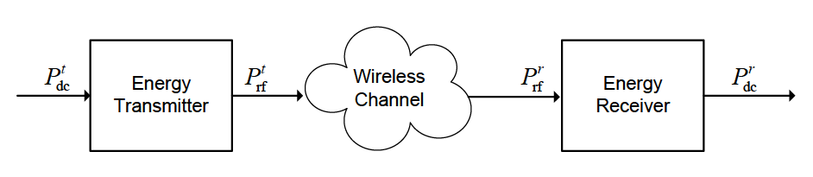
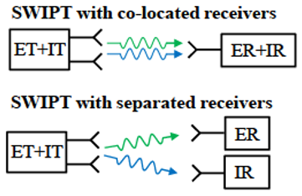
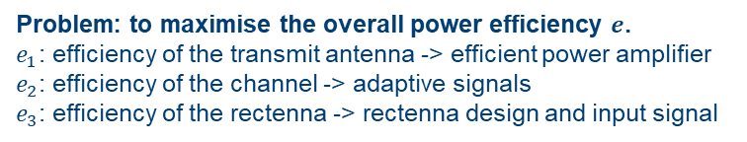

SWIPT Architecture
Waveform Optimisation for Information and Power Transfer
15 Feb. 19
Blocks of WIPT system
$e=\frac{P_{dc}^{r}}{P_{dc}^{t}}=\frac{P_{rf}^{t}}{P_{dc}^{t}}$ $\frac{P_{rf}^{r}}{P_{rf}^{t}}$ $\frac{P_{dc}^{r}}{P_{rf}^{r}}=e_{1}e_{2}e_{3}$
Problem: to maximise the overall power efficiency $e$.
$e_{1}$: efficiency of the transmit antenna -> efficient power amplifier
$e_{2}$: efficiency of the channel -> adaptive signals
$e_{3}$: efficiency of the rectenna -> rectenna design and input signal
Simultaneous WIPT
Diode linear model: $e_{1}$ and $e_{3}$ are independent of input signal power and shape (optimise $e_{1}$, $e_{2}$, $e_{3}$separately)
Diode nonlinear model: $e_{1}$, $e_{2}$, $e_{3}$ are coupled, $e_{3}$ is a nonlinear function of the input signal (jointly optimise $e_{2}e_{3}$)
Clerckx, Bruno, et al. "Fundamentals of wireless information and power transfer: From RF energy harvester models to signal and system designs." IEEE Journal on Selected Areas in Communications 37.1 (2019): 4-33.

Slide 5
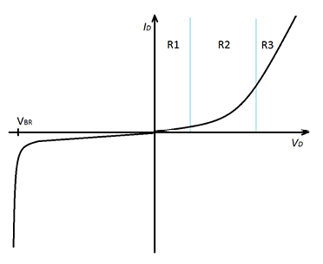
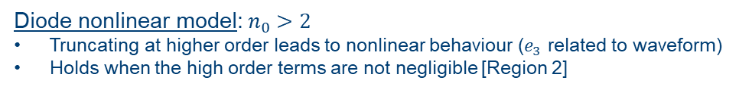
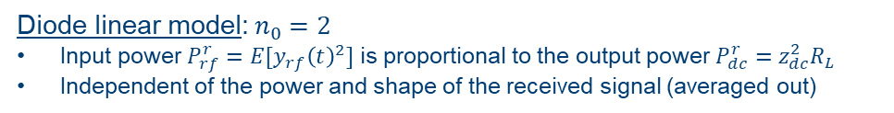
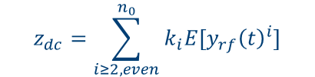


Diode Nonlinearity, Harvester Models and Efficiency
Waveform Optimisation for Information and Power Transfer
15 Feb. 19
R1: region of diode linear model
R2: region of diode nonlinear model
Diode DC current (determines output power):
$$z_{dc}=\sum_{i≥2, even}^{n_{0}}{k_{i}E[{y_{rf}\left(t\right)}^{i}]}$$
Diode linear model:${ n}_{0} =2$
Input power $P_{rf}^{r}=E[{y_{rf}\left(t\right)}^{2}]$ is proportional to the output power $P_{dc}^{r}=z_{dc}^{2}R_{L}$
Independent of the power and shape of the received signal (averaged out)
Diode nonlinear model:${ n}_{0} >2$
Truncating at higher order leads to nonlinear behaviour ($e_{3}$ related to waveform)
Holds when the high order terms are not negligible [Region 2]
Diode characteristics
Clerckx, Bruno, et al. "Fundamentals of wireless information and power transfer: From RF energy harvester models to signal and system designs." IEEE Journal on Selected Areas in Communications 37.1 (2019): 4-33.
Diode current and DC current:
$$i_{d}\left(t\right)=\sum_{i=0}^{∞}{k_{i}^{′}R_{ant}^{\frac{i}{2}}y_{rf}{(t)}^{i}}$$
$$i_{out}=E\left[i_{d}\left(t\right)\right]$$

Slide 6
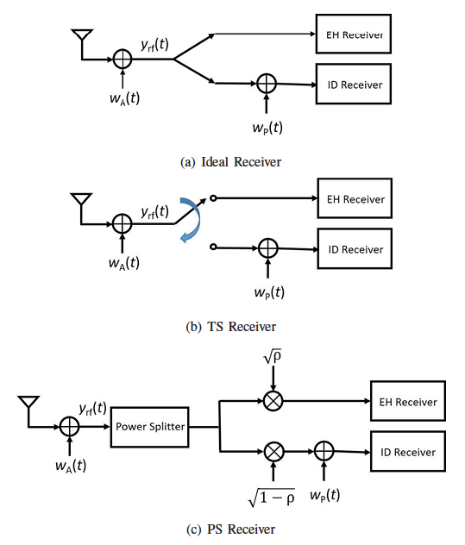
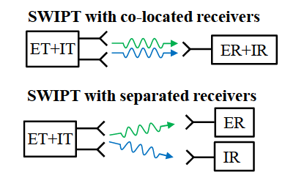
Waveform Optimisation for Information and Power Transfer
15 Feb. 19
EH: energy harvester
ID: information decoder
Fig. 1 Architectures of Simultaneous WIPT [1]

Slide 8
Waveform Optimisation for Information and Power Transfer
15 Feb. 19

Slide 9
Waveform Optimisation for Information and Power Transfer
15 Feb. 19

