Slide 1


Why are you here?
Allan Deyoung
New job with new processes
Build confidence
Baseline skills
Contribute quickly
@
CONTOSO

Slide 2




Path
What are these new tools?
How can you get started?
How can you use this? (Demo)
What else can you do? (Demo)

Slide 3


What are these new tools?
Interactive Computing Ecosystem
Notebook Format
Client (.ipynb)
Interactive Protocol
(ZeroMQ)
Kernels
Server (Python, C#, PS, etc…)
Notes:
https://jupyter.org/#:~:text=Open%20Standards%20for%20Interactive%20Computing
https://github.com/jupyter/jupyter/wiki/Jupyter-kernels

Slide 4

What are these new tools?
Interactive Computing Ecosystem
Notebook Format
Client (.ipynb)
Interactive Protocol
(ZeroMQ)
Kernels
Server (Python, C#, PS, etc…)
.NET Interactive (Kernels)
C#
NuGet
Kusto & SQL
PowerShell
F#
Notes:
https://github.com/dotnet/interactive
https://github.com/dotnet/interactive/blob/main/docs/kernels-overview.md
https://github.com/dotnet/interactive/blob/main/docs/working-with-data.md
https://github.com/dotnet/interactive/blob/main/docs/nuget-overview.md

Slide 5


What are these new tools?
Interactive Computing Ecosystem
Notebook Format
Client (.ipynb)
Interactive Protocol
(ZeroMQ)
Kernels
Server (Python, C#, PS, etc…)
.NET Interactive (Kernels)
C#
NuGet
Kusto & SQL
PowerShell
F#
Polyglot Notebooks Extension
Familiar Visual Studio Code Experience
Rich Notebook Authoring
Use Kernels Locally
Notes:
https://devblogs.microsoft.com/dotnet/dotnet-interactive-notebooks-is-now-polyglot-notebooks/
https://marketplace.visualstudio.com/items?itemName=ms-dotnettools.dotnet-interactive-vscode

Slide 6


Path
What are these new tools?
How can you get started?
How can you use this? (Demo)
What else can you do? (Demo)

Slide 7



How can you get started?
Windows
Mac
Linux
Install Visual Studio Code
winget install `
--id Microsoft.VisualStudioCode
https://code.visualstudio.com/download

Slide 8
How can you get started?
Windows
Mac
Linux
Install Visual Studio Code
winget install `
--id Microsoft.VisualStudioCode
https://code.visualstudio.com/download
Install .NET SDK
Category description
winget install `
--id Microsoft.DotNet.SDK.7 `
--log C:\temp\temp.log
https://dotnet.microsoft.com/download

Slide 9

How can you get started?
Windows
Mac
Linux
Install Visual Studio Code
winget install `
--id Microsoft.VisualStudioCode
https://code.visualstudio.com/download
Install .NET SDK
Category description
winget install `
--id Microsoft.DotNet.SDK.7 `
--log C:\temp\temp.log
https://dotnet.microsoft.com/download
Install PowerShell Core
Category description
winget install `
--id Microsoft.PowerShell
https://github.com/PowerShell/PowerShell

Slide 10
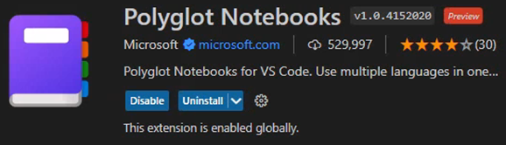
How can you get started?
Windows
Mac
Linux
Install Visual Studio Code
winget install `
--id Microsoft.VisualStudioCode
https://code.visualstudio.com/download
Install .NET SDK
Category description
winget install `
--id Microsoft.DotNet.SDK.7 `
--log C:\temp\temp.log
https://dotnet.microsoft.com/download
Install PowerShell Core
Category description
winget install `
--id Microsoft.PowerShell
https://github.com/PowerShell/PowerShell
Install Polyglot Notebooks
Visual Studio Code Extension
https://marketplace.visualstudio.com/items?itemName=ms-dotnettools.dotnet-interactive-vscode

Slide 11

Path
What are these new tools?
How can you get started?
How can you use this? (Demo)
What else can you do? (Demo)

Slide 12
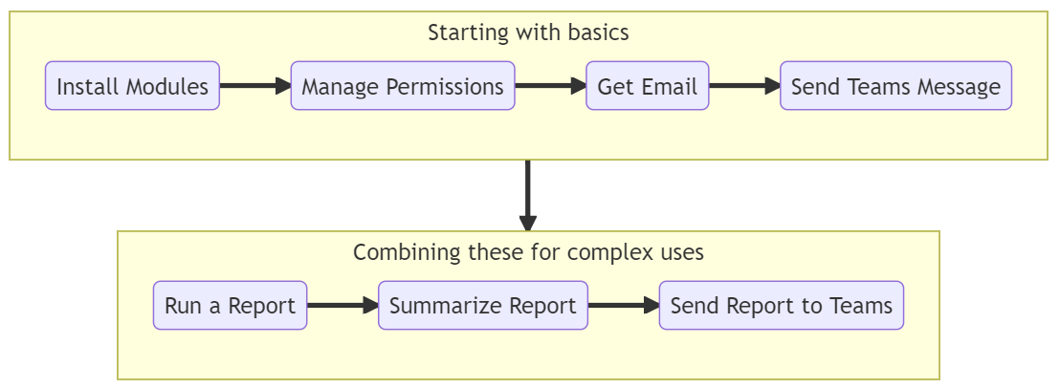
How can you use this?

Slide 13

How can you use this?
https://mermaid.js.org

Slide 14

Path
What are these new tools?
How can you get started?
How can you use this? (Demo)
What else can you do? (Demo)

Slide 15

What else can you do?
Allan’s Experience
New job with new processes
Build confidence
Baseline skills
Contribute quickly
Notes:
May not have experience with VS Code or even PS for that matter
Python opens up a lot of network automation like RESTCONF too
Writing documentation sucks though, so just ask ChatGPT to do it and format it in MD

Slide 16
What else can you do?
Allan’s Experience
New job with new processes
Build confidence
Baseline skills
Contribute quickly
Contoso’s Experience
Accessible by Multiple Users
Secure with Single Sign-On
Centralized Management
Consistent & Cost Efficient
Notes:
May not have experience with VS Code or even PS for that matter
Python opens up a lot of network automation like RESTCONF too
Writing documentation sucks though, so just ask ChatGPT to do it and format it in MD

Slide 17

What else can you do?
Allan’s Experience
New job with new processes
Build confidence
Baseline skills
Contribute quickly
Contoso’s Experience
Accessible by Multiple Users
Secure with Single Sign-On
Centralized Management
Consistent & Cost Efficient
Notes:
May not have experience with VS Code or even PS for that matter
Python opens up a lot of network automation like RESTCONF too
Writing documentation sucks though, so just ask ChatGPT to do it and format it in MD

Slide 18

What else can you do?
Allan’s Experience
Next Steps
New job with new processes
Build confidence
Baseline skills
Contribute quickly
Privileged & Remote Access
Contoso’s Experience
Accessible by Multiple Users
Secure with Single Sign-On
Centralized Management
Consistent & Cost Efficient
Notes:
May not have experience with VS Code or even PS for that matter
Python opens up a lot of network automation like RESTCONF too
Writing documentation sucks though, so just ask ChatGPT to do it and format it in MD

Slide 19

What else can you do?
Allan’s Experience
Next Steps
New job with new processes
Build confidence
Baseline skills
Contribute quickly
Privileged & Remote Access
Collaborate Across 70+ Languages
Contoso’s Experience
Accessible by Multiple Users
Secure with Single Sign-On
Centralized Management
Consistent & Cost Efficient
Notes:
May not have experience with VS Code or even PS for that matter
Python opens up a lot of network automation like RESTCONF too
Writing documentation sucks though, so just ask ChatGPT to do it and format it in MD

Slide 20

What else can you do?
Allan’s Experience
Next Steps
New job with new processes
Build confidence
Baseline skills
Contribute quickly
Privileged & Remote Access
Collaborate Across 70+ Languages
Contoso’s Experience
Accessible by Multiple Users
Secure with Single Sign-On
Centralized Management
Consistent & Cost Efficient
Documentation is Time Consuming
Notes:
May not have experience with VS Code or even PS for that matter
Python opens up a lot of network automation like RESTCONF too
Writing documentation sucks though, so just ask ChatGPT to do it and format it in MD

Slide 21








Who is Michael Soule?
Michael Soule
National Director
Sentinel Technologies
misoule@sentinel.com
Migration & Modernization
Identity & Security
Hybrid Cloud
Licensing & Cost Optimization

Slide 22
Additional References
This content | https://github.com/Snozzberries/jupyterDemo
.Net Interactive GitHub Docs | https://github.com/dotnet/interactive/blob/main/docs/NotebookswithJupyter.md
Ideas for the Graph API demo | https://www.youtube.com/watch?v=ib3BrVNQkFM
Good practices for Read, Eval, Print, Loop | https://nbdev.fast.ai/tutorials/best_practices.html
JupyterHub Fargate Spawner | https://github.com/uktrade/fargatespawner
JupyterHub Azure AD Authenticator | https://oauthenticator.readthedocs.io/en/stable/getting-started.html
Mermaid diagrams project | https://mermaid.js.org/
Convert notebooks to other formats | https://nbconvert.readthedocs.io/
Automatic GitHub to Jupyter | https://mybinder.org/
.Net Interactive Magic Commands | https://github.com/dotnet/interactive/blob/main/docs/magic-commands.md
Get Started with PowerShell Notebooks | https://github.com/dfinke/powershell-notebooks
Parameterize and automate Notebooks | https://papermill.readthedocs.io/en/latest/

