Slide 1


Library Book Recommendation
Sarah Miller
University of Missouri Kansas City
04.21.24

Slide 2
Introduction
Uibg are important because they are an effective way to organize data.
03
Book Recommendation System using a User-Item Bipartite Graph (Uibg)
01
Goal: Integrate a User-Interface Bipartite Graph For recommending library books
02

Slide 3
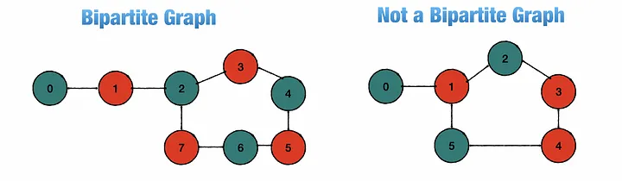
Problem Statement
What is a Bipartite Graph?
Is a set of graph vertices decomposed into two disjoint sets where no graph vertices within the same set are adjacent.
Why is it important?
Understanding Bi-graphs will give us an effective way to organize data on an academic and industry level. Examples: Advertising, Food recommendations etc.…

Slide 4
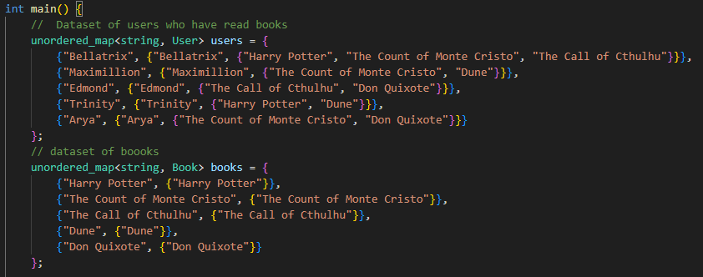
Methodology
I first explored the topic.
I used Stack Overflow and ChatGPT for guidance on my project.
Created two datasets for my library recommendation program: One for users who have borrowed books and the other as a books list.

Slide 5
Data Collection
My source of data were from books I have read and other books that I want to read in the future.
My methods of data collection were choices of books that are popular and recognizable to the mainstream audience.
I had some issues with the coding because I am not fluent in C++.

Slide 6
Implementation
Project was implemented by first understanding what a UIBG is.
Second, selecting what books I want to use as data.
Two datasets for the bi – graph, 1) for users and their reading history, 2) for the selection of novels.

Slide 7


Results
Users and books they have read
Recommendation for Arya
Recommendation for Edmond

Slide 8
Discussion
I am satisfied with the results the user and their books they have read were recommended books they have not read.
I wish I could take this project a step further and allow user input of their name and books that they have read and implement that information into my database, rather than built in users.
I was not able to implement precision, recall, or an F1 – score for the users. Due to a lack of understanding on the subject.

Slide 9
Conclusion
Was able to build a simple program that recommended users a selection of novels they have not read.
Understanding User-Interface-Bipartite-Graphs is an efficient way for advertisers to recommend products to consumers.

Slide 10
Future Work
A great way to enhance this project would be my ability for a stronger understanding of C++.
This topic can be expanded by having the user input their preferences of novels, themes, romances and more, and the bi – graph algorithm can sort through a large database to fit the user’s preferences.

Slide 11
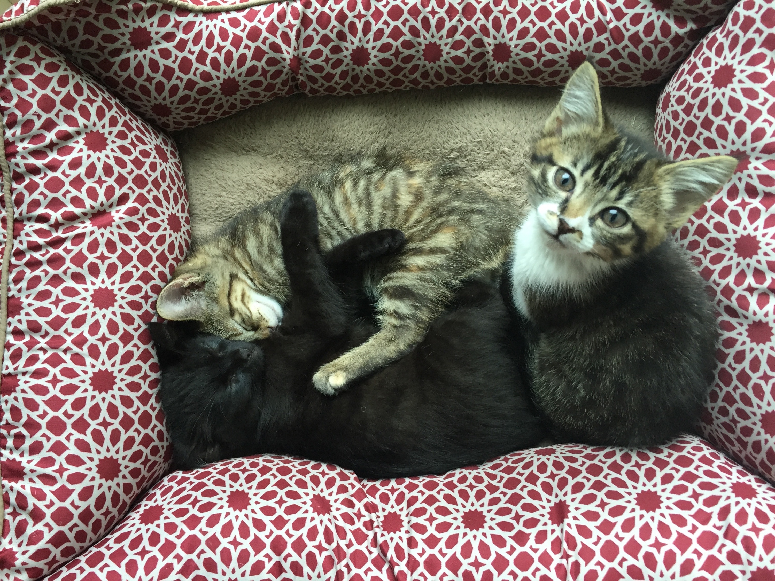
Acknowledgements
Shoutout to my cats for being cute and supportive!

Slide 12
References
https://chat.openai.com/
https://stackoverflow.com/questions/62247407/difficulties-understanding-bipartite-graphs
https://www.youtube.com/watch?v=bZBmN7I7GNQ
https://www.quora.com/What-are-the-practical-uses-of-bipartite-graphs

Slide 13
Thank you!
For giving me the opportunity to show you the topic of UIBG! It is an important subject and I have learned a lot from this mini project!

