Slide 1
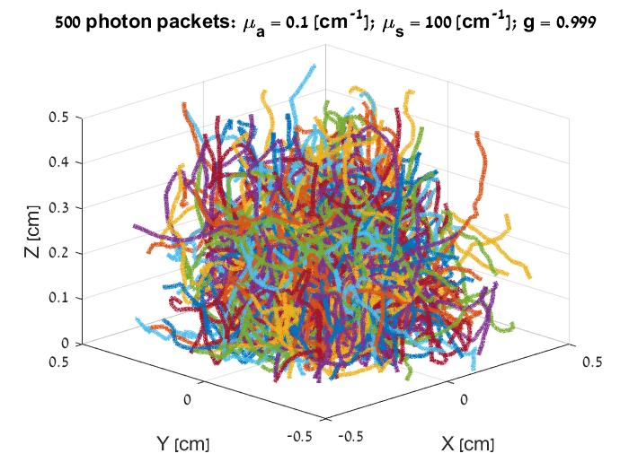

Sara Meir Matan Slook Daniel Dobkin
MCML Simulation

Slide 2
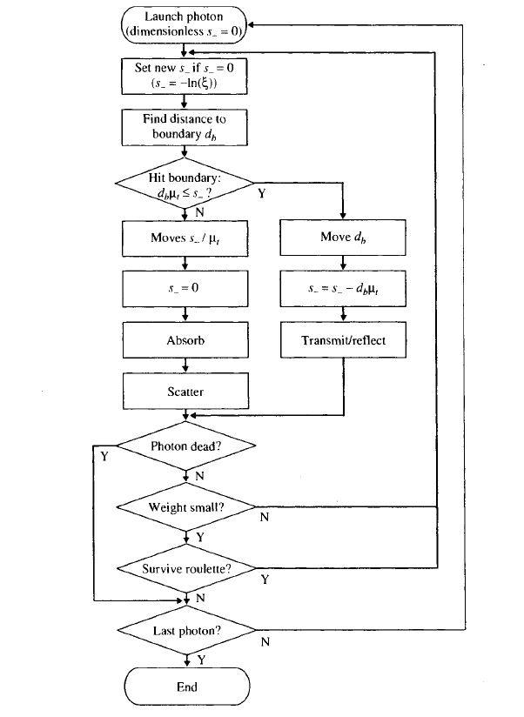
Simulation Algorithm

Slide 3
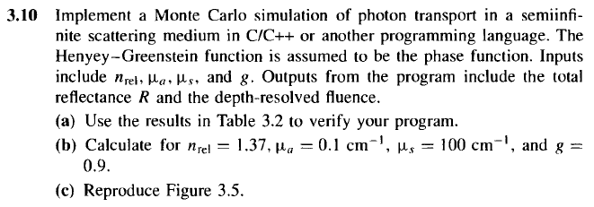
Q3.10

Slide 4
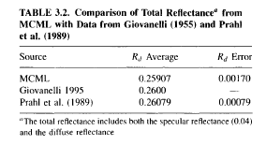
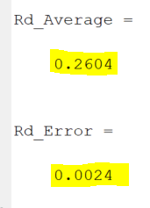
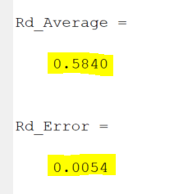
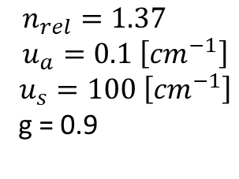

Section a/b: Simulation results comparison
Section a :
Calculated with
Section b :
Calculated with
$$n_{rel}=1.5 \\ u_{a}=10 \left[{cm}^{−1}\right]$$
$$u_{s}=90 \left[{cm}^{−1}\right]$$
g = 0
$$n_{rel}=1.37 \\ u_{a}=0.1 \left[{cm}^{−1}\right]$$
$$u_{s}=100 \left[{cm}^{−1}\right]$$
g = 0.9

Slide 5
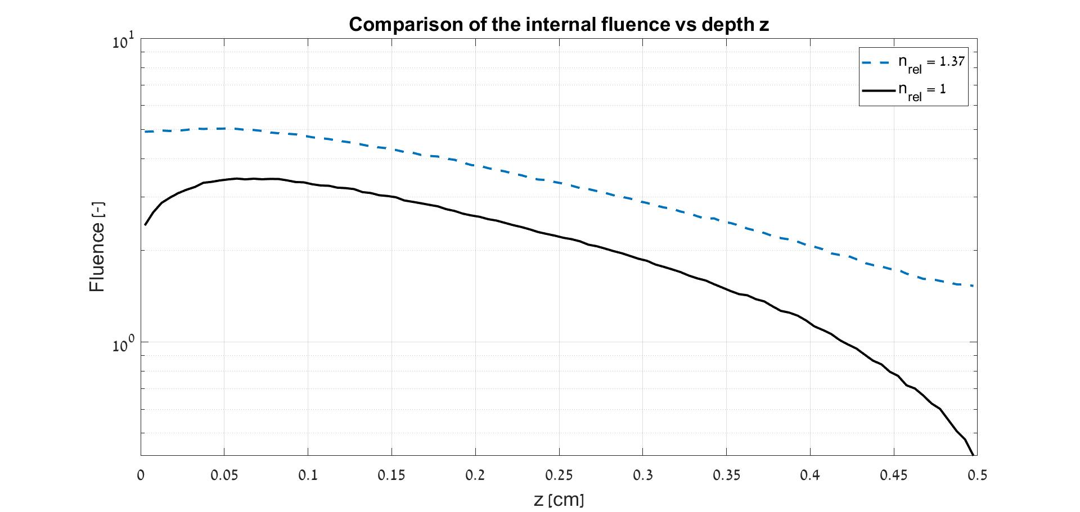
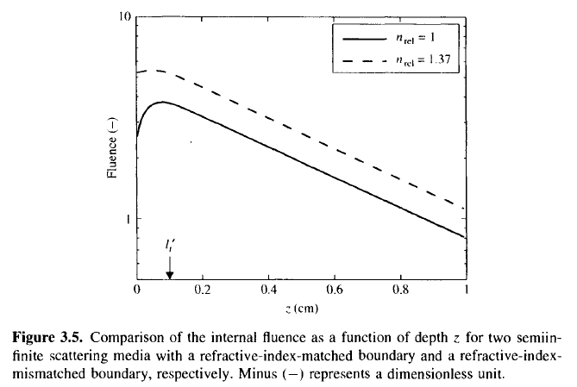
Section c: Internal Fluence Comparison
Comparison done with averaging 10 instances of 5000 Photon packets

Slide 6
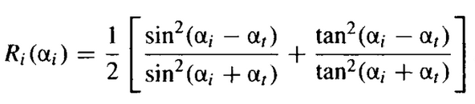



Increased Transmittance for lower $n_{rel}$is due to lower critical angle required to pass the boundary.
Increased Fluence in first $100\left[μm\right]$ is caused due to resonation caused by the biological matter.
Absorption decreases as we get deeper into the layer, due to lower packet weight passing through and packets dying on the way.
For $n_{rel}\text{=}\text{1.37}$, the Fluence is higher due to higher amount of internal reflection as the critical angle extracted from Snell’s law and used in calculating the average reflectance that is compared to a randomly generated number.
$R_{sp}$ is also lower for a higher $n_{rel}$ and thus less weight is lost at the first step.

Slide 7
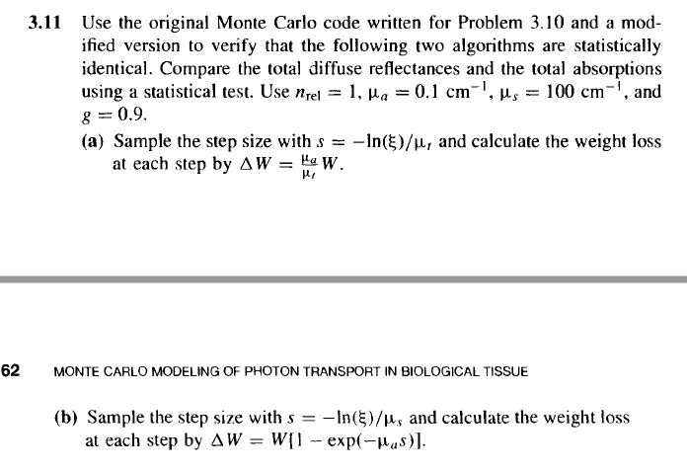
Q3.11

Slide 8
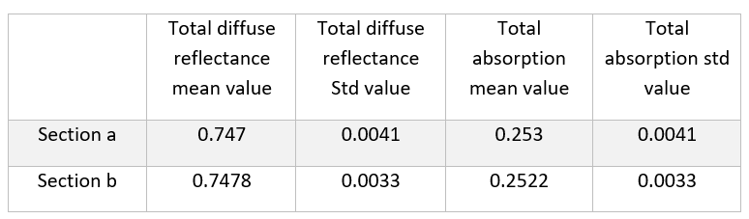
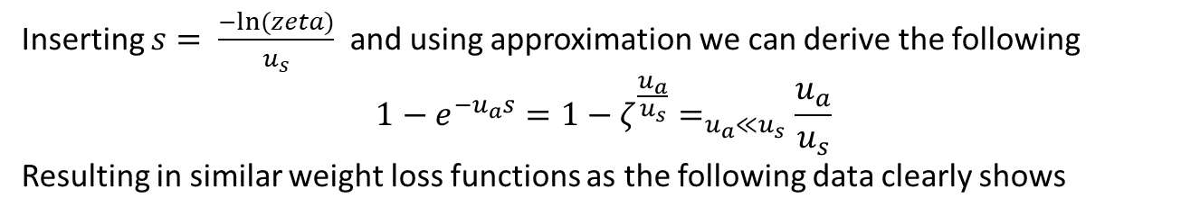
Q3.11
Inserting $s= \frac{−ln⁡(zeta)}{u_{s}}$ and using approximation we can derive the following
$$1−e^{−u_{a}s}=1−ζ^{\frac{u_{a}}{u_{s}}}=_{u_{a}≪u_{s}}\frac{u_{a}}{u_{s}}$$
Resulting in similar weight loss functions as the following data clearly shows

Slide 9
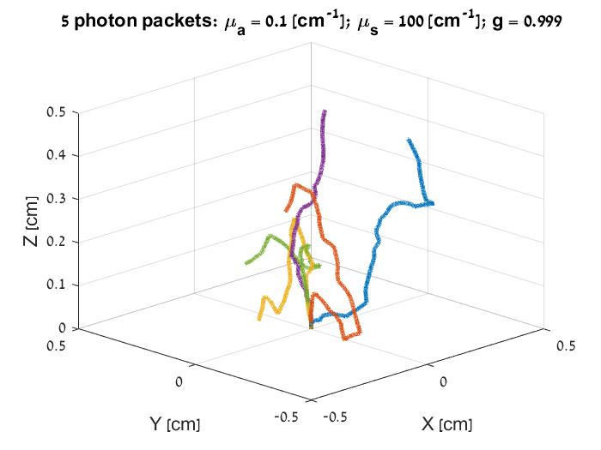
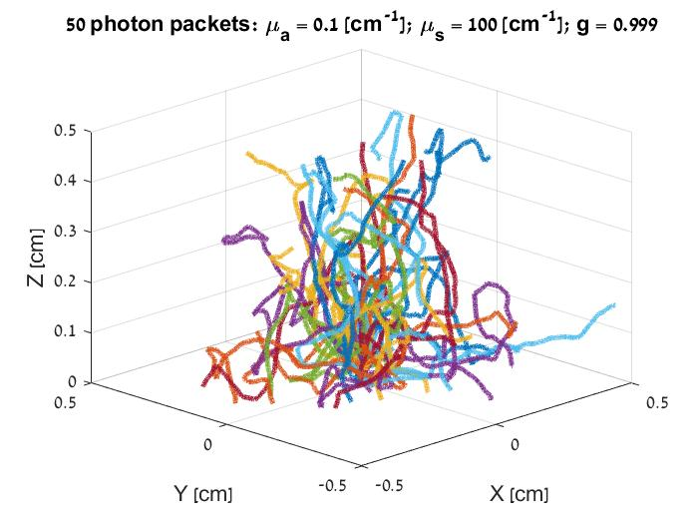
Photon propagation in semi-infinite biological Tissue

Slide 10
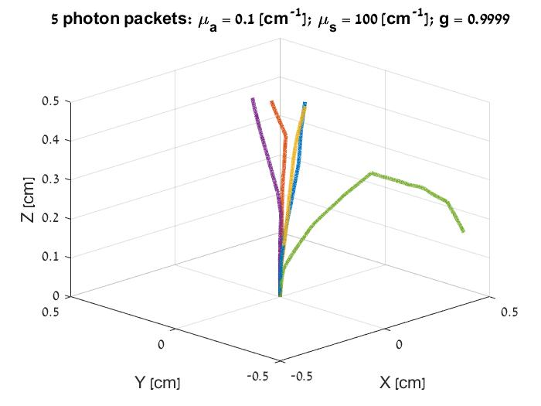
Photon propagation in semi-infinite biological Tissue sanity check
As a sanity check we ran another simulation with a higher g value, expecting a stronger forward bias. The results confirm this we can clearly see the more consistent forward propagation in comparison between the two graphs.

Slide 11
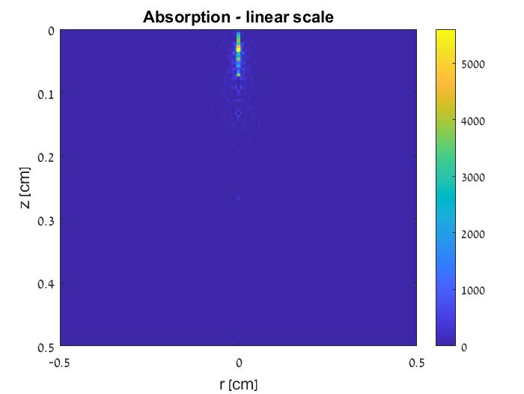
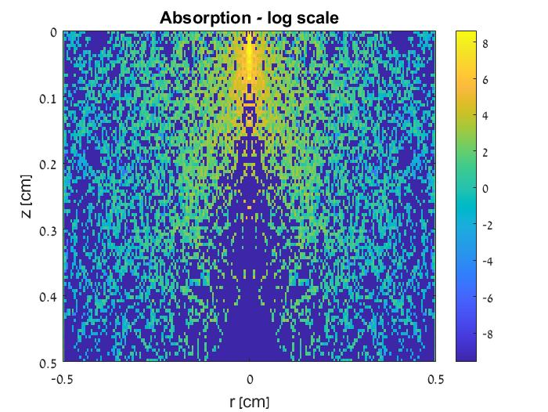
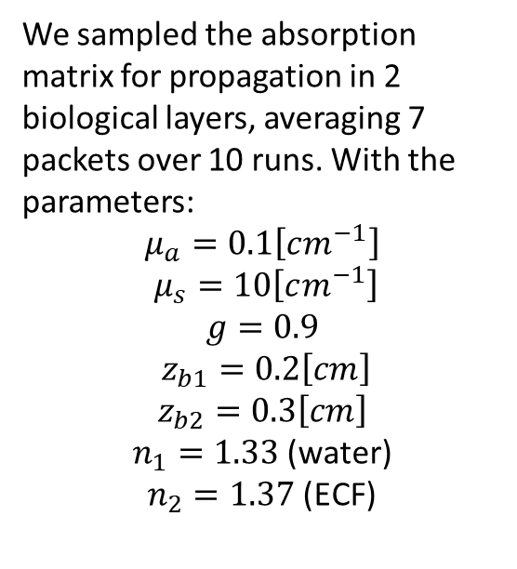
Absorption matrix
We sampled the absorption matrix for propagation in 2 biological layers, averaging 7 packets over 10 runs. With the parameters:
$$μ_{a}=0.1\left[cm^{−1}\right]$$
$$μ_{s}=10\left[cm^{−1}\right]$$
$$g=0.9$$
$z_{b1}=0.2\left[cm\right]$
$$z_{b2}=0.3\left[cm\right]$$
$n_{1}=1.33$ (water)
$n_{2}=1.37$ (ECF)
In the linear scale we can clearly see the maximum penetration depth is 1[mm], as expected.
Due to close values of the refractive index for each layer it appears almost as if we don’t have 2 layers due to packages easily transmitting between the layers.

Slide 12
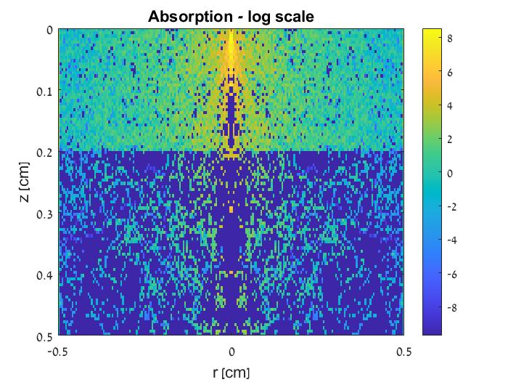
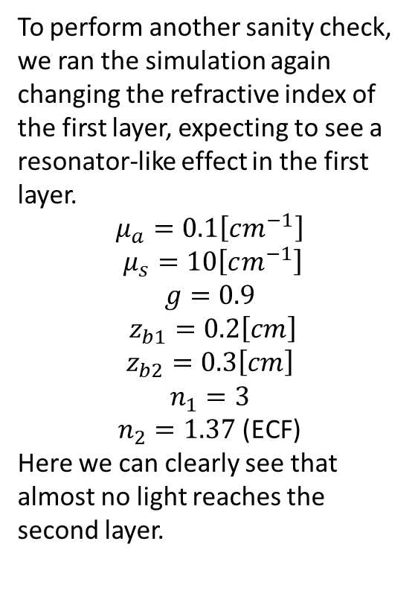
Absorption matrix: sanity check
To perform another sanity check, we ran the simulation again changing the refractive index of the first layer, expecting to see a resonator-like effect in the first layer.
$$μ_{a}=0.1\left[cm^{−1}\right]$$
$$μ_{s}=10\left[cm^{−1}\right]$$
$$g=0.9$$
$z_{b1}=0.2\left[cm\right]$
$$z_{b2}=0.3\left[cm\right]$$
$$n_{1}=3$$
$n_{2}=1.37$ (ECF)
Here we can clearly see that almost no light reaches the second layer.

