Slide 1
DIGITAL ERA

Slide 2






DIGITAL ERA
The Problem

Slide 3
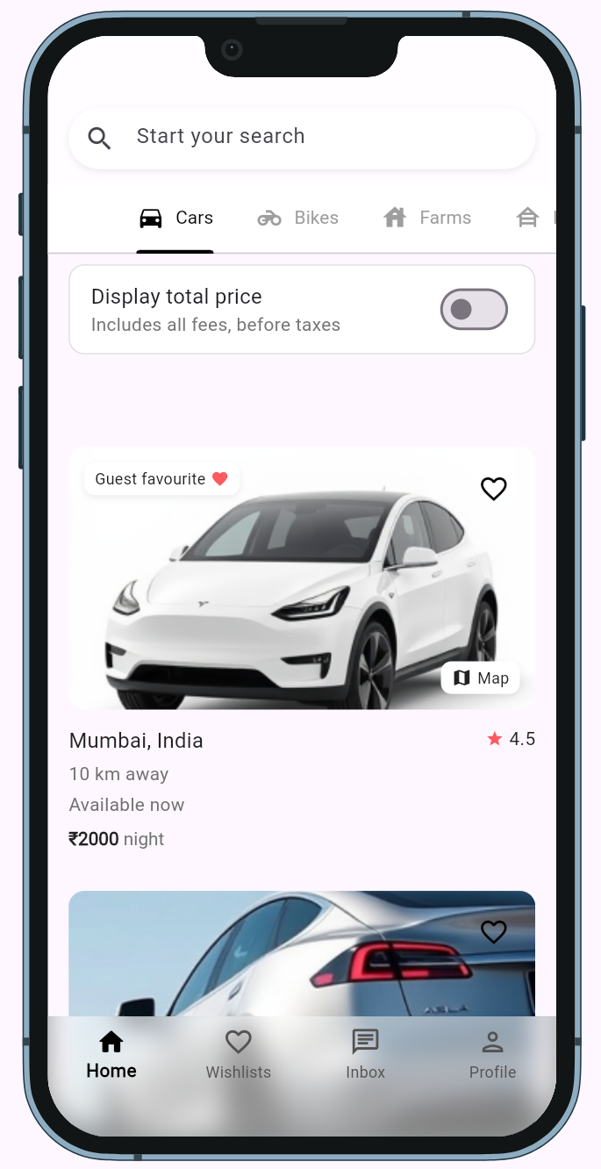
DIGITAL ERA
The Problem
Users
Vendors
Struggle to find rental
services
Low Visibility & Lack
of Customers
Unclear Demand &
Pricing Strategy
Limited Rental Choices
Time Consuming
Lack of Trustable Customer
Details
Trust and Safety Issues
High Marketing Cost
LEEZ
One stop Rental Marketplace

Slide 4
The Problem
Users
Vendors
Struggle to find rental
services
Low Visibility & Lack
of Customers
Unclear Demand &
Pricing Strategy
Limited Rental Choices
Time Consuming
Lack of Trustable Customer
Details
Trust and Safety Issues
High Marketing Cost
LEEZ
One stop Rental Marketplace

Slide 5




Competitors
The Problem
Users
Vendors
Struggle to find rental
services
Low Visibility & Lack
of Customers
Unclear Demand &
Pricing Strategy
Limited Rental Choices
Time Consuming
Lack of Trustable Customer
Details
Trust and Safety Issues
High Marketing Cost
LEEZ
Users
One stop Rental Marketplace
One App for All Rentals
More Options to Rent
Transparent Pricing
Vendors
List Rentals, Get Wider Reach
Clear Demand & Pricing Strategy
Business with Trustable Customers

Slide 6

Competitors
The Problem
Users
Vendors
Struggle to find rental
services
Low Visibility & Lack
of Customers
Unclear Demand &
Pricing Strategy
Limited Rental Choices
Time Consuming
Lack of Trustable Customer
Details
Trust and Safety Issues
High Marketing Cost
LEEZ
Users
User Features
One stop Rental Marketplace
One App for All Rentals
User Reviews & Ratings
More Options to Rent
Booking History & Favorites
Transparent Pricing
Direct Vendor Contact
Vendors
Vendor Features
List Rentals, Get Wider Reach
Useful Insights & Dashboard
Clear Demand & Pricing Strategy
Customer Reviews & Ratings
Business with Trustable Customers
Fraud Prevention

Slide 7
Competitors
Analysis
LEEZ
One stop Rental Marketplace
Car Rentals
Bike Rentals
Furniture Rentals
Zoomcar, Drivezy, LongDriveCars
Royal Brothers
Rentomojo, Furlenco
User Features
User Reviews & Ratings
Booking History & Favorites
Direct Vendor Contact
Vendor Features
Useful Insights & Dashboard
Customer Reviews & Ratings
Fraud Prevention

Slide 8
LEEZ
Competitors
Revenue Streams
One stop Rental Marketplace
Zero Commission
(Listing Fee Only)
Commission Based
& Own Inventory
Wide Rental Categories
Limited Categories
Market Coverage (Tier2&3)
Mostly Present in Tier 1
Useful Insights to Vendors
No User Feedback
Car Rentals
Bike Rentals
Furniture Rentals
Users
Zoomcar, Drivezy, LongDriveCars
Royal Brothers
Rentomojo, Furlenco
One App for All Rentals
Listing Fees
More Options to Rent
Featured Listings
Marketing
4
Data Insights
3
2
1
Vendors pay to showcase products.
Top placements for vendors.
Targeted vendor ads.
Monetizing user behavior data.
Transparent Pricing
Vendors
List Rentals, Get Wider Reach
Clear Demand & Pricing Strategy
Business with Trustable Customers

Slide 9
LEEZ
Competitors
Revenue Streams
One stop Rental Marketplace
Listing Fees
Zero Commission
(Listing Fee Only)
Commission Based
& Own Inventory
1
Vendors pay to showcase products.
Wide Rental Categories
Limited Categories
2
Featured Listings
Top placements for vendors.
Market Coverage (Tier2&3)
Mostly Present in Tier 1
3
Marketing
Useful Insights to Vendors
No User Feedback
Targeted vendor ads.
4
Data Insights
Monetizing user behavior data.
Market Analysis
 | Turnover (Approx.)
 | 269cr
 | 95cr
 | 193cr
Company

Slide 10



LEEZ
Revenue Streams
One stop Rental Marketplace
1
Listing Fees
Vendors pay to showcase products.
2
Featured Listings
Top placements for vendors.
3
Marketing
Targeted vendor ads.
4
Data Insights
Monetizing user behavior data.
Market Analysis
 | Turnover (Approx.)
 | 269cr
 | 95cr
 | 193cr
Business Model
Company
Value Proposition
2
Key Partners
1
Revenue
3

Slide 11

LEEZ
Revenue Streams
One stop Rental Marketplace
1
Listing Fees
Vendors pay to showcase products.
2
Featured Listings
Top placements for vendors.
3
Marketing
Targeted vendor ads.
4
Data Insights
Monetizing user behavior data.
Market Analysis
Business Model
Value Proposition
2
One-stop, no commission
Key Partners
1
Vendors, Logistics
Revenue
3
Listing fees, ads
 | Turnover (Approx.)
 | 269cr
 | 95cr
 | 193cr
Company
One Stop Rental Marketplace

Slide 12
LEEZ
Revenue Streams
One stop Rental Marketplace
1
Listing Fees
Vendors pay to showcase products.
Business Model
2
Featured Listings
Top placements for vendors.
3
Marketing
Targeted vendor ads.
4
Data Insights
Monetizing user behavior data.
Market Analysis
Business Model
Value Proposition
2
One-stop, no commission
Key Partners
1
Vendors, Logistics
One Stop Rental Marketplace
Revenue
3
Listing fees, ads
ONE STOP RENTAL MARKETPLACE
 | Turnover (Approx.)
 | 269cr
 | 95cr
 | 193cr
Company

