Slide 1
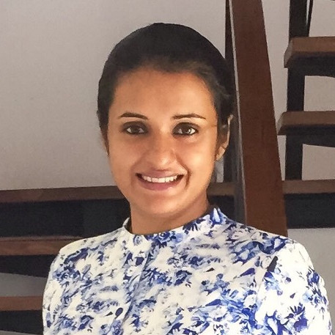




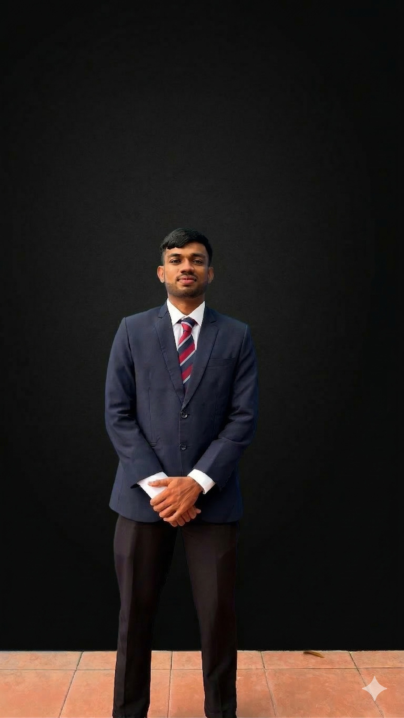
AI-Powered Unified Sri Lankan Tourism Platform
Using GraphRAG and LLM Orchestration
Project ID: R26-IT-050
    MRS. DILANI LUNUGALAGE
    (SUPERVISOR)
    MRS. DULANI JAYASINGHE
    (CO-SUPERVISOR)
Deniyawatte D.G.A.D.N.
(IT22895196)
    Wijesinghe I.D.W.
    (IT22555458)
    Kumarasinghe K.G.A.M.S.D.C.
    (IT22224866)
    Madushan M.
    (IT22214720)

Slide 2
USER AND STAKEHOLDERS
Problem Statement
Existing tourism platforms in Sri Lanka are fragmented and lack integrated services, intelligent itinerary generation, and real-time personalization, making travel planning inefficient for tourists.
Primary Users :
Local and foreign independent travelers seeking personalized, safe, and efficient travel experiences in Sri Lanka.
Stakeholders :
    Service Providers: Hotel owners, vehicle suppliers, and private drivers.
    Government Authorities: Sri Lanka Tourism Board and Disaster Management Centre (DMC).
    Local Communities: Heritage sites and cultural attractions seeking better visibility.

Slide 3
IMPACT OF THE PROBLEM
FRAGMENTED PLANNING
Tourists must use multiple disconnected apps for booking, navigation, and information, leading to a complex and time-consuming experience.
MISS SAFETY HAZARD
Lack of integration with real-time landslide/flood alerts and failure to account for road gradients causes mechanical failures and accidents.
INEFFICIENT ROUTING
Static maps ignore personal preferences and practical travel radii, resulting in wasted time on the road and suboptimal itineraries.
KNOWLEDGE GAP
Travelers often visit heritage sites without understanding their historical or cultural significance due to a lack of immediate, contextual information.

Slide 4
EXISTING SOLUTIONS AND THEIR LIMITATIONS
DISTANCE-BASED NAVIGATION
Current apps like Google Maps focus only on the shortest path, ignoring vehicle capacity , road steepness, and weather conditions.
STATIC RECOMMENDATIONS
Existing platforms offer generic itineraries that do not adapt to individual constraints like budget, dietary needs, or real-time availability.
UNRELIABLE AI OUTPUTS
Standard LLMs often produce "hallucinations" or generic info because they lack a structured knowledge base for the Sri Lankan context.

Slide 5
THE PROPOSED SOLUTION
UNIFIED AI ECOSYSTEM
A single platform integrating GraphRAG and LLM Orchestration to bridge the gap between tourism data and user needs.
CONTEXT-AWARE REASONING
Combines vehicle mechanics, geospatial boundaries, and personal preferences to provide safe and personalized travel plans.
REAL-TIME DATA FUSION
Integrates live Weather APIs, Google Elevation data, and DMC alerts to ensure itineraries are practically executable.
GROUNDED INFORMATION GENERATION
Uses a Knowledge Graph to ensure all historical facts and recommendations are accurate and contextually relevant.

Slide 6
INDIVIDUAL COMPONENTS / CONTRIBUTIONS
DENIYAWATTE D.G.A.D.N (IT22895196)
Focuses on generating fully integrated, constraint-validated tour packages (Hotels, Transport, Activities) using a Knowledge Graph.
WIJESINGHE I.D.W. (IT22555458)
Develops the Intelligent Mobility Engine to match vehicle engine capacity with road gradients and real-time safety alerts
KUMARASINGHE K.G.A.M.S.D.C. (IT22224866)
Implements spatiotemporal optimization to create reachable daily travel radii and time-saving day-by-day itineraries.
MADUSHAN M. (IT22214720)
Provides AI-powered landmark recognition from images and generates detailed contextual historical/cultural information using LLMs.

Slide 7
Hotel and Activity Knowledge Graph Module for an AI-Based Tour Package Generator
DENIYAWATTE D.G.A.D.N
IT22895196
Focuses on generating fully integrated, constraint-validated tour packages (Hotels, Transport, Activities) using a Knowledge Graph.
Notes:
8

Slide 8
Hotel and Activity Knowledge Graph Module for an AI-Based Tour Package Generator | IT22895196
Problem Definition
  Tourists use many apps to find hotels and activities.
  Most systems recommend separate services, not full tour packages.
  Hotels and activities are not properly connected in many systems.
  Some AI travel tools create impractical travel plans.
  A system is needed to connect hotels and activities for better trip planning.
Main Objective
Develop a knowledge graph module for hotels and activities to support tour package generation.
Sub Objectives
  Collect hotel and activity data.
  Define key attributes (location, price, availability).
  Build a knowledge graph connecting hotels and activities.
  Find compatible hotel–activity combinations.
  Integrate with the vehicle module.

Slide 9
Hotel and Activity Knowledge Graph Module for an AI-Based Tour Package Generator | IT22895196
Research Methodology
Latest Technologies Used
  Artificial Intelligence for travel planning.
  Knowledge Graphs to connect tourism data.
  Tourism systems for hotel and activity management.
  Constraint matching based on user preferences.
  Knowledge Graph
  GraphRAG
  LLM API
  Node.js & Express
  MongoDB
  React.js
How to Validate and Evaluate the Proposed Solution
  Constraint Validation
Check whether selected hotels and activities match user preferences (location, price, availability).
  Graph Validation
Verify that hotels and activities are correctly connected in the knowledge graph.
  Integration Testing
Test if the hotel and activity module works correctly with the vehicle module.
  Performance Testing
Measure system response time when generating tour packages.
  User Evaluation
Collect user feedback on the relevance and practicality of the generated plans.

Slide 10
Hotel and Activity Knowledge Graph Module for an AI-Based Tour Package Generator | IT22895196
Data Availability
  Tourism data will be collected from public tourism websites, travel platforms, and tourism authority resources.
  This data will be structured and stored in the system database for itinerary generation.
  Hotel Data: Location, Price category, Availability
  Activity Data: Location, Type of activity, Operating hours
Security and Ethical Clearance
  Protect user preference data.
  Use data only for research purposes.
  Generate results using validated graph data.
  Follow ethical AI guidelines.

Slide 11
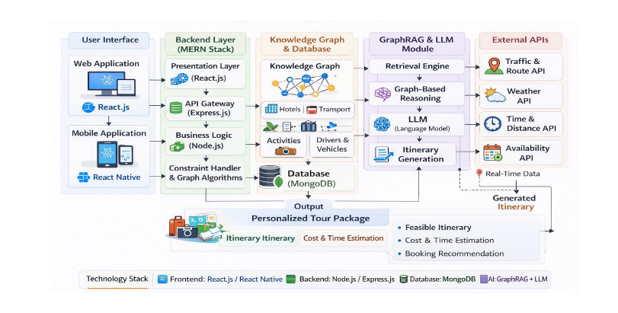
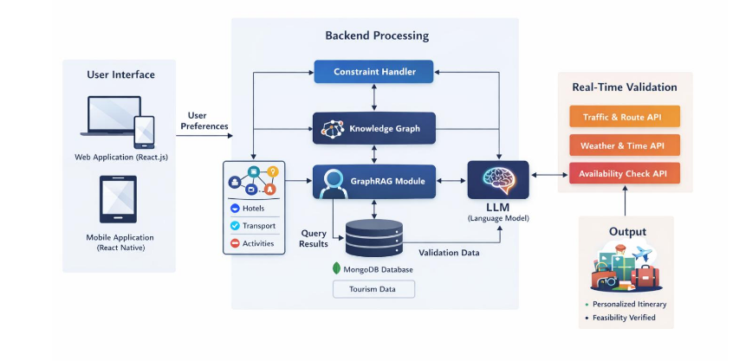
Hotel and Activity Knowledge Graph Module for an AI-Based Tour Package Generator | IT22895196
System Overview of the Individual Component
  Develop a knowledge graph module for hotels and tourism activities.
  Store structured tourism data such as hotel details and activity information.
  Extract user preferences from prompts (e.g., destination, hotel type, activity).
  Match hotels and activities using graph relationships and constraints.
  Provide selected results to the GraphRAG module for itinerary generation.
Dependencies and Common Components
Dependencies
  Vehicle Module – transport services integrated with hotel and activity results.
  GraphRAG Module – retrieves graph data for itinerary generation.
  LLM API – generates human-readable travel plans.
Common Components
  Backend: Node.js & Express
  Database: MongoDB
  Frontend: React.js interface

Slide 12
Intelligent Mobility and Vehicle Selection Engine
WIJESINGHE I.D.W.
(IT22555458)
Develops the Intelligent Mobility Engine to match vehicle engine capacity with road gradients and real-time safety alerts

Slide 13
Intelligent Mobility and Vehicle Selection Engine | IT22555458
Problem Definition
  Current Limit: Navigation apps like Google Maps only show the shortest way, not if the vehicle is safe for the road
  Vehicle Power: Small cars with low engine capacity often struggle or fail on very steep mountain roads.
  Safety Gaps: Real-time landslide or flood alerts from the DMC are not connected to current travel apps.
  Wrong Costs: Travel costs are calculated only by distance, ignoring fuel used for climbing steep hills.
Main Objective
Build an AI engine using GraphRAG to suggest the safest vehicle and route for Sri Lankan tourists.
Sub Objectives
  Create a Knowledge Graph of Sri Lankan roads and vehicle specs
  Build a logic to match Engine CC with Road Steepness.
  Connect DMC and Weather alerts for live safety updates.
  Calculate "True Trip Cost" based on engine strain.

Slide 14
Intelligent Mobility and Vehicle Selection Engine | IT22555458
Research Methodology – Knowledge Domain
Latest Technologies Used
  Knowledge Graph (Neo4j): Storing road gradients and vehicle mechanical data to help the AI "reason" better than a normal database
  Reasoning Engine: Linking a Large Language Model (LLM) with the graph to find facts about vehicle limits.
  Safety Score Logic: A special formula that checks engine power, passenger weight, and road steepness.
  Knowledge Graph
  GraphRAG
  Gemini 1.5
  LangChain
  External APIs
How to Validate and Evaluate the Proposed Solution
  System Testing: Comparing AI suggestions with real-world road scenarios in Sri Lanka.
  Expert Review: Asking travel experts to check if the safety warnings are correct and helpful.
  Accuracy Check: Comparing results against standard apps like Google Maps to prove better safety.
  Component Testing: Using Postman to ensure all APIs and reasoning logic work without errors

Slide 15
Intelligent Mobility and Vehicle Selection Engine | IT22555458
Data Availability
  Vehicle Specifications: Technical data like Engine Capacity and Torque are collected for various vehicle types
  Road & Terrain Data: Elevation and steepness (gradient) details are pulled from the Google Elevation API
  Road Network: Structured info about Sri Lankan road types and connections is stored in the Neo4j Knowledge Graph
  Live Safety Data: Real-time hazard alerts (landslides/floods) come directly from the Disaster Management Centre (DMC)
  Weather Conditions: Live environmental data like rain or mist is fetched from Weather APIs.
  Points of Interest (POIs): Verified data for "Scenic Routes" is stored in MongoDB
Security & Ethics
  Secure Storage: All personal traveler profiles and past trip logs are kept safe in MongoDB Atlas
  Ethical Goal: The AI is designed to save lives by giving "Explainable AI" reasons it tells the user exactly why a vehicle is dangerous for a specific road

Slide 16
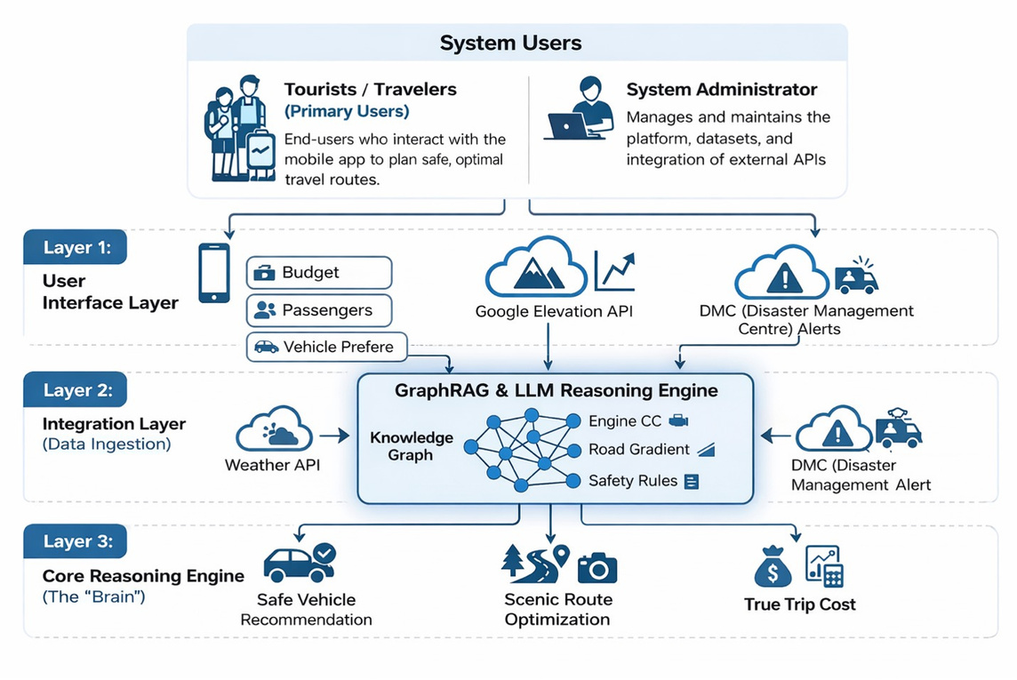
Intelligent Mobility and Vehicle Selection Engine | IT22555458
System Overview of the Individual Component
  GraphRAG Reasoning Engine: Links the LLM with a Neo4j Knowledge Graph for accurate, safe travel advice.
  Safety Score Calculator: Logic that matches Engine CC against Road Gradient and passenger load
  Hazard Integration: Fetches live landslide and flood alerts from the DMC API and Weather API.
  Smart Optimizer: Generates Safe Vehicle Recommendations, Scenic Routes, and True Trip Costs
Dependencies and Common Components
Dependencies
  Terrain Module: Matches vehicle power with road steepness using Google Elevation API.
  GraphRAG Module: Retrieves structured facts from the Knowledge Graph for "hallucination-free" plans.
  LLM API: Uses Gemini 1.5 Pro to generate human-readable justifications for recommendations.
  External API Layer: Continuous data streams from the DMC and Weather services for live safety.
Common Components
  Backend: Node.js & Express.js for logic and REST APIs
  Database: Neo4j (Graph data) and MongoDB Atlas
  Frontend: React Native mobile interface for real-time alerts and maps.

Slide 17
Context-Aware Spatio-Temporal Itinerary Optimization System
Kumarasinghe K.G.A.M.S.D.C.
IT22224866
Develops the Spatio-Temporal Itinerary Engine to match tourist preferences with time-constrained travel boundaries and optimized shortest-path routing.

Slide 18
Context-Aware Spatio-Temporal Itinerary Optimization System - IT22224866
Problem Definition
  Tourists face the complex Tourist Trip Design Problem.
  Existing maps provide manual point-to-point routing.
  They do not automatically optimize places based on strict time limits.
  Balancing personal interests, distances, and time is difficult.
  This lack of automation causes time loss and travel fatigue.
Main Objective
Develop an AI-assisted itinerary optimization engine to automatically generate time-efficient, day-by-day travel plans.
Sub Objectives
  Collect Sri Lankan Points of Interest (POI) data.
  Apply K-Means ML profiling to identify tourist interests.
  Generate a dynamic geo-spatial travel radius.
  Use a Genetic Algorithm to determine the shortest route.
  Convert optimized routes into human-readable text using Explainable AI.

Slide 19
Context-Aware Spatio-Temporal Itinerary Optimization System - IT22224866
Research Methodology – Knowledge Domain
Latest Technologies Used
  Python
  scikit-learn (K-Means)
  Genetic Algorithm
  Node.js & Express
  MongoDB & Redis
  React.js
  Gemini API (Strictly for XAI text formatting)
  Artificial Intelligence for user preference profiling.
  Metaheuristic Optimization for complex routing problems.
  Geospatial Computing to calculate travel boundaries.
  Solving the Tourist Trip Design Problem, an NP-hard optimization problem.
How to Validate and Evaluate the Proposed Solution
  System Testing: Testing the algorithm to ensure it generates logical, time-efficient, day-by-day travel plans.
  Expert Review: Asking local tour guides and travel agents to check if the generated travel sequences are practical.
  Accuracy Check: Comparing total travel distance and time against standard apps like Google Maps to prove better efficiency.
  Component Testing: Using Postman to ensure the Python routing microservice and APIs work without errors.

Slide 20
Context-Aware Spatio-Temporal Itinerary Optimization System - IT22224866
Data Availability
  Tourism and geospatial data will be collected from official tourism authorities (e.g., SLTDA) and mapping platforms (e.g., OpenStreetMap).
  This data will be structured and stored in the system database for routing optimization.
  POI Data: Location coordinates, Tourist category (beaches, culture), Operating hours.
  User Travel Data: Available time limits, Hotel location, Personal interests.
Security and Ethical Clearance
  Protect user preference and location data.
  Use data strictly for research purposes.
  Generate results using validated algorithmic routing.
  Follow ethical Explainable AI guidelines.

Slide 21
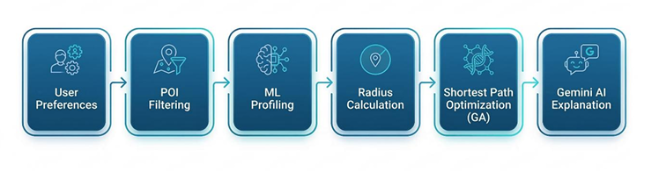
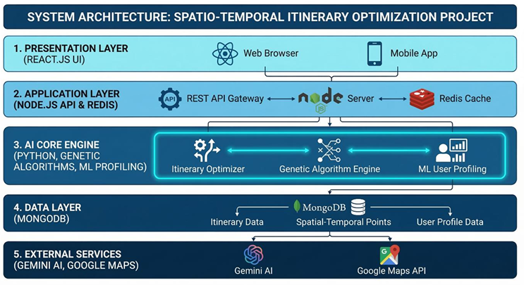
Context-Aware Spatio-Temporal Itinerary Optimization System - IT22224866
System Overview of the Individual Component
  Develop a routing engine using K-Means clustering and a Genetic Algorithm.
  Extract user preferences (e.g., interests, hotel location, available time).
  Filter Point of Interest (POI) data based on tourist preferences.
  Calculate dynamic travel boundaries and find the shortest travel paths.
  Provide optimized map coordinates to the XAI layer for human-readable text generation.
Dependencies and Common Components
Dependencies
  Gemini API: Utilized strictly as an Explainable AI (XAI) text formatter.
  Redis Cache: Caches frequently generated routes for low-latency retrieval.
  Google Maps API: Provides real-world map distances and location data.
Common Components
  Backend: Node.js & Express
  Database: MongoDB
  Frontend: React.js interface

Slide 22
AI Landmark Recognition and Tourist Information System
Madushan.M
IT22214720
Provides AI-based landmark recognition from tourist images and delivers contextual historical and cultural information using large language models.
Notes:
8

Slide 23
AI Landmark Recognition and Tourist Information System | IT22214720
Problem Definition
  Tourists visiting Sri Lanka often encounter landmarks but do not know their names or historical importance.
  Existing tourism apps mainly require manual search or map navigation.
  These systems cannot automatically identify landmarks using images.
  Tourists therefore miss important historical, cultural, and tourism information about locations they visit.
Main Objective
Develop an AI-powered landmark recognition system that identifies tourist landmarks from images and provides detailed tourism information.
Sub Objectives
  Develop an image recognition model to identify Sri Lankan landmarks.
  Integrate AI-based information generation to provide historical and tourism details.
  Create a mobile application interface where users can capture or upload images.
  Provide real-time landmark identification and tourist guidance.

Slide 24
AI Landmark Recognition and Tourist Information System | IT22214720
Research Methodology
Latest Technologies Used
  Computer Vision for image-based landmark recognition.
  Deep Learning models for landmark classification.
  Natural Language Processing for tourism information generation.
  Tourism Information Systems for managing landmark data.
  Convolutional Neural Network(CNN)
  Large Language Models (LLM)
  TensorFlow
  Node.js & Express
  MongoDB
  React.js
How to Validate and Evaluate the Proposed Solution
  Landmark Recognition Validation
Check whether the system correctly identifies landmarks from user-uploaded images.
  Model Accuracy Evaluation
Measure the performance of the deep learning model using metrics such as accuracy, precision, and recall.
  Information Generation Validation
Verify that the generated historical and cultural information about landmarks is correct and relevant.
  Integration Testing
Test whether the image recognition module and the tourism information module work together properly.
  Performance Testing
Measure the system response time for processing images and generating tourism information.
  User Evaluation
Collect feedback from users about the usefulness, clarity, and accuracy of the information provided.

Slide 25
AI Landmark Recognition and Tourist Information System | IT22214720
Data Availability
  Tourism landmark data will be collected from public tourism websites, open travel platforms, and official tourism authority resources.
  This data will be organized and stored in the system database to support landmark recognition and information retrieval.
  Landmark Image Data: Images of tourist landmarks used for training and testing the recognition model.
  Landmark Information Data: Historical background, cultural significance, and tourism descriptions of landmarks.
  Location Data: Geographic location and basic visiting information of tourist sites such as Sigiriya Rock Fortress and Temple of the Sacred Tooth Relic.
Security and Ethical Clearance
  Protect user-uploaded images and personal data.
  Use collected data only for academic research purposes.
  Ensure that tourism information is generated from verified tourism sources.
  Follow responsible AI and data privacy guidelines in the system design.

Slide 26
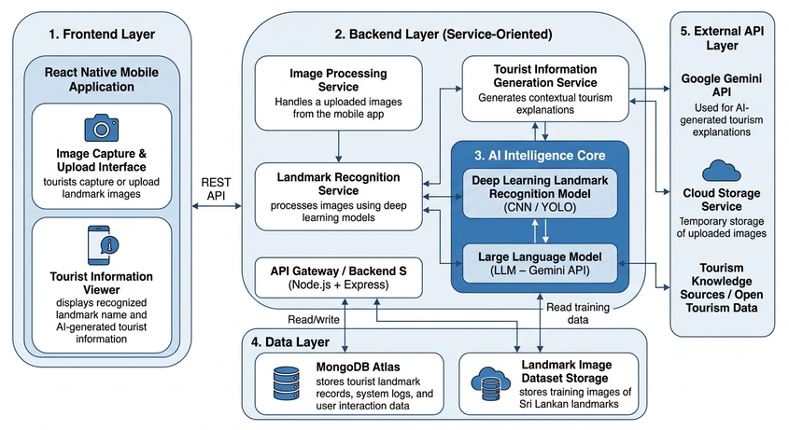
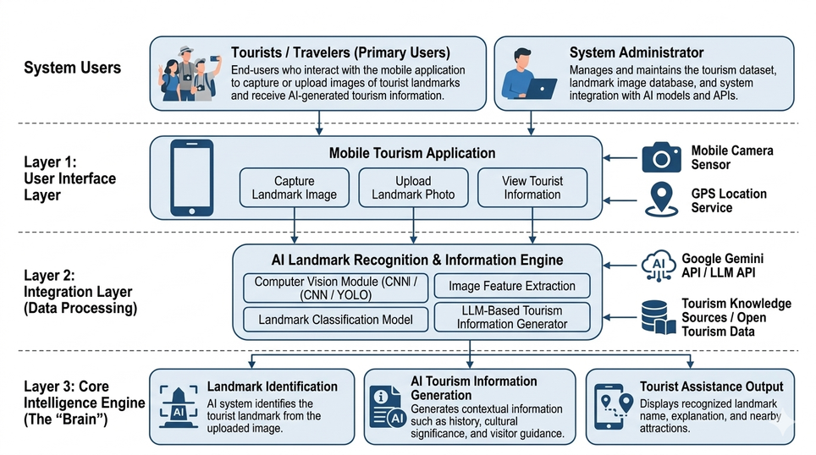
AI Landmark Recognition and Tourist Information System | IT22214720
System Overview of the Individual Component
  Develop an AI-based landmark recognition module to identify tourist landmarks from images.
  Store structured tourism information such as historical details and cultural descriptions of landmarks.
  Process images uploaded by users to extract visual features for landmark identification.
  Generate contextual tourism information for the identified landmark using AI language models.
  Provide recognized landmark details and tourism information to the user interface.
Dependencies and Common Components
Dependencies
  Image Recognition Model – identifies landmarks using deep learning techniques.
  LLM API – generates contextual tourism descriptions and explanations.
  Tourism Data Sources – provide historical and cultural information about landmarks.
Common Components
  Backend: Node.js & Express
  Database: MongoDB
  Frontend: React.js interface

Slide 27
Commercialization Potential of the AI Tourism Platform
Investment / Cost
  System development by student team (no external labour cost)
  Cloud hosting and servers
  API services (maps, traffic, LLM)
  Database and system maintenance
Cost Recovery (Pricing)
  Subscription service for travel agencies
  Commission from hotel and activity bookings
  Premium AI travel planning service for tourists
Target Market & Customers
  Target Market: Tourism industry in Sri Lanka
  Customers: International tourists, travel agencies, tour operators
Intellectual Property
  AI-based tour package generation system
  Tourism knowledge graph dataset
  Custom GraphRAG-based itinerary generation framework
Value Proposition
  Generates personalized tour packages automatically
  Integrates hotels, activities, and transport in one system
  Uses AI + Knowledge Graph for smart travel planning

Slide 28
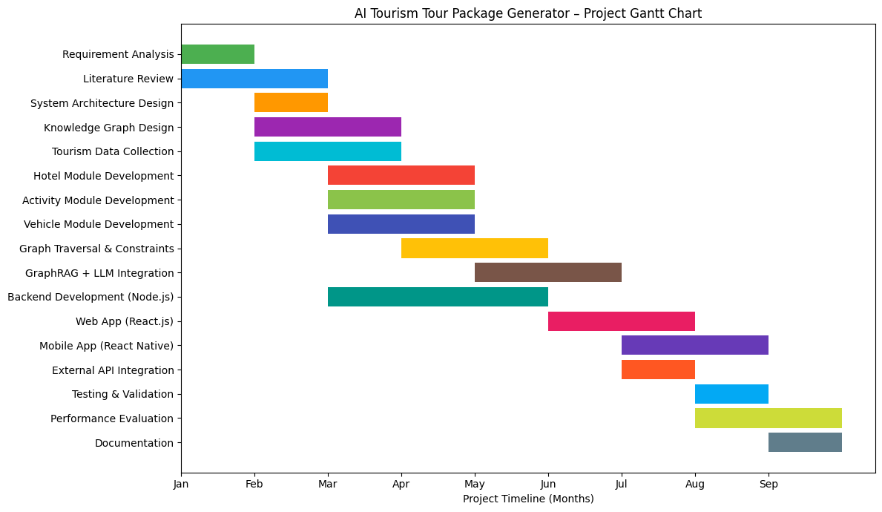
Grant Chart

Slide 29
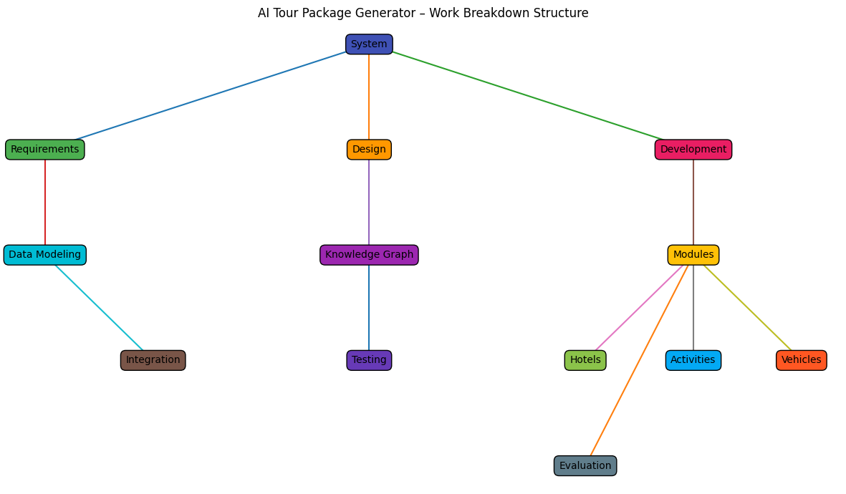
Work breakdown structure

