Slide 1
3D Hand Pose Identification
- Bharat Nagaraju
- Vignesh

Slide 2
Problem Statement
3D hand pose estimation
Data available from
MSRA Hand Pose Dataset [link] [paper]

Slide 3

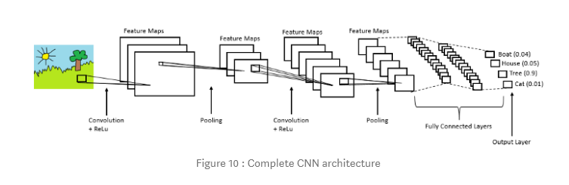

Existing system & Related Works
Various combinations of inputs and outputs for 3D pose estimation from a single depth image using Generative Models, Particle Swam Optimization, CNN, etc.
Recently, powerful discriminative approaches based on (CNNs) are outperforming existing methods, but they still suffer from inaccurate estimation because of severe self-occlusions, highly articulated shapes of target objects, and low quality of depth images.

Slide 4
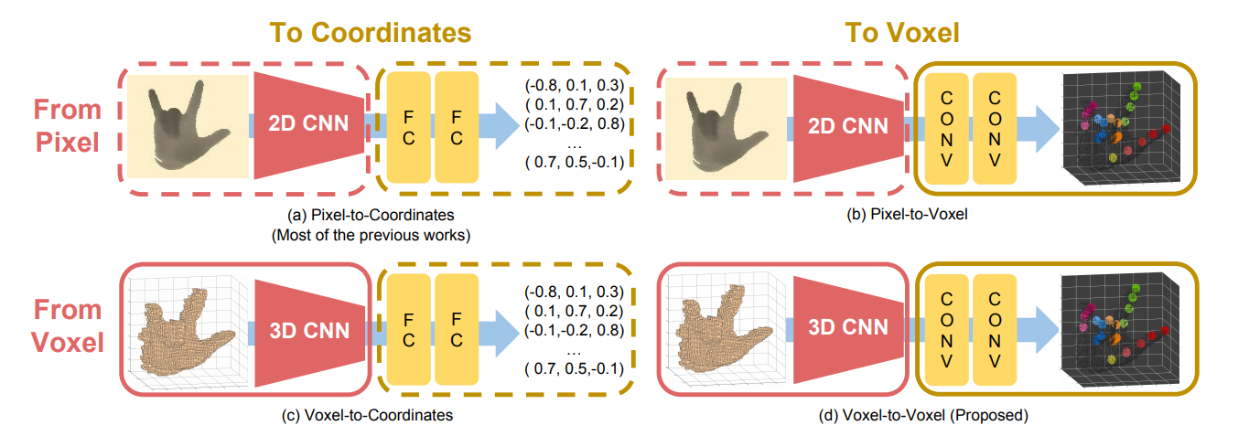
Proposed system
Voxel to-voxel prediction network for pose estimation
V2V-PoseNet estimates the per-voxel likelihood from a voxelized grid input.
Experiment and Validate.
Most of the previous works take a 2D depth image as input and estimate the 3D coordinates of key points as in (a). In contrast, the proposed system takes a 3D voxelized grid and estimates the per-voxel likelihood of each keypoint as in (d). Note that (b) and (d) are solely composed of the convolutional layers that become the fully convolutional architecture
https://arxiv.org/pdf/1711.07399.pdf

Slide 5
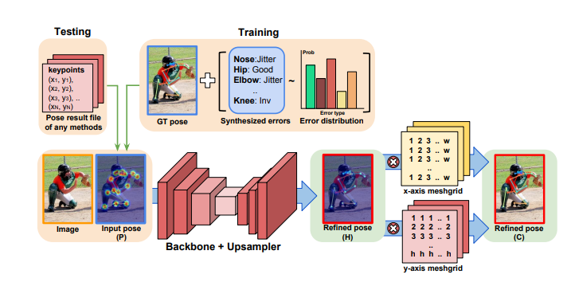
Improvements
An experiment demo on MSRA hand pose dataset, result in ~12mm mean error.
Additional Integral Pose Loss (or PoseFix Loss) implementation, result in ~10mm mean error on the same dataset – which is model agnostic.
https://arxiv.org/abs/1711.08229 Integral Human Pose Regression
https://arxiv.org/abs/1812.03595 PoseFix: Model-agnostic General Human Pose Refinement Network

Slide 6
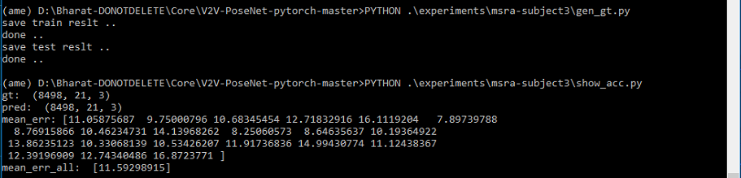
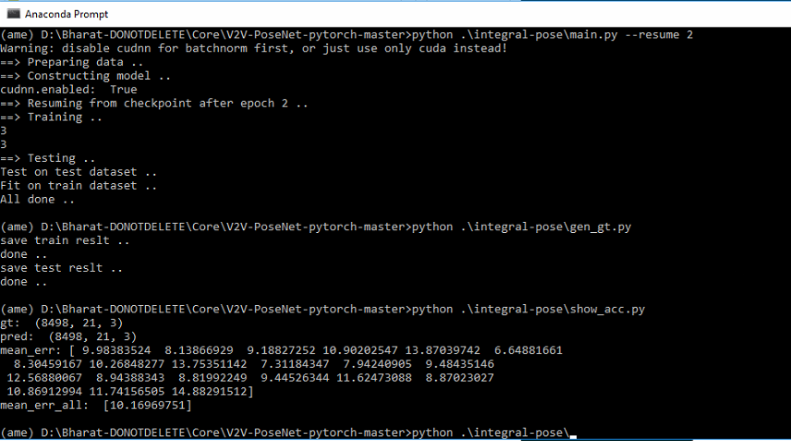
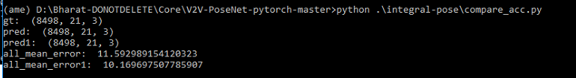
Results & Learnings
Estimated Results Achieved on improved model
End-to-End model, trained from scratch .
No Transfer learning / use of pre-trained models
So far 3-Epochs each. More epochs may achieve better accuracy
Code portability missing from base paper implementation.
Package alternatives used. Parallel data loading in Pytorch is disabled in windows
Parameter Tuning, Based on Pytorch Version; (torch.backends.cudnn.enabled)
Training Overhead for Pose Fix. Double the training time of base model under current configurations

Slide 7
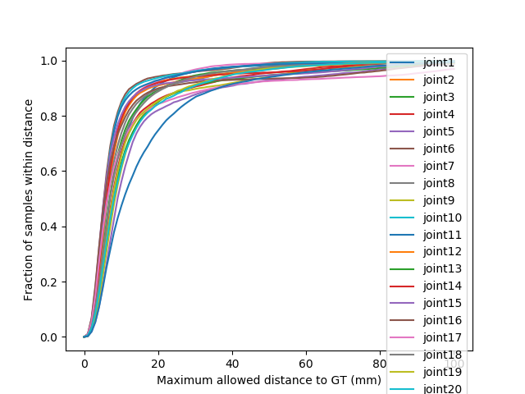
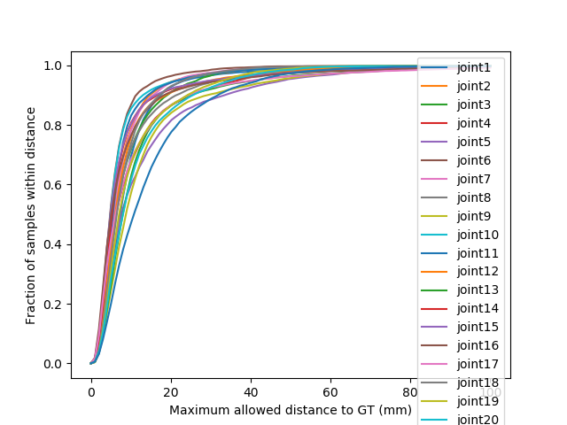
Results…

Slide 8
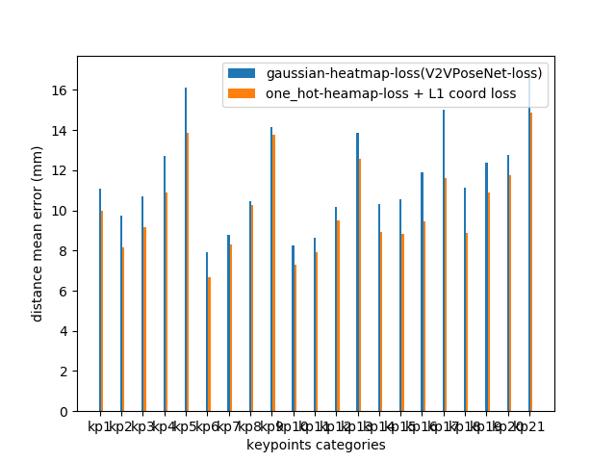
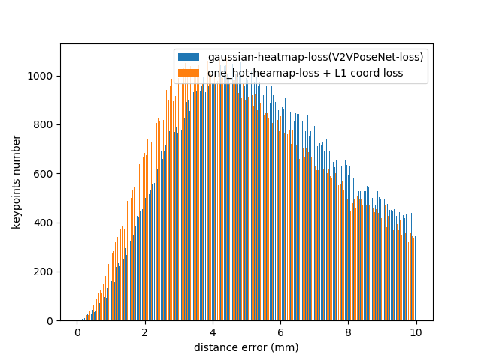
Results…Comparison

Slide 9
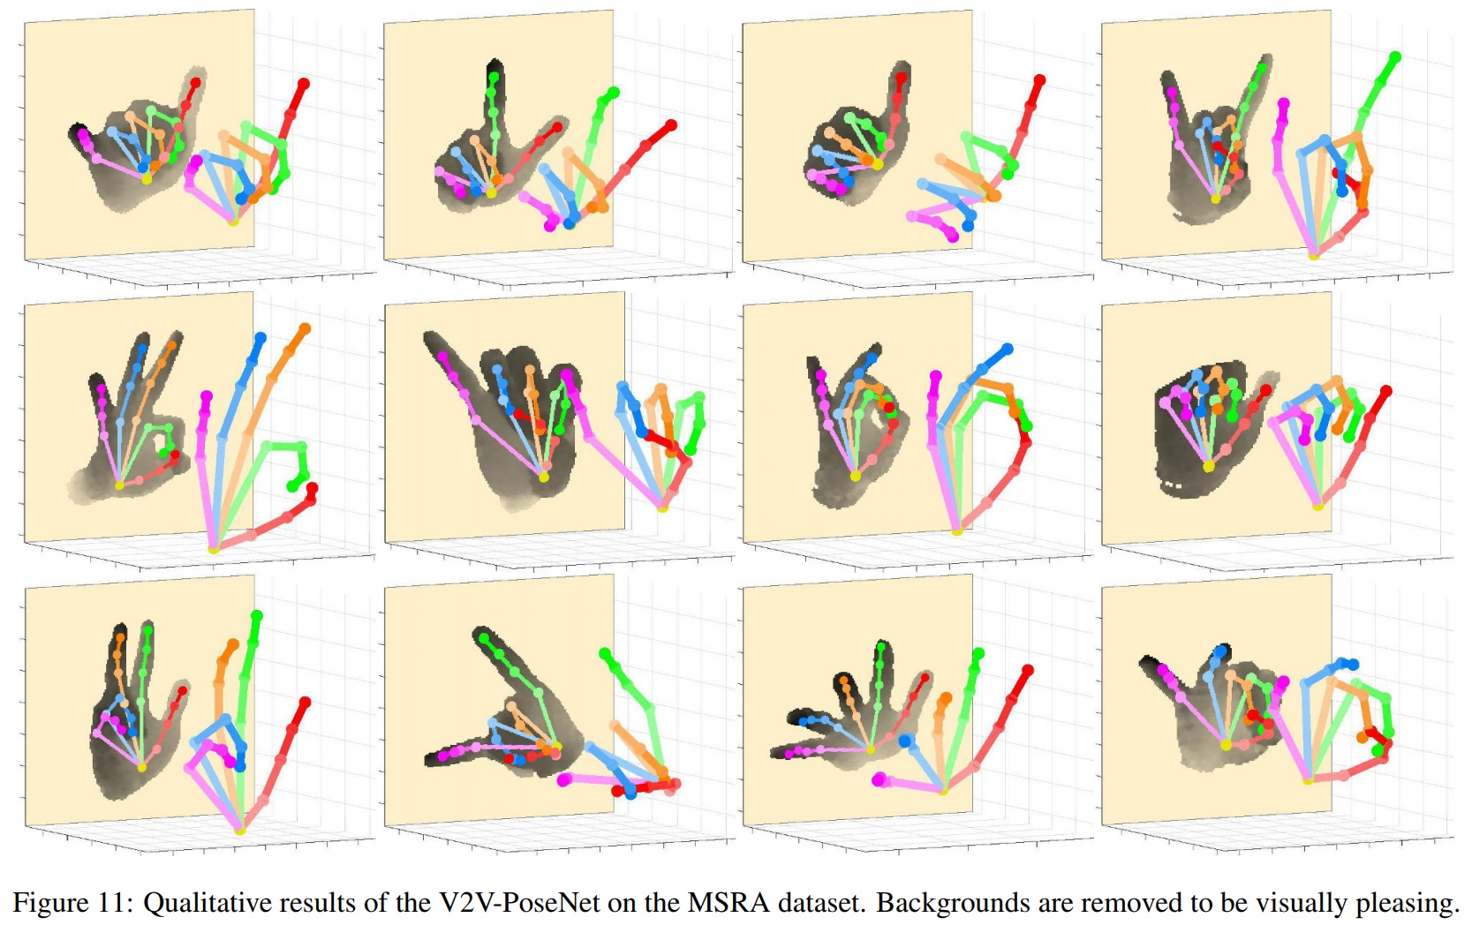

Visualization

Slide 10
Softwares & Environment
Pytorch 1.0
Nvidia CUDA 10.1 + CUDNN 7.6.5 (Latest)
Nvidia 1080ti Geforce + Windows 10 + 32 Gig RAM
Parameter Tuning, Based on Pytorch Version; (torch.backends.cudnn.enabled)
Will be faster on linux using parallel data loaders (Multi Threading)
Will be faster If multiple GPUs are used. Due to low memory on GPU – We couldn’t launch both the AS-IS & TO-BE Model training together

Slide 11
Future Work
Real time Hand pose detection (MXNET)
Implement Multi-GPU and Parallel Training for faster training

Slide 12
Thank You
References:
https://arxiv.org/pdf/1606.06650.pdf
https://github.com/DavexPro/pytorch-pose-estimation
https://github.com/Superlee506/Mask_RCNN_Humanpose
https://github.com/Naman-ntc/Pytorch-Human-Pose-Estimation
https://github.com/last-one/Pytorch_Realtime_Multi-Person_Pose_Estimation
https://github.com/MVIG-SJTU/AlphaPose/tree/pytorch (MXNET)
https://github.com/bearpaw/pytorch-pose (Multi-GPU and Parallel Training)
https://github.com/cbsudux/awesome-human-pose-estimation
https://github.com/dragonbook/V2V-PoseNet-pytorch

