Slide 1
Deck Builder Catalog
20 representative slide forms
macOS stable · Windows beta

Slide 2
01
Narrative Structure
Slides are selected by content relationship.

Slide 3
Pick the form before writing slide text.
The builder is a constraint system, not a decoration layer.
deck skill catalog
01

Slide 4
Operating Signals
Forms
Default
Fallback
20
1
0.5x
Representative pages
Primary builder per slide
Bullets stay rare
deck skill catalog
02

Slide 5
Fallback Bullets
Use when no stronger content relationship exists.
Keep each item short.
Split slides before shrinking below readable size.
deck skill catalog
03

Slide 6
Release Comparison
Area | macOS | Windows beta
Generate | Verified | Verified in Windows CI
Polish | Verified | Script included; target QA pending
Render QA | Verified | Adapter included; target QA pending
deck skill catalog
04

Slide 7
Format Decisions
2-column table
Use deflist when the left column is only a label.
Donut label
Put the numeric value in the category label.
Fixed template
Ask before redesigning externally mandated layouts.
deck skill catalog
05

Slide 8
Skill Package
deck/
SKILL.md
scripts/
assets/
Installable skill
examples/
build_catalog.py
Smoke catalog
agents/
openai.yaml
Codex routing metadata
deck skill catalog
06

Slide 9
Deck Workflow
1. Preflight
2. Classify
3. Build
4. Render
→
→
→
Check OS deps
New or existing
Call one form
Inspect PDF
deck skill catalog
07

Slide 10
Validation Roadmap
Now
Next
Later
macOS preflight
Windows generation
Windows render parity
deck skill catalog
08

Slide 11
Issue Volume
deck skill catalog
09

Slide 12
Builder Usage
deck skill catalog
10

Slide 13
Deck Mix
deck skill catalog
11

Slide 14
Package Progress
Skill docs
ready
Examples
ready
Windows QA
beta
deck skill catalog
12

Slide 15
Builder Choice
narrative
decision
gate
Evidence density
cards
lightweight
dense
table
statement
Structure
deck skill catalog
13

Slide 16
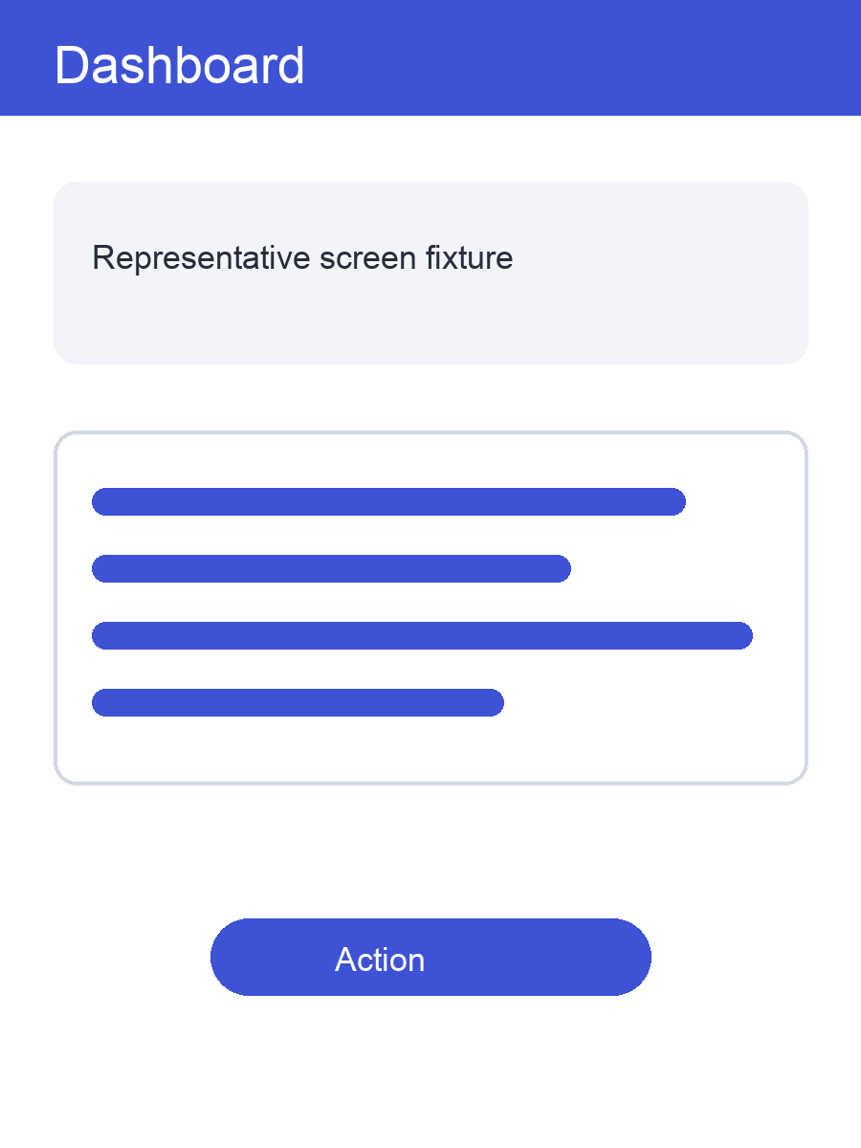
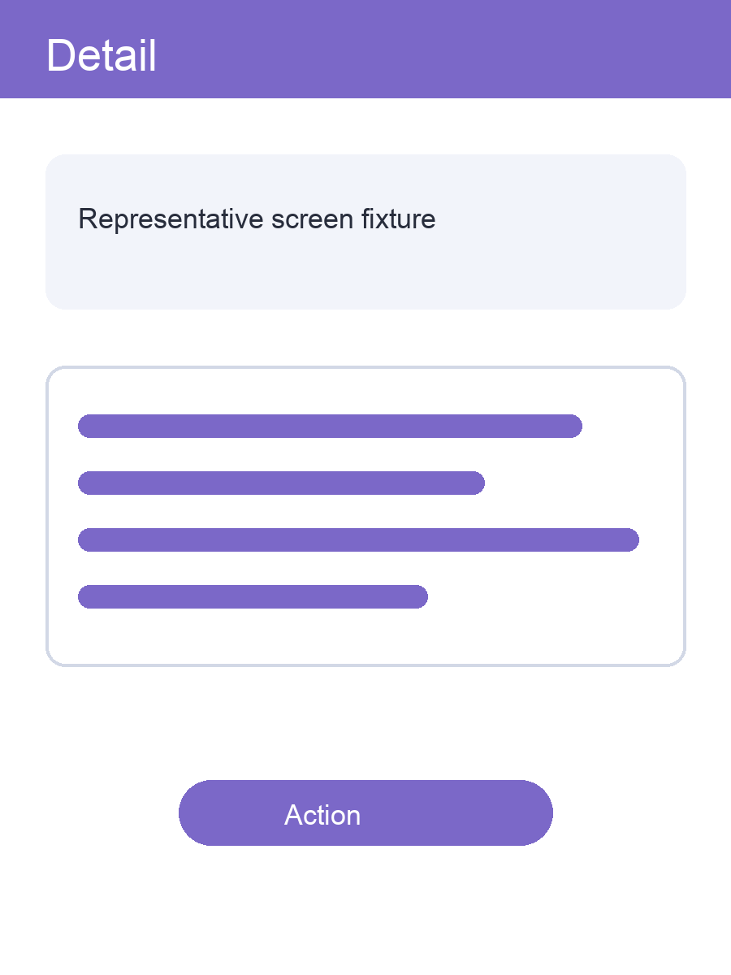
Screenshot Fixtures
Dashboard
Detail
deck skill catalog
14

Slide 17
Packaging Decision
Duplicated OS repos
One installable repo
Maintenance
Two divergent docs
One source of truth
Support claim
Easier to overstate
Beta clearly labelled
Install
Different paths
Same deck/ payload
deck skill catalog
15

Slide 18
“
The deck should make the decision visible before it looks pretty.
So-Yul workflow note
Design principle
deck skill catalog
16

Slide 19
20
Generated from the public builder API
PPTX, PDF, and contact sheet included
Representative page types in one catalog
deck skill catalog
17

Slide 20
Publish Gate
●
README states install path
Clone plus symlink/copy
●
Windows claim scoped
Beta only
●
macOS render evidence
PPTX and embedded-font PDF
○
Windows target evidence
Run on a physical Windows host
3 / 4 통과 · 전 항목이 통과해야 게이트가 열린다
deck skill catalog
18

