Slide 1
FLEXPART versions
Ignacio Pisso
NILU
1st July 2019
Ignacio.Pisso@nilu.no

Slide 2

Outline
Brief FLEXPART versions history (up to v9)
FLEXPART forks, for different regional models, CTMs, GCMs and meto input
FLEXPART development branches
FLEXPART 10.3 current release candidate
Current and future developments

Slide 3
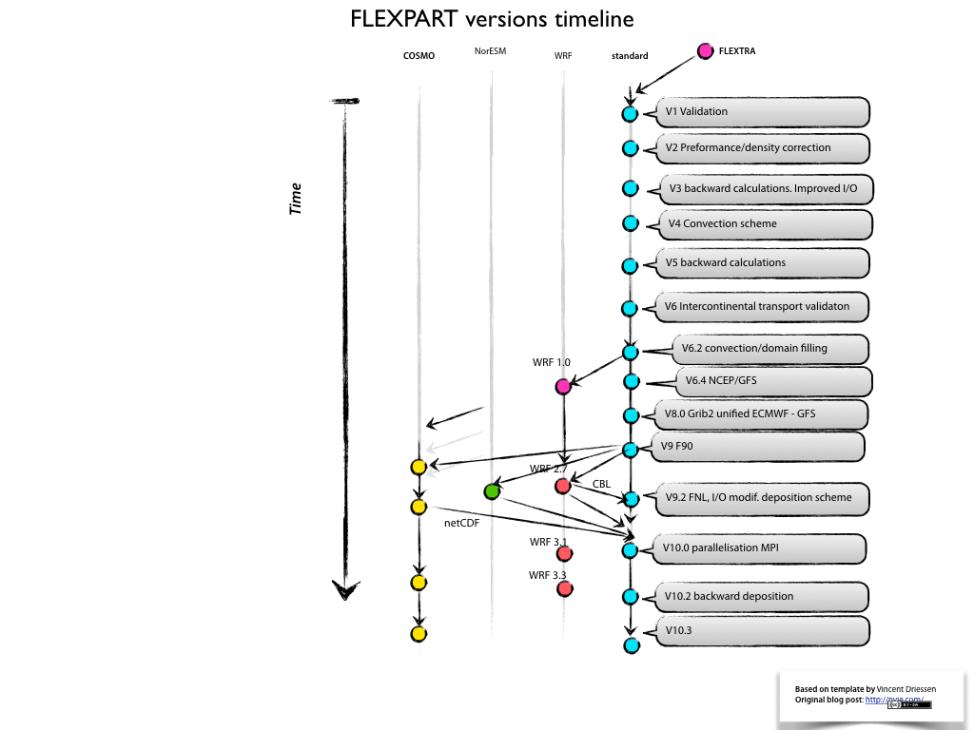

Slide 4

FLEXPART v1 and v2
Further development of the trajectory model FLEXTRA
Gridded output of concentrations of chemical species and radionuclides
Meteorological input data based on ECMWF's specific GRIB-1 (Gridded Binary) format
First applied in an extensive validation study using measurements from large scale tracer experiments
Deposition module (v2)

Slide 5
FLEXPART v3 and v4
Improvements in performance
Subgrid scale terrain effects parametrization
Output format (sparse matrix) optimized (3.1)
Optional mixing ratio and particle positions output (3.1)
PBL density correction (3.2)
1st convection scheme (3.2)
Mass fluxes across grid cell faces (3.2)
Convection scheme of Emanuel and Živkovic ́-Rothman (v4)

Slide 6
FLEXPART v5 and v6
Unit of the backward calculation was changed to seconds
Validation during intercontinental air pollution transport studies 1990s, 2000s (v5)
Corrections of the numerics in the convection scheme (v6.0)
Domain-filling option
Nested output

Slide 7
FLEXPART v5 and v6
Sources and receptors in both mass and mixing ratio units (v6.2)
Use of NCEP GFS meteorological input data possible (v6.4)

Slide 8
FLEXPART v8
v7 unreleased internal version
Unified the code for ECMWF-IFS and NCEP-GFS input data (different makefiles)
Fortran 90 constructs introduced in parts of the code
Global land use inventory
Gridded sensitivity to initial conditions in backward model runs

Slide 9
FLEXPART v8 cont.
Distinguished between in-cloud and below- cloud scavenging for washout
One definition file per species
Gravitational settling scheme for heavy particles

Slide 10
FLEXPART v9
Source code transformed to the Fortran 90 free-form format
Option to produce output in compressed NetCDF 4 format
Option to output surface gridded output only
Wet deposition in-cloud and below-cloud

Slide 12
Some of the FLEXPART forks
MM5, WRF–PILT (deprecated)
WRF 3.3
AROME
FLEXPART-NorESM/CAM
COSMO
FLEXPART-CTM
TRACZILLA
FLEXCPP, Etc.

Slide 13
FLEXPART-WRF
Uses output from the Weather Research and Forecasting (WRF) mesoscale model.
Originally developed at the Pacific Northwest National Laboratory, named PILT (PNNL Integrated Lagrangian Transport).
New FLEXPART-WRF can use both instantaneous and time-averaged WRF output.
Includes the skewed turbulence scheme, subsequently exported to the standard FLEXPART
Output can either be binary or NetCDF format, both of which have efficient data compression.
Parallelisation with Open-MP in shared memory and MPI in distributed memory.

Slide 14
FLEXPART-NorESM/CAM
Tailored to run with the meteorological output data generated by the CMIP5-version of NorESM1-M (the Norwegian Earth System Model)
1.89◦× 2.5◦horizontal resolution
26 vertical levels
Based on FLEXPART V9
the atmospheric component of NorESM1-M based on CAM4 (the Community Atmosphere Model).
New routines to read meteorological fields,
New post-processing routines to obtain the vertical velocity in the FLEXPART coordinate system

Slide 15
FLEXPART-AROME
The Applications of Research to Operations at Mesoscale (AROME) numerical weather prediction model is run operationally by Météo France at mesoscale. AROME forecasts for Europe exist at a resolution ranging from 0.5 to 2.5 km
Based on FLEXPART-WRF, using AROME high-resolution (2.5 × 2.5 km²)
Simulates turbulent transport using the Thomson turbulent scheme (Thomson, 1987), already implemented by Lin et al. (2003) in the stochastic time-inverted Lagrangian transport (STILT) model.
This method constrains mass transport between different turbulent regions to conserve mass locally for a passive well-mixed tracer.
Turbulent kinetic energy profiles are taken directly from AROME model outputs.
This ensures consistency between the turbulence in the meteorological fields calculated by the NWP model and turbulence computed in the offline Lagrangian transport model.
Simulations using the Thompson scheme show better representation of the turbulent mixing between boundary layer air and free tropospheric air.

Slide 16
FLEXPART COSMO
In Europe several national weather services and research groups develop and operate the non-hydrostatic limited-area atmospheric model COSMO (Consortium for Small-scale Modeling).
At MeteoSwiss COSMO is operationally run with data assimilation on two grids with approximately 7 × 7 km² and 2 × 2 km² horizontal resolution centered over Switzerland. This enables the study of atmospheric transport over complex terrain on a long-term basis.
FLEXPART-COSMO coupled to COSMO output, supports output from multiple COSMO nests.
Uses native vertical coordinate system used in COSMO and not, as in standard FLEXPART, in a terrain following z-system. This eliminates the need for an additional interpolation step.
New flux de-accumulation scheme removes the need for pre-processing of input files.
In addition to the Emanuel convection parameterisation, uses the Tiedtke scheme, as in COSMO.
Possibility for offline nesting of FLEXPART-COSMO into a FLEXPART-ECMWF for backward simulations allows particles to leave the limited COSMO domain.
The OpenMP shared-memory parallelisation allows for asynchronous reading of input data.

Slide 17
TRACZILLA
Fork from FLEXPART version 5 originally developed for studies of transport and mixing in the upper troposphere- lower stratosphere region.
The modifications from FLEXPART advection scheme consists mainly in discarding the intermediate terrain following coordinate system and in performing a direct vertical interpolation of winds, linear in log-pressure, from hybrid levels.
The vertical velocities are computed by the FLEXPART pre-processor using a mass conserving scheme in the hybrid ECMWF coordinates.
Alternatively the vertical velocities can be computed from the rates of diabatic heating from ECMWF winds.
Variable high atmosphere diffusivity.
In addition to the re-analyses from ECMWF, the current version can use MERRA (Modern-Era Retrospective analysis for Research and Applications) from NASA and JRA-55 (the Japanese 55-year Reanalysis) from JMA.
The parallelisation uses the OMP version of PGI.
All arrays are allocated dynamically

Slide 18
FLEXPART v10
New skewed turbulence scheme (instead of Gaussian statistics in the convective ABL)
Wet deposition scheme for aerosols revised: dependencies on aerosol size, precipitation type (rain or snow) and distinguishing between in-cloud and below-cloud scavenging
Reading of 3D cloud water fields from meteorological input files

Slide 19
FLEXPART v10
Sensitivity of deposited quantities to sources in backward mode
Chemical reactions with the hydroxyl radical (OH) made dependent on the temperature
Parallelized using the Message Passing Interface (MPI)
Code unified in single executable for both ECMWF and GFS input data

Slide 20
FLEXPART v10
Dust mobilization scheme
Retrieval ECMWF data software modernized
Testing environments

Slide 21
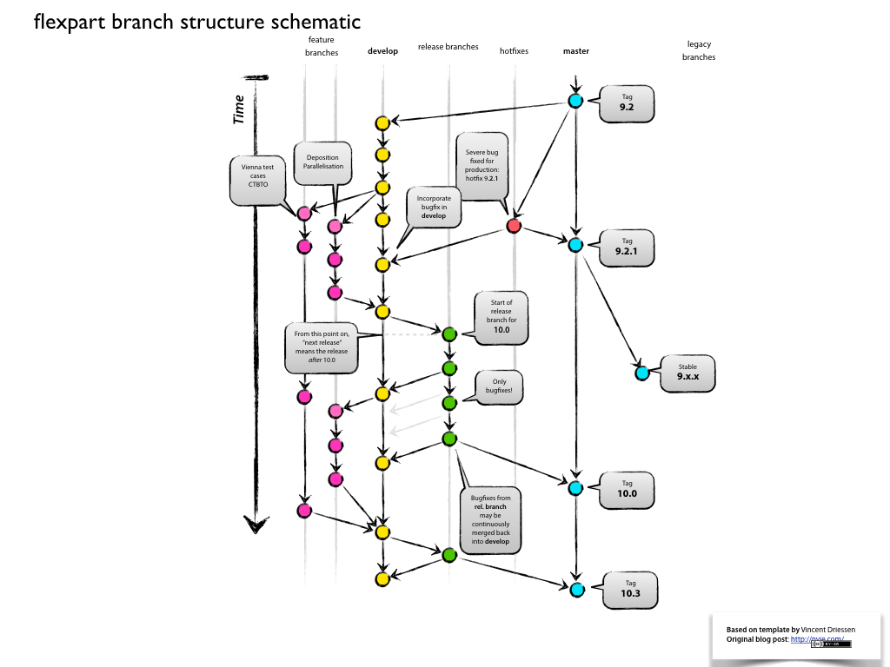

Slide 22
FLEXPART main development branches (main version)
master: stable version, last release
dev: development version (integrated at NILU)
hotfixes: only urgent bug fixes
release-10: current release
univie: contributions from U. Vienna
ctbto: contributions from
topical branches: GFS, input options, testing and integration...

Slide 23

Current and future developments
Integrate the ingestion of different meteorologies (e.g. regional models, climate/chemistry models, various reanalysis)
Plume raise model
Further development of the deposition scheme
Increased support for chemical modeling
Further development of the mixing scheme (e.g. turbulent intermittency)
Further development of the testing protocols

