Slide 1
FLEXPART in a nutshell
Questions? Write delia.arnold-arias@zamg.ac.at
Notes:
1

Slide 2

What is FLEXPART?
The is…
flexpart.eu
… a (Flexible) Lagrangian Particle Dispersion Model, originally developed at the University of Natural Resources and Life Sciences in Vienna, further developed by its main developer Andreas Stohl at the Norwegian Institute for Air Research in the Department of Atmospheric and Climate Research and with by group of developers in different institutions
It is released under the GNU General Public License V3.0
Variety of applications and application environments:
Operational / Quasi-operational → CTBTO, ZAMG, Meteoswiss, ...
Research → NILU, BOKU-Met, INTE, ZAMG, Reunion University, ...
Others → including private companies/consultancies
Notes:
2

Slide 3
What is FLEXPART?
First:
Track the particles in a given velocity field.
Second:
Model the Sub-grid scale (SGS) unresolved physical processes that affect the particles dispersion:
Boundary Layer Turbulence
Mesoscale Turbulence
Cumulus turbulent convection
Third:
Modify particles properties based on locally acting processes, e.g. radioactive decay , deposition
Fourth:
Count particles in a volume and extract concentration value
Notes:
3

Slide 4
What is FLEXPART?
EMISSIONS:
Computational particles can carry more than one species (MIND that then there is automatic switching off of gravitational settling)
Emissions can include radionuclides (radioactive decay specified in the SPECIES_XXX files)
Emissions can be tracked independently (even if the same species is emitted)
Releases have to be defined as one or multiple sets of rectangular prisms , allowing for point, line, area and volume sources. Coordinates given in lat lon m or meters in the projection space only for the WRF version
URC lat/lon
LLC lat/lon
Notes:
4

Slide 5
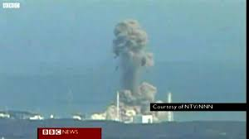
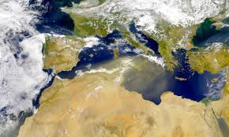
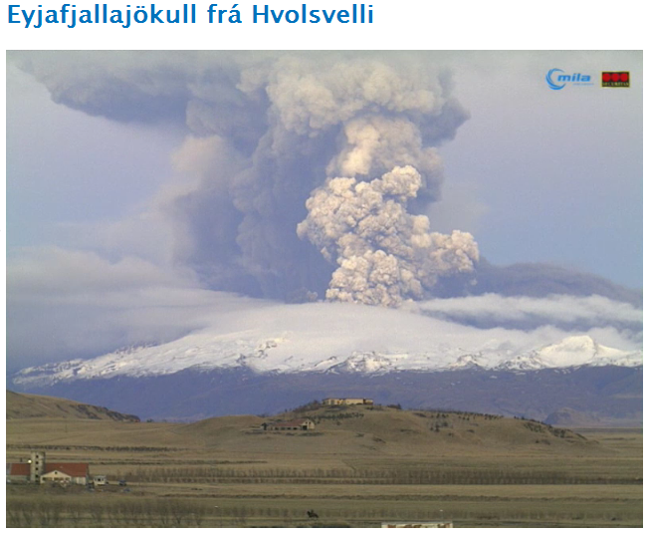
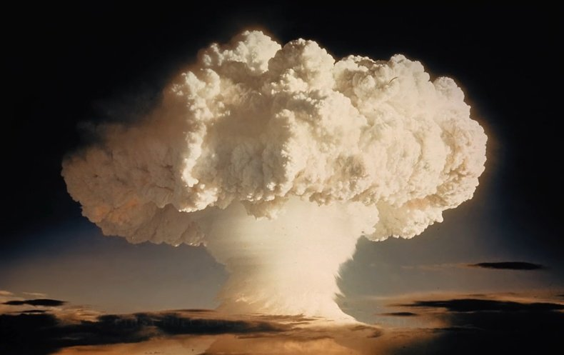
What is FLEXPART?
EMISSIONS in the real world:
Linear emission in the vertical
Area sources
More complex sources
Notes:
5

Slide 6
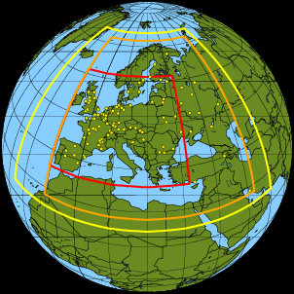
What is FLEXPART?
DOMAINS:
Computational domain defined by the meteorological outermost domain (yellow)
Output grid must be smaller than computational grid and can contain one single higher resolution (in the horizontal) domain (orange and red)
Nesting is allowed, both in the input (user-defined, usually 2) and in the output (max 1 nest)
Notes:
6

Slide 7

… some very useful aspects
Parallelised
NetCDF output for easy visualization
Testing environment
Easy to automatise
Improved python-based extraction routines
Active and engaged developers
Flexpart.eu system (issue tracking, version control, other information)
Mailing list: at ​https://lists.univie.ac.at/mailman/listinfo/flexpart. As the this website has been blocked for certain countries because of high spam levels, you have the alternative to subscribe by sending email to ​flexpart-request /at/ lists.univie.ac.at (pls correct the address manually - spam protection), no subject and subscribe flexpart in the mail body.
Robust, with an active scientific community improving it constantly, used in many research centers BUT also in operational centers! Computationally very efficient, versatile.
Notes:
7

Slide 8

… what is not...
User friendly
No GUI interface
No detailed manual with examples BUT:
Special issue: https://www.geosci-model-dev.net/special_issue878.html
Detailed manuscript: https://www.geosci-model-dev-discuss.net/gmd-2018-333/ Pisso, I., Sollum, E., Grythe, H., Kristiansen, N., Cassiani, M., Eckhardt, S., Arnold, D., Morton, D., Thompson, R. L., Groot Zwaaftink, C. D., Evangeliou, N., Sodemann, H., Haimberger, L., Henne, S., Brunner, D., Burkhart, J. F., Fouilloux, A., Brioude, J., Philipp, A., Seibert, P., and Stohl, A.: The Lagrangian particle dispersion model FLEXPART version 10.3, Geosci. Model Dev. Discuss., https://doi.org/10.5194/gmd-2018-333, in review, 2019.
No easy to use web interface, not even for past events.
Compressed difficult to use (but very efficient) output format now alleviated by the NetCDF option.
ECMWF Meteorological data can not be directly used and processing and expertise is required
ECMWF data must be extracted with specialized (provided) software.
Libraries usually are one of the most problematic aspects for new users
Notes:
8

Slide 9
FLEXPART more detail
Notes:
9

Slide 10
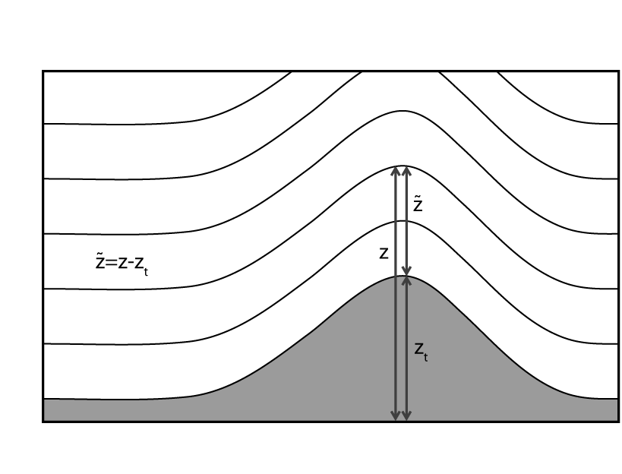
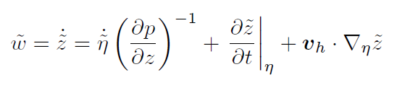
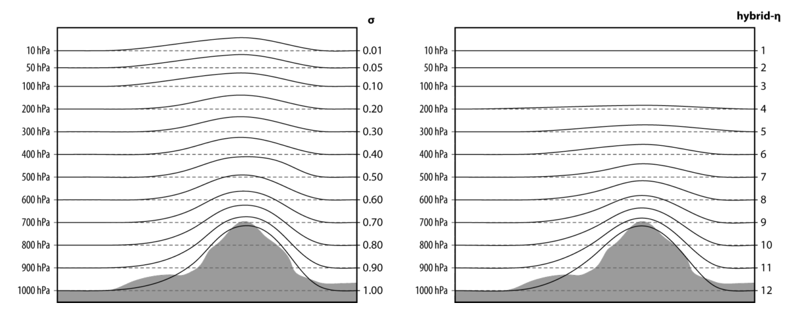
FLEXPART in a nutshell
COORDINATES:
FLEXPART internal coordinates are regular i,j positions with respect to the lower left coordinate of the computational domain
FLEXPART needs the vertical velocity in m s⁻¹ because of the parametrized random velocities
verttransform.f
verttransform_gfs.f
Notes:
10
10

Slide 11
FLEXPART in a nutshell
PBL:
Boundary layer height calculated using critical Richardson number (Vogelezang and Holtslag, 1996). All parameters needed for parametrization coming/derived from the meteorological data (stresses, ustar, L)
If convective (unstable) situations then one iteration is made (max number iterations 3) to account for excess temperature due to thermal rising
To notice:
Related to the temporal interpolation of the BL height:
Nothing can be done here → importance of having frequent input data (3 hours)
Interpolated blh
x
12
18
Notes:
11
11

Slide 12
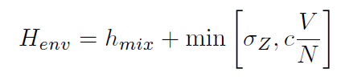
FLEXPART in a nutshell
12
18
Spatial heterogeneities – not interpolated to particle position, but the max in space and time
h1
h2
h5
h6
Particle sees blh = h6
h3
h4
h7
h8
advance.f
t1?
t2?
FLEXPART workaround – envelope mixing height
If unstable hmix + sigz
If stable then depending on Froude number
Remember to set an appropriate hmix_min in includepar or similar module!
Notes:
12
12

Slide 13
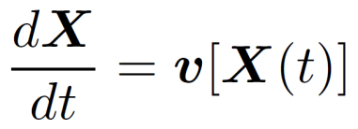
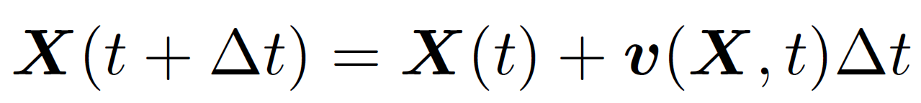
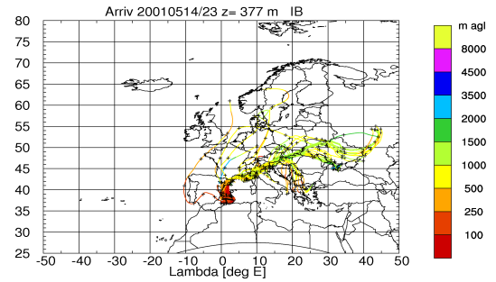

FLEXPART in a nutshell: transport/diffusion
TRANSPORT AND DIFFUSION:
FLEXPART calculates trajectories of computational particles (each particle carries a certain amount of mass or mixing ratio of species – computational -, as defined in the releases) (change of mass described later)
Integration (1st order, zero acceleration scheme)
Grid scale wind → what simple trajectory models use (e.g. FLEXTRA)
Turbulent wind fluctuations
Mesoscale wind fluctuations (meandering)
October 2012
Notes:
13
13

Slide 14
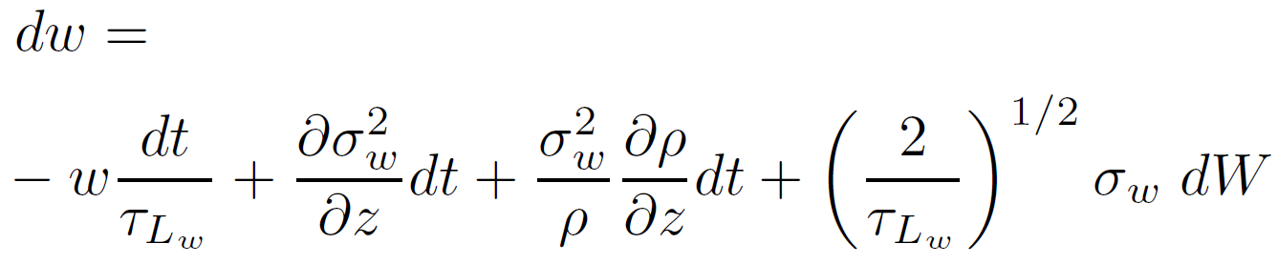
FLEXPART in a nutshell: transport/diffusion
Turbulent wind fluctuations
FLEXPART calculates the turbulent motions assuming a Markov process (for the velocity) based on the Langevin equation (Thomson 1987)
drift
diffusion
Wiener process - stochastic
We need to assume certain statistical proprieties of the atmosphere to sample dW and solve the equation – gaussian turbulence (not valid for skewed turbulence in convective)
w(0) = wr
σ²_{u}= avg(u²)
Average speed non-zero
Notes:
14
14

Slide 15
The guts of FLEXPART : transport/diffusion
Turbulent wind fluctuations
HOWEVER two corrections are needed:
Drift correction (McNider at al. 1988) – to prevent accumulation of particles in areas of low-turbulence
Density correction (Stohl and Thomson 1999) – to account for the decrease of air density with height
Sample only for the vertical velocity, horizontal no drift/density corrections
October 2012
Notes:
15
15

Slide 16
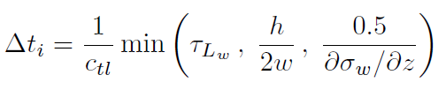

FLEXPART in a nutshell: transport/diffusion
Which time step?
COMMAND
Two possibilities:
Fixed time step (=synchronisation time) without adaptation to the lagrangian timescales → FASTER but LESS ACCURATE (COMMAND ctl <0) may be useful for long range applications if computational resources are limited
Time step adapting to the vertical lagrangian time scales → turbulence is described in a more accurate/realistic way (COMMAND ctl >0, ifine) and thus needed for any BL studies – the time step for the horizontal will be defined as:
The time step in the vertical is split:
Notes:
16
16

Slide 17


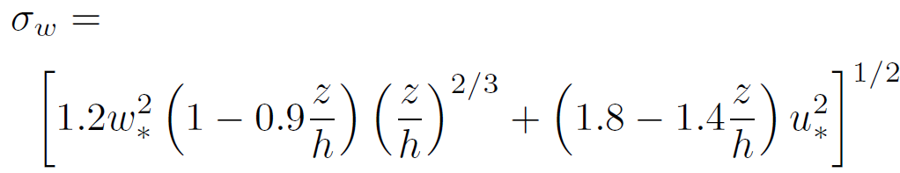


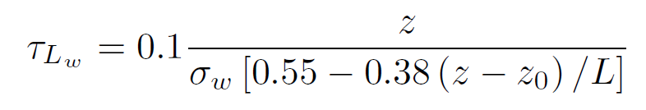
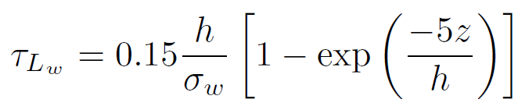
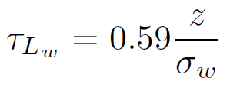
FLEXPART in a nutshell: transport/diffusion
Vertical profiles of the turbulent quantities inside the ABL
Depend on the state of the turbulent atmosphere. Following Hanna 1982.
Unstable meteorological conditions
Notes:
17
17

Slide 18
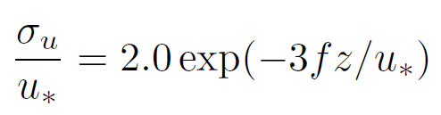
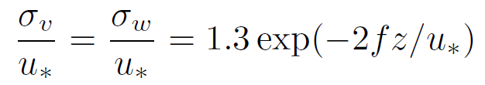
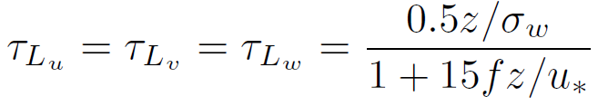
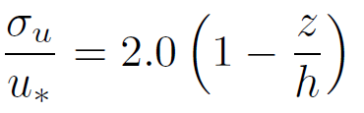
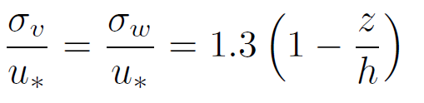
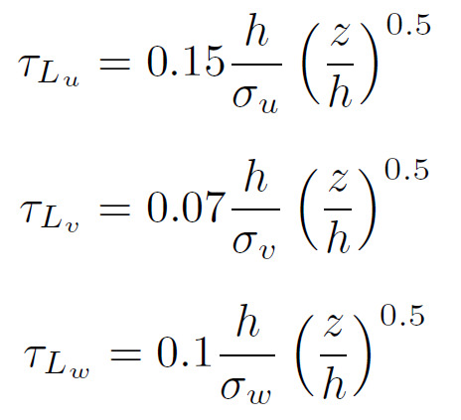
FLEXPART in a nutshell: transport/diffusion
2. Neutral
3. Stable
Notes:
18
18

Slide 19



FLEXPART in a nutshell: transport/diffusion
What about above the ABL?
In the free atmosphere turbulence is in small places coming from gravity waves, around jet streams... it is not yet parameterized in detail.
FLEXPART treats the stratosphere with a constant vertical diffusivity (Legras et al. 2003)
And a constant horizontal diffusivity in the free troposphere
with an intermediate zone from free-troposphere to stratosphere. Turbulent velocity scales are then calculated by
Notes:
19
19

Slide 20
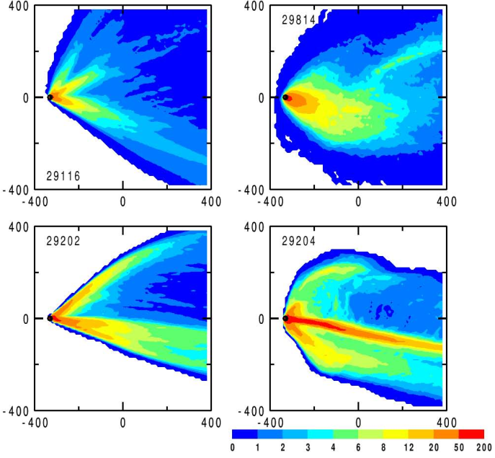
FLEXPART in a nutshell: transport/diffusion
Mesoscale wind fluctuations (important for very low wind conditions)
Fluctuations neither resolved by ECMWF nor by the turbulence parameterization, created by mountain waves, pulsating drainage flows, wake vortices, ...
FLEXPART solves another Langevin equation and assumes that the variance of the wind a the grid scale provides sub-grid scale information (Maryon 1998) → this acts as a source of dispersion (without really physically representing the phenomena)
Vickers, D., Mahrt, L. and Belusic, D. 2008. Particle simulations of dispersion using observed meandering and turbulence. Acta Geophys. 56 (with permission of authors)
Notes:
20
20

Slide 21
FLEXPART in a nutshell: transport/diffusion
Gravitational settling
Trajectories for aerosols are modified due to gravitational settling – a vertical velocity due to gravitational settling is added to the vertical velocity at each time step (get_settling.f90)
Based on obtaining the Reynolds number and settling velocity with dependence on temperature of the dynamic viscosity(Naeslung and Thaning 1991 and Sutherland 1893)
Particles are considered spheres
Notes:
21
21

Slide 22
FLEXPART in a nutshell: more?
See Seibert’s and Thompson lectures:
Deep convection
Loss processes:
Dry deposition
Wet deposition
OH reaction
Radioactive decay
Notes:
22
22

Slide 23
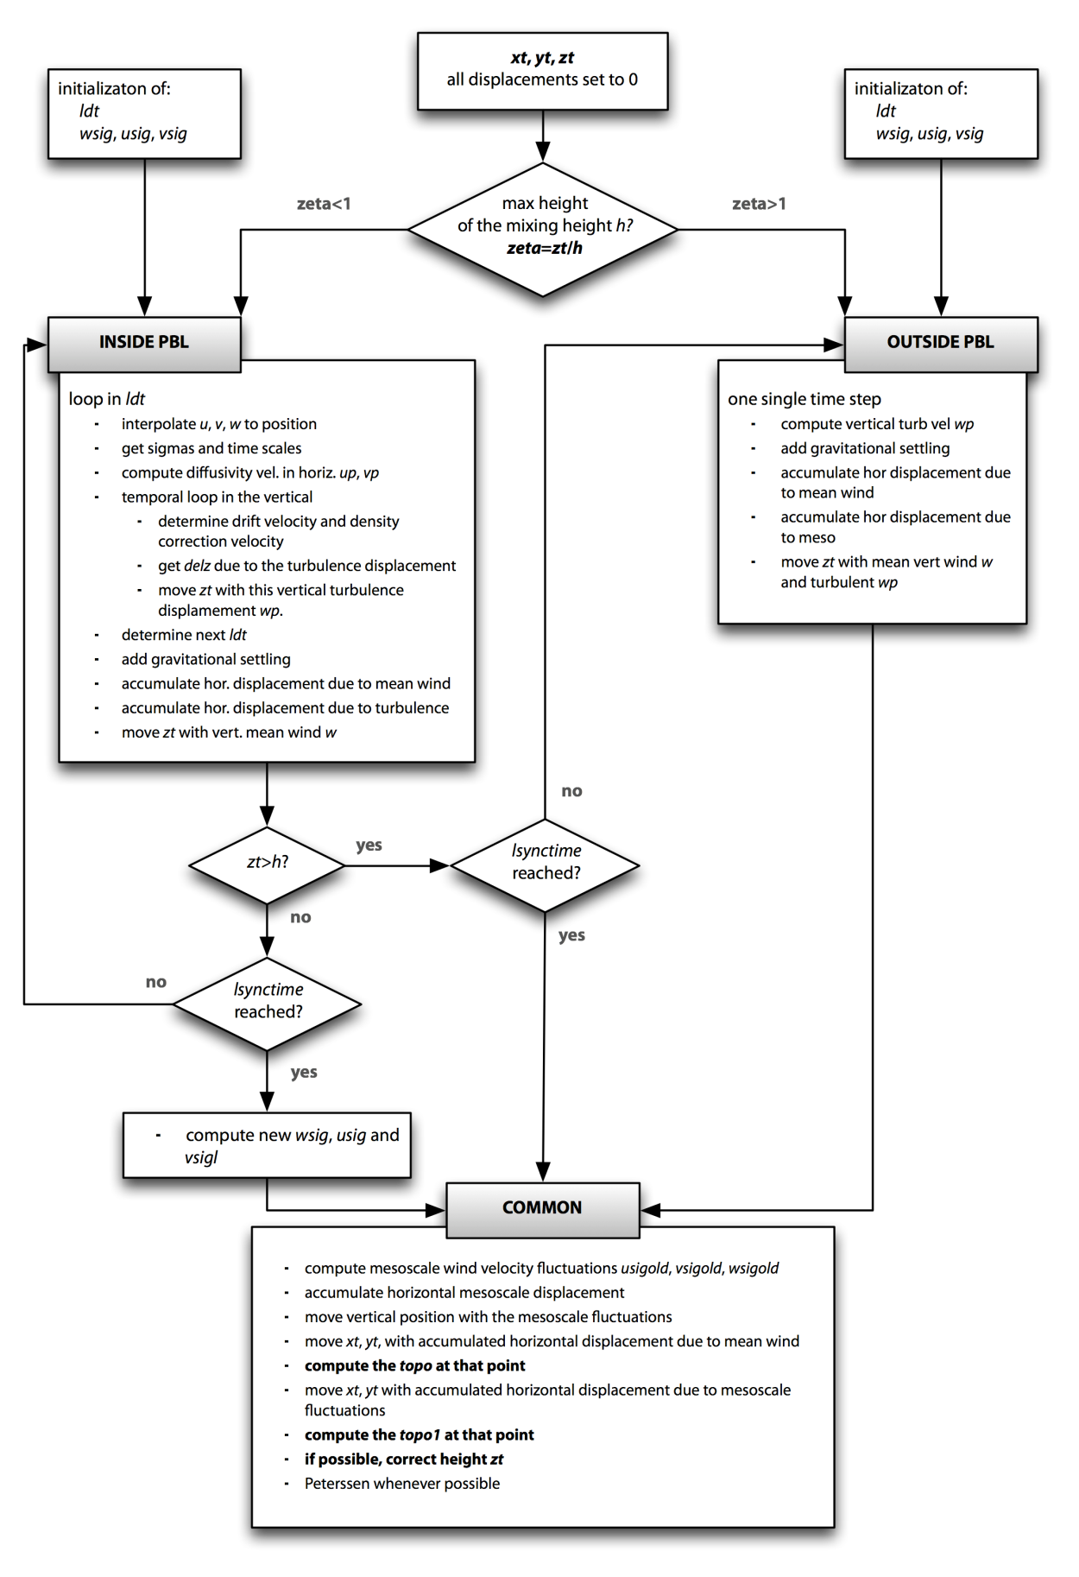
The life of a particle
Notes:
23
23

Slide 24
Additional features … many
Plume trajectories
Particles are clustered into a number of trajectories (ncluster in includepar) via k-means clustering using the horizontal distance as the distance function. The centroids are given by x,y,z but z is not used in the clustering algorithm
Warm start
Particle positions may be dumped (with additional information) and used for a warm start.
Notes:
24
24

Slide 25
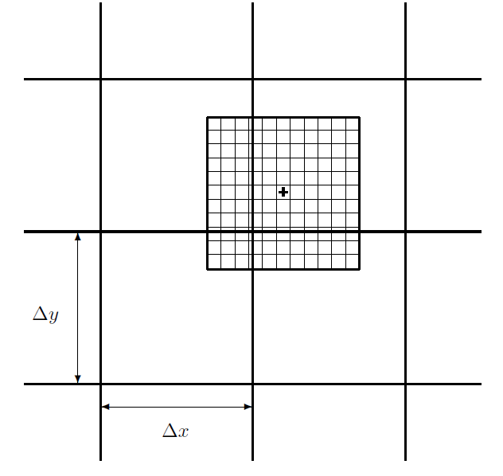
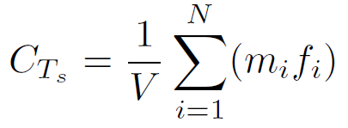
FLEXPART output: kernels
Concentration /residence time uniform kernel
The mass of a particle is distributed into the adjacent grid cells.
It is not used the 3 hours after the particle release to avoid smoothing → CAREFUL! The default flexpart version does use the kernel for dry and wet deposition regardless the time.
To know:
Concentrations are given as time averages whereas deposition is accumulated within the interval time and along the run
Radioactive decay IS applied to the deposited substance
Notes:
25
25

Slide 26
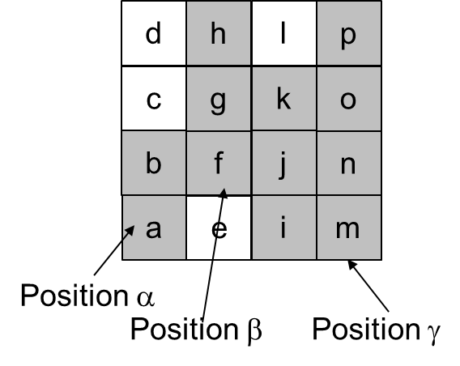
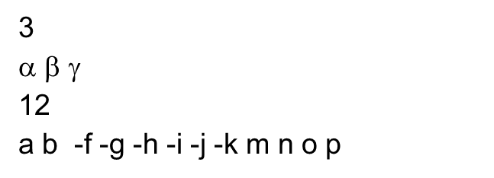
FLEXPART output – the STRUCTURE
Condensed sparse matrix output
pseudocode:
For species
For maxpoint
For ageclasses
(wetdepo)
sp_count_i=0
sp_count_r=0
sp_fact = -1
sp_zer = .true.
For y direction
For x direction
If wetgrid > 0 then
If sp_zer = .true. Then → first non 0 value
sp_count_i = spcount _i + 1 (total number of non-zero segments)
sparse_dump_i → index of non-zero segment
sp_zer= . False.
sp_fact = sp_fact*-1
sp_count_r = sp_count +1
sparse_dump = value of wet deposition (FACTORS! 1E12)
Else no wetgrid and sp_zer = .true
write(unitoutgrid) sp_count_i
write(unitoutgrid) (sparse_dump_i(i),i=1,sp_count_i)
write(unitoutgrid) sp_count_r
write(unitoutgrid) (sparse_dump_r(i),i=1,sp_count_r)
Notes:
26
26

Slide 27
FLEXPART MODES
Notes:
27

Slide 28
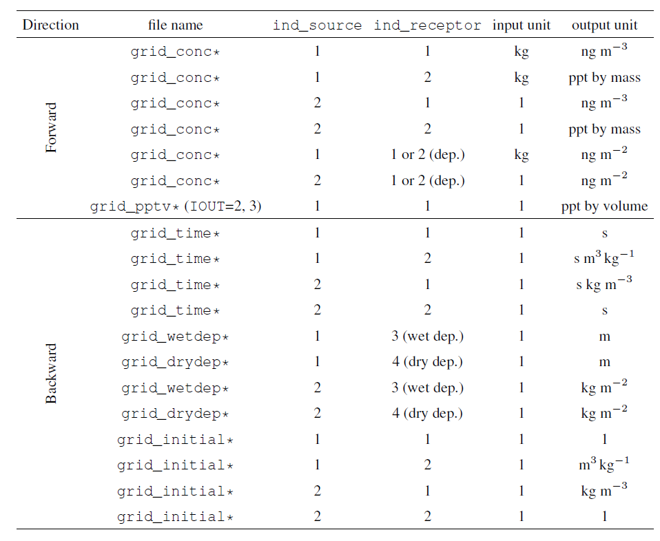
Forward and backward runs
Forward: the particles are released from the emission location(s) and a 4-D (space + time) concentration output is the result. Deposition fields are not output
COMMAND
Notes:
28
28

Slide 29
Forward and backward runs
Forward: the particles are released from the emission location(s) and a 4-D (space + time) concentration output is the result. Deposition fields are included in the concentration files
10**12 factor
COMMAND
Notes:
29
29

Slide 30
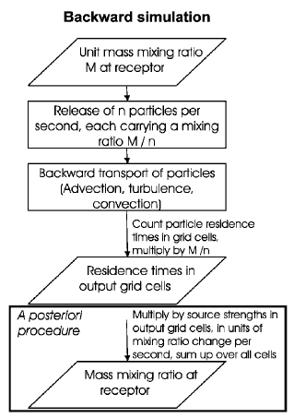
Forward and backward runs
Backward: the particles are released from a receptor (measurement site) and a 4-D (space + time) sensitivity function to the emision is given. This is especially useful to calculate source-receptor sensitivities when the number of receptors < number of potential sources. Everything is normalized with the mass released so any value other than 0 is correct. Dry and wet deposition correct the sensitivities. (Seibert 2001, Stohl et al. 2003, Seibert and Frank 2004).Deposition fields are not output
COMMAND
Notes:
30
30

Slide 31
Forward and backward runs
Backward: the particles are released from a receptor (measurement site) and a 4-D (space + time) sensitivity function to the emission is given. This is especially useful to calculate source-receptor sensitivities when the number of receptors < number of potential sources. Everything is normalized with the mass released so any value other than 0 is correct. Dry and wet deposition correct the sensitivities (Seibert 2001, Stohl et al. 2003, Seibert and Frank 2004).
COMMAND
NO 10**12 factor
Notes:
31
31

Slide 32
Other interesting aspects
Source receptor matrix calculation of deposited material
Question: where/when this deposited material may have originated from? Example: ice cores, precipitation samples
Eckhardt et al. 2017 introduced the option to calculate SRS for dry and wet deposition. See reference paper for details on set-up.
A couple of details:
For dry deposition “backtracking”, particles are released in a shallow layer
For wet deposition “backtracking”, particles are released in the whole column, and those with no scavenging are immediately terminated
Notes:
32
32

Slide 33
Other interesting aspects
Sensitivity to initial conditions
Question: how do we get the SRS for long-lived species and therefore those with “background” non-zero conditions? How do we treat the baseline?
Since version 8, FLEXPART provides the sensitivity functions to the initial conditions on the receptor.
Notes:
33
33

Slide 34
FLEXPART PRACTICAL ASPECTS
Notes:
34

Slide 35
Requirements
Libraries and installation:
ECCODES / GRIB_API – to decode meteorological data
For compressed GRIB2 data – Jasper libraries
If output in NetCDF is wanted, then NetCDF Fortran libraries are needed
Notes:
35

Slide 36
Structure and important files
Meteorological data
AVAILABLE
FLEXPART src
Options
files
par_mod.f90
makefile
RELEASES
OUTGRID
COMMAND
SPECIES
…
Notes:
36

Slide 37
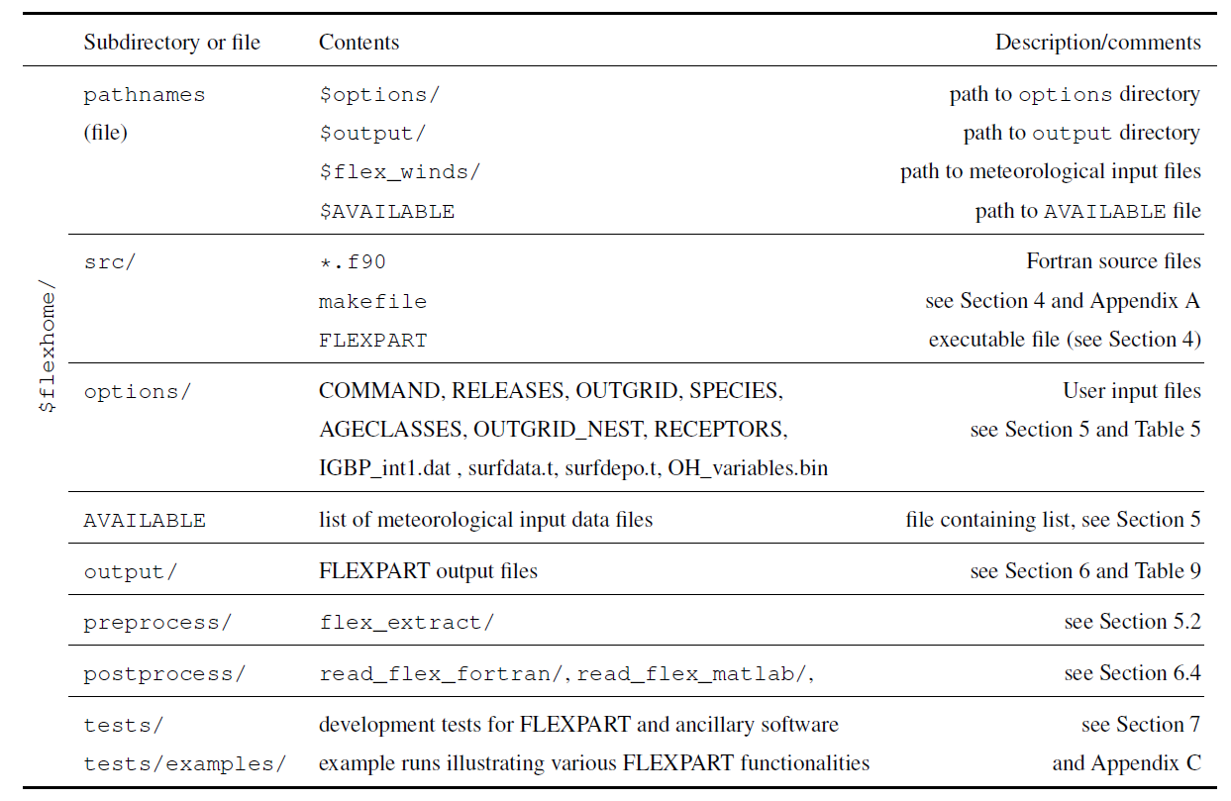
Requirements
Flexpart structure and input files
Notes:
37

Slide 38
Requirements
Flexpart structure and input files
Notes:
38

Slide 39
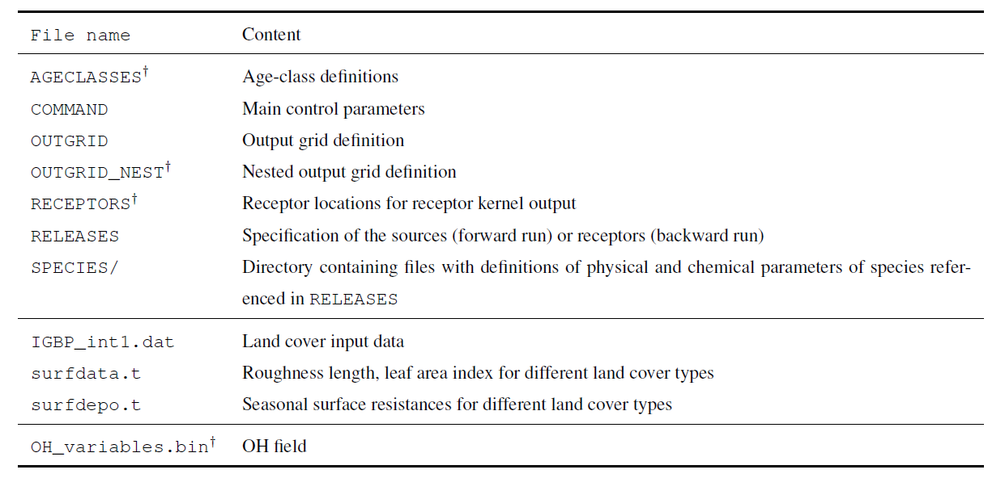
Requirements
Flexpart input files
Notes:
39

Slide 40
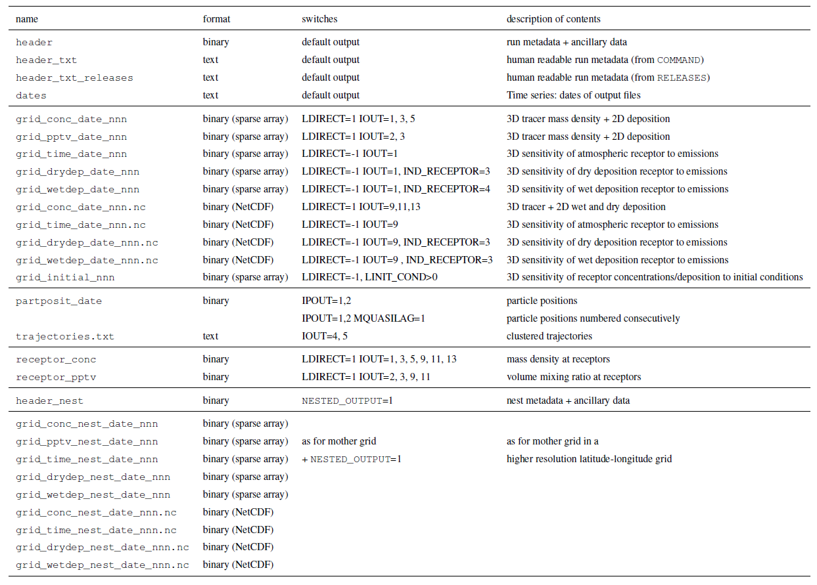
Requirements
Flexpart output files
Notes:
40

Slide 41
Requirements
Flexpart output files
Notes:
41

