Slide 1
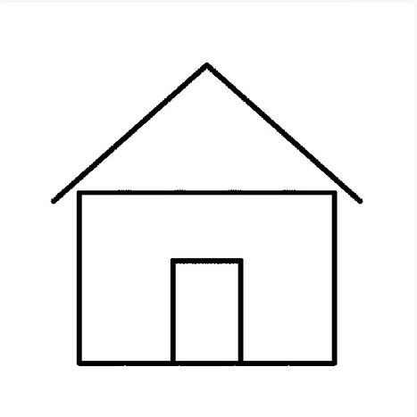
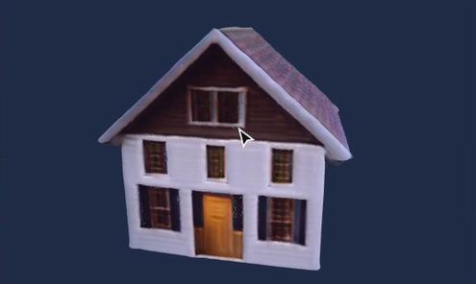
Sketch2Shape
Draw one object. Get a 3D model you can turn around.
No 3D skills. One sketch in, one textured model out.
98%
of this sketch's strokes landed on the model
TechZephyr 4.0 | IIT Bhubaneswar
Notes:
Sketch2Shape turns one sketch, drawn or uploaded, into a textured 3D model. A prompt is optional. This house is a real result from the app.

Slide 2
Sketches carry ideas, not depth
1
No depth
One view says nothing about volume
2
No back
Hidden sides must be imagined
real 3D, real texture
3
Rough lines
Edges alone can't build an object
Goal Keep the sketch's shape. Imagine the rest. Export a file any 3D tool can open.
Notes:
3D modeling takes expert skills, but ideas often start as sketches. A single view has no depth or hidden surfaces, so the system has to interpret lines and imagine what is missing while staying faithful to the drawing.

Slide 3
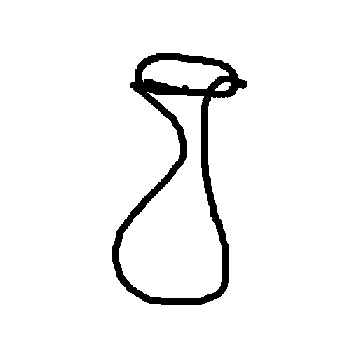
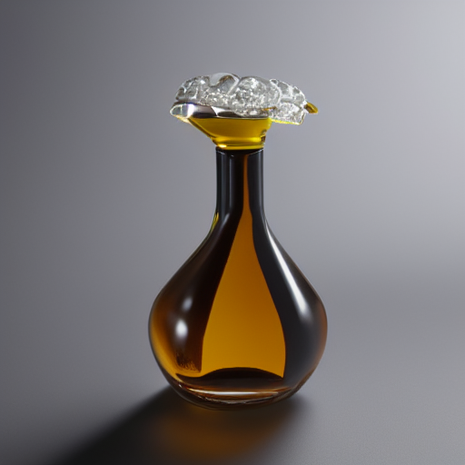
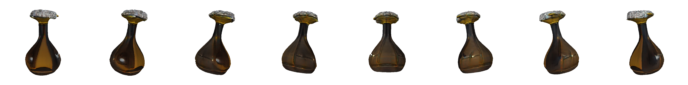
Seven stages, with checks that retry
Failed a check? New seed, up to 3 tries
Clean
OpenCV
Understand
CLIP
Paint
SD 1.5 + ControlNet
Isolate
rembg
Build 3D
TripoSR
Finish
trimesh, xatlas
Validate
reload, check
sketch
image
3D model from 8 sides. Real run, no prompt
Notes:
Clean the sketch. CLIP names it if there is no prompt. Stable Diffusion 1.5 with ControlNet Scribble paints an image that follows the lines. rembg isolates the object. TripoSR builds the mesh. Then we clean it, bake the texture and export .glb and .obj. Files are reloaded and validated. If the object drifts from the sketch or validation fails, it retries with a new seed. Failures raise a stage-named error, never a fake result.

Slide 4
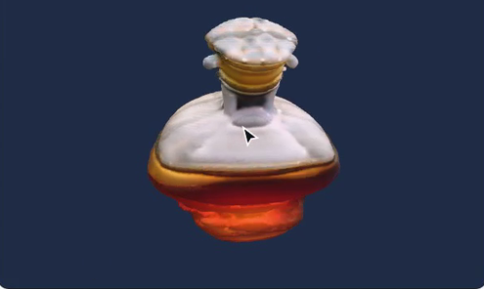
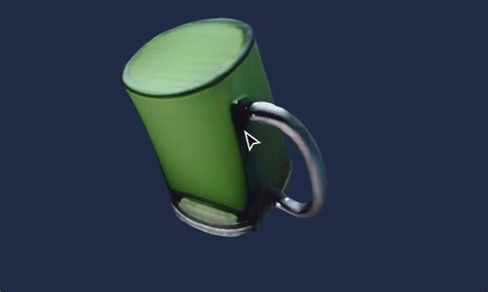
Real models, measured on every run
Neat house
98% match
18 / 18
97%
valid models
strokes on the model
Rough vase
85% match
31 s
2.68 GB
per model
peak VRAM
Uploaded mug
98% match
18 runs on an RX 9070 XT: 2 distinct user sketches plus scripted variations, so not a general accuracy claim. Silhouette IoU averaged 0.65.
Notes:
Every run records its own metrics. 18 of 18 models were valid, about 97 percent of strokes landed on the model, a model takes about 31 seconds and peak VRAM is 2.68 GB. The house and mug scored 98 percent and the rough vase 85 percent. The test set is small, so these are not a general accuracy claim.

Slide 5
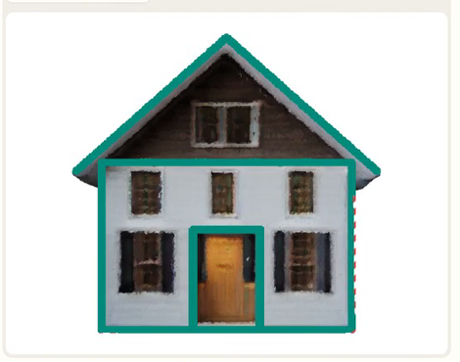
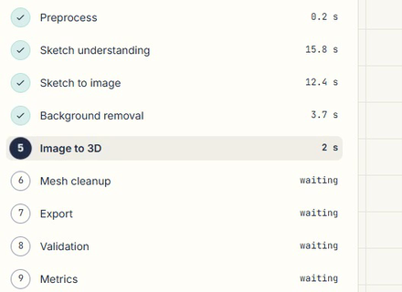
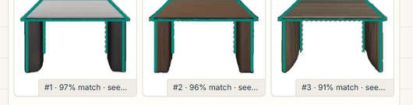
It shows its work and checks itself
Sketch match
Ranked variants
Live stages
Your strokes over the model. Teal hit, dashed red missed.
Three seeds, best sketch match first.
Every step with its real time.
CLIP names it, no prompt needed
Ink check before slow 3D
Runs on AMD via ROCm
Notes:
Most tools hide how faithful the result is. Sketch match draws the strokes over the model so you can see it. Variants generates three models and ranks them by how well they follow the sketch, not by looks. Live stages show each step and its time. CLIP names the sketch when there is no prompt, an ink check retries before the slow 3D step, and it runs on an AMD GPU despite NVIDIA-focused tooling.

Slide 6
Honest limits, real uses, full disclosure
Limits
Uses
Disclosed
Backs and sides are guesses
Thin parts come out thick
Full runs on one AMD GPU
Product design
Architecture
Games and education
Pretrained models, no custom dataset
AI used: Claude Code, Claude Design
Everything logged in ATTRIBUTION.md
Now hand us a fresh sketch
github.com/SoAkeD1/sketch2shape
Notes:
Be upfront: hidden geometry is a plausible guess, thin repeated parts are weak, and full runs were tested on one AMD GPU. We used pretrained models with no custom dataset, and AI assistants as logged in ATTRIBUTION.md. Start the app before this slide, because startup takes about 60 seconds. Then invite a fresh sketch from the judges.

