Slide 1
Dynamic Partial Reconfiguration for Fault-Tolerance in automotive ECUs
Andreas Hirtenlehner, Rupert Schorn, Peter Schober, Constantin Schieber

Slide 2
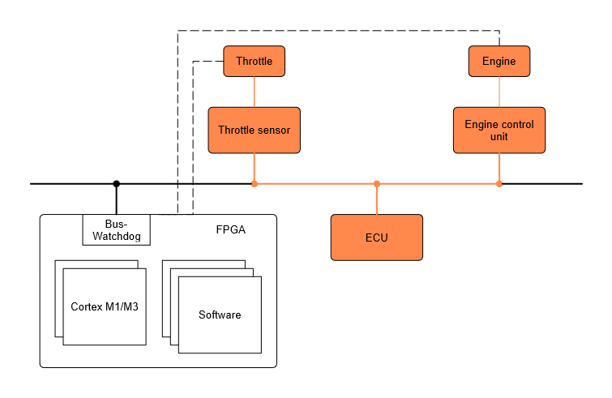
Designed Architecture

Slide 3
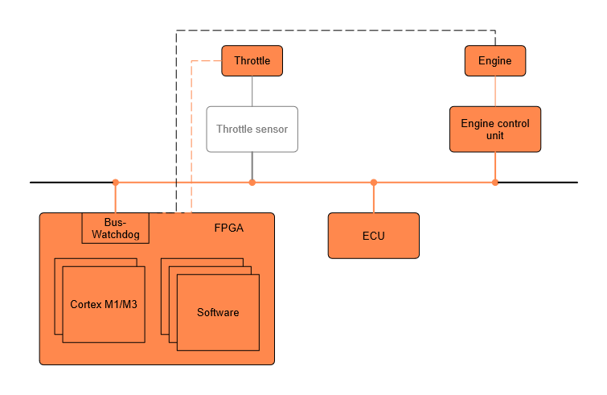
Designed Architecture (malfunction)

Slide 4
FPGA Design
Top.vhd
Cortex_wrapper.vhd
AXI_Interconnect_inst
AXI
Cortex_Inst
AXI Interconnect
Initialization Processor
AXI
Cortex_wrapper.vhd
AXI
Vivado Block Design
AXI_Interconnect_inst
AXI Peripherals
BUS
Cortex_Inst

Slide 5
Partial Reconfiguration I
Still provides enough challenges
Evaluation of possible solutions based on Xilinix Microblaze
Better documentation and faster compile time

Slide 6
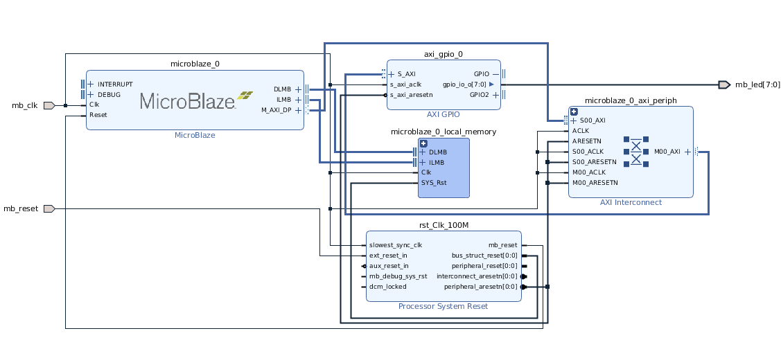

Partial Reconfiguration II
Create packaged IP for DPR-Part
Notes:
Mention Problems:
- not possible to configure clock within PR Parition
- not possible to utilize PR in a Block Design
When selecting Pblock ranges to define the size and shape of the Reconfigurable Partition, do not use the CLOCKREGION resource type for 7 series or Zynq-7000 designs. Pblock ranges must only include types SLICE, RAMB18, RAMB36, and DSP48 resource types.

Slide 7
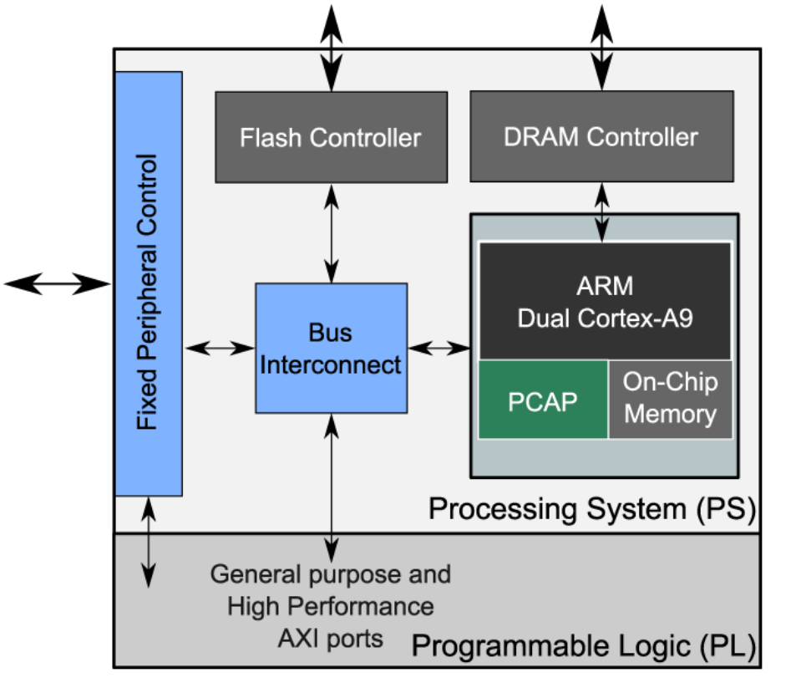
Partial Reconfiguration III
Decide between PCAP and ICAP
[1] K. Vipin and S. A. Fahmy, “ZyCAP: Efficient Partial Reconfiguration Management on the Xilinx Zynq"
Notes:
PCAP yields way superior performance metrics
Better usable

Slide 8
Partial Reconfiguration IV
Create .bin file for partial bitstream
Xilinx provides tool "write_cfgmem" for this
Documentation always uses DDR for PR
SD-Card --> DDR --> PCAP
// Transfer bitstream from DDR into fabric in non secure mode Status = XDcfg_Transfer(Instance, (u32 *) StartAddress, WordLength, (u32 *) XDCFG_DMA_INVALID_ADDRESS, 0, XDCFG_NON_SECURE_PCAP_WRITE);

Slide 9

Operating System Support
Common Codebase for MCU and Xilinx Core
Compile Application for different Targets
Application
Xilinx FPGA Core
STM32 MCU

Slide 10
OS Support – Progress
Find minimal feature set that needs to be ported
Create new Target and implement Xilinx APIs
Implement Mbed OS stepwise in sample Keil project from Xilinx

Slide 11
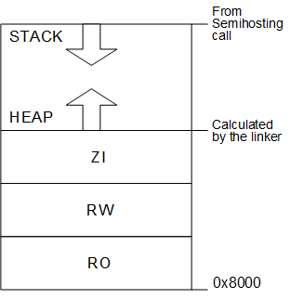
OS Support – Faced Problems
Post Process hex File using fromelf
Produce Byte oriented output
Keil 32kB Code Size limit
Use Linker Feedback to remove unused code
Move Stack and Heap
[2] Keil Compiler Getting Started Guide, Default memory map

Slide 12
OS Support – Future Plan
Use Mbed CLI for compiling
Switch between Targets
Mbed version upgradable
Exclude unused parts of Mbed
Use GCC compiler
Avoid Code Size limit
Implement full Mbed OS

Slide 13
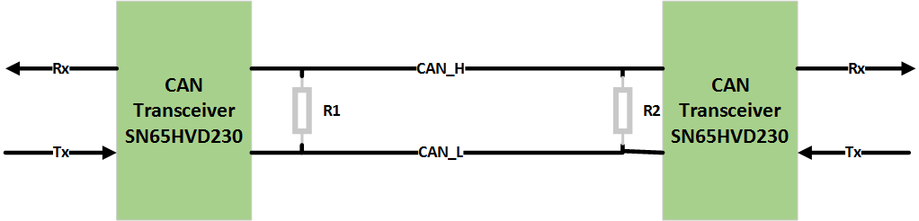
Communication link
CAN IP licencing issues
CAN replaced by UART
Master/Slave Protocol
CAN Transceivers SN65HVD230

Slide 14


Communication Protocol
Control packet
Data packet
CTRL |  | Function
0 | 0 | Request data
0 | 1 | Error 1
1 | 0 | Error 2
1 | 1 | Acknowledge

Slide 15
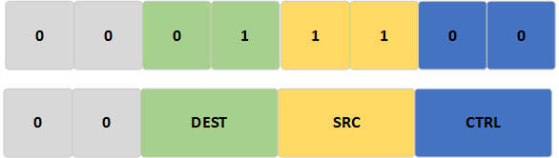
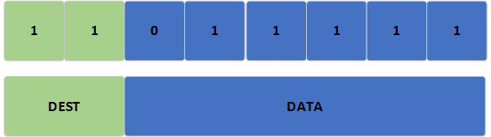
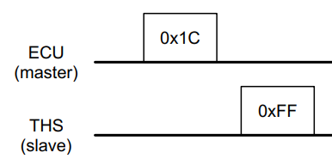
Communication Protocol (Example)
Request Data
ECU (Master)
Addr: 11
THS (Slave)
Addr: 01
0xDF

Slide 16
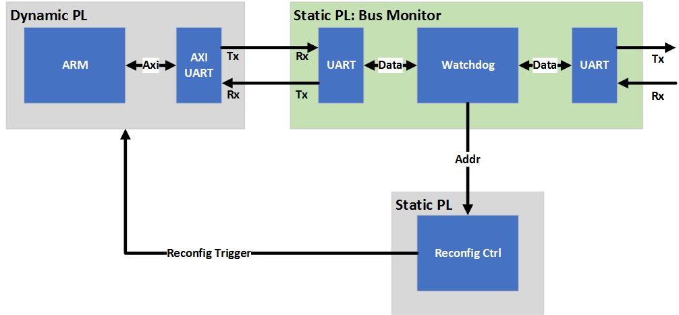
Bus Monitor
Monitoring according to protocol
Timeout detection
Error detection
VHDL implementation

Slide 17
Future Plan
Bus participants (Nucleo64 Boards)
Mbed configuration
Application
Test setup
(Simple) harness
connectors

Slide 18
Thank you for your attention!

