Slide 1
Dynamic Partial Reconfiguration for Fault-Tolerance in automotive ECUs
Andreas Hirtenlehner, Rupert Schorn, Peter Schober, Constantin Schieber

Slide 2
Introduction
Electronic Control Units (ECU) in automotive
Control tasks like
Ignition
ESP
ABS
Often, redundancy is required

Slide 3
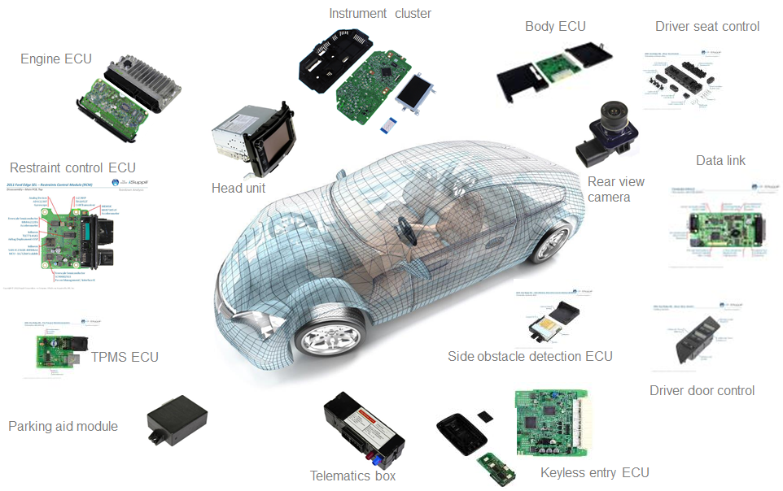
Introduction (optional)
https://financialcounselor24.com/2018/08/automotive-electronic-control-unit-ecu-market-2018-mro-490353/

Slide 4
Purpose and Goal of our System
Hardware redundancy is expensive
Provide redundancy with FPGA
In case of malfunction: Instantiate ECU in FPGA
Same code
Same communication channel
No one should notice malfunction

Slide 5
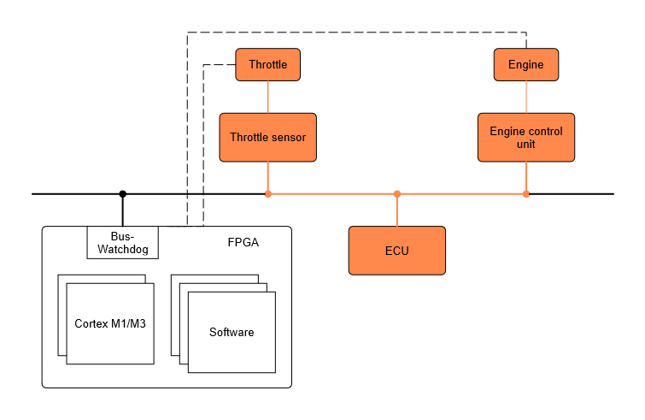
Designed Architecture

Slide 6
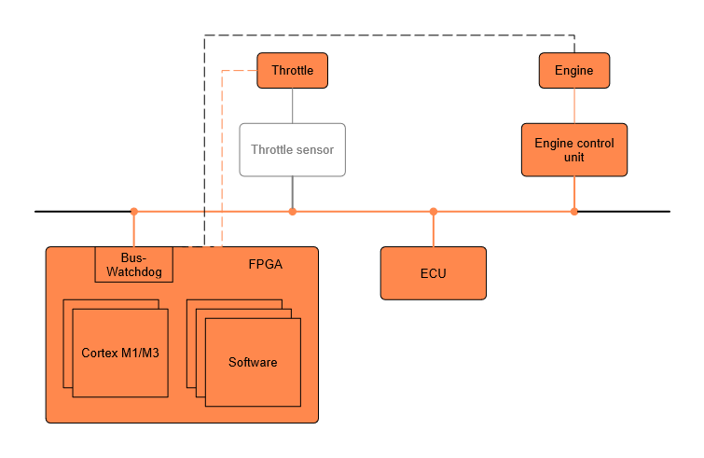
Designed Architecture (malfunction)

Slide 7
Progress
Instantiated a Cortex M1 Core on FPGA and toggle LEDs
Same with Microblaze Core as backup
Obtained Cortex M0 and M3 boards, CAN Transceivers and I2C ADC
Defined custom Bus-Protocol
Wrote MCU Application Code

Slide 8
Zedboard Quick Demo (optional)
1 LED
active
SD CARD
Cortex A9
Programmable Logic
BOOT.bin
Cortex M1
AXI
GPIO LED
FSBL
PL Bitstream
Drive 1 LED
Time
Reset PL with Button
3 LEDs
active
Cortex A9
Programmable Logic
Cortex M1
AXI
GPIO LED
Drive 1 LED

Slide 9
Faced Problems and their Solutions (1/2)
Reprogramming of instantiated Softcore implies re-synthesis
Inconvenience due to free licence
Possible Solution: Replace Keil with SDK
Problem: Correctly configure SDK. E.g. Toolchain
ARM Designstart
Vivado
Modify Blockdiagram
Time
BSP
Xilinx SDK
Modify Software
Arm Keil
Generate next Bitstream
Vivado

Slide 10
Faced Problems and their Solutions (2/2)
Find common Codebase for MCU and Xilinx Core
Problem: ARM Mbed OS does not support Xilinx Cores
Possible Solutions:
Port Mbed to Xilinx Core
Design custom HAL
Application
Application
Custom HAL
ARM Mbed OS
Xilinx BSP
STM32 HAL
Xilinx FPGA Core
STM32 MCU
Xilinx FPGA Core
STM32 MCU

Slide 11
Future Plan
FPGA Cortex M1/3
Systic Timer
I2C-IP
CAN-IP
FPGA Health Monitor
Design Middleware
port Mbed or design custom HAL
Realize Hardware Setup

Slide 12
Potential for Collaboration
Partial Dynamic Reconfiguration
With other PDR group
Will also use static and dynamic partitions
Exchange experience on PDR

Slide 13
Thank you for your attention!

Slide 14
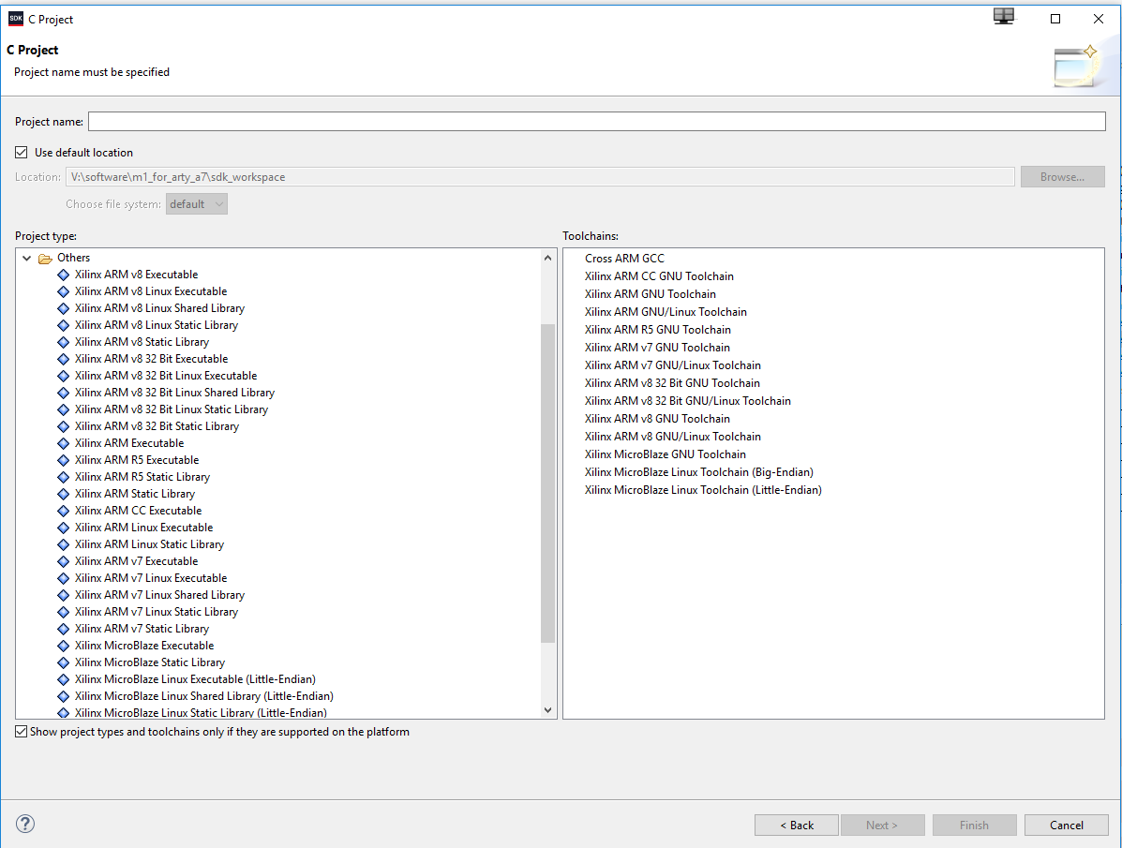
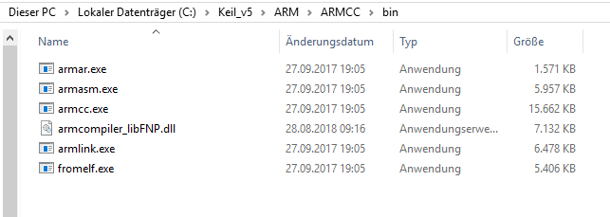
Backup Slides
Einstellungen in der Keil Software
Tool Versions:
Toolchain: MDK-Lite Version: 5.26.2.0
Toolchain Path: C:\Keil_v5\ARM\ARMCC\Bin
C Compiler: Armcc.exe V5.06 update 6 (build 750)
Assembler: Armasm.exe V5.06 update 6 (build 750)
Linker/Locator: ArmLink.exe V5.06 update 6 (build 750
Library Manager: ArmAr.exe V5.06 update 6 (build 750)
Hex Converter: FromElf.exe V5.06 update 6 (build 750)
CPU DLL: SARMCM3.DLL V5.26.2.0
Dialog DLL: DARMCM1.DLL V1.19.1.0
Target DLL: UL2CM3.DLL V1.161.6.0
Dialog DLL: TARMCM1.DLL V1.14.0.0

Slide 15
