Slide 1
DDEC: Data-Driven Equivalence Checking
Rahul Sharma, Eric Schkufza, Berkeley Churchill, Alex Aiken

Slide 2
Equivalence checking
Prove two programs are equivalent
Compiler optimizations
Validate refactorings
Cross checking different implementations
Old and well studied problem
Undecidable in general
Major challenge: prove equivalence of loops
Straight line programs relatively easy

Slide 3


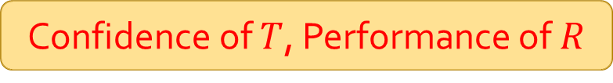
Motivating applications
Prove equivalence of two binaries
$$T$$
Trustworthy Compiler
CompCert, gcc –O0
…
while …
…
Confidence of $T$, Performance of $R$
$$R$$
Optimizing Compiler
gcc –O3, icc –O3

Slide 4

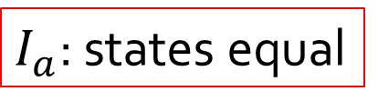
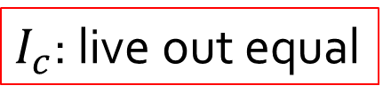
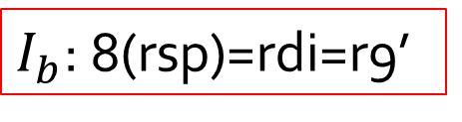

Simulation relation
Decompose proof
Rewrite $R$
a’
Target $T$
movq 8(rsp), r9
a
movq 8(rsp), rdi
#rdi != 0
#r9 != 0
b
b’
movq 8(rsp), rdi
decq rdi
movq rdi, 8(rsp)
retq
decq r9
retq
c
c’
$I_{a}$: states equal
$I_{b}$: 8(rsp)=rdi=r9’
$I_{c}$: live out equal

Slide 5
Inference
Given a simulation relation, proofs for loops reduce to proofs for loop free fragments
Use decision procedures
Main challenge: infer a simulation relation
Infer synchronization points
Infer invariants
We use compilers as black boxes
Mine relations from concrete executions

Slide 6
Runtime information
Attempt to detect synchronization points
Number of times program points are executed
Rewrite $R$
n
Target $T$
movq 8(rsp), r9
movq 8(rsp), rdi
#rdi != 0
#r9 != 0
n+1
n+1
movq 8(rsp), rdi
decq rdi
movq rdi, 8(rsp)
retq
decq r9
retq
1
n
n

Slide 7

Invariants
Invariants are restricted to equalities
Infer invariants from observed data values
Target $T$
8(rsp) | rdi
2 | 2
1 | 1
0 | 0
movq 8(rsp), rdi
#rdi != 0
movq 8(rsp), rdi
decq rdi
movq rdi, 8(rsp)
retq

Slide 8


Invariants
Invariants are restricted to equalities
Infer invariants from observed data values
Rewrite $R$
8(rsp) | rdi | r9’
2 | 2 | 2
1 | 1 | 1
0 | 0 | 0
movq 8(rsp), r9
#r9 != 0
decq r9
retq
$$I≡8\left(rsp\right)=rdi∧rdi=r9′$$

Slide 9
Check simulation relation
Query SMT solvers
Incorporate counter-examples in relations
Sound but not complete
If checking succeeds then equivalent
Can fail to infer a sound simulation relation

Slide 10
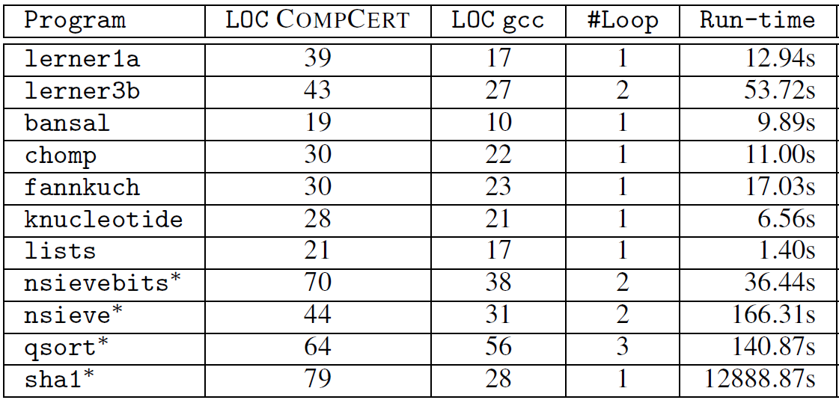
Cross compiler validation

Slide 11
Conclusion
Prove equivalence of loops in two stages
Infer simulation relation
Check the inferred relation using SMT solvers
Use runtime data for inference
No change required to the compilers

Slide 12
Inference from concrete states
M. D. Ernst, J. H. Perkins, P. J. Guo, S. McCamant, C. Pacheco, M. S. Tschantz, and C. Xiao. The Daikon system for dynamic detection of likely invariants. Sci. Comput. Program., 69(1-3):35–45, 2007
T. Nguyen, D. Kapur, W. Weimer, and S. Forrest. Using dynamic analysis to discover polynomial and array invariants. ICSE 2012
R. Sharma, A. V. Nori, A. Aiken: Interpolants as Classifiers. In CAV, 2012
E. Schkufza, R. Sharma, Alex Aiken: Stochastic Superoptimization . In ASPLOS, 2013.
A.V. Nori, R. Sharma: Termination proofs from tests. ESEC/SIGSOFT FSE 2013
R. Sharma, A. Nori, A. Aiken: Bias-Variance Tradeoffs in Program Analysis. In POPL, 2014 (To appear).

