Slide 1
Relevant Inputs Analysis and its Applications
Yan Wang Rajiv Gupta Iulian Neamtiu
University of California, Riverside

Slide 2

Motivation
Parser.c
1 void ParseHtmlDoc(){
doc->head=ParseHead(); …
ParseFrameSet(NULL);
}
7 void ParseFrameSet(Node*p){
8 Node*fs=NULL;
char c=GetChar(fin);
if(c==‘S’) { … }
23 ParseNoFrame(fs); …
}
51 HandlePsOutsideBody() {
52 if(doc->seeEndBody==true) {
53 Node*body=Findbody();
54 ParseParagraphs(body);
}
else ConsumeParagraphs();
}
85 void ParseParagraphs(Node*b)
86{ char c=Getchar(fin);
87 while(c==‘p’){…
ParseTextNode(b);
c=GetChar(fin); …
} …}
99 Node* NewNode(NodeType type)
100{ Node*node=malloc(..);
104 node->sibling=NULL; // origin of NULL
return node;
}
106 AddChild(Node*p, Node*c)
107 { if(p->lastChild!=NULL) // unguarded check, crashes if p is NULL
108 p->lastChild->sibling=c;
109 else p->firstChild=c;
110 p->lastChild=c;
}
112 void ParseTextNode(Node*p)
113{ char c=GetChar(fin);
114 if(c==‘”’){
c=GetChar(fin);
…}
}
121 char GetChar(Stream *fp){
if(fp->r_ptr>=fp->r_end)
return RefillBuf(fp);
return *(fp->r_ptr++);
}
<!DOCTYPE html PUBLIC "-//W3C//DTD XHTML+RDFa 1.0//EN"
"http://www.w3.org/MarkUp/DTD/xhtml-rdfa-1.dtd">
<html xmlns="http://www.w3.org/1999/xhtml" xml:lang="en" version="XHTML+RDFa 1.0" dir="ltr"
xmlns:content="http://purl.org/rss/1.0/modules/content/"
xmlns:dc="http://purl.org/dc/terms/"
xmlns:foaf="http://xmlns.com/foaf/0.1/"
xmlns:og="http://ogp.me/ns#"
xmlns:rdfs="http://www.w3.org/2000/01/rdf-schema#"
xmlns:sioc="http://rdfs.org/sioc/ns#"
xmlns:sioct="http://rdfs.org/sioc/types#"
xmlns:skos="http://www.w3.org/2004/02/skos/core#"
xmlns:xsd="http://www.w3.org/2001/XMLSchema#">
<head profile="http://www.w3.org/1999/xhtml/vocab">
<meta http-equiv="Content-Type" content="text/html; charset=utf-8" />
<meta about="/registration" property="sioc:num_replies" content="0" datatype="xsd:integer" />
<link rel="shortcut icon" href="http://2013.issre.net/misc/favicon.ico" type="image/vnd.microsoft.icon" />
<meta content="Registration" about="/registration" property="dc:title" />
<link rel="shortlink" href="/node/36" />
<meta name="Generator" content="Drupal 7 (http://drupal.org)" />
<link rel="canonical" href="/registration" />
<title>Registration | ISSRE 2013</title>
<style type="text/css" media="all">@import url("http://2013.issre.net/modules/system/system.base.css?muzybs");
@import url("http://2013.issre.net/modules/system/system.menus.css?muzybs");
@import url("http://2013.issre.net/modules/system/system.messages.css?muzybs");
@import url("http://2013.issre.net/modules/system/system.theme.css?muzybs");</style>
<style type="text/css" media="all">@import url("http://2013.issre.net/modules/comment/comment.css?muzybs");
@import url("http://2013.issre.net/modules/field/theme/field.css?muzybs");
@import url("http://2013.issre.net/modules/node/node.css?muzybs");
@import url("http://2013.issre.net/modules/search/search.css?muzybs");
@import url("http://2013.issre.net/modules/user/user.css?muzybs");
@import url("http://2013.issre.net/sites/all/modules/views/css/views.css?...
Header FrameSet
FrameSet
Frame*
Noframes?
Body
Paragraph*
Paragraph (outside the body)
NULL pointer dereference bug in Tidy-34132

Slide 3
Existing Relevant Input Analysis are imprecise and inadequate
Original input: S S F F N B P “ a ” / P / B P “ b ” / P / N /S /S
Input labeled with position info:
S¹ S² F¹ F ² N¹ B¹ P¹ “¹ a¹ ”² /¹ P² /² B² P³ “³ b¹ ”⁴ /³ P⁴ /⁴ N² / ⁵ S³ /⁶ S ⁴
Relevant Input for failure point 107₈ (p is NULL):
No Input flow into p
through data dependence
Result of Lineage[Zhang et al., VLDB’07]: {}
due to data/(strict) control dependence chains caused by buffer index-- fp->r_ptr
Result of Penumbra[Clause and Orso, ISSTA’09]:
{} | {S¹, S², F¹, F², N¹, B¹, P¹, “¹, /¹, /², B², P³}
Result of Lineage with Strict Control Dependence [Bao et al., ISSTA’10] :
{S¹, S², F¹, F², N¹, B¹, P¹, “¹, /¹, /², B², P³}
Input needs to be exactly SSNB/BP to reach the failure point
NULL originates from node->sibling at line 104
Result of our approach:
{S²⁼ →NULL(node-> sibling@104) }
∧ {S¹⁼ , S²⁼ , F¹ , F² , N¹⁼, B¹⁼, P¹, “¹, /¹, /²⁼, B²⁼ → true(doc-> seeEndBody@67, P³⁼}
∧ {S¹ , S², F¹, F², N¹, B¹, P¹, “¹, /¹, /², B², P³}
Notes:
Penumbra [23] can be configured to consider either data dependences only, or both data and control dependences

Slide 4
Dependence Definitions & Example
Value Dependence
Address Dependence
Control Dependence
Value Dependence due to a[x]
4:a[x]=m+1
v
1: read m // 1
2: read z // 2
3: read x // 3
4: a[x]=m+1
5: w=m
6: if(z>0)
7: y=a[x]
7: y=a[x]
Address Dependence due to x
Control
Dependence
a
c
3: read x
6: if(z>0)

Slide 5
Role of Relevant Inputs
Relevant inputs for a value VAL are represented as follows:
VAL DERIVED ∧ CINFLUENCED ∧ AINFLUENCED
Value VAL is derived from DERIVED:
{ r | r ∈ INPUTS ∧ ∃ VAL … READ(r) }
Value VAL is control influenced by CINFLUENCED:
{ r | r ∈ INPUTS ∧ ∃ VAL … READ(r) }
At lease one control dependence present in the dependence chain
Value VAL is address influenced by AINFLUENCED:
{ r | r ∈ INPUTS ∧ ∃ VAL … READ(r)}
At lease one address dependence present in the dependence chain
v
v
v/c
v/c
v/c/a
v/c/a

Slide 6
Role of Relevant Inputs: Example
VAL DERIVED ∧ CINFLUENCED ∧ AINFLUENCED
1: read m //1
VAL(m) {1} ∧ {} ∧ {}
1₁ READ(1)
2: read z // 2
VAL(z) {2} ∧ {} ∧ {}
2₁ READ(2)
3: read x // 3
VAL(x) {3} ∧ {} ∧ {}
3₁ READ(3)
v
4₁ 1₁ READ(1)
4: a[x]=m+1
VAL(a[x]) {1} ∧ {} ∧ {3}
a
4₁ 3₁ READ(3)
5: w=m
VAL(w) {1} ∧ {} ∧ {}
v
5₁ 1₁ READ(1)
6: if(z>0) true
VAL(if(z>0)) {2} ∧ {} ∧ {}
v
6₁ 2₁ READ(2)
v
v
7₁ 4₁ 1₁ READ(1)
c
v
7: y=a[x]
VAL(y=a[x]) {1} ∧ {2} ∧ {3}
7₁ 6₁ 1₁ READ(2)
a
7₁ 1₁ READ(3)

Slide 7
Strength of Relevant Inputs
Strong Input r: denoted as r⁼
Computed value relies upon the precise value of input r
If we change the input value, the computed value is highly likely to be changed
Weak Input r: denoted as just r
The input value is among one of many values that can cause similar behavior
If we change the input value, the computed value may be changed
Strong dependence maintains the strength of inputs
1: read x //10
VAL(x) {10⁼} ∧ {} ∧ {}
2: y=x
VAL(y) {10⁼} ∧ {} ∧ {}
Weak dependence (“computed from”) weakens the strength of inputs
3: z=f(x)
VAL(z) {10} ∧ {} ∧ {}

Slide 8
Applications of Relevant Inputs Analysis
Accelerate Delta Debugging (DD) [Zeller&Hildebrandt, TSE’02]
DD finds 1-minimal input
- increase granularity
- complement
Relevant Inputs Analysis
1. Remove Irrelevant Inputs
2. Input Decomposition Tree
3. Search 1-minimal Input
Test Input Generation
Buffer Overflow Detection

Slide 9
Accelerating Delta Debugging, Step 1: Removal of Irrelevant Inputs
Construct and try simpler input based on result of relevant input analysis:
First Input: DERIVED⁼
Second Input: DERIVED⁼ ∪ CINFLUENCED⁼
Third Input: DERIVED⁼ ∪ CINFLUENCED⁼ ∪ AINFLUENCED⁼
Fourth Input: DERIVED ∪ CINFLUENCED⁼ ∪ AINFLUENCED⁼
Fifth Input: DERIVED ∪ CINFLUENCED ∪ AINFLUENCED⁼
Sixth Input: DERIVED ∪ CINFLUENCED ∪ AINFLUENCED
DERIVED⁼ only contains inputs labeled with “=“ in DERIVED
Example:
A longer input for the example extracted based on NULL pointer dereference bug in Tidy:
H “ t ” / H S F F F S F F N P “ a ” / P P “ b ” / P B P “ c ” / P P “ d ” / P / B P “ e ” / P P “ f ” / P / N / S / S
Input labeled with occurrence frequency:
H¹ “¹ t¹ ” ² /¹ H² S¹ F¹ F ² F³ S² F⁴ F⁵ N¹ P¹ “³ a¹ ”⁴ / ² P² P³ “⁵ b¹ ” ⁶ /³ P⁴ B¹ P⁵ “⁷ c¹ ”⁸ /⁴ P⁶ P⁷
“⁹ d¹ ” ¹⁰ /⁵ P⁸ /⁶ B² P⁹ “¹¹ e¹ ”¹² /⁷ P¹⁰ P¹¹ “¹³ f¹ ”¹⁴ /⁸ P¹² /⁹ N ² /S³ /¹¹ S ⁴

Slide 10
Accelerating Delta Debugging, Step 1: Removal of Irrelevant Inputs
Relevant Input for failure point 107₁₄ (p is NULL):
VAL(107₁₄) {S²⁼ →NULL(node-> sibling@104) }
∧ {H¹, “¹ , /¹ , S¹⁼ , F¹⁼ , F²⁼ , F³⁼, S²⁼, F⁴ , F⁵, N¹⁼, P¹, “³, / ², P³, “⁵, /³, B¹⁼, P⁵, “⁷, /⁴, P⁷, “⁹, /⁵, /⁶⁼, B²⁼ → true(doc-> seeEndBody@67, P⁹⁼}
∧ {H¹, “¹ , /¹ , S¹ , F¹, F², F³, S², F⁴ , F⁵, N¹, P¹, “³, / ², P³, “⁵, /³, B¹, P⁵, “⁷, /⁴, P⁷, “⁹, /⁵, /⁶, B², P⁹}
Construct and try simpler inputs based on result of Relevant Input Analysis :
First input: DERIVED⁼ ={S²}
→ S → original failure cannot be reproduced.
Second input: DERIVED⁼ ∪ CINFLUENCED⁼ ={S¹, F¹, F², F³, S², N¹, B¹ /⁶, B², P⁹}
→ S F F F S N B / B P → original failure is reproduced!!
Resulting simpler input following Step 1: →
S F F F S N B / B P
But we can do even better than this!

Slide 11
Accelerating Delta Debugging, Step 2: Construct Input Decomposition Tree
107₁₄
SFFFSNB/BP
Disjoint sets in each level
53₁
SFFFSNB/B
READ
P
10₂
SFFFS
52₂
NB/B
16₄
SFFF
READ
S
READ
N
64₁
B/
READ
B
16₂
SFF
READ
F
READ
B
READ
/
16₁
SF
READ
F
Leaf Nodes: READ
READ
S
READ
F
An Input Decomposition Tree (IDT) is constructed based on the dependence subgraph
Notes:
The root of the tree represents the wrong value computed in the failing run and its children represent a subset of other values computed during execution upon which the root value is dependent. Moreover, while the root is labeled with the entire input on which it is dependent, its children are labeled with disjoint subsets of inputs labeling the root node. The inputs labeling each child node of the root node are similarly further decomposed among their children and so on. Finally, each leaf node represents a read of an input value.

Slide 12
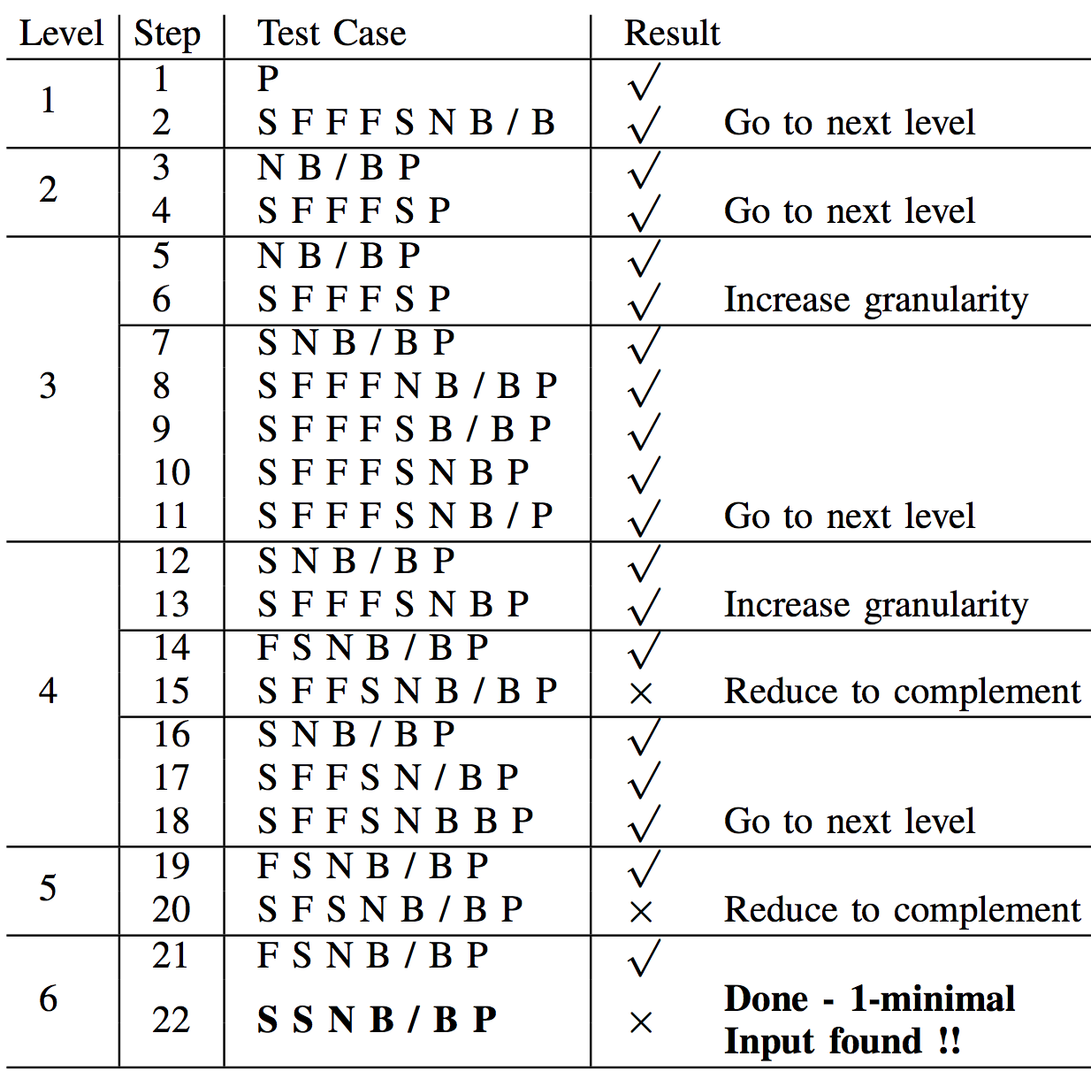
Accelerating Delta Debugging, Step 3: Search for 1-Minimal Input
Only consider complementary sets for each level + leaves from upper levels
Similar to Hierarchical Delta Debugging (HDD, [Miserghi and Su, ICSE’06]) according to levels in the input decomposition tree (IDT) -> IDTHDD
107₁₄
SFFFSNB/BP
53₁
SFFFSNB/B
READ
P
10₂
SFFFS
52₂
NB/B
16₄
SFFF
READ
S
READ
N
64₁
B/
READ
B
16₂
SFF
READ
F
READ
B
READ
/
16₁
SF
READ
F
READ
S
READ
F

Slide 13
Summary of Comparison with Standard Delta Debugging (SDD)
Program | Test Case (input size) | SDD |  | IDTHDD |  | IDTHDD*
 |  | #runs | input size | #runs | input size | # runs | input size (reduction v. original input)
tidy-34132 null ptr deref. | test1.html (2,018) | 852 | 50 | 176 | 44 | 405 | 39 (51x)
bc-1.06 buffer overflow | test1.b (1,310) | 10,800 | 191 | 1,194 | 190 | 4,185 | 190 (56x)
expat-1.95.3 illegal ptr deref | test1.xml (1,138) | 1,785 | 63 | 216 | 52 | 393 | 49 (36x)
IDTHDD: always include leaf nodes in the generated input
IDTHDD*: reconsider leaf nodes when we go to next level
Notes:
DDMIN=DD

Slide 14
Conclusions
Relevant input analysis determines the role and strength inputs play in program behavior
Derived v. control-influenced v. address-influenced
Strong v. weak input
Applications
Debugging, testing
Results
Efficiently find 1-minimal inputs for bugs in 3 real-world programs

Slide 15
Backup
15

Slide 16
Motivation
<!DOCTYPE html PUBLIC "-//W3C//DTD XHTML+RDFa 1.0//EN"
"http://www.w3.org/MarkUp/DTD/xhtml-rdfa-1.dtd">
<html xmlns="http://www.w3.org/1999/xhtml" xml:lang="en" version="XHTML+RDFa 1.0" dir="ltr"
xmlns:content="http://purl.org/rss/1.0/modules/content/"
xmlns:dc="http://purl.org/dc/terms/"
xmlns:foaf="http://xmlns.com/foaf/0.1/"
xmlns:og="http://ogp.me/ns#"
xmlns:rdfs="http://www.w3.org/2000/01/rdf-schema#"
xmlns:sioc="http://rdfs.org/sioc/ns#"
xmlns:sioct="http://rdfs.org/sioc/types#"
xmlns:skos="http://www.w3.org/2004/02/skos/core#"
xmlns:xsd="http://www.w3.org/2001/XMLSchema#">
<head profile="http://www.w3.org/1999/xhtml/vocab">
<meta http-equiv="Content-Type" content="text/html; charset=utf-8" />
<meta about="/registration" property="sioc:num_replies" content="0" datatype="xsd:integer" />
<link rel="shortcut icon" href="http://2013.issre.net/misc/favicon.ico" type="image/vnd.microsoft.icon" />
<meta content="Registration" about="/registration" property="dc:title" />
<link rel="shortlink" href="/node/36" />
<meta name="Generator" content="Drupal 7 (http://drupal.org)" />
<link rel="canonical" href="/registration" />
<title>Registration | ISSRE 2013</title>
<style type="text/css" media="all">@import url("http://2013.issre.net/modules/system/system.base.css?muzybs");
@import url("http://2013.issre.net/modules/system/system.menus.css?muzybs");
@import url("http://2013.issre.net/modules/system/system.messages.css?muzybs");
@import url("http://2013.issre.net/modules/system/system.theme.css?muzybs");</style>
<style type="text/css" media="all">@import url("http://2013.issre.net/modules/comment/comment.css?muzybs");
@import url("http://2013.issre.net/modules/field/theme/field.css?muzybs");
@import url("http://2013.issre.net/modules/node/node.css?muzybs");
@import url("http://2013.issre.net/modules/search/search.css?muzybs");
@import url("http://2013.issre.net/modules/user/user.css?muzybs");
@import url("http://2013.issre.net/sites/all/modules/views/css/views.css?...
HTML Tidy to find&fix invalid HTML
HTML Tidy
HTML Tidy developer
Bug report
Crash: NULL pointer dereference
Which character(s) in this 2,018-character input causes the crash?

Slide 17
Comparing our results with prior work
Lineage [Zhang et al., VLDB’07]
Only data dependences
Penumbra [Clause and Orso, ISSTA’09]
Consider either only data dependences or both data and control dependences
Lineage with Strict Control Dependence [Bao et al., ISSTA’10]
Consider data and strict control dependences
Prior work: inadequate or imprecise
<!DOCTYPE html PUBLIC "-//W3C//DTD XHTML+RDFa 1.0//EN"
"http://www.w3.org/MarkUp/DTD/xhtml-rdfa-1.dtd">
<html xmlns="http://www.w3.org/1999/xhtml" xml:lang="en" version="XHTML+RDFa 1.0" dir="ltr"
xmlns:content="http://purl.org/rss/1.0/modules/content/"
xmlns:dc="http://purl.org/dc/terms/"
xmlns:foaf="http://xmlns.com/foaf/0.1/"
xmlns:og="http://ogp.me/ns#"
xmlns:rdfs="http://www.w3.org/2000/01/rdf-schema#"
xmlns:sioc="http://rdfs.org/sioc/ns#"
xmlns:sioct="http://rdfs.org/sioc/types#"
xmlns:skos="http://www.w3.org/2004/02/skos/core#"
xmlns:xsd="http://www.w3.org/2001/XMLSchema#">
<head profile="http://www.w3.org/1999/xhtml/vocab">
<meta http-equiv="Content-Type" content="text/html; charset=utf-8" />
<meta about="/registration" property="sioc:num_replies" content="0" datatype="xsd:integer" />
<link rel="shortcut icon" href="http://2013.issre.net/misc/favicon.ico" type="image/vnd.microsoft.icon" />
<meta content="Registration" about="/registration" property="dc:title" />
<link rel="shortlink" href="/node/36" />
<meta name="Generator" content="Drupal 7 (http://drupal.org)" />
<link rel="canonical" href="/registration" />
<title>Registration | ISSRE 2013</title>
<style type="text/css" media="all">@import url("http://2013.issre.net/modules/system/system.base.css?muzybs");
@import url("http://2013.issre.net/modules/system/system.menus.css?muzybs");
@import url("http://2013.issre.net/modules/system/system.messages.css?muzybs");
@import url("http://2013.issre.net/modules/system/system.theme.css?muzybs");</style>
<style type="text/css" media="all">@import url("http://2013.issre.net/modules/comment/comment.css?muzybs");
@import url("http://2013.issre.net/modules/field/theme/field.css?muzybs");
@import url("http://2013.issre.net/modules/node/node.css?muzybs");
@import url("http://2013.issre.net/modules/search/search.css?muzybs");
@import url("http://2013.issre.net/modules/user/user.css?muzybs");
@import url("http://2013.issre.net/sites/all/modules/views/css/views.css?...
Our work: compute the role and strength of inputs in the computation
Applications: debugging, testing
Results: reduce the input from 2,018 to 39 characters
Which character(s) in this 2,018-character input causes the crash?
Notes:
Existing approaches do not characterize the role and strength of inputs in the computation.
During debugging, when a program crashes, knowing the part of the input that triggered the crash can help the programmer. During testing, understanding the role of inputs in one execution can help in generating new inputs that will likely exercise different program behaviors.
The role indicates whether a computed value is derived from an input value or its computation is simply influenced by an input value. The strength indicates if role relied upon the precise value of the input or it is among one of many values that can play a similar role.

Slide 18
Why does Tidy crash on this input?
Parser.c
1 void ParseHtmlDoc(){
doc->head=ParseHead(); …
ParseFrameSet(NULL);}
7 void ParseFrameSet(Node*p){
8 Node*fs=NULL;
char c=GetChar(fin);
if(c==‘S’) { … }
ParseNoFrame(fs); … }
30 void ParseNoFrame(Node *fS) {
35 HandlePsOutsideBody();… }
51 void HandlePsOutsideBody() {
52 if(doc->seeEndBody==true) {
53 Node*body=FindBody();
ParseParagraphs(body);
…}
57 void parseBody(Node *noF) {…
Node *body=NewNode(…);
AddChild(noF, body); …}
71 Node *FindBody() {…
80 while (node…) {
81 node = node->sibling;
99 Node* NewNode(NodeType type)
100{ Node*node=malloc(…);…
104 node->sibling=NULL; // origin of NULL
return node;
}
106 AddChild(Node*p, Node*c)
107 { if(p->lastChild!=NULL) // unguarded check, crashes if p is NULL
108 p->lastChild->sibling=c;
109 else p->firstChild=c;
110 p->lastChild=c;
}
112 void ParseTextNode(Node*p)
113{ char c=GetChar(fin);
114 if(c==‘”’){
c=GetChar(fin);
…}
}
121 char GetChar(Stream *fp){
if(fp->r_ptr>=fp->r_end)
return RefillBuf(fp);
return *(fp->r_ptr++);
}
Header FrameSet
Frame*
Noframes?
Body
Paragraph*
Paragraph (outside the body)
<!DOCTYPE html PUBLIC "-//W3C//DTD XHTML+RDFa 1.0//EN"
"http://www.w3.org/MarkUp/DTD/xhtml-rdfa-1.dtd">
<html xmlns="http://www.w3.org/1999/xhtml" xml:lang="en" version="XHTML+RDFa 1.0" dir="ltr"
xmlns:content="http://purl.org/rss/1.0/modules/content/"
xmlns:dc="http://purl.org/dc/terms/"
xmlns:foaf="http://xmlns.com/foaf/0.1/"
xmlns:og="http://ogp.me/ns#"
xmlns:rdfs="http://www.w3.org/2000/01/rdf-schema#"
xmlns:sioc="http://rdfs.org/sioc/ns#"
xmlns:sioct="http://rdfs.org/sioc/types#"
xmlns:skos="http://www.w3.org/2004/02/skos/core#"
xmlns:xsd="http://www.w3.org/2001/XMLSchema#">
<head profile="http://www.w3.org/1999/xhtml/vocab">
<meta http-equiv="Content-Type" content="text/html; charset=utf-8" />
<meta about="/registration" property="sioc:num_replies" content="0" datatype="xsd:integer" />
<link rel="shortcut icon" href="http://2013.issre.net/misc/favicon.ico" type="image/vnd.microsoft.icon" />
<meta content="Registration" about="/registration" property="dc:title" />
<link rel="shortlink" href="/node/36" />
<meta name="Generator" content="Drupal 7 (http://drupal.org)" />
<link rel="canonical" href="/registration" />
<title>Registration | ISSRE 2013</title>
<style type="text/css" media="all">@import url("http://2013.issre.net/modules/system/system.base.css?muzybs");
@import url("http://2013.issre.net/modules/system/system.menus.css?muzybs");
@import url("http://2013.issre.net/modules/system/system.messages.css?muzybs");
@import url("http://2013.issre.net/modules/system/system.theme.css?muzybs");</style>
<style type="text/css" media="all">@import url("http://2013.issre.net/modules/comment/comment.css?muzybs");
@import url("http://2013.issre.net/modules/field/theme/field.css?muzybs");
@import url("http://2013.issre.net/modules/node/node.css?muzybs");
@import url("http://2013.issre.net/modules/search/search.css?muzybs");
@import url("http://2013.issre.net/modules/user/user.css?muzybs");
@import url("http://2013.issre.net/sites/all/modules/views/css/views.css?...
NULL pointer dereference bug in Tidy reveals - data dependence insufficient (no input propagates to 107)
- control dependence too imprecise (almost all input)

Slide 19
Dependence Definitions
Given i^{th} execution statement s. s_{i} defines VAL(sto_{i}) and uses m variables sfr₁, sfr₂, sfr_{k,} …, sfr_{m},
Value Dependence - VAL(sto_{i}) VAL(sfr_{k}):
VAL(sfr_{k}) is used as operand to compute VAL(sto_{i})
Address Dependence - VAL(sto_{i}) VAL(sfr_{k}):
VAL(sfr_{k}) is used to select the address whose contents are used to compute VAL(sto_{i})
Control Dependence - VAL(sto_{i}) VAL(pred_{j}):
VAL(pred_{j}) determines the execution of s_{i}
v
a
c

Slide 20
Role of Relevant Inputs: Example
VAL DERIVED ∧ CINFLUENCED ∧ AINFLUENCED
1: read m //1
VAL(m) {1} ∧ {} ∧ {}
1₁ READ(1)
2: read z // 2
VAL(z) {2} ∧ {} ∧ {}
2₁ READ(2)
3: read x // 3
VAL(x) {3} ∧ {} ∧ {}
3₁ READ(3)
v
4₁ 1₁ READ(1)
4: a[x]=m+1
VAL(a[x]) {1} ∧ {} ∧ {3}
a
4₁ 3₁ READ(3)
5: w=m
VAL(w) {1} ∧ {} ∧ {}
v
5₁ 1₁ READ(1)
6: if(z>0) true
VAL(if(z>0)) {2} ∧ {} ∧ {}
v
6₁ 2₁ READ(2)
v
v
7₁ 4₁ 1₁ READ(1)
c
v
7: y=a[x]
VAL(y=a[x]) {1} ∧ {2} ∧ {3}
7₁ 6₁ 1₁ READ(2)
a
7₁ 1₁ READ(3)

Slide 21
Time Overhead of Relevant Input Analysis
Relevant input analysis time overhead from start to program failure point
Program | Null Pin seconds | Relevant Input Analysis seconds (factor)
tidy-34132 | 1.08 | 37.4(34.6x)
bc-1.06 | 0.73 | 28.6(39.2x)
expat-1.95.3 | 0.48 | 15.2(31.7x)
Null Pin: the program running time under Pin without our debugger

Slide 22
Strength of Relevant Inputs—Value Dependence
Strong dependence maintains the strength of inputs
VAL DERIVED ∧ CINFLUENCED ∧ AINFLUENCED
1: read x //10
VAL(x) {10⁼} ∧ {} ∧ {}
2: y=x
VAL(y) {10⁼} ∧ {} ∧ {}
3: z=f(x)
VAL(z) {10} ∧ {} ∧ {}
Weak dependence (“computed from”) weakens the strength of inputs
4: w=z
VAL(w) {10} ∧ {} ∧ {}
5: if(x==10) true
VAL(if(x==10)) {10⁼} ∧ {} ∧ {}
6: if(x!=10) false
VAL(if(x!=10)) {10⁼} ∧ {} ∧ {}
7: if(x>0)
VAL(if(x>0)) {10} ∧ {} ∧ {}

Slide 23
Strength of Relevant Inputs—Control Dependence
VAL DERIVED ∧ CINFLUENCED ∧ AINFLUENCED
1: read x //0
VAL(x) {0⁼} ∧ {} ∧ {}
2: z=x
VAL(z) {0⁼} ∧ {} ∧ {}
Data Dependence is obfuscated as control dependence
VAL(if(x==0)) {0⁼} ∧ {} ∧ {}
3: if(x==0) true
4: w=z
VAL(w) {0⁼} ∧ {0⁼} ∧ {}
5: y=1
VAL(y) {0⁼ →1(y@5) } ∧ {0⁼} ∧ {}
6: if(y<100)
VAL(if(y<100)) {0} ∧ {0} ∧ {}

Slide 24
Strength of Relevant Inputs—Address Dependence
VAL DERIVED ∧ CINFLUENCED ∧ AINFLUENCED
Strong dependence maintains the strength of inputs
VAL(x) {10⁼} ∧ {} ∧ {}
1: read x //10
2: z=buf[x] //50
VAL(z) {50⁼} ∧ {} ∧ {10⁼}
3: y=f(x)
VAL(y) {10} ∧ {} ∧ {}
4: w=buf[y];//40
VAL(w) {40⁼} ∧ {} ∧ {10}
5: if(z>0)
VAL(if(z>0)) {50} ∧ {} ∧ {10}

Slide 25
Accelerating Delta Debugging, Step 3: Search for 1-Minimal Input
Only consider complementary sets for each level + leaves from upper levels
Similar to Hierarchical Delta Debugging (HDD, [Miserghi and Su, ICSE’06]) according to levels in the input decomposition tree (IDT) -> IDTHDD
107₁₄
SFFFSNB/BP
53₁
SFFFSNB/B
READ
P
10₂
SFFFS
52₂
NB/B
16₄
SFFF
READ
S
READ
N
64₁
B/
READ
B
16₂
SFF
READ
F
READ
B
READ
/
16₁
SF
READ
F
READ
S
READ
F

Slide 26
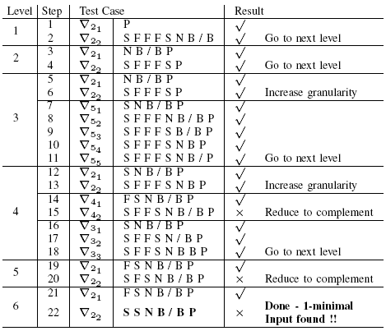
Accelerating Delta Debugging, Step 3: Search for 1-Minimal Input
Apply Hierarchical Delta Debugging (HDD, [Miserghi and Su, ICSE’06]) according to levels in the input decomposition tree (IDT) -> IDTHDD
Only consider complementary set for each level
Two choices about leaf node:
IDTHDD
Always include leaf nodes in the generated input
IDTHDD*
Reconsider leaf nodes when we go to next level
Guarantee 1-minimal input
IDTHDD

Slide 27
Other Applications
Test Input Generation
Make use of DERIVED, CINFLUENCED and AINFLUENCED sets from a single execution to effectively derive test inputs at a moderate cost
Avoid test cases that induce same behavior
Construct new test cases that lead to different dependences/different behavior
Security
Data dependences may be obfuscated as control dependences to avoid detection
Our formation of chains in the DERIVED and AINFLUENCED sets help find obfuscated vulnerabilities
e.g., our test program Bc-1.06 has a buffer overflow

Slide 28
Experimental Evaluation
Efficiency and effectiveness for actual bugs in three real-world programs
Tidy-34132: NULL pointer dereference bug
Bc-1.06: buffer overflow error
Expat-1.95.3: illegal pointer dereference

Slide 29
Comparison with Standard Delta Debugging After Step 1
Program | Test Case (input size) | Step 1 |  | SDD on Input After Step 1 |  | IDTHDD Step 3 | IDTHDD* Step 3
 |  | #runs | input size | #runs | input size | #runs | #runs
tidy-34132 | test1.html (2,018) | 3 | 124 | 378 | 44 | 173 | 402
bc-1.06 | test1.b (1,310) | 2 | 399 | 8,372 | 190 | 1,192 | 4,183
expat-1.95.3 | test1.xml (1,138) | 2 | 125 | 896 | 56 | 214 | 391
Notes:
DD=DDMIN

