Slide 2

Hands on Git & Github
Organized By
SofoLab @ Daffodil International University

Slide 3
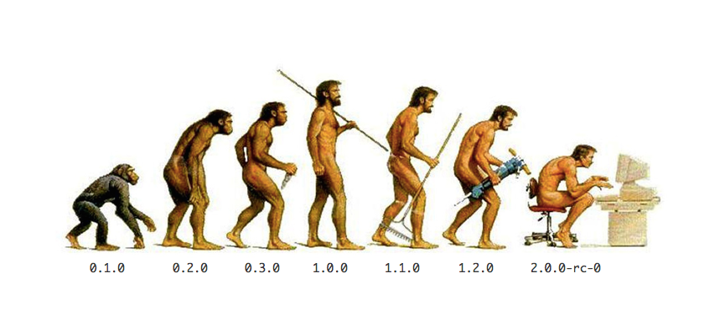
What do you mean by seeing this picture ?

Slide 4


Slide 5
Git
Version control tool
Using git tool versioning project file and stages

Slide 6
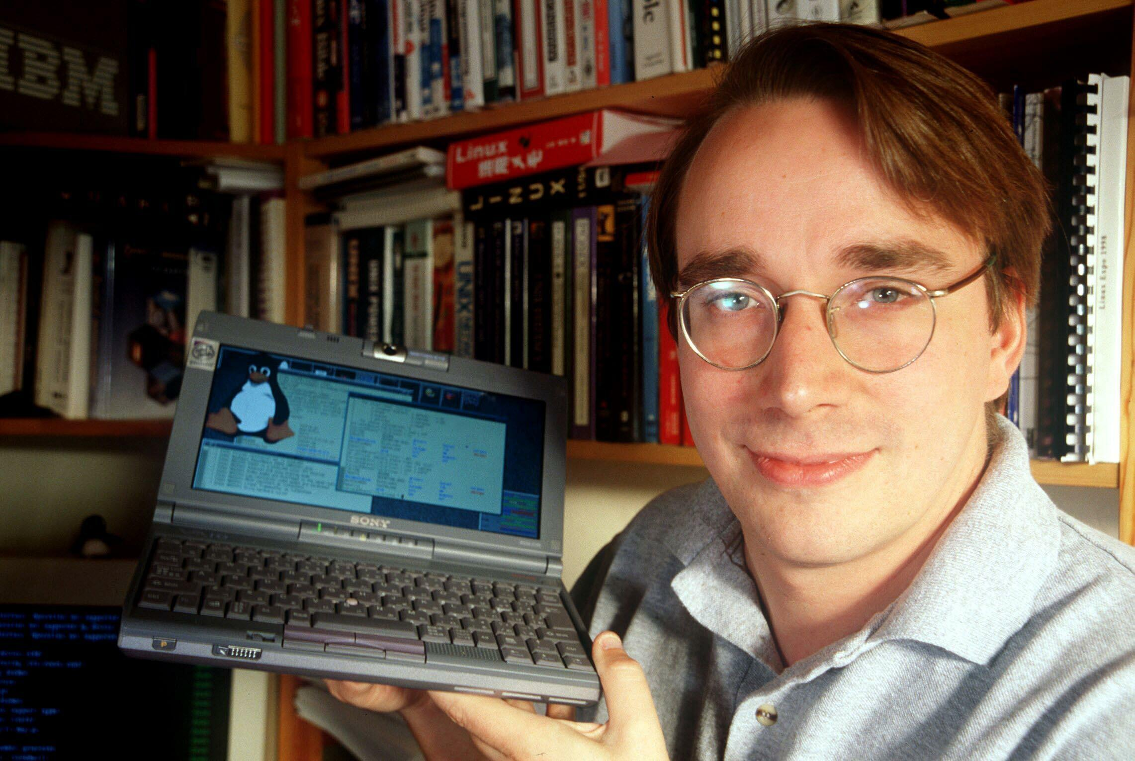
Who is this person ?
Linus Torvalds
The creator of Linux

Slide 7
Creator of Git
Git was created by Linus Torvalds, in 2005 for allowing other developers to contribute towards the Linux kernel

Slide 8
What Problem Git Solve
1.Multiple programmer working on same project
how code share between them?
how their work integrated together ?
who done which portion ?
how track top level management how much work done?
2.working on multiple work space
how move code between different workspace?
3. what if you want to roll back your project previous state?

Slide 9

What is this ?
Repository…

Slide 10
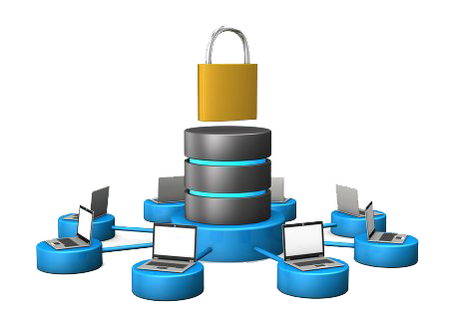

Two way of hosting a project on Git
Private Hosting Publicly Hosting

Slide 11


GitHub
GitHub is a web-based git repository(project) hosting service.
Two way project can be hosted. Public and private.
There are many git hosting service gitlab, gitbucket etc
gitlab, gitbucket

Slide 12

Why Git is so Important?
To keep code revision
Easily manage code when multiple programmer work in same project
Backup old code
Restoring Previous Versions
Tracking how much work is being done, and where, when and by whom
Experiment new feature without interfering with working code
Share your code, or let other people work on your code
Submit a change to someone else's code

Slide 13
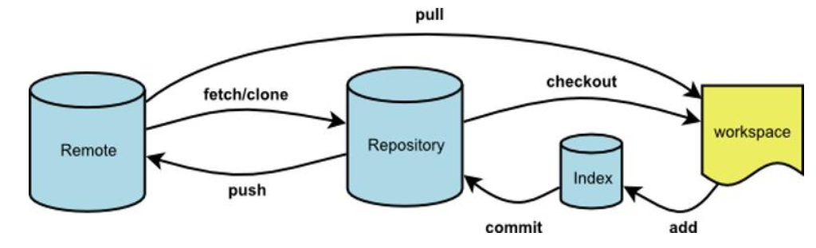
How Git and GitHub(remote) works together

Slide 14
Git Commands one file
git init
Create a new local repository
git status
Changed files in your working directory
git add filename
Add all current changes to the next commit
git commit –m “comment” filename
Commit all local changes in tracked files
git log
Show all commits, starting with newest
git diff
Show changes after change in file

Slide 15
Git command multiple file
git add filename1 filename2
Multiple file add using file name
git add .
All file added from repository
git commit –am “comment”
Commit multiple added file
git diff hash1 hash2
Show changes between given commits
git log filename
Show log for given filename

Slide 16
Git Commands
git checkout hash
Switch to full commit
Git checkout master
Switch back to master branch commit
git checkout hash filename
Switch to committed individual file
Git checkout master –f
Switch back to master for individual file
git commit –amend
Change the last commit
git show
Show what change made in last commit
git show hash
Show the change made in given hash commit

Slide 17
Git Reset Command
git reset
Want to cancel last add file
git reset –soft hash
Totally rollback to selected commit with changes
git reflog
Listed all repository reference log
Git reset headname
Want to back in reflog point
git reset –hard hash
Tollay rollback to selected commit without changes
git ignore
File and folder ignored by git

Slide 18
Configuring Git
git config --global user.name "yourname"
git config --global user.email “youremail@email.com”

Slide 19
Repository Related Information
git remote add remote_name remote_url
Add remote repository to local repository
git remote show remote_name
Show Detail about remote repository
git push branch_name remote_name
Local repository copy to remote repository
git pull branch_name remote_name
Local repository sync with remote repository
git remote –v
List all remote repository added in local repository

Slide 20
Upload a Project Using Git to GitHub (Clone)
Create a repository on GitHub then clone the repository
Create some new files whatever you want
touch file.txt
Add files to Git
git add file.txt
Commit for all those files
git commit -m “This is my first commit in GitHub for file.txt”
Finally push all files to your remote repository in GitHub
git push -u origin master
Username for 'https://github.com':yourusername
Password for 'https://username@github.com':yourpassword

Slide 21
Upload a project using Git to GitHub
Create a folder in your computer and also create a repository in GitHub
Initialize an existing directory as a Git repository
git init
Create new files on your folder
Add all fil touch first.txt
es to Git
git add .
Commit for all of those files
git commit -m “add your desire commit”
Add remote repository
git remote add origin https://github.com/yourusername/repositoryname.git
Push all files local to remote repository
git push -u origin master

Slide 22

Github Features
Fork
Git clone
Issue
Readme
Github page

Slide 23
References
Git website: http://git-scm.com/
Free on-line book: http://git-scm.com/book
Reference page for Git: http://gitref.org/index.html
Git tutorial: http://schacon.github.com/git/gittutorial.html

Slide 24

Thank You ☺

