Slide 1
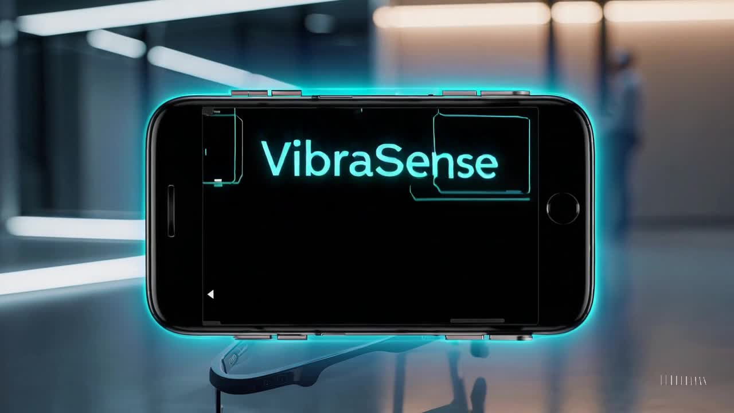
Vibranium for Enhanced Perception

Slide 2
Problem
Visually impaired individuals face difficulties navigating unfamiliar buildings, such as courthouses, hospitals, or universities. They rely on external assistance to find specific rooms, which limits their independence.

Slide 3
Solution
Integrating real-time navigation using floor plan databases and wearable smart glasses to provide voice-guided navigation for visually impaired users.

Slide 4
Automated Floor Plan Analysis & Real-Time Navigation
Objective:
Automate detection of doors, walls, and rooms from 2D floor plans.
Extract room names using OCR.
Generate a 3D model for visualization and navigation.
Develop a real-time person detection system using a camera.
Provide auditory feedback using text-to-speech (TTS) for position tracking.
Notes:
Key Features:**
- **YOLOv8 Model:** Used for accurate and fast person detection.
- **Bounding Box Analysis:** Calculates the area of the detected person's bounding box to determine position changes.
- **Text-to-Speech (TTS):** Announces "Person is closer" or "Person is farther" based on changes in bounding box area.
- **Logging:** Records position changes with timestamps in a log file for later analysis.

Slide 5
Achieved
Key Achievements: ✔️ Successfully processed floor plans to detect architectural elements. ✔️ Implemented OCR-based room label extraction. ✔️ Generated 3D models from 2D floor plans. ✔️ Developed real-time person tracking based on bounding box size changes. ✔️ Integrated TTS feedback for position guidance.
Notes:
Key Features:**
- **YOLOv8 Model:** Used for accurate and fast person detection.
- **Bounding Box Analysis:** Calculates the area of the detected person's bounding box to determine position changes.
- **Text-to-Speech (TTS):** Announces "Person is closer" or "Person is farther" based on changes in bounding box area.
- **Logging:** Records position changes with timestamps in a log file for later analysis.

Slide 6
Scalability & Future Enhancements
Notes:
Key Features:**
- **YOLOv8 Model:** Used for accurate and fast person detection.
- **Bounding Box Analysis:** Calculates the area of the detected person's bounding box to determine position changes.
- **Text-to-Speech (TTS):** Announces "Person is closer" or "Person is farther" based on changes in bounding box area.
- **Logging:** Records position changes with timestamps in a log file for later analysis.

Slide 7
Local Mapping & Floor Plan Integration
📍 Blueprint-Based Navigation:
Buildings provide digital floor plans stored in a centralized database.
Users access floor plans via an entry code or NFC scan at the building entrance.
📍 AI-Based Object & Room Detection:
Smart glasses detect doors, hallways, and obstacles using computer vision.
OCR technology extracts room names for precise indoor navigation.
📍 Real-Time Guidance:
Voice feedback provides step-by-step directions.
Obstacle detection ensures a safe navigation experience.
Notes:
Key Features:**
- **YOLOv8 Model:** Used for accurate and fast person detection.
- **Bounding Box Analysis:** Calculates the area of the detected person's bounding box to determine position changes.
- **Text-to-Speech (TTS):** Announces "Person is closer" or "Person is farther" based on changes in bounding box area.
- **Logging:** Records position changes with timestamps in a log file for later analysis.

Slide 8
Seamless Indoor-Outdoor Navigation
📍 Google Maps Integration for Outdoor Travel:
Users receive turn-by-turn navigation to a building entrance.
System switches from outdoor GPS navigation to indoor floor plan guidance.
📍 Smart Handoff Between Systems:
Automatic transition between GPS-based navigation (outdoors) and floor plan-based navigation (indoors).
Users can set destinations across multiple floors with elevator/stair directions.
Notes:
Key Features:**
- **YOLOv8 Model:** Used for accurate and fast person detection.
- **Bounding Box Analysis:** Calculates the area of the detected person's bounding box to determine position changes.
- **Text-to-Speech (TTS):** Announces "Person is closer" or "Person is farther" based on changes in bounding box area.
- **Logging:** Records position changes with timestamps in a log file for later analysis.

Slide 9
Wearable Technology for Hands-Free Assistance
📍 Smart Glasses with Built-in Camera & AI:
Detects doors, hallways, room labels and provides voice instructions.
Can recognize people (e.g., courthouse staff) and important landmarks.
📍 Mobile App Integration:
Users can set destinations, receive voice navigation, and request assistance.
Frequently visited locations are stored for quick access.
Notes:
Key Features:**
- **YOLOv8 Model:** Used for accurate and fast person detection.
- **Bounding Box Analysis:** Calculates the area of the detected person's bounding box to determine position changes.
- **Text-to-Speech (TTS):** Announces "Person is closer" or "Person is farther" based on changes in bounding box area.
- **Logging:** Records position changes with timestamps in a log file for later analysis.

Slide 10
Other Ideas
📍 AI-Powered Route Optimization:
Adapts to crowd density and suggests less obstructed paths.
Supports real-time rerouting based on detected obstacles.
📍 Multi-Building Navigation System:
Expanding to malls, airports, hospitals, government offices.
Users can preload floor plans before arriving at a new location.
📍 IoT & Smart Building Integration:
Connects with automated doors, elevators, and emergency alert systems.
Provides enhanced accessibility and smart assistance.
Notes:
Key Features:**
- **YOLOv8 Model:** Used for accurate and fast person detection.
- **Bounding Box Analysis:** Calculates the area of the detected person's bounding box to determine position changes.
- **Text-to-Speech (TTS):** Announces "Person is closer" or "Person is farther" based on changes in bounding box area.
- **Logging:** Records position changes with timestamps in a log file for later analysis.

Slide 11
Demo

Slide 12
Thank You

