Slide 1
LD0230 웹정보시스템 프로젝트
성신여자대학교
정보시스템공학과
홍 기 형

Slide 2
General Information
Course Title : Web Information System Project
Course Objectives :
Web Application (Architecture)
Classical Web Application Development Environment
Servlets
JSP
JDBC
Introduction to the web application (development) platforms
Node.js,

Slide 3
Course Introduction
Text :
Head First Servlets & JSP, 2nd Edition, Bryan Basham, Kathy Sierra and Bert Bates, O'Reilly, 2008.
Head First Servlets & JSP(개정판) : 상상력을 자극하는 몰입의 학습법, 한빛미디어, 2009, 김종호 역
Other References
Web and XML tutorials, http://www.w3schools.com/

Slide 4
Prerequistes
Java Programming
HTML5, CSS3, Javascript
Database Design & SQL

Slide 5
Tools for this course
Web Browser : Chrome, IE, Firefox, Safari
Eclipse EE IDE (http://www.eclipse.org/)
Apache Tomcat (http://www.apache.org/)
MySQL

Slide 6
How to Contact
Course Homepage
http://webinformationsystem.honglab.org/
HW E-mail: professor@honglab.org
Submit your programming homework
Don’t forget “[web]” in the subject of your mail
전공 및 학업 관련 상담: 학교 online 상담시스템
When you have any question about the course

Slide 7
Homework
Programming
Usually 2 weeks
Submit a zip file via e-mail until the due date
Do not copy or paste from any resource including internet (web pages), books, and boy/girl friend’s
If you do copy, you will get ‘F’ for this course.
How to e-mail your homework
In Subject, “[web] 200738001 homework-name”
Zip all the files you’ve done into a single zip
Naming rule for your homework zip file
StudentID_HWname.zip
Ex) 200738001_stack1.zip
Paper writing
1 week
Do not use any word processor
Must be done by your own hand!

Slide 8
Evaluation
Quiz 40%
Anytime, max 4 times (usually 3)
(Sum{Q1, Q2, .. , Qn} - Min{Q1, Q2, .. , Qn})/ ( n-1)
Homework 10%
Project 30%
Attendance 20%

Slide 9
지켜야 할 것.
당일 자신이 작업할 directory를 임시로 생성
자신의 이름으로 c:\hongkh (예)
항상 위에서 생성한 directory에서 수업 및 실습
강의 종료 전 10분간 자신이 작업한 directory내에 backup할 것은 backup
PC를 off하기 전에 반드시 임시 directory 제거

Slide 10
Introduction to Web Applications

Slide 11
INTERNET & THE WEB
The Internet is a global system of interconnected computer networks that use the standard Internet Protocol Suite (TCP/IP) to serve billions of users worldwide.
The Internet is a global data communications system. It is a hardware and software infrastructure that provides connectivity between computers.

Slide 12
WHAT’S THE WORLD WIDE WEB?
The Web is a system of interlinked hypertext documents accessed via the Internet
3 first bricks:
Uniform Resource Locator (URL) i.e.,
unique identifiers for resources on the Web
HyperText Markup Language (HTML)
i.e., the publishing language
Hypertext Transfer Protocol (HTTP)
i.e., the exchange protocol
This is a technological point of view of course!

Slide 13
What is web application ?
It is a client/server application that uses a web browser as its client program, and performs an interactive service by connecting with servers over the Internet (or Intranet).
A web site simply delivers content from static files. A web application presents dynamically tailored content based on request parameters, tracked user behaviors, and security considerations.

Slide 14
What is web application ?
[wikipedia.org] A web application is an application that is accessed over a network such as the Internet or an intranet. The term may also mean a computer software application that is hosted in a browser-controlled environment or coded in a browser-supported language and reliant on a common web browser to render the application executable […] Web applications can be considered as a specific variant of client-server

Slide 15
What is web application ?
[sitepoint.com] Web applications are stored on a server and delivered to users over the Internet. A Web application is usually a three-tier structure, comprising a User Service tier (allowing user access to the application), a Business Service tier (allowing the user to carry out complex activities) and a Data.

Slide 16
What is web application ?
[about.com][Shklar & Rosen]A web application is any application that uses a web browser as a client.

Slide 17
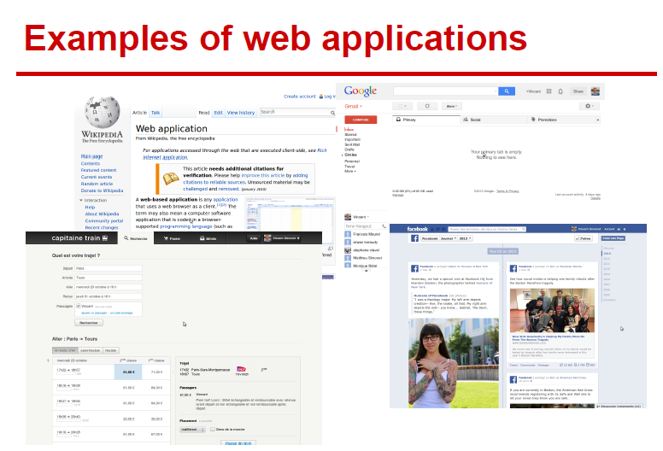

Slide 18
Benefits :
Easy to deploy and upgrade,
Cross-platform compatibility,
Limited resources on client side,
Interoperability.

Slide 19
Drawbacks :
Limitations on user interface compared to native Graphical User Interface,
Compatibility issues with some web browser,
Require a network connection,
The user does not own the software.

Slide 20
A Brief History

Slide 21
Where is the birthplace of the Web?
Who is the mother of the Web?

Slide 22
CERN
Tim Berners-Lee

Slide 23
Key dates
1993: Mosaic browser, CGI
1995: PHP 1.0
1996: JavaScript 1.0
1999: Web Application, Java Servlet (server)
2005: AJAX
2008: HTML5 first public working draft
2014?: HTML5 specification

Slide 24
(User) client vs (remote) server
70s: Light user terminals, everything is done by the server.
80s/90s: Personal computers. Everything happens on client side.
90s/2000s: Light client (web browser), all logic in server.
2000s: Logic is back in the client ("Web 2.0").
2010s: Mobile applications.
2020s: ?? (smart IoT, Web+AI services, … )

Slide 25
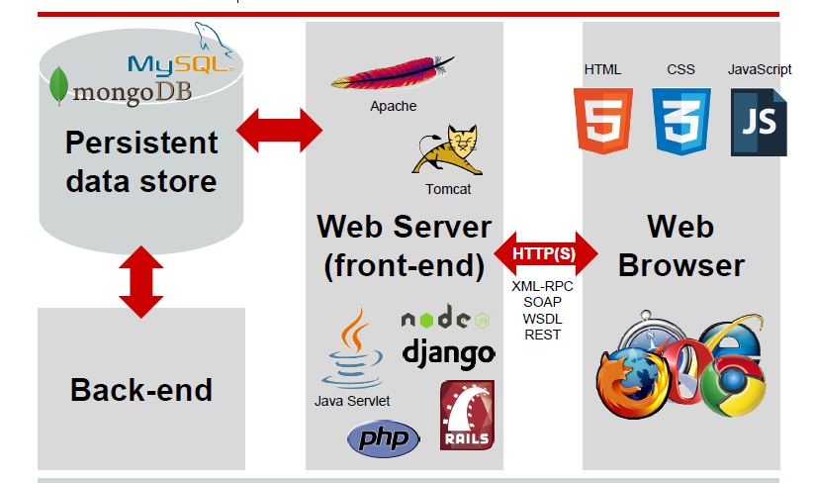
Typical architecture of a web application

Slide 26
Web browser
Mainly user interface,
Short term state (in general),
May implement some logic, especially for fast response time (but untrusted),
Communicate with the web server using HTTP(S),
Executing HTML, CSS and JavaScript code.

Slide 27
Web browser
Main task :
Generate and submit web requests to web servers
Accept responses from web servers and produce visual presentations out of it
Render the results

Slide 28
Web server (front-end)
Answers to HTTP(S) requests from the web clients,
Stateless,
Reads and writes data in a persistent data store,
Performs most of the business logic,
Consists in a general of a server/container(Apache, Tomcat) and a framework (PHP, Java Servlets, etc.) running business logic.

Slide 29
Data store
The state of the web application,
Historically a (My)SQL database, some more recent evolutions,
The synchronisation point.

Slide 30
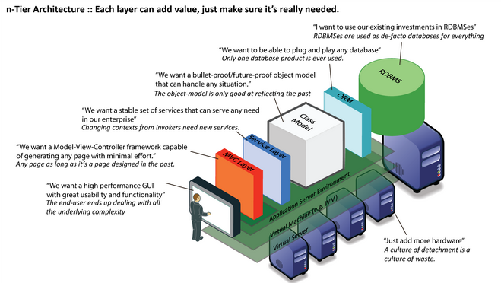
N-tier Architecture
N-tier architectures

Slide 31
N-tier architectures have the same components
Presentation
Business/Logic
Data
N-tier architectures try to separate the components into different tiers/layers
Tier: physical separation
Layer: logical separation

Slide 32
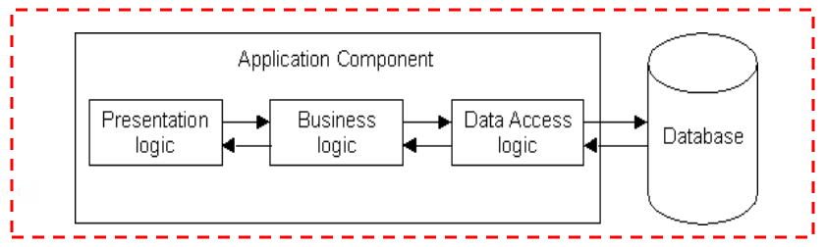
1-Tier Architecture
All 3 layers are on the same machine
All code and processing kept on a single machine
Presentation, Logic, Data layers are tightly connected
Scalability: Single processor means hard to increase volume of processing
Portability: Moving to a new machine may mean rewriting everything
Maintenance: Changing one layer requires changing other layers

Slide 33
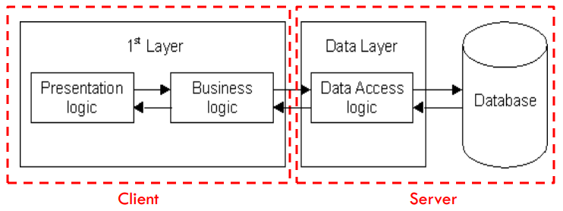
2-Tier Architecture
Database runs on Server
Separated from client
Easy to switch to a different database
Presentation and logic layers still tightly connected (coupled)
Heavy load on server
Potential congestion on network
Presentation still tied to business logic

Slide 34
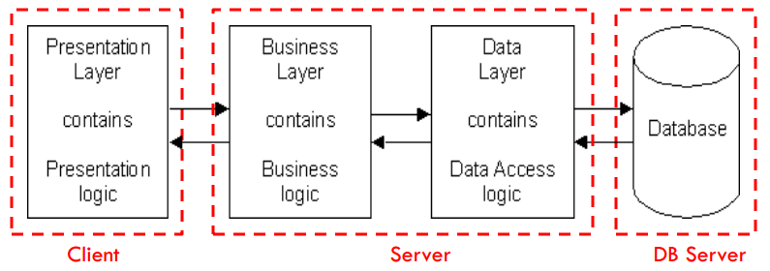
3-Tier Architecture
Each layer can potentially run on a different machine
Presentation, logic, data layers disconnected

Slide 35
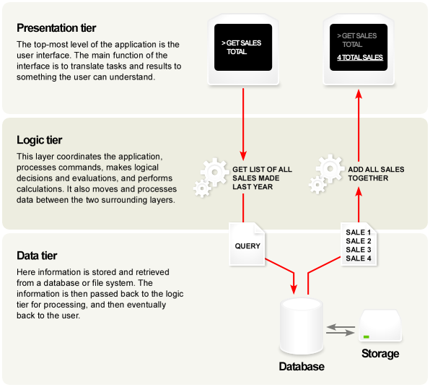
A Typical 3-tier Architecture
Architecture Principles
Client-server architecture
Each tier (Presentation, Logic, Data) should be independent and should not expose dependencies related to the implementation
Unconnected tiers should not communicate
Change in platform affects only the layer running on that particular platform

Slide 36
A Typical 3-tier Architecture
Presentation Layer
Provides user interface
Handles the interaction with the user
Sometimes called the GUI or client view or front-end
Should not contain business logic or data access code

Slide 37
A Typical 3-tier Architecture
Logic Layer
The set of rules for processing information
Can accommodate many users
Sometimes called middleware/ back-end
Should not contain presentation or data access code

Slide 38
A Typical 3-tier Architecture
Data Layer
The physical storage layer for data persistence
Manages access to DB or file system
Sometimes called back-end
Should not contain presentation or business logic code

Slide 39
The 3-Tier Architecture for Web Apps
Presentation Layer
Static or dynamically generated content rendered by the browser (front-end)
Logic Layer
A dynamic content processing and generation level application server, e.g., Java EE, ASP.NET, PHP, ColdFusion platform (middleware)
Data Layer
A database, comprising both data sets and the database management system or RDBMS software that manages and provides access to the data (back-end)

Slide 40
3-Tier Architecture - Advantages
Independence of Layers
Easier to maintain
Components are reusable
Faster development (division of work)
Web designer does presentation
Software engineer does logic
DB admin does data model

Slide 41
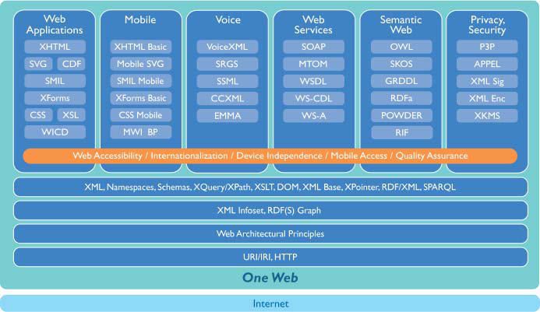
W3C Web Standard Stack

