Slide 1
Introduction to Servlets and JSP LD0230 웹정보시스템 프로젝트
성신여자대학교
정보시스템공학과
홍 기 형

Slide 2
Objectives
How web clients (browsers) and web servers communicate with one another.
HTTP Methods
GET, POST, HEAD and so on
benefits and functionality
when and how to trig the HTTP methods

Slide 3
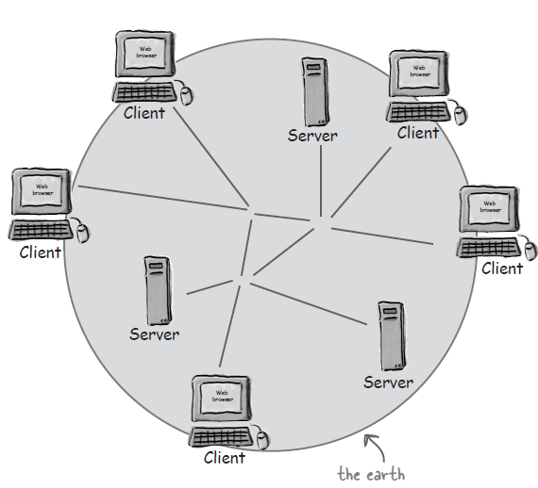
World-Wide Web
Web : gazillions of clients and servers connected through wires and wireless networks.
Goal : To build web applications that clients in the earth can access

Slide 4
Web Server and Client
Web Client
Human user
browser SW
send user’s request to the server
receive the server’s response
interpret the response (HTML code) and rendering it for the user
Web Server
HW and the server SW
receive the client’s request
finds the resource (HTML pages, pictures, sound files, PDF files, etc.)
return something to the client

Slide 5
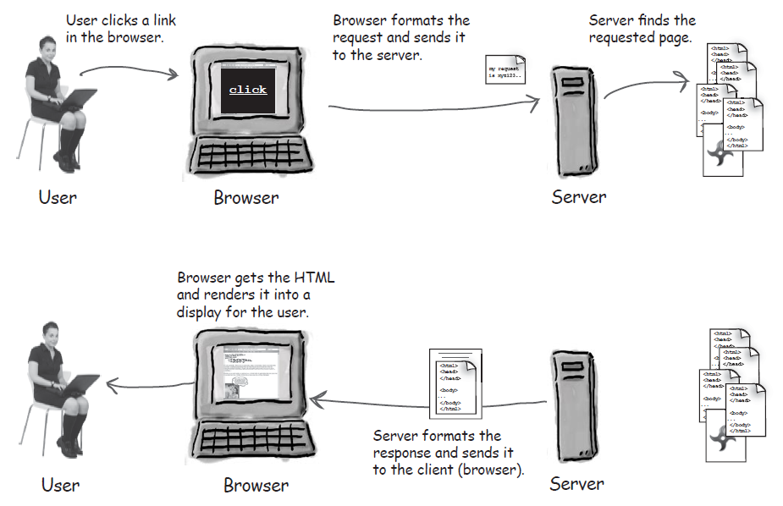
How to communicate

Slide 6
HTTP protocol
HyperText Transfer Protocol
running on TCP/IP
HTTP Request
HTTP Method (action to be performed) : GET, POST
the page to access (URL)
Form parameters
HTTP Response
status code (success or fail)
Content-type (text, picture, HTML, etc.)
content (the actual HTML page, image, etc.)
header

Slide 7
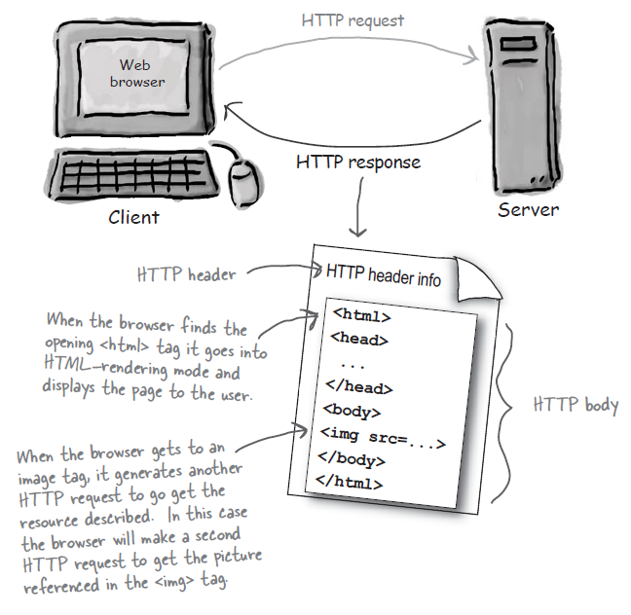
HTTP response
header
to help process the body (HTML page, image, etc.)
body
the content to be processed by the client

Slide 8
HTTP Requests
Method
GET
ask the server to get a resource and send it back
simple request with small amount of data
POST
request something (like GET) and send form data to the server
HEAD, TRACE, PUT, DELETE, OPTIONS, CONNECT

Slide 9
Reason to use POST
The total amount of characters in a GET is really limited (depending on the server).
If the user types, say, a long passage into a “search” input box, the GET might not work.
The data you send with the GET is appended to the URL up in the browser bar, so whatever you send is exposed.
Better not put a password or some other sensitive data as part of a GET!
the user can’t bookmark a form submission if you use POST instead of GET.
Depending on your app, you may or may not want users to be able to bookmark the resulting request from a form submission.

Slide 10
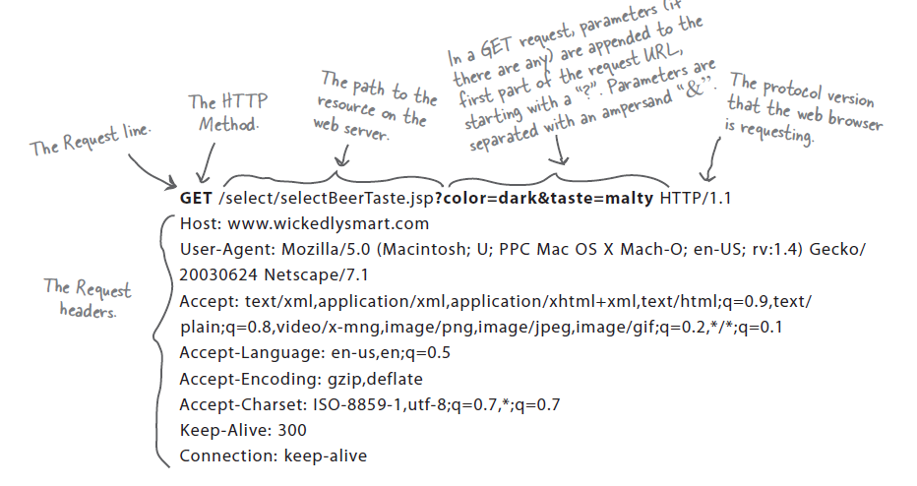
HTTP GET request

Slide 11
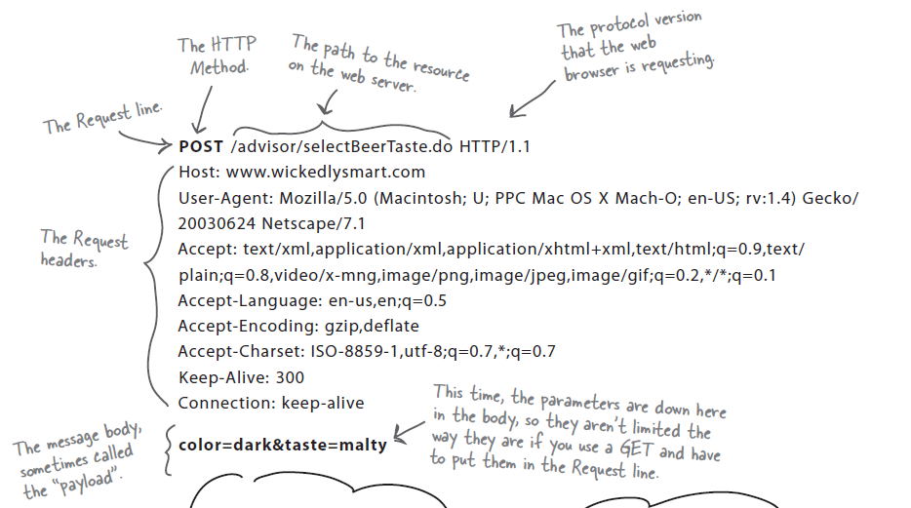
HTTP POST request

Slide 12
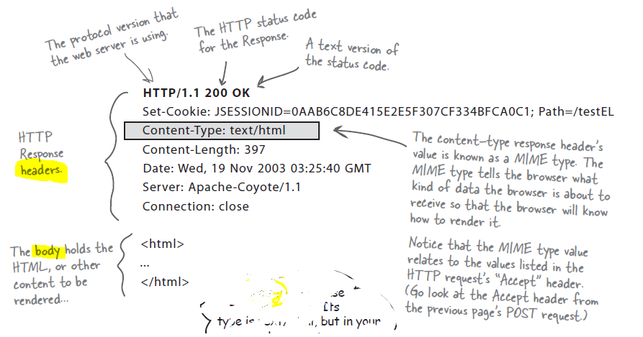
HTTP response

Slide 13
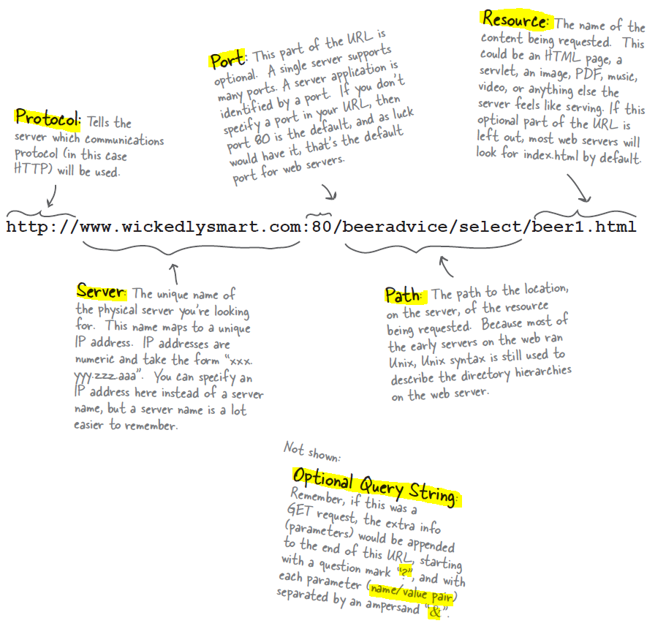
Anatomy of a URL
Uniform Resource Locator
Every resource on the web has its own unique address, in the URL format.

Slide 14
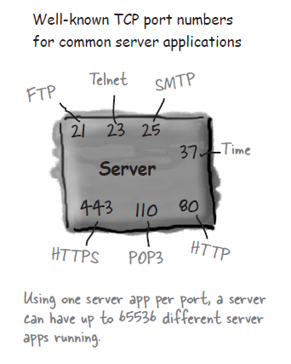
TCP port
a 16-bit number
identifies a specific SW on the server
0 to 1023 are reserved for well-known services
If you’re writing services (server programs) to run on a company network, you should check with the sys-admins to find out which ports are already taken.

Slide 15
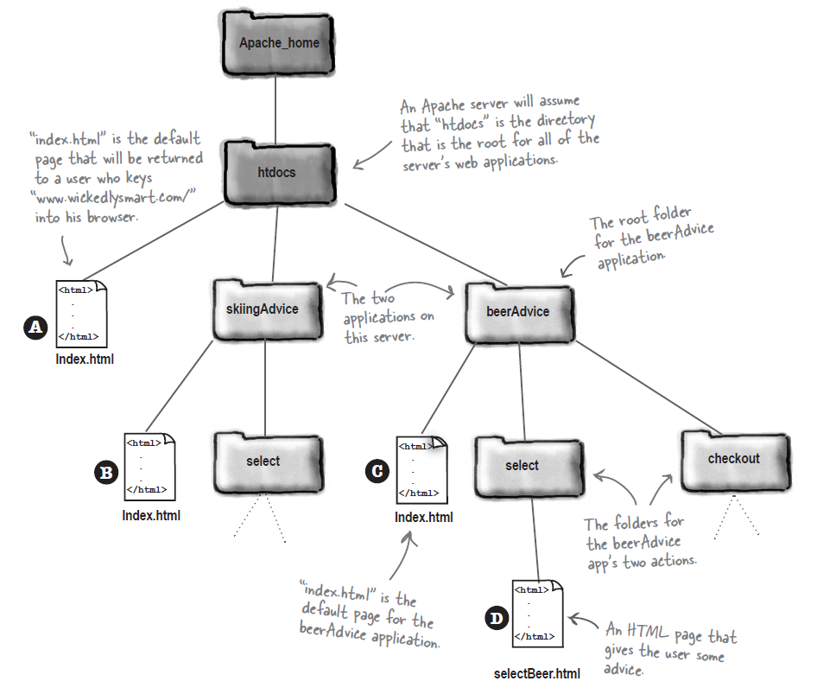
Directory structure for a static web site
A : http://www.wickedlysmart.com
B : http://www.wickedlysmart.com/skiingAdvice
C: http://www.wickedlysmart.com/beerAdvice
D: http://www.wickedlysmart.com/beerAdvice/selectBeer.html
Apache Web server

Slide 16
Web Server and Dynamic contents
Web server alone can not do
Dynamic content (just-in-time page)
Saving data on the server
Helper applications generate dynamic contents (or save data from the client to a file or DB in the server)
CGI
Servlet
HTML 5

Slide 17
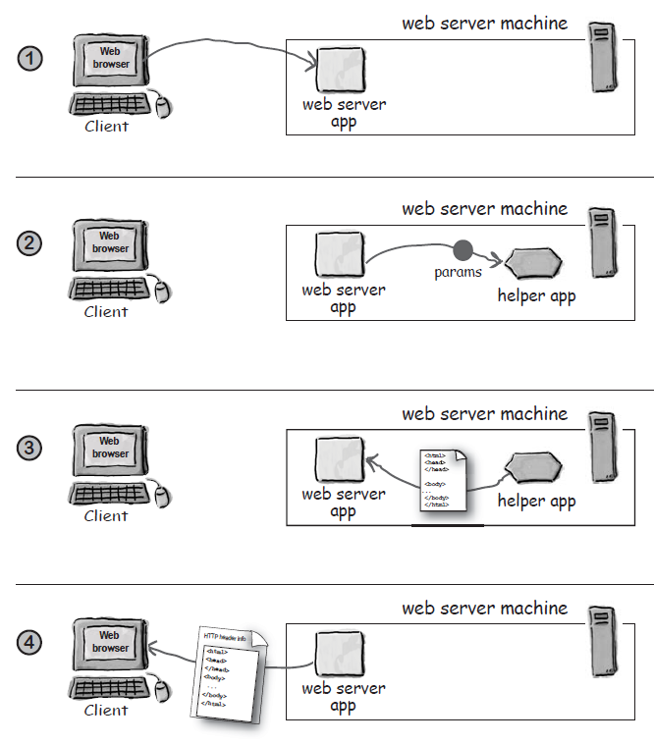
How to work a CGI Program

Slide 18
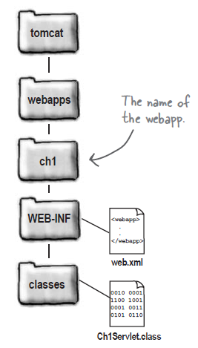
Servlets managed by Tomcat
Directory Structure
Tomcat installed directory

Slide 19
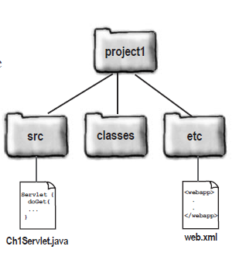
How to build a servlet
Build a directory tree for development
depend on IDE
Write a servlet, named Ch1Servlet.java
import javax.servlet.*;
import javax.servlet.http.*;
import java.io.*;
public class Ch1Servlet extends HttpServlet {
public void doGet(HttpServletRequest request,
HttpServletResponse response)
throws IOException {
PrintWriter out = response.getWriter();
java.util.Date today = new java.util.Date();
out.println(“<html> “ +
“<body>” +
“<h1 align=center>HF\’s Chapter1 Servlet</h1>” +
+ “<br>” + today + “</body>” + “</html>”);
}
}

Slide 20
Create a DD (deployment descriptor, named web.xml)
<?xml version=”1.0” encoding=”ISO-8851-1” ?>
<web-app xmlns=”http://java.sun.com/xml/ns/j2ee”
xmlns:xsi=”http://www.w3.org/2001/XMLSchema-instance”
xsi:schemaLocation=”http://java.sun.com/xml/ns/j2ee
http://java.sun.com/xml/ns/j2ee/web-app_2_4.xsd”
version=”2.4”>
<servlet>
<servlet-name>Chapter1 Servlet</servlet-name>
<servlet-class>Ch1Servlet</servlet-class>
</servlet>
<servlet-mapping>
<servlet-name>Chapter1 Servlet</servlet-name>
<url-pattern>/Serv1</url-pattern>
</servlet-mapping>
</web-app>

Slide 21
Build the directory tree under the tomcat web application directory (Tomcat/webapps/)
compile the servlet code (Ch1Servlet.class)
Copy the class file in WEB-INF/classes
Copy the DD (web.xml) to WEB-INF
restart Tomcat server

Slide 22
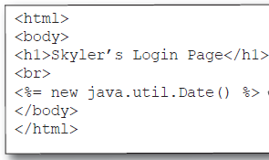
JSP
HTML page with Java
Putting HTML inside a println() statement is ugly and error-prone, but JSPs solve that problem by letting you put Java into an HTML page rather than putting HTML into Java code.
out.println(“<html> “ +
“<body>” +
“<h1 align=center>HF\’s Chapter1 Servlet</h1>” +
+ “<br>” + today + “</body>” + “</html>”);

