Slide 1
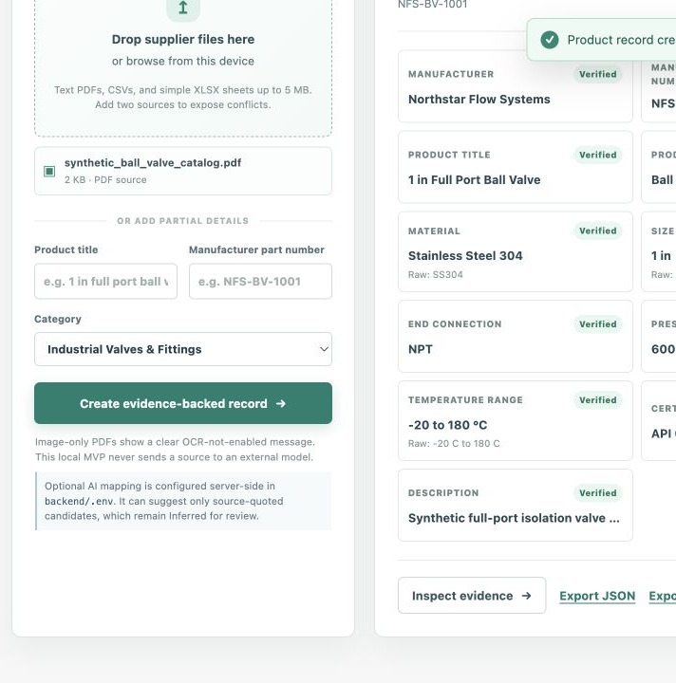
VERICATALOG PROOF
Every catalog field
needs proof.
Evidence-first product intelligence for industrial commerce.
A functional local prototype for industrial valves & fittings.
UniHack 2026 • Synthetic demonstration data
01
Notes:
Open with the problem: industrial specs cannot be exported safely when their origin is unclear.
[Sources] Local project screenshot and README, verified 2026-08-20.

Slide 2
Industrial catalog data breaks down when proof is separated from the value.
A source file can contain the right information while still being unsafe to export unless each field is traceable, normalized, and reviewable.
Column Label | Column Label | Column Label | Column Label | Column Label
Data Point | $00.000 / item | Yes | 1,000,000k / s | 0.00023862381
Data Point | $00.000 / item | No | 1,000,000k / s | 0.00023862381
Data Point | $00.000 / item | Yes | 1,000,000k / s | 0.00023862381
Data Point | $00.000 / item | No | 1,000,000k / s | 0.00023862381
Data Point | $00.000 / item | Yes | 1,000,000k / s | 0.00023862381
Data Point | $00.000 / item | No | 1,000,000k / s | 0.00023862381
Data Point | $00.000 / item | Yes | 1,000,000k / s | 0.00023862381
Data Point | $00.000 / item | Yes | 1,000,000k / s | 0.00023862381
Source reality | Example | Why it is risky | What a steward needs | VeriCatalog response
Unstructured document | Valve PDF | Field origin is hard to inspect | The original snippet | Retained evidence
Inconsistent label | SS304 / 25.4 mm | Values need consistent PIM format | Raw + canonical value | Deterministic normalization
Conflicting sources | 600 WOG / 400 WOG | A silent choice could be wrong | Both competing sources | Conflict → review
Partial records | Missing pressure rating | No basis for a reliable value | An explicit gap | Missing → review queue
02
Notes:
This slide states workflow risks qualitatively and does not claim a measured business impact.
[Sources] Product requirements, README, and synthetic conflict fixture in backend/demo_data, verified 2026-08-20.

Slide 3
VeriCatalog Proof is a trust layer before the PIM.
It turns source documents into structured records while preserving the proof needed to decide what can move forward.
Evidence
Rules
Review
Source file, location, snippet, raw value, and extraction method stay attached to the field.
Units and aliases are normalized deterministically; missing, duplicate, and conflicting values are flagged.
A bounded local agent ranks exceptions; a steward remains the only one who can approve, reject, or edit a field.
03
Notes:
The core proposition is not an AI answer. It is an auditable decision workflow.
[Sources] README; docs/01-product-requirements.md; docs/05-data-schema-and-validation.md; local implementation, verified 2026-08-20.

Slide 4
A record explains itself field by field.
Synthetic ball-valve example processed locally: the source text is preserved beside the canonical PIM-ready value and validation result.
Column Label | Column Label | Column Label | Column Label | Column Label
Data Point | $00.000 / item | Yes | 1,000,000k / s | 0.00023862381
Data Point | $00.000 / item | No | 1,000,000k / s | 0.00023862381
Data Point | $00.000 / item | Yes | 1,000,000k / s | 0.00023862381
Data Point | $00.000 / item | No | 1,000,000k / s | 0.00023862381
Data Point | $00.000 / item | Yes | 1,000,000k / s | 0.00023862381
Data Point | $00.000 / item | No | 1,000,000k / s | 0.00023862381
Data Point | $00.000 / item | Yes | 1,000,000k / s | 0.00023862381
Data Point | $00.000 / item | Yes | 1,000,000k / s | 0.00023862381
Attribute | Raw source text | Canonical value | Validation explanation | Truth status
Material | SS304 | Stainless Steel 304 | Alias standardized; raw retained | Verified
Size | 25.4 mm | 1 in | Metric size normalized | Verified
Pressure rating | 600 WOG | 600 WOG | Direct source evidence retained | Verified
Temperature | -20 C to 180 C | -20 to 180 °C | Readable canonical notation | Verified
04
Notes:
Point to Size: the app shows both 25.4 mm and 1 in, so normalization never erases the original evidence.
[Sources] Synthetic ball-valve PDF and local app record, verified 2026-08-20. All displayed source values are fabricated demo data.

Slide 5
A short, evidence-first path from supplier file to PIM export.
The optional AI mapper needs source quotes. The bounded Review Agent only ranks human work; it never changes a value.
Column Label | Column Label | Column Label | Column Label | Column Label
Data Point | $00.000 / item | Yes | 1,000,000k / s | 0.00023862381
Data Point | $00.000 / item | No | 1,000,000k / s | 0.00023862381
Data Point | $00.000 / item | Yes | 1,000,000k / s | 0.00023862381
Data Point | $00.000 / item | No | 1,000,000k / s | 0.00023862381
Data Point | $00.000 / item | Yes | 1,000,000k / s | 0.00023862381
Data Point | $00.000 / item | No | 1,000,000k / s | 0.00023862381
Data Point | $00.000 / item | Yes | 1,000,000k / s | 0.00023862381
Data Point | $00.000 / item | Yes | 1,000,000k / s | 0.00023862381
Step | Input | System action | Decision evidence | Output
1. Ingest | PDF, CSV, XLSX, manual | Read supported source text | File + page/row context | Candidate values
2. Extract | Labels and values | Fixed-schema extraction | Raw value + snippet | Structured field
3. Verify | Structured field | Normalize and validate | Rules + retained provenance | Verified / Inferred / Missing / Conflict
4. Triage + review | Exceptions | Agent ranks; steward decides | 4 local checks + human approval | Reviewed record
5. Export | Reviewed record | Produce JSON / CSV | Source trace remains stored | Downstream handoff
05
Notes:
If an AI key is added, it stays on the backend. AI-only candidates remain Inferred until reviewed.
The Evidence Review Agent is a fixed sequence of inspect-only local tools. It can rank the queue but cannot mutate a record.
[Sources] docs/06-system-architecture.md and backend implementation, verified 2026-08-20.

Slide 6
Batch health makes the next review decision visible.
The shipped synthetic batch confirms the app can calculate a review queue. These are properties of this demo batch—not real-world performance claims.
60
93.3%
28
synthetic rows processed locally
required field instances marked Verified
fields needing review: inferred, missing, or conflict
Also observed: 1 conflict • 15 missing mandatory fields • 1 duplicate candidate
06
Notes:
Completeness counts only required field instances marked Verified. It is not an accuracy estimate.
[Sources] Local run of backend/demo_data/synthetic_valve_batch.csv and Catalog Health UI, verified 2026-08-20. All data is synthetic.

Slide 7
VERICATALOG PROOF
Ready for a human-reviewed
PIM handoff.
Functional local prototype
Evidence-first review before export
Synthetic demo; no real-world accuracy claim
Notes:
Close with the decision: this project is ready to demonstrate, configure with an optional key, and submit with a repository link.
[Sources] README, docs/SUBMISSION_DESCRIPTION.md, and local implementation, verified 2026-08-20.

