Slide 1
Machine Learning – Facial Keypoint Recognition
Soma Molnar

Slide 2
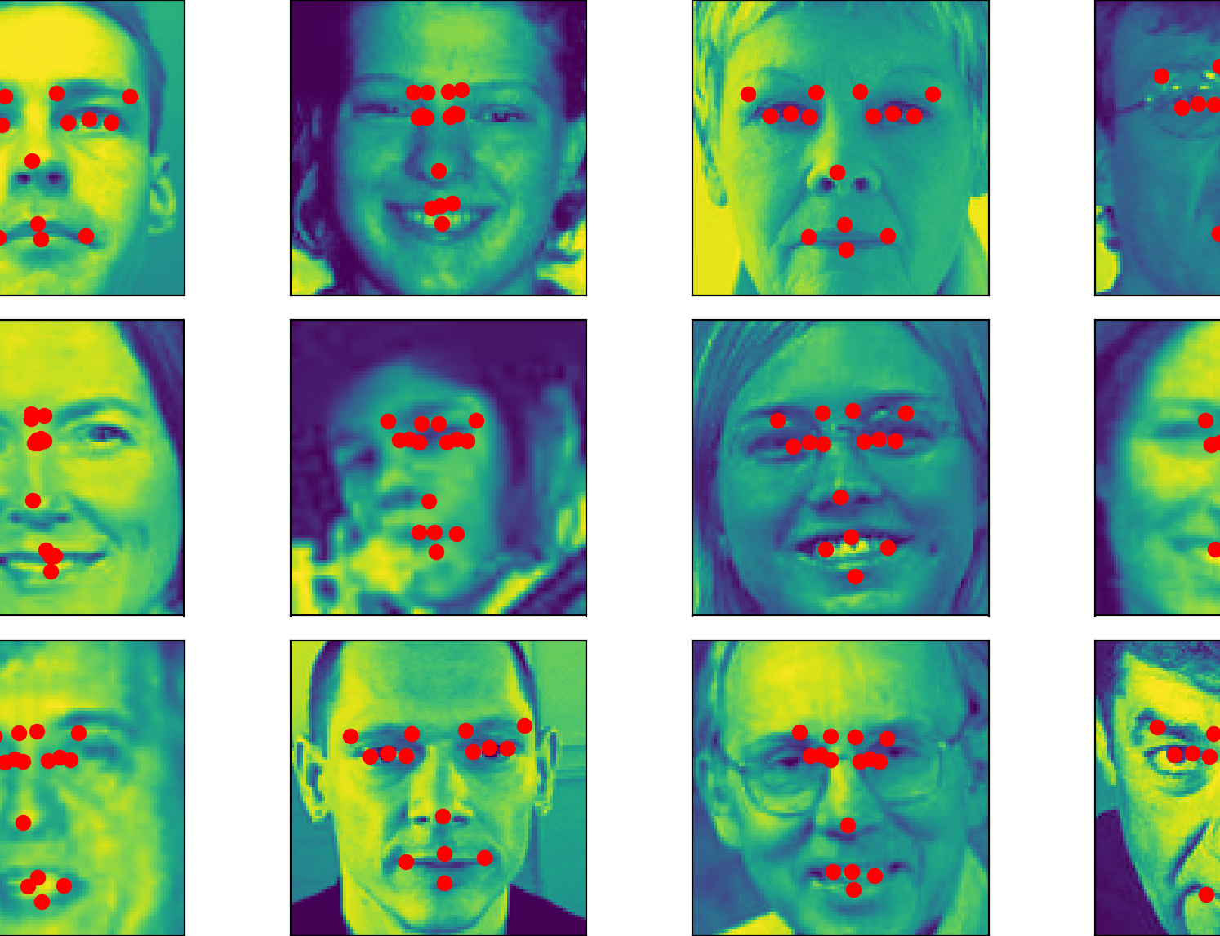
State
Experimenting with existing python script
Cleaning, extending training data
Training ML Model with tensorflow
Creating own test dataset

Slide 3


Plan
Applying trained ML model on array of pixels
Accessing Webcam
Capture a snapchot
Get facial keypoints from backend
Apply points, filters on picture

