Slide 1
Machine Learning – Facial Keypoint Recognition
Soma Molnar

Slide 2


Dataset, Training
Dataset, training script from Kaggle
Jupiter Notebook used to:
Clean and extend training data
Actual ML model training
Test data modification, preparation

Slide 3


Architecture
Image modifications
Application of ML model
Accessing Webcam
Capturing a snapshot
Displaying images

Slide 4
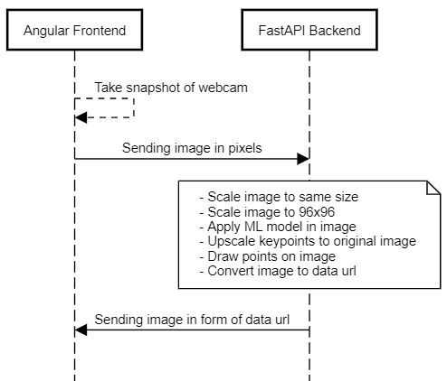
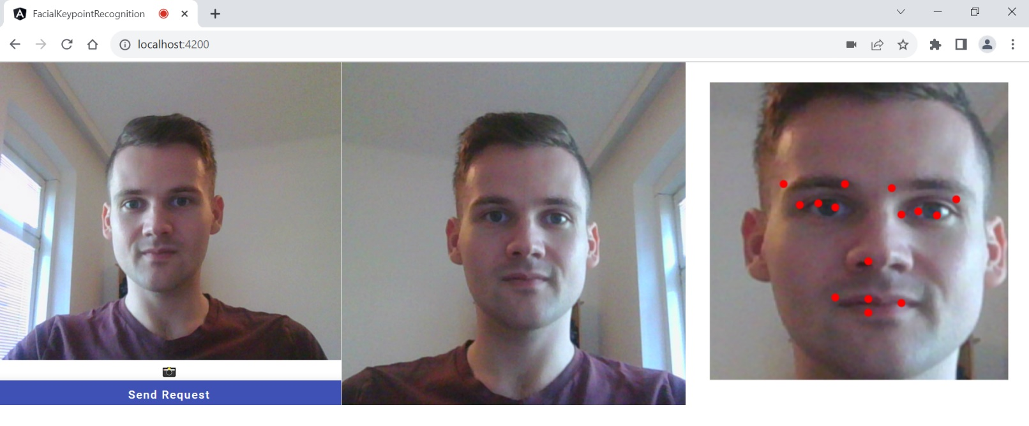
Workflow

Slide 5
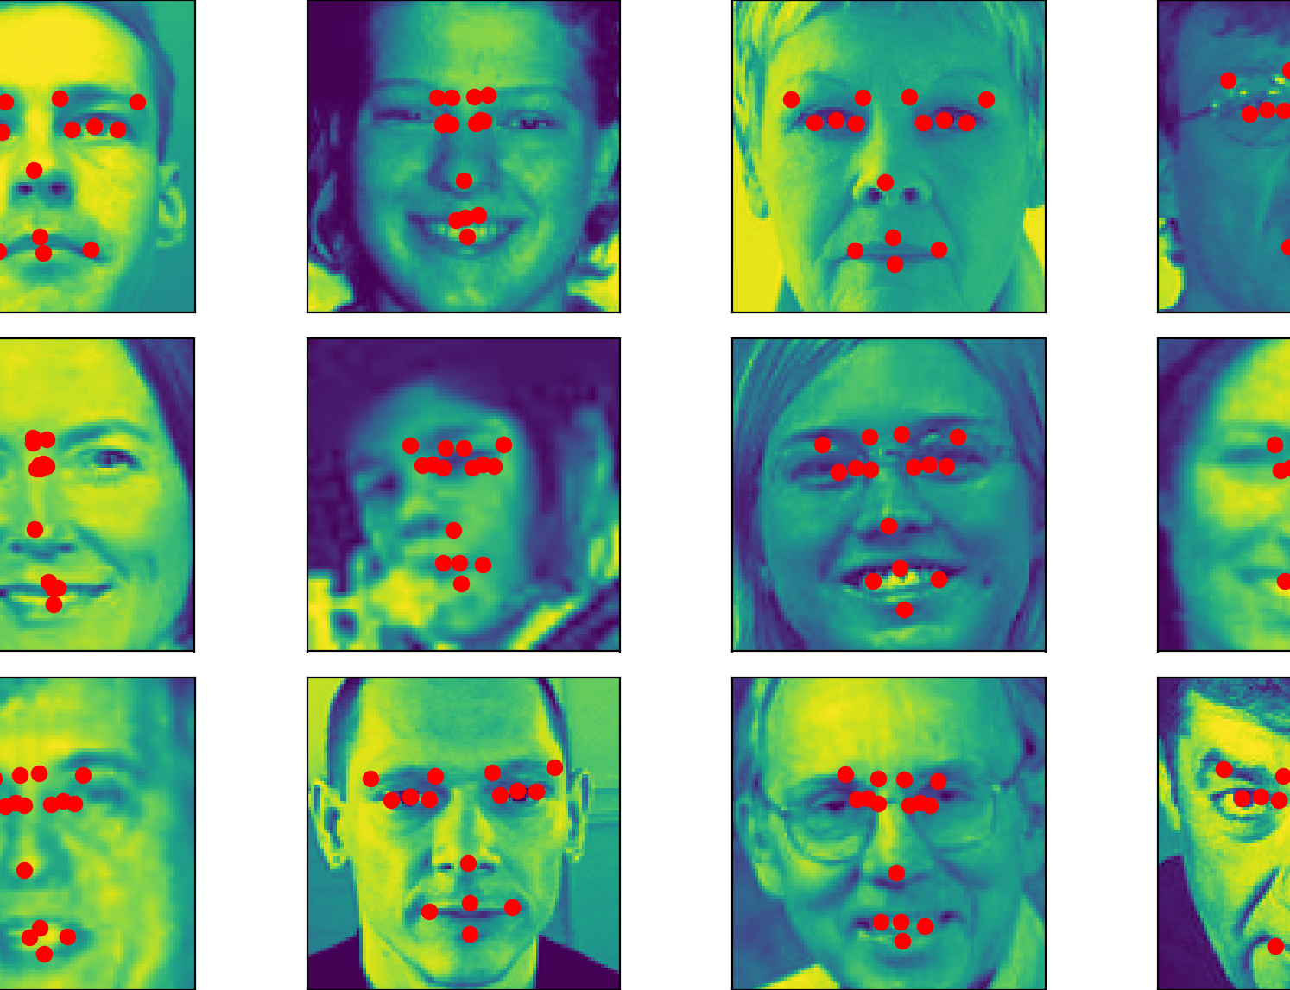
State
Base functionalities implemented
Keypoint prediction not accurate yet
Filter functionalities missing

Slide 6
Questions?

