Slide 1
Machine Learning – Facial Keypoint Recognition
Soma Molnar

Slide 2


Architecture
Image modifications
Application of ML model
Accessing Webcam
Capturing a snapshot
Displaying images

Slide 3
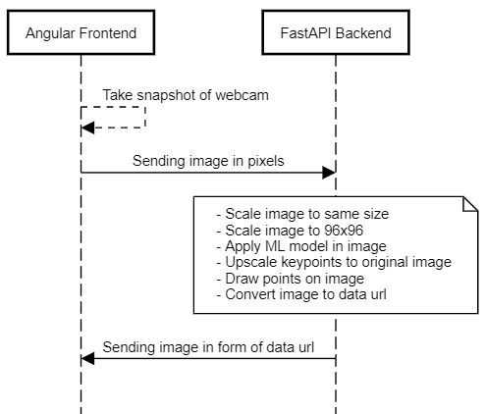
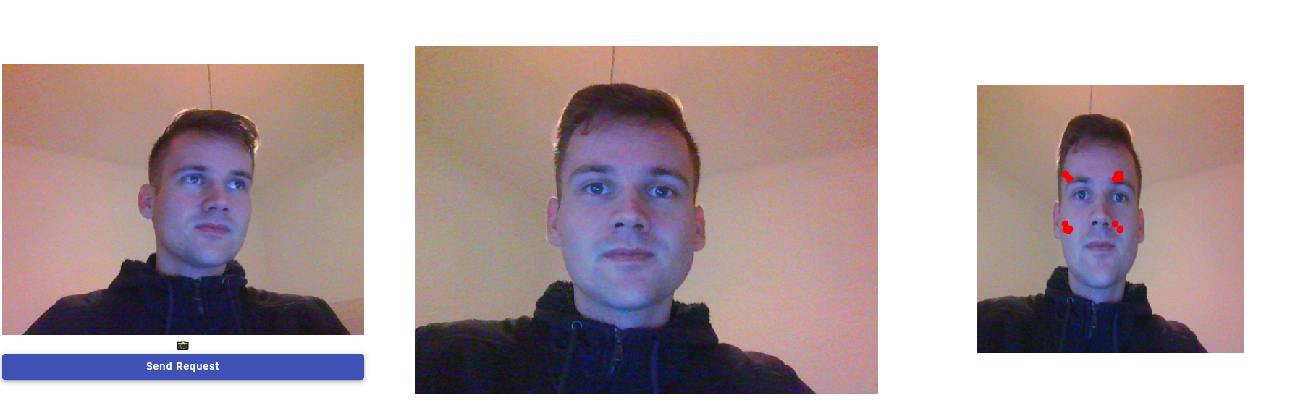
Workflow

Slide 4
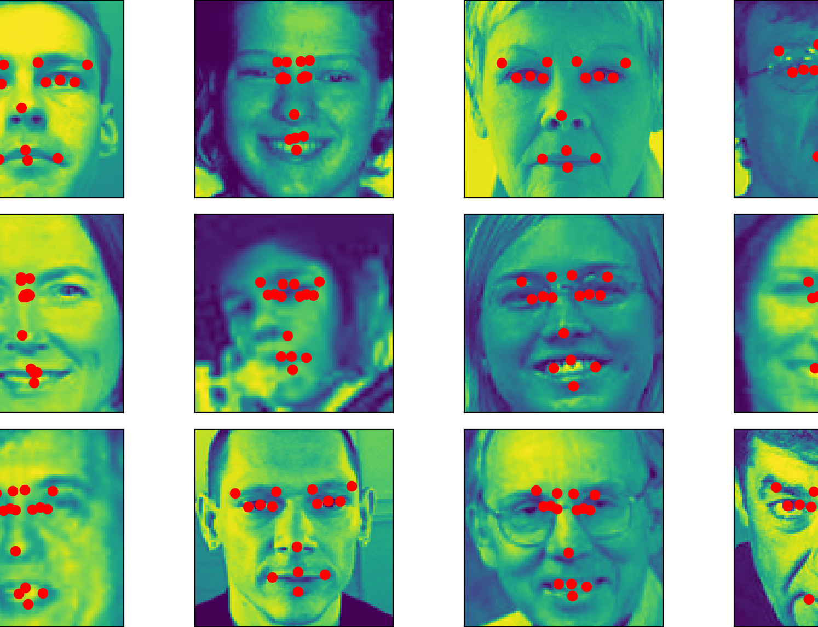
State
Base functionalities implemented
Keypoint prediction not accurate yet
Filter functionalities missing

