Slide 1
Insights from Airbnb Analysis from Pre-COVID Period
Notes:
Objective

Slide 2
AGENDA
Objective
Background
Key Findings
Recommendations
Appendix:
Data sources
Data methodology
Data model assumptions
Notes:
Objective

Slide 3
OBJECTIVE
Improve our strategies to revive the business in the post-COVID period.
Understand key insights from Airbnb NYC business in pre-COVID period.
Estimate customer preferences for the post-COVID period travel.
Notes:
Objective

Slide 4
BACKGROUND
The COVID-19 pandemic affected Airbnb business due to travel restrictions.
The revenue took the largest hit in NYC in the Q2 of 2020.
Now that the travel restrictions are lifted, the business should be operated to recover the loss.
Notes:
Objective

Slide 5
Objective of the Analysis of the Airbnb NYC Data
Customer preferences and ratings of different hosts of Airbnb in were analyzed.
The data was analyzed to derive key insights from the Pre-COVID period.
The insights will be used to take decisions for the NYC Airbnb business for travel in post-COVID period.
Notes:
Objective

Slide 6
Data Preparation and Cleaning
The data was cleaned from any missing values and outliers.
The data was analyzed using simple statistical analysis of the data.
The visualizations were derived using the Plotly tool to understand key inferences from the analysis.
Notes:
Objective

Slide 7
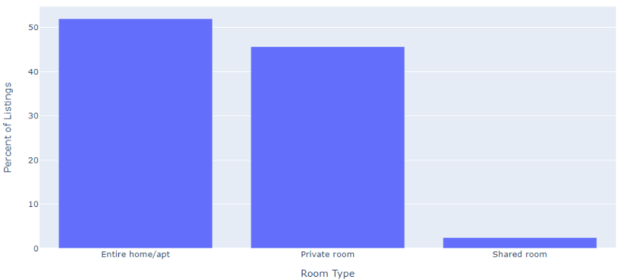
Customer Preferences of the Three Property Types
The properties of Entire home/apt and Private room remain preferred over shared rooms by Airbnb hosts offering rentals in NYC
The room types ‘Entire home/apt’ and ‘Private room’ account for a major portion of the listed properties in NYC (around 97.6%).
Shared rooms account for only 2.4% of the total listed properties.
Notes:
Objective

Slide 8
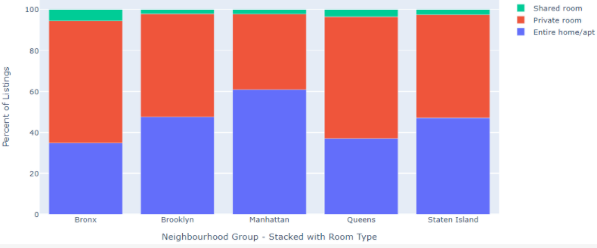
Customer Preferences of Properties in NYC Areas
Customer Preferences of Properties in NYC Areas
The properties in Manhattan are the most expensive than any other area while those in Bronx are the least expensive.
Manhattan has a 14.7% higher contribution of ‘Entire home/apt’ compared to the overall contribution of ‘Entire home/apt’.
Queens has a 23.2% higher contribution of ‘Private room’ compared to the overall contribution of ‘Private room’.
Notes:
Objective

Slide 9
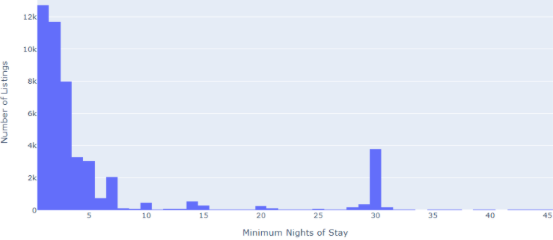
Preferences for Min Nights Stay and Property Price
The number of listings cross as high as 12k for min nights stay below 5 nights and decreases until a spike is observed at 30 min nights.
Properties with lower prices have more reviews, which means more bookings for such properties.
Properties with a higher number of minimum nights of stay and higher price have low reviews.
Notes:
Objective

Slide 10
APPENDIX - DATA ASSUMPTIONS
We assumed the data prior to the COVID – 19 period was achieving the desired revenue.
We assumed the company does not want to expand yet to new territories in NYC.
The company’s strategies are decided considering the travel will increased in the post COVID period.
Notes:
Objective

